Slide 1
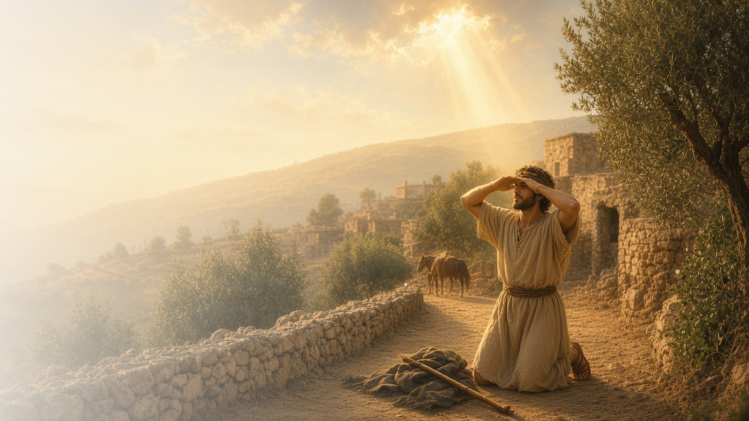
COME, FOLLOW ME · FOR CHILDREN
What Wilt Thou
Have Me to Do?
July 5–11
Acts 6–9
Notes:
TEACHING
This week children learn that they can stand for the right like Stephen, that priesthood power is a priceless gift from God, that Jesus can help anyone change like Saul, and that disciples are full of good works like Tabitha.
SCRIPTURE (KJV)
Acts 9:3–6
3 And as he journeyed, he came near Damascus: and suddenly there shined round about him a light from heaven:
4 And he fell to the earth, and heard a voice saying unto him, Saul, Saul, why persecutest thou me?
5 And he said, Who art thou, Lord? And the Lord said, I am Jesus whom thou persecutest: it is hard for thee to kick against the pricks.
6 And he trembling and astonished said, Lord, what wilt thou have me to do? And the Lord said unto him, Arise, and go into the city, and it shall be told thee what thou must do.
DISCUSSION
• What did Saul ask Jesus?
• How can you follow Jesus this week?

Slide 2
ACTS 6–7
I can stand for the right
Stephen was brave and kept testifying of Jesus.
“And Stephen, full of faith and power, did great wonders and miracles among the people.”
ACTS 6:8
Notes:
TEACHING
Tell how Stephen loved Jesus and kept teaching about Him even when people were angry. He was full of faith and the Holy Ghost. Talk about times when children can be brave and choose the right.
SCRIPTURE (KJV)
Acts 6:8–10
8 And Stephen, full of faith and power, did great wonders and miracles among the people.
9 Then there arose certain of the synagogue, which is called the synagogue of the Libertines, and Cyrenians, and Alexandrians, and of them of Cilicia and of Asia, disputing with Stephen.
10 And they were not able to resist the wisdom and the spirit by which he spake.
DISCUSSION (questions quoted from the manual)
• “What do we learn about Heavenly Father and Jesus Christ from this vision?”

Slide 3
ACTS 8:9–24
Priesthood power is a gift
God shares His power to bless us through the priesthood.
“Then laid they their hands on them, and they received the Holy Ghost.”
ACTS 8:17
Notes:
TEACHING
Explain that Peter and John laid their hands on people's heads so they could receive the Holy Ghost. A man named Simon tried to buy that power with money, but Peter taught that it is a gift from God that cannot be bought. Talk about priesthood blessings children have seen.
SCRIPTURE (KJV)
Acts 8:14, 17–18, 20
14 Now when the apostles which were at Jerusalem heard that Samaria had received the word of God, they sent unto them Peter and John:
17 Then laid they their hands on them, and they received the Holy Ghost.
18 And when Simon saw that through laying on of the apostles’ hands the Holy Ghost was given, he offered them money,
20 But Peter said unto him, Thy money perish with thee, because thou hast thought that the gift of God may be purchased with money.
Full passage: Acts 8:14–20
Restoration scripture (public-domain text: bcbooks/scriptures-json)
Articles of Faith 1:5 (Pearl of Great Price)
5 We believe that a man must be called of God, by prophecy, and by the laying on of hands by those who are in authority, to preach the Gospel and administer in the ordinances thereof.
DISCUSSION (questions quoted from the manual)
• “If we had a chance to teach Simon about the priesthood, what would we tell him? (For ideas, see Articles of Faith 1:5; General Handbook, 3.6.)”

Slide 4
ACTS 9:1–20
Jesus can help me change
Jesus helped Saul become a great missionary.
“Lord, what wilt thou have me to do?”
ACTS 9:6
Notes:
TEACHING
Tell how Saul was mean to followers of Jesus until Jesus appeared to him in a bright light. Saul asked what Jesus wanted him to do, and he changed. He became the Apostle Paul. Jesus can help each of us change and become better too.
SCRIPTURE (KJV)
Acts 9:3–6
3 And as he journeyed, he came near Damascus: and suddenly there shined round about him a light from heaven:
4 And he fell to the earth, and heard a voice saying unto him, Saul, Saul, why persecutest thou me?
5 And he said, Who art thou, Lord? And the Lord said, I am Jesus whom thou persecutest: it is hard for thee to kick against the pricks.
6 And he trembling and astonished said, Lord, what wilt thou have me to do? And the Lord said unto him, Arise, and go into the city, and it shall be told thee what thou must do.
DISCUSSION (questions quoted from the manual)
• “What do we learn from Saul about how we can become more like Jesus?”
• “How did Saul show that he had a soft heart and was willing to change? (see Acts 9:4–6).”
• “How can we show the Lord that we’re willing to change?”

Slide 5
ACTS 9:36–42
Full of good works
Tabitha served others by making clothes for them.
“This woman was full of good works and almsdeeds which she did.”
ACTS 9:36
Notes:
TEACHING
Show a piece of clothing. Tell how Tabitha made coats for people who needed them, and how everyone was sad when she died. Peter prayed, and she lived again. Help children plan a good work they can do for someone.
SCRIPTURE (KJV)
Acts 9:36–40
36 Now there was at Joppa a certain disciple named Tabitha, which by interpretation is called Dorcas: this woman was full of good works and almsdeeds which she did.
37 And it came to pass in those days, that she was sick, and died: whom when they had washed, they laid her in an upper chamber.
38 And forasmuch as Lydda was nigh to Joppa, and the disciples had heard that Peter was there, they sent unto him two men, desiring him that he would not delay to come to them.
39 Then Peter arose and went with them. When he was come, they brought him into the upper chamber: and all the widows stood by him weeping, and shewing the coats and garments which Dorcas made, while she was with them.
40 But Peter put them all forth, and kneeled down, and prayed; and turning him to the body said, Tabitha, arise. And she opened her eyes: and when she saw Peter, she sat up.
DISCUSSION (questions quoted from the manual)
• (The manual gives no direct questions for this section.)
Suggested: What good work can you do for someone this week?

Slide 6
ACTS 9:6
“Lord, what wilt thou have me to do?”
Ask Heavenly Father in prayer what He wants you to do.
Notes:
TEACHING
Saul asked Jesus what He wanted him to do. Invite children to ask Heavenly Father the same question in their prayers this week.
SCRIPTURE (KJV)
Acts 9:6
6 And he trembling and astonished said, Lord, what wilt thou have me to do? And the Lord said unto him, Arise, and go into the city, and it shall be told thee what thou must do.
DISCUSSION
• What can you ask Heavenly Father in your prayers?
• How can you help someone like Tabitha did?

