Slide 1
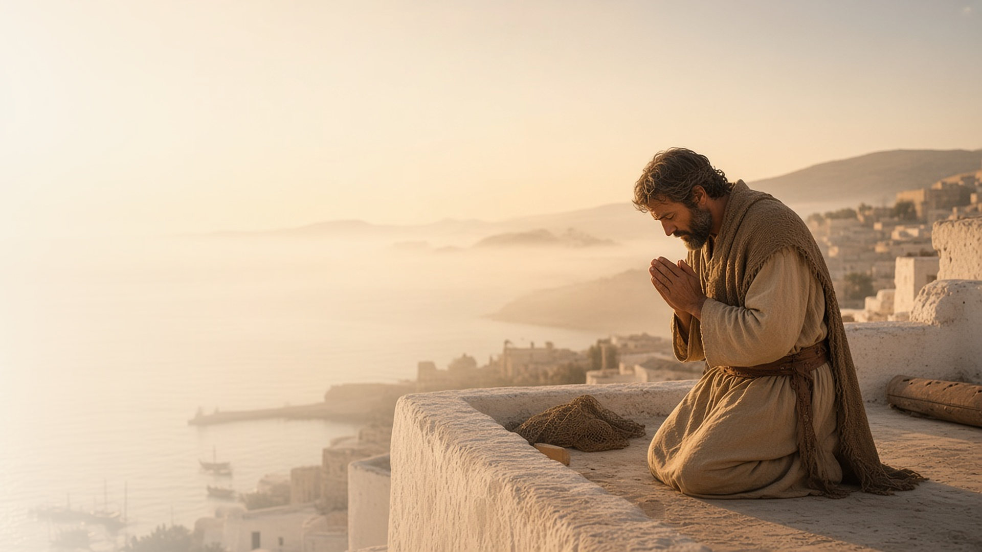
COME, FOLLOW ME · NEW TESTAMENT 2027
The Word of God
Grew and Multiplied
July 12–18
Acts 10–15
Notes:
TEACHING
In Acts 10–15 the gospel moves beyond Israel. A Roman centurion named Cornelius and the Apostle Peter both receive revelation, and Peter learns that God is no respecter of persons. Disciples are first called Christians at Antioch, the Church prays an imprisoned Peter free, and a council in Jerusalem settles a hard question by revelation. Through it all, the word of God grows and multiplies.
SCRIPTURE (KJV)
Acts 12:24
24 But the word of God grew and multiplied.
DISCUSSION
• Where do you see the Lord directing His Church in these chapters?
• How has revelation come to you line upon line?

Slide 2
ACTS 10
Line upon line
Cornelius and Peter each received revelation step by step.
“What God hath cleansed, that call not thou common.”
ACTS 10:15
Notes:
TEACHING
An angel told Cornelius to send for Peter, but did not explain why. Meanwhile Peter saw a vision of unclean animals and heard, "What God hath cleansed, that call not thou common," without yet understanding it. Only as messengers arrived and Peter acted did the meaning unfold. Revelation often comes this way, one step at a time.
SCRIPTURE (KJV)
Acts 10:1–6
1 There was a certain man in Caesarea called Cornelius, a centurion of the band called the Italian band,
2 A devout man, and one that feared God with all his house, which gave much alms to the people, and prayed to God alway.
3 He saw in a vision evidently about the ninth hour of the day an angel of God coming in to him, and saying unto him, Cornelius.
4 And when he looked on him, he was afraid, and said, What is it, Lord? And he said unto him, Thy prayers and thine alms are come up for a memorial before God.
5 And now send men to Joppa, and call for one Simon, whose surname is Peter:
6 He lodgeth with one Simon a tanner, whose house is by the sea side: he shall tell thee what thou oughtest to do.
Acts 10:9–20
9 On the morrow, as they went on their journey, and drew nigh unto the city, Peter went up upon the housetop to pray about the sixth hour:
10 And he became very hungry, and would have eaten: but while they made ready, he fell into a trance,
11 And saw heaven opened, and a certain vessel descending unto him, as it had been a great sheet knit at the four corners, and let down to the earth:
12 Wherein were all manner of fourfooted beasts of the earth, and wild beasts, and creeping things, and fowls of the air.
13 And there came a voice to him, Rise, Peter; kill, and eat.
14 But Peter said, Not so, Lord; for I have never eaten any thing that is common or unclean.
15 And the voice spake unto him again the second time, What God hath cleansed, that call not thou common.
16 This was done thrice: and the vessel was received up again into heaven.
17 Now while Peter doubted in himself what this vision which he had seen should mean, behold, the men which were sent from Cornelius had made enquiry for Simon’s house, and stood before the gate,
18 And called, and asked whether Simon, which was surnamed Peter, were lodged there.
19 While Peter thought on the vision, the Spirit said unto him, Behold, three men seek thee.
20 Arise therefore, and get thee down, and go with them, doubting nothing: for I have sent them.
DISCUSSION (questions quoted from the manual)
• “What kind of man was Cornelius?”
• “What prepared him to receive revelation? (see verses 2, 4, 22, 30–31).”
• “Why do you think the Lord may have wanted Cornelius and Peter to have their own spiritual experiences?”
• “How did Cornelius and Peter both act in faith as they gradually learned the Lord’s will? (see verses 7–8, 17–23, 29, 33).”
• “Why do you think God answered you in that way?”

Slide 3
ACTS 10; 11:1–18; 15:1–11
The Lord directs His Church
Through Peter’s revelation, the gospel went to the Gentiles.
“Of a truth I perceive that God is no respecter of persons.”
ACTS 10:34
Notes:
TEACHING
When the Holy Ghost fell on Cornelius and his household, Peter recognized the Lord's will and baptized them. Later, when some insisted Gentile converts must keep the law of Moses, the Apostles and elders met in council, and Peter testified that God made no difference between them. The Lord directs His Church through revelation to His servants.
SCRIPTURE (KJV)
Acts 10:34–35
34 Then Peter opened his mouth, and said, Of a truth I perceive that God is no respecter of persons:
35 But in every nation he that feareth him, and worketh righteousness, is accepted with him.
Acts 10:44–48
44 While Peter yet spake these words, the Holy Ghost fell on all them which heard the word.
45 And they of the circumcision which believed were astonished, as many as came with Peter, because that on the Gentiles also was poured out the gift of the Holy Ghost.
46 For they heard them speak with tongues, and magnify God. Then answered Peter,
47 Can any man forbid water, that these should not be baptized, which have received the Holy Ghost as well as we?
48 And he commanded them to be baptized in the name of the Lord. Then prayed they him to tarry certain days.
Acts 15:6–11
6 And the apostles and elders came together for to consider of this matter.
7 And when there had been much disputing, Peter rose up, and said unto them, Men and brethren, ye know how that a good while ago God made choice among us, that the Gentiles by my mouth should hear the word of the gospel, and believe.
8 And God, which knoweth the hearts, bare them witness, giving them the Holy Ghost, even as he did unto us;
9 And put no difference between us and them, purifying their hearts by faith.
10 Now therefore why tempt ye God, to put a yoke upon the neck of the disciples, which neither our fathers nor we were able to bear?
11 But we believe that through the grace of the Lord Jesus Christ we shall be saved, even as they.
DISCUSSION (questions quoted from the manual)
• “Why is it important to you to know that the Lord is at the head of His Church?”
• “What does it mean to you that God “is no respecter of persons”? (see verses 34–35).”
• “How can you follow His example?”
• “How have you come to know that the Lord directs His Church today through prophets and apostles?”

Slide 4
ACTS 11:26
Called Christians
Disciples at Antioch were first known by Christ’s name.
“And the disciples were called Christians first in Antioch.”
ACTS 11:26
Notes:
TEACHING
At Antioch, Barnabas and Saul taught a growing body of believers for a whole year, and there the disciples were first called Christians. The name declares whom we follow. Discuss what it means to be a Christian in belief and in action, and how others can recognize Christ in us.
SCRIPTURE (KJV)
Acts 11:19–26
19 Now they which were scattered abroad upon the persecution that arose about Stephen travelled as far as Phenice, and Cyprus, and Antioch, preaching the word to none but unto the Jews only.
20 And some of them were men of Cyprus and Cyrene, which, when they were come to Antioch, spake unto the Grecians, preaching the Lord Jesus.
21 And the hand of the Lord was with them: and a great number believed, and turned unto the Lord.
22 Then tidings of these things came unto the ears of the church which was in Jerusalem: and they sent forth Barnabas, that he should go as far as Antioch.
23 Who, when he came, and had seen the grace of God, was glad, and exhorted them all, that with purpose of heart they would cleave unto the Lord.
24 For he was a good man, and full of the Holy Ghost and of faith: and much people was added unto the Lord.
25 Then departed Barnabas to Tarsus, for to seek Saul:
26 And when he had found him, he brought him unto Antioch. And it came to pass, that a whole year they assembled themselves with the church, and taught much people. And the disciples were called Christians first in Antioch.
DISCUSSION (questions quoted from the manual)
• “What does it mean to you to be a Christian? (see Acts 11:26).”
• “What things do you put your name on?”
• “Why do you do that, and what does it communicate about that thing?”
• “How is your life different because of your willingness to take Christ’s name upon you?”
• “Corbitt, “Do You Know Why I as a Christian Believe in Christ?,””

Slide 5
ACTS 12:1–17
Prayer without ceasing
The Church prayed, and an angel freed Peter from prison.
“Peter therefore was kept in prison: but prayer was made without ceasing of the church unto God for him.”
ACTS 12:5
Notes:
TEACHING
Herod killed James and imprisoned Peter, chained between soldiers. The Church prayed without ceasing. An angel woke Peter, his chains fell off, and the gates opened on their own. When he knocked at the house where the Saints were praying, they could hardly believe it. Heavenly Father hears and answers prayers, sometimes beyond our expectations.
SCRIPTURE (KJV)
Acts 12:1–17
1 Now about that time Herod the king stretched forth his hands to vex certain of the church.
2 And he killed James the brother of John with the sword.
3 And because he saw it pleased the Jews, he proceeded further to take Peter also. (Then were the days of unleavened bread.)
4 And when he had apprehended him, he put him in prison, and delivered him to four quaternions of soldiers to keep him; intending after Easter to bring him forth to the people.
5 Peter therefore was kept in prison: but prayer was made without ceasing of the church unto God for him.
6 And when Herod would have brought him forth, the same night Peter was sleeping between two soldiers, bound with two chains: and the keepers before the door kept the prison.
7 And, behold, the angel of the Lord came upon him, and a light shined in the prison: and he smote Peter on the side, and raised him up, saying, Arise up quickly. And his chains fell off from his hands.
8 And the angel said unto him, Gird thyself, and bind on thy sandals. And so he did. And he saith unto him, Cast thy garment about thee, and follow me.
9 And he went out, and followed him; and wist not that it was true which was done by the angel; but thought he saw a vision.
10 When they were past the first and the second ward, they came unto the iron gate that leadeth unto the city; which opened to them of his own accord: and they went out, and passed on through one street; and forthwith the angel departed from him.
11 And when Peter was come to himself, he said, Now I know of a surety, that the Lord hath sent his angel, and hath delivered me out of the hand of Herod, and from all the expectation of the people of the Jews.
12 And when he had considered the thing, he came to the house of Mary the mother of John, whose surname was Mark; where many were gathered together praying.
13 And as Peter knocked at the door of the gate, a damsel came to hearken, named Rhoda.
14 And when she knew Peter’s voice, she opened not the gate for gladness, but ran in, and told how Peter stood before the gate.
15 And they said unto her, Thou art mad. But she constantly affirmed that it was even so. Then said they, It is his angel.
16 But Peter continued knocking: and when they had opened the door, and saw him, they were astonished.
17 But he, beckoning unto them with the hand to hold their peace, declared unto them how the Lord had brought him out of the prison. And he said, Go shew these things unto James, and to the brethren. And he departed, and went into another place.
DISCUSSION (questions quoted from the manual)
• “What did you learn from the experience?”
• “Nielson, “Is There No Balm in Gilead?,””

Slide 6
ACTS 12:24
“But the word of God grew and multiplied.”
Share one way you have seen the Lord direct His Church.
Notes:
TEACHING
Despite persecution and hard questions, the word of God kept growing. Close by inviting class members to share an experience of seeing the Lord direct His Church or their own lives.
SCRIPTURE (KJV)
Acts 12:24
24 But the word of God grew and multiplied.
DISCUSSION
• How have you seen the word of God grow in your own life?
• What can you do to help it grow in others?

