Slide 1
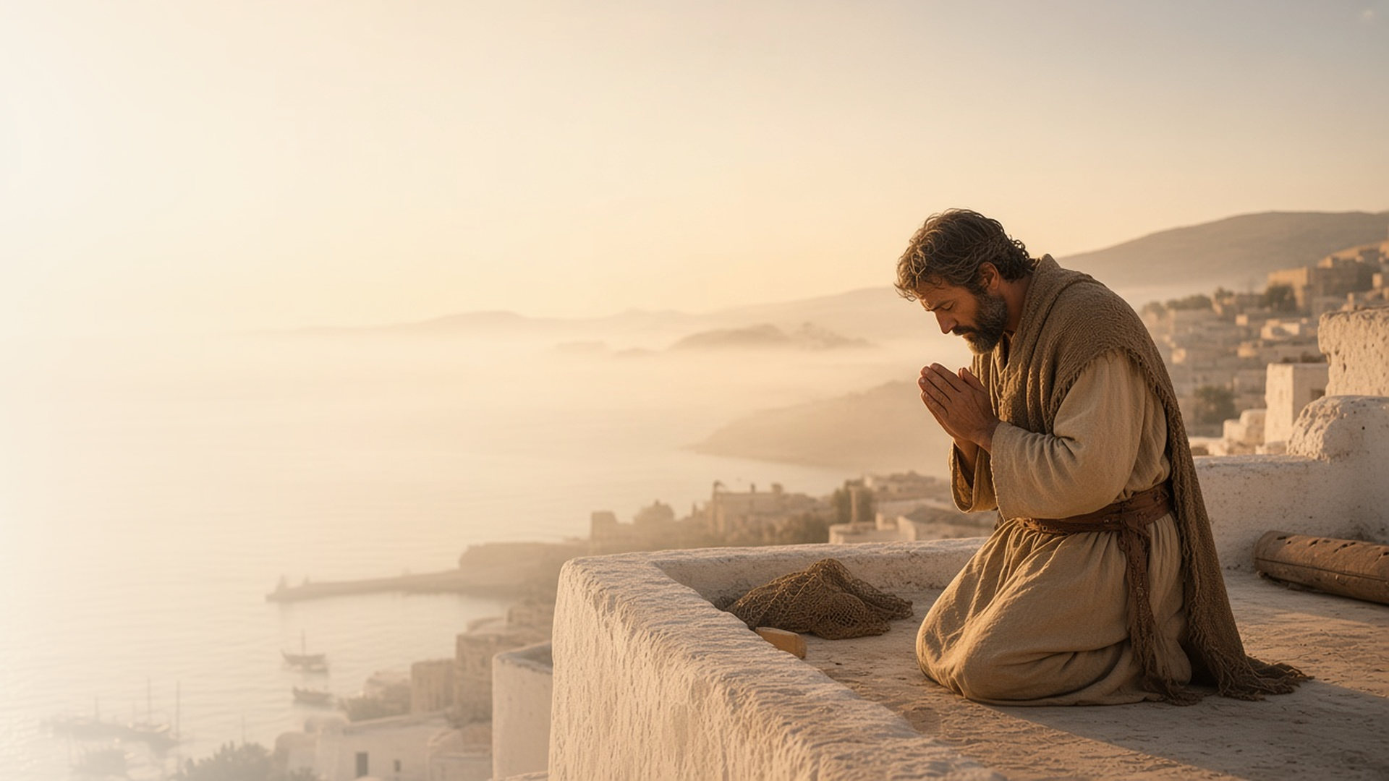
COME, FOLLOW ME · FOR CHILDREN
The Word of God
Grew and Multiplied
July 12–18
Acts 10–15
Notes:
TEACHING
This week children learn that Heavenly Father loves all His children, that Jesus went about doing good, that a Christian believes in and follows Jesus Christ, and that Heavenly Father hears and answers prayers.
SCRIPTURE (KJV)
Acts 10:38
38 How God anointed Jesus of Nazareth with the Holy Ghost and with power: who went about doing good, and healing all that were oppressed of the devil; for God was with him.
DISCUSSION
• What good things did Jesus do?
• Why are we called Christians?

Slide 2
ACTS 10:34–35
God loves all His children
Heavenly Father loves everyone, everywhere.
“Of a truth I perceive that God is no respecter of persons.”
ACTS 10:34
Notes:
TEACHING
Show pictures of children from many places. Explain that Peter learned that Heavenly Father loves everyone the same, no matter where they live or what they look like. Talk about ways to show love to people who are different from us.
SCRIPTURE (KJV)
Acts 10:34–35
34 Then Peter opened his mouth, and said, Of a truth I perceive that God is no respecter of persons:
35 But in every nation he that feareth him, and worketh righteousness, is accepted with him.
DISCUSSION (questions quoted from the manual)
• (The manual gives no direct questions for this section.)
Suggested: How can you show love to someone who is different from you?

Slide 3
ACTS 10:38
Jesus went about doing good
I can do good things like Jesus did.
“How God anointed Jesus of Nazareth with the Holy Ghost and with power.”
ACTS 10:38
Notes:
TEACHING
Have children name good things Jesus did, like healing the sick and being kind to children. Peter said Jesus went about doing good. Help each child think of one good thing they can do today.
SCRIPTURE (KJV)
Acts 10:38
38 How God anointed Jesus of Nazareth with the Holy Ghost and with power: who went about doing good, and healing all that were oppressed of the devil; for God was with him.
DISCUSSION (questions quoted from the manual)
• (The manual gives no direct questions for this section.)
Suggested: What good thing can you do today, like Jesus?

Slide 4
ACTS 11:26
I am a Christian
A Christian believes in and follows Jesus Christ.
“And the disciples were called Christians first in Antioch.”
ACTS 11:26
Notes:
TEACHING
Point out the word Christ inside Christian. Explain that followers of Jesus were first called Christians in a city called Antioch. We are Christians because we believe in Jesus and try to follow Him.
SCRIPTURE (KJV)
Acts 11:26
26 And when he had found him, he brought him unto Antioch. And it came to pass, that a whole year they assembled themselves with the church, and taught much people. And the disciples were called Christians first in Antioch.
DISCUSSION (questions quoted from the manual)
• “How can we show that we are followers of Jesus Christ and belong to His Church?”
• “How do we show that we belong to Jesus Christ?”

Slide 5
ACTS 12:5–17
Heavenly Father hears my prayers
The Saints prayed for Peter, and God sent an angel.
“But prayer was made without ceasing of the church unto God for him.”
ACTS 12:5
Notes:
TEACHING
Act out the story of Peter in prison: chains falling off, the angel leading him out, and Peter knocking on the door. His friends had been praying for him. Testify that Heavenly Father hears our prayers too.
SCRIPTURE (KJV)
Acts 12:5–7, 10
5 Peter therefore was kept in prison: but prayer was made without ceasing of the church unto God for him.
6 And when Herod would have brought him forth, the same night Peter was sleeping between two soldiers, bound with two chains: and the keepers before the door kept the prison.
7 And, behold, the angel of the Lord came upon him, and a light shined in the prison: and he smote Peter on the side, and raised him up, saying, Arise up quickly. And his chains fell off from his hands.
10 When they were past the first and the second ward, they came unto the iron gate that leadeth unto the city; which opened to them of his own accord: and they went out, and passed on through one street; and forthwith the angel departed from him.
Full passage: Acts 12:5–10
DISCUSSION (questions quoted from the manual)
• “As you and your children read together Acts 12:5–17 or “An Angel Frees Peter from Prison” (in New Testament Stories), you could invite them to look for answers to this question: How did Heavenly Father answer the prayers of the Church members?”

Slide 6
ACTS 10:38
“Who went about doing good.”
Do one good thing each day this week, like Jesus.
Notes:
TEACHING
Jesus went about doing good. Invite children to do one good thing each day this week.
SCRIPTURE (KJV)
Acts 10:38
38 How God anointed Jesus of Nazareth with the Holy Ghost and with power: who went about doing good, and healing all that were oppressed of the devil; for God was with him.
DISCUSSION
• What good things will you do this week?
• How does doing good help you feel close to Jesus?

