Slide 1
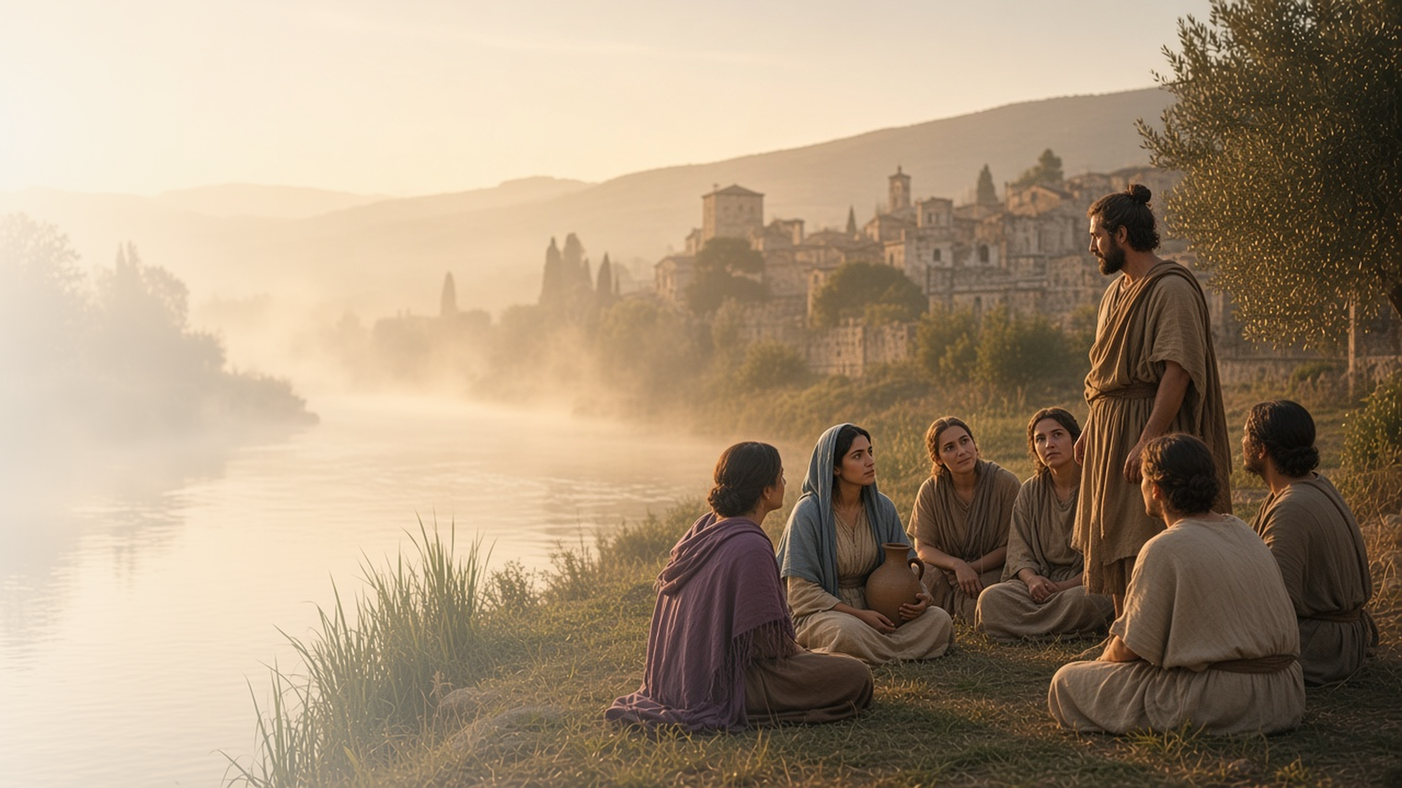
COME, FOLLOW ME · NEW TESTAMENT 2027
The Lord Had Called Us
for to Preach the Gospel
July 19–25
Acts 16–21
Notes:
TEACHING
On his second and third missionary journeys, Paul followed the Spirit's direction into Europe. In Philippi the Lord opened Lydia's heart and a jailer's household was baptized after Paul and Silas sang in prison. In Athens Paul taught that we are the offspring of God, and in Ephesus new believers burned their costly magic books. In every circumstance, Paul declared the gospel.
SCRIPTURE (KJV)
Acts 16:9–10
9 And a vision appeared to Paul in the night; There stood a man of Macedonia, and prayed him, saying, Come over into Macedonia, and help us.
10 And after he had seen the vision, immediately we endeavoured to go into Macedonia, assuredly gathering that the Lord had called us for to preach the gospel unto them.
DISCUSSION
• What can we learn from how Paul responded to the Spirit's direction?
• When has the Lord opened someone's heart to you?

Slide 2
ACTS 16
Whose heart the Lord opened
Lydia listened, and the Lord opened her heart.
“Whose heart the Lord opened, that she attended unto the things which were spoken of Paul.”
ACTS 16:14
Notes:
TEACHING
By a river outside Philippi, Paul spoke to women gathered for prayer. Lydia, a seller of purple, listened, and the Lord opened her heart. She and her household were baptized, and she opened her home to the missionaries. Conversion is the Lord's work; our part is to share and invite.
SCRIPTURE (KJV)
Acts 16:13–15
13 And on the sabbath we went out of the city by a river side, where prayer was wont to be made; and we sat down, and spake unto the women which resorted thither.
14 And a certain woman named Lydia, a seller of purple, of the city of Thyatira, which worshipped God, heard us: whose heart the Lord opened, that she attended unto the things which were spoken of Paul.
15 And when she was baptized, and her household, she besought us, saying, If ye have judged me to be faithful to the Lord, come into my house, and abide there. And she constrained us.
DISCUSSION (questions quoted from the manual)
• “How did the Lord help Paul find those who had been prepared? (see Acts 16:6–15).”
• “Why was Lydia different?”
• “What can you understand from Acts 16:13–15, 40 about the kind of person Lydia was?”
• “When have you seen evidence that the Lord prepared someone to receive His gospel?”

Slide 3
ACTS 16–21
Singing at midnight
In prison, Paul and Silas prayed, sang, and taught the jailer.
“Believe on the Lord Jesus Christ, and thou shalt be saved, and thy house.”
ACTS 16:31
Notes:
TEACHING
Beaten and locked in stocks, Paul and Silas prayed and sang praises at midnight. An earthquake opened the doors, and the terrified jailer asked what he must do to be saved. That same night he and his house were baptized. Paul declared the gospel whatever his circumstances, and so can we.
SCRIPTURE (KJV)
Acts 16:25–34
25 And at midnight Paul and Silas prayed, and sang praises unto God: and the prisoners heard them.
26 And suddenly there was a great earthquake, so that the foundations of the prison were shaken: and immediately all the doors were opened, and every one’s bands were loosed.
27 And the keeper of the prison awaking out of his sleep, and seeing the prison doors open, he drew out his sword, and would have killed himself, supposing that the prisoners had been fled.
28 But Paul cried with a loud voice, saying, Do thyself no harm: for we are all here.
29 Then he called for a light, and sprang in, and came trembling, and fell down before Paul and Silas,
30 And brought them out, and said, Sirs, what must I do to be saved?
31 And they said, Believe on the Lord Jesus Christ, and thou shalt be saved, and thy house.
32 And they spake unto him the word of the Lord, and to all that were in his house.
33 And he took them the same hour of the night, and washed their stripes; and was baptized, he and all his, straightway.
34 And when he had brought them into his house, he set meat before them, and rejoiced, believing in God with all his house.
DISCUSSION (questions quoted from the manual)
• “What do you find in Acts 18:9–10 that may have helped him?”
• “What truths did Paul know that gave him confidence?”
• “Why are we sometimes afraid to share the gospel?”
• “What do you learn from Paul’s example?”

Slide 4
ACTS 17:16–34
The offspring of God
On Mars’ Hill, Paul taught that we are God’s children.
“For in him we live, and move, and have our being; as certain also of your own poets have said, For we are also his offspring.”
ACTS 17:28
Notes:
TEACHING
In Athens, surrounded by idols and an altar to the unknown god, Paul declared the God who made the world and does not dwell in temples made with hands. He quoted their own poets: we are His offspring. Knowing we are children of God changes how we see ourselves and everyone around us.
SCRIPTURE (KJV)
Acts 17:22–31
22 Then Paul stood in the midst of Mars’ hill, and said, Ye men of Athens, I perceive that in all things ye are too superstitious.
23 For as I passed by, and beheld your devotions, I found an altar with this inscription, TO THE UNKNOWN GOD. Whom therefore ye ignorantly worship, him declare I unto you.
24 God that made the world and all things therein, seeing that he is Lord of heaven and earth, dwelleth not in temples made with hands;
25 Neither is worshipped with men’s hands, as though he needed any thing, seeing he giveth to all life, and breath, and all things;
26 And hath made of one blood all nations of men for to dwell on all the face of the earth, and hath determined the times before appointed, and the bounds of their habitation;
27 That they should seek the Lord, if haply they might feel after him, and find him, though he be not far from every one of us:
28 For in him we live, and move, and have our being; as certain also of your own poets have said, For we are also his offspring.
29 Forasmuch then as we are the offspring of God, we ought not to think that the Godhead is like unto gold, or silver, or stone, graven by art and man’s device.
30 And the times of this ignorance God winked at; but now commandeth all men every where to repent:
31 Because he hath appointed a day, in the which he will judge the world in righteousness by that man whom he hath ordained; whereof he hath given assurance unto all men, in that he hath raised him from the dead.
DISCUSSION (questions quoted from the manual)
• “What does it mean to you to be the “offspring of God”? (Acts 17:29).”
• “How does this truth influence how you see yourself and others?”

Slide 5
ACTS 17:32–34
When others mock
Some mocked Paul’s witness of the Resurrection; some believed.
“And when they heard of the resurrection of the dead, some mocked: and others said, We will hear thee again of this matter.”
ACTS 17:32
Notes:
TEACHING
When Paul spoke of the Resurrection, some Athenians mocked, others put him off, and a few believed, including Dionysius and a woman named Damaris. Belief in Jesus Christ is not always popular. Discuss how to stand firm in our witness with kindness when others disagree.
SCRIPTURE (KJV)
Acts 17:32–34
32 And when they heard of the resurrection of the dead, some mocked: and others said, We will hear thee again of this matter.
33 So Paul departed from among them.
34 Howbeit certain men clave unto him, and believed: among the which was Dionysius the Areopagite, and a woman named Damaris, and others with them.
DISCUSSION (questions quoted from the manual)
• “What helped you keep your faith strong?”

Slide 6
ACTS 19:13–20
Burning the books
New believers gave up costly magic books for the gospel.
“So mightily grew the word of God and prevailed.”
ACTS 19:20
Notes:
TEACHING
In Ephesus, many who had practiced magic arts brought their books and burned them publicly, books worth fifty thousand pieces of silver. They valued the gospel more than their expensive past. Invite class members to consider what they might need to give up to put the Lord first.
SCRIPTURE (KJV)
Acts 19:13–20
13 Then certain of the vagabond Jews, exorcists, took upon them to call over them which had evil spirits the name of the Lord Jesus, saying, We adjure you by Jesus whom Paul preacheth.
14 And there were seven sons of one Sceva, a Jew, and chief of the priests, which did so.
15 And the evil spirit answered and said, Jesus I know, and Paul I know; but who are ye?
16 And the man in whom the evil spirit was leaped on them, and overcame them, and prevailed against them, so that they fled out of that house naked and wounded.
17 And this was known to all the Jews and Greeks also dwelling at Ephesus; and fear fell on them all, and the name of the Lord Jesus was magnified.
18 And many that believed came, and confessed, and shewed their deeds.
19 Many of them also which used curious arts brought their books together, and burned them before all men: and they counted the price of them, and found it fifty thousand pieces of silver.
20 So mightily grew the word of God and prevailed.
DISCUSSION (questions quoted from the manual)
• “Are there worldly possessions or activities you need to give up to receive heavenly blessings?”
• “What do you learn about the blessings of sacrificing worldly things?”

Slide 7
ACTS 16:10
“The Lord had called us
for to preach the gospel unto them.”
Pray for one person this week whose heart the Lord may open.
Notes:
TEACHING
Paul and his companions followed a vision into Macedonia, confident that the Lord had called them. Close by inviting class members to pray for someone whose heart the Lord may be opening, and to watch for a chance to share.
SCRIPTURE (KJV)
Acts 16:9–10
9 And a vision appeared to Paul in the night; There stood a man of Macedonia, and prayed him, saying, Come over into Macedonia, and help us.
10 And after he had seen the vision, immediately we endeavoured to go into Macedonia, assuredly gathering that the Lord had called us for to preach the gospel unto them.
DISCUSSION
• Whom do you feel prompted to pray for?
• What helps you share the gospel naturally?

