Slide 1
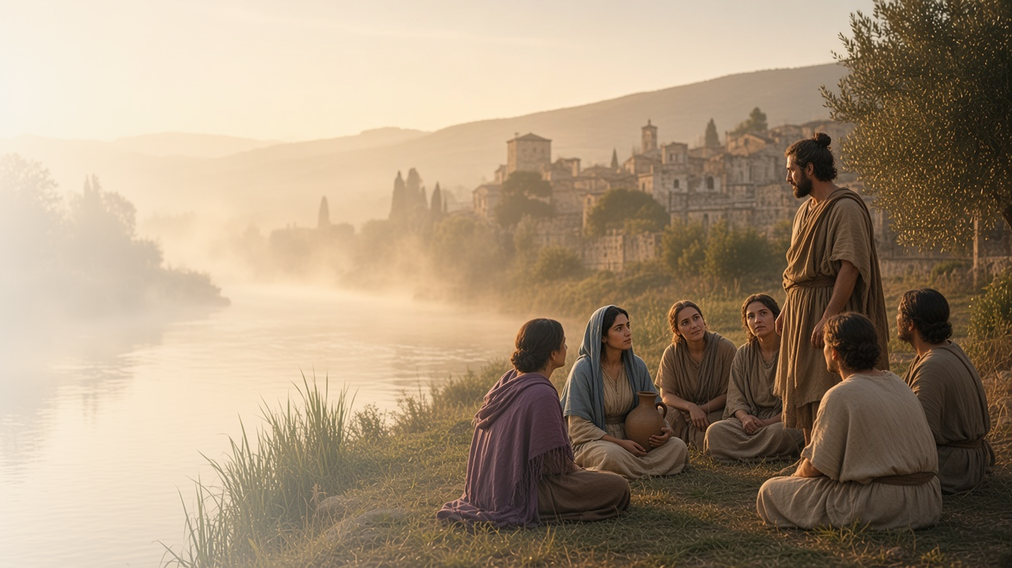
COME, FOLLOW ME · FOR CHILDREN
The Lord Had Called Us
for to Preach the Gospel
July 19–25
Acts 16–21
Notes:
TEACHING
This week children learn that they can be missionaries now, that the scriptures testify of Heavenly Father and Jesus Christ, and that each of us is a child of God.
SCRIPTURE (KJV)
Acts 17:28–29
28 For in him we live, and move, and have our being; as certain also of your own poets have said, For we are also his offspring.
29 Forasmuch then as we are the offspring of God, we ought not to think that the Godhead is like unto gold, or silver, or stone, graven by art and man’s device.
DISCUSSION
• How can you share the gospel now?
• Whose child are you?

Slide 2
ACTS 16:14–15, 25–34; 18:7–8, 24–28
I can be a missionary now
Lydia and the jailer shared the gospel with their families.
“Believe on the Lord Jesus Christ, and thou shalt be saved, and thy house.”
ACTS 16:31
Notes:
TEACHING
Tell how Lydia and a jailer learned about Jesus and then helped their families be baptized too. Children can be missionaries by being kind, inviting friends to Church activities, and telling others about Jesus.
SCRIPTURE (KJV)
Acts 16:14
14 And a certain woman named Lydia, a seller of purple, of the city of Thyatira, which worshipped God, heard us: whose heart the Lord opened, that she attended unto the things which were spoken of Paul.
Full passage: Acts 16:14–15
Acts 16:30–31, 33
30 And brought them out, and said, Sirs, what must I do to be saved?
31 And they said, Believe on the Lord Jesus Christ, and thou shalt be saved, and thy house.
33 And he took them the same hour of the night, and washed their stripes; and was baptized, he and all his, straightway.
Full passage: Acts 16:30–34
DISCUSSION (questions quoted from the manual)
• “Why were Paul and Silas so positive during this scary experience?”

Slide 3
ACTS 17:2–4, 10–12; 18:28
The scriptures testify of Jesus
The Bereans searched the scriptures every day.
“Searched the scriptures daily, whether those things were so.”
ACTS 17:11
Notes:
TEACHING
Tell how people in a city called Berea read the scriptures every day to learn if what Paul taught about Jesus was true. Help children find a favorite scripture about Jesus and plan a time each day to read.
SCRIPTURE (KJV)
Acts 17:10–12
10 And the brethren immediately sent away Paul and Silas by night unto Berea: who coming thither went into the synagogue of the Jews.
11 These were more noble than those in Thessalonica, in that they received the word with all readiness of mind, and searched the scriptures daily, whether those things were so.
12 Therefore many of them believed; also of honourable women which were Greeks, and of men, not a few.
DISCUSSION (questions quoted from the manual)
• “According to these verses, what helped people believe the gospel of Jesus Christ?”

Slide 4
ACTS 17:22–31
I am a child of God
Paul taught that we are all God’s children.
“Forasmuch then as we are the offspring of God.”
ACTS 17:29
Notes:
TEACHING
Explain that offspring means children. Paul taught that every person is a child of God. Sing "I Am a Child of God" and help children feel that Heavenly Father knows and loves them.
SCRIPTURE (KJV)
Acts 17:28–29
28 For in him we live, and move, and have our being; as certain also of your own poets have said, For we are also his offspring.
29 Forasmuch then as we are the offspring of God, we ought not to think that the Godhead is like unto gold, or silver, or stone, graven by art and man’s device.
DISCUSSION (questions quoted from the manual)
• “What do we learn about God from Acts 17:27–29?”

Slide 5
ACTS 17:28
“For we are also his offspring.”
Remember every day: I am a child of God.
Notes:
TEACHING
We are all God's children. Invite children to remember that each day this week.
SCRIPTURE (KJV)
Acts 17:28
28 For in him we live, and move, and have our being; as certain also of your own poets have said, For we are also his offspring.
DISCUSSION
• How does Heavenly Father show He loves you?
• How can you treat others as children of God?

