Slide 1
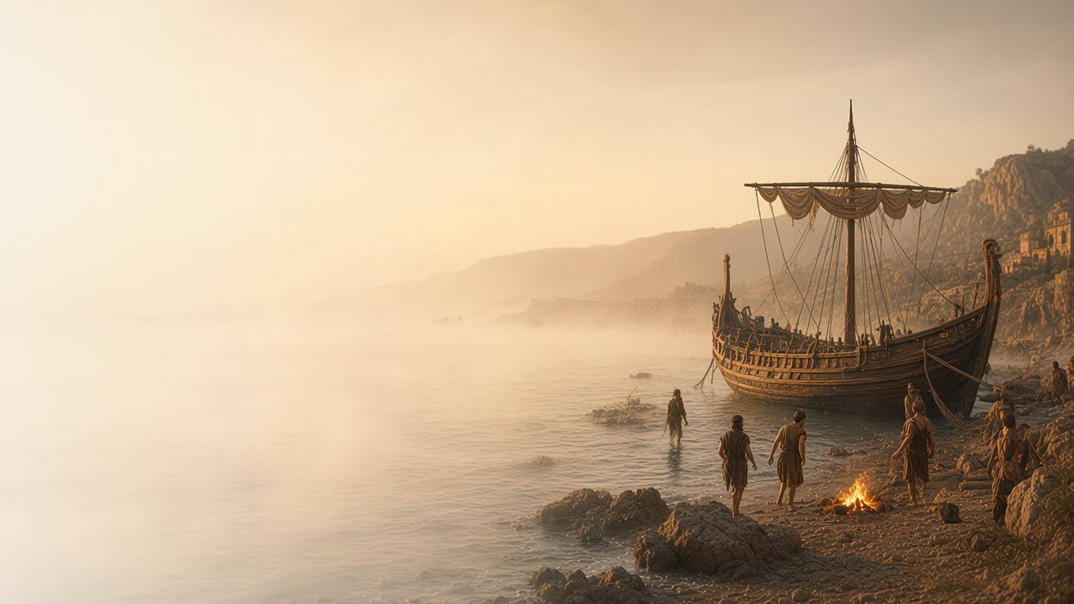
COME, FOLLOW ME · NEW TESTAMENT 2027
Be of Good Cheer …:
Thou Hast Testified of Me
July 26–August 1
Acts 22–28
Notes:
TEACHING
In Acts 22–28 Paul is arrested in Jerusalem and spends years as a prisoner, testifying before crowds, councils, governors, and King Agrippa. The Lord stands by him in the night, and on the voyage to Rome he warns of danger, survives shipwreck, and is unharmed by a viper on Malta. Acts ends with Paul in Rome, still preaching the kingdom of God with all confidence.
SCRIPTURE (KJV)
Acts 23:11
11 And the night following the Lord stood by him, and said, Be of good cheer, Paul: for as thou hast testified of me in Jerusalem, so must thou bear witness also at Rome.
DISCUSSION
• What strengthens you as you read Paul's testimony in such hard circumstances?
• When has the Lord stood by you?

Slide 2
ACTS 22:1–21; 26:1–29; 28:22–41
Not disobedient to the vision
Paul freely told how the risen Lord had changed his life.
“I was not disobedient unto the heavenly vision.”
ACTS 26:19
Notes:
TEACHING
Twice Paul told the story of his conversion, once to a hostile crowd and once to King Agrippa, holding nothing back. The manual notes that young Joseph Smith drew strength from Paul's example when he was mocked for his First Vision (Joseph Smith—History 1:24–25). The manual's reference for this section reads "Acts 28:22–41," but Acts 28 has only 31 verses, so the slide uses Acts 22 and 26.
SCRIPTURE (KJV)
Acts 22:6–16
6 And it came to pass, that, as I made my journey, and was come nigh unto Damascus about noon, suddenly there shone from heaven a great light round about me.
7 And I fell unto the ground, and heard a voice saying unto me, Saul, Saul, why persecutest thou me?
8 And I answered, Who art thou, Lord? And he said unto me, I am Jesus of Nazareth, whom thou persecutest.
9 And they that were with me saw indeed the light, and were afraid; but they heard not the voice of him that spake to me.
10 And I said, What shall I do, Lord? And the Lord said unto me, Arise, and go into Damascus; and there it shall be told thee of all things which are appointed for thee to do.
11 And when I could not see for the glory of that light, being led by the hand of them that were with me, I came into Damascus.
12 And one Ananias, a devout man according to the law, having a good report of all the Jews which dwelt there,
13 Came unto me, and stood, and said unto me, Brother Saul, receive thy sight. And the same hour I looked up upon him.
14 And he said, The God of our fathers hath chosen thee, that thou shouldest know his will, and see that Just One, and shouldest hear the voice of his mouth.
15 For thou shalt be his witness unto all men of what thou hast seen and heard.
16 And now why tarriest thou? arise, and be baptized, and wash away thy sins, calling on the name of the Lord.
Acts 26:13–19
13 At midday, O king, I saw in the way a light from heaven, above the brightness of the sun, shining round about me and them which journeyed with me.
14 And when we were all fallen to the earth, I heard a voice speaking unto me, and saying in the Hebrew tongue, Saul, Saul, why persecutest thou me? it is hard for thee to kick against the pricks.
15 And I said, Who art thou, Lord? And he said, I am Jesus whom thou persecutest.
16 But rise, and stand upon thy feet: for I have appeared unto thee for this purpose, to make thee a minister and a witness both of these things which thou hast seen, and of those things in the which I will appear unto thee;
17 Delivering thee from the people, and from the Gentiles, unto whom now I send thee,
18 To open their eyes, and to turn them from darkness to light, and from the power of Satan unto God, that they may receive forgiveness of sins, and inheritance among them which are sanctified by faith that is in me.
19 Whereupon, O king Agrippa, I was not disobedient unto the heavenly vision:
Restoration scripture (public-domain text: bcbooks/scriptures-json)
Joseph Smith—History 1:24–25 (Pearl of Great Price)
24 However, it was nevertheless a fact that I had beheld a vision. I have thought since, that I felt much like Paul, when he made his defense before King Agrippa, and related the account of the vision he had when he saw a light, and heard a voice; but still there were but few who believed him; some said he was dishonest, others said he was mad; and he was ridiculed and reviled. But all this did not destroy the reality of his vision. He had seen a vision, he knew he had, and all the persecution under heaven could not make it otherwise; and though they should persecute him unto death, yet he knew, and would know to his latest breath, that he had both seen a light and heard a voice speaking unto him, and all the world could not make him think or believe otherwise.
25 So it was with me. I had actually seen a light, and in the midst of that light I saw two Personages, and they did in reality speak to me; and though I was hated and persecuted for saying that I had seen a vision, yet it was true; and while they were persecuting me, reviling me, and speaking all manner of evil against me falsely for so saying, I was led to say in my heart: Why persecute me for telling the truth? I have actually seen a vision; and who am I that I can withstand God, or why does the world think to make me deny what I have actually seen? For I had seen a vision; I knew it, and I knew that God knew it, and I could not deny it, neither dared I do it; at least I knew that by so doing I would offend God, and come under condemnation.
DISCUSSION (questions quoted from the manual)
• “What inspires you about his words?”
• “For example, do your friends know how you feel about Him?”
• “Does your family know how you gained your testimony?”
• “When was the last time you told someone about a spiritual experience you had?”
• “How would you summarize what Joseph Smith learned from Paul?”
• “What do you learn from these two witnesses of Jesus Christ?”
(+2 more in the manual)

Slide 3
ACTS 23:1; 24:16
A conscience void of offence
Through Christ, we can repent and live with a clear conscience.
“And herein do I exercise myself, to have always a conscience void of offence toward God, and toward men.”
ACTS 24:16
Notes:
TEACHING
Before the council and before Felix, Paul declared that he had lived in good conscience and strove always to keep it clear before God and others. Paul had once persecuted the Saints; his clear conscience came through repentance and the Savior's grace. Discuss how repentance brings peace of conscience.
SCRIPTURE (KJV)
Acts 23:1
1 And Paul, earnestly beholding the council, said, Men and brethren, I have lived in all good conscience before God until this day.
Acts 24:14–16
14 But this I confess unto thee, that after the way which they call heresy, so worship I the God of my fathers, believing all things which are written in the law and in the prophets:
15 And have hope toward God, which they themselves also allow, that there shall be a resurrection of the dead, both of the just and unjust.
16 And herein do I exercise myself, to have always a conscience void of offence toward God, and toward men.
DISCUSSION (questions quoted from the manual)
• “How could he say that, given his history of persecuting God’s people?”
• “What do you learn about Jesus Christ and repentance from these scriptures and Paul’s words?”

Slide 4
ACTS 23–26
Almost persuaded
Felix trembled and Agrippa wavered; open hearts receive more.
“Almost thou persuadest me to be a Christian.”
ACTS 26:28
Notes:
TEACHING
Felix trembled as Paul spoke of righteousness and judgment but put him off until a convenient season. Agrippa said he was almost persuaded. Both heard the truth from a servant of God, but neither fully opened his heart. Invite class members to consider how they receive the Lord's servants and their counsel.
SCRIPTURE (KJV)
Acts 24:24–25
24 And after certain days, when Felix came with his wife Drusilla, which was a Jewess, he sent for Paul, and heard him concerning the faith in Christ.
25 And as he reasoned of righteousness, temperance, and judgment to come Felix trembled, and answered, Go thy way for this time; when I have a convenient season, I will call for thee.
Acts 26:27–29
27 King Agrippa, believest thou the prophets? I know that thou believest.
28 Then Agrippa said unto Paul, Almost thou persuadest me to be a Christian.
29 And Paul said, I would to God, that not only thou, but also all that hear me this day, were both almost, and altogether such as I am, except these bonds.
DISCUSSION (questions quoted from the manual)
• “How are these reactions similar to the way the Lord’s servants are sometimes received today?”
• “What do your actions say about your attitude toward the Lord’s servants?”

Slide 5
ACTS 23:10–11; 27:13–25, 40–44; 28:1–10
The Lord stood by him
In prison and shipwreck, the Lord stood by His servant.
“And the night following the Lord stood by him, and said, Be of good cheer, Paul.”
ACTS 23:11
Notes:
TEACHING
After a violent night before the council, the Lord stood by Paul and told him to be of good cheer, for he would testify in Rome. Later, in a storm that lasted fourteen days, an angel promised Paul that every life aboard would be saved. The Lord stands by those who strive to serve Him, even when trials do not end quickly.
SCRIPTURE (KJV)
Acts 23:10–11
10 And when there arose a great dissension, the chief captain, fearing lest Paul should have been pulled in pieces of them, commanded the soldiers to go down, and to take him by force from among them, and to bring him into the castle.
11 And the night following the Lord stood by him, and said, Be of good cheer, Paul: for as thou hast testified of me in Jerusalem, so must thou bear witness also at Rome.
Acts 27:21–25
21 But after long abstinence Paul stood forth in the midst of them, and said, Sirs, ye should have hearkened unto me, and not have loosed from Crete, and to have gained this harm and loss.
22 And now I exhort you to be of good cheer: for there shall be no loss of any man’s life among you, but of the ship.
23 For there stood by me this night the angel of God, whose I am, and whom I serve,
24 Saying, Fear not, Paul; thou must be brought before Caesar: and, lo, God hath given thee all them that sail with thee.
25 Wherefore, sirs, be of good cheer: for I believe God, that it shall be even as it was told me.
DISCUSSION (questions quoted from the manual)
• “How did the Lord support Paul during His trials? (see, for example, Acts 23:10–11; 27:13–25, 40–44; 28:1–10).”
• “How has He supported you?”

Slide 6
ACTS 27
Heed the warning
The centurion ignored Paul’s warning, and the ship was lost.
“Sirs, I perceive that this voyage will be with hurt and much damage.”
ACTS 27:10
Notes:
TEACHING
Paul warned that sailing on would bring loss, but the centurion trusted the ship's master instead. The storm came. Later the soldiers listened to Paul and cut away the lifeboat so the sailors could not flee, and all reached land safely. The Lord guides and protects us through His servants when we heed them.
SCRIPTURE (KJV)
Acts 27:9–11
9 Now when much time was spent, and when sailing was now dangerous, because the fast was now already past, Paul admonished them,
10 And said unto them, Sirs, I perceive that this voyage will be with hurt and much damage, not only of the lading and ship, but also of our lives.
11 Nevertheless the centurion believed the master and the owner of the ship, more than those things which were spoken by Paul.
Acts 27:30–32
30 And as the shipmen were about to flee out of the ship, when they had let down the boat into the sea, under colour as though they would have cast anchors out of the foreship,
31 Paul said to the centurion and to the soldiers, Except these abide in the ship, ye cannot be saved.
32 Then the soldiers cut off the ropes of the boat, and let her fall off.
Acts 27:40–44
40 And when they had taken up the anchors, they committed themselves unto the sea, and loosed the rudder bands, and hoised up the mainsail to the wind, and made toward shore.
41 And falling into a place where two seas met, they ran the ship aground; and the forepart stuck fast, and remained unmoveable, but the hinder part was broken with the violence of the waves.
42 And the soldiers’ counsel was to kill the prisoners, lest any of them should swim out, and escape.
43 But the centurion, willing to save Paul, kept them from their purpose; and commanded that they which could swim should cast themselves first into the sea, and get to land:
44 And the rest, some on boards, and some on broken pieces of the ship. And so it came to pass, that they escaped all safe to land.
DISCUSSION (questions quoted from the manual)
• “Why do you think the centurion responded that way?”
• “What would you have said to the centurion to help him have faith in Paul’s prophecy?”
• “Have you ever followed the counsel of the Lord’s servants even though it differed from opinions of others?”
• “What did you learn from that experience?”
• “What other lessons do you learn from Acts 27 about following the Lord’s servants?”

Slide 7
ACTS 23:11
“For as thou hast testified of me in Jerusalem,
so must thou bear witness also at Rome.”
Share your witness of Christ with one person this week.
Notes:
TEACHING
The Lord's promise to Paul was fulfilled: Acts ends with him in Rome, teaching about the Lord Jesus Christ with all confidence. Close by inviting class members to share their witness with someone this week.
SCRIPTURE (KJV)
Acts 23:11
11 And the night following the Lord stood by him, and said, Be of good cheer, Paul: for as thou hast testified of me in Jerusalem, so must thou bear witness also at Rome.
Acts 28:30–31
30 And Paul dwelt two whole years in his own hired house, and received all that came in unto him,
31 Preaching the kingdom of God, and teaching those things which concern the Lord Jesus Christ, with all confidence, no man forbidding him.
DISCUSSION
• Where is your "Rome," the place the Lord may want you to testify?
• What gives you confidence to share your witness?

