Slide 1
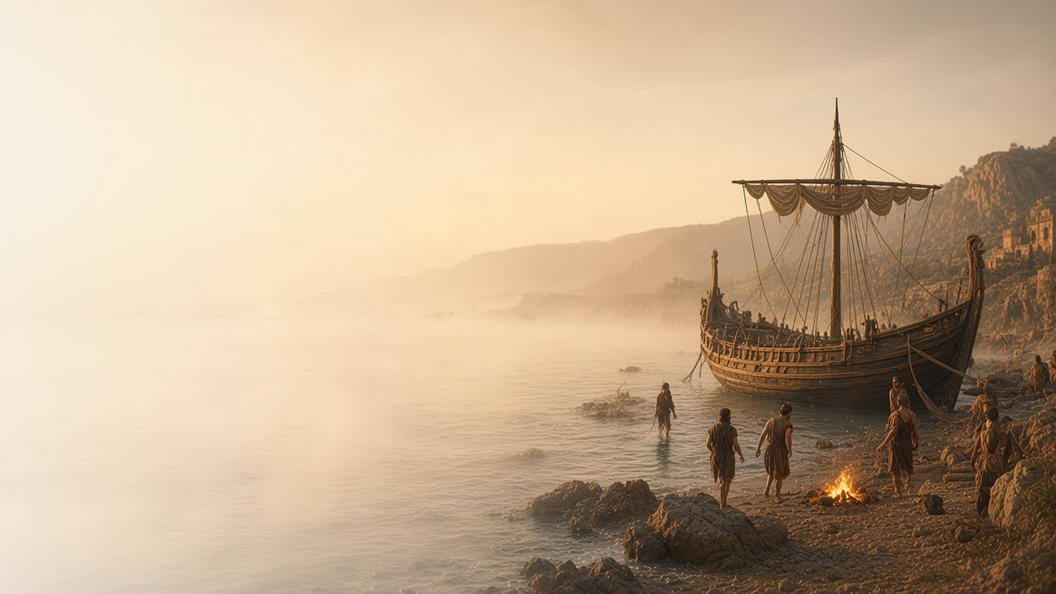
COME, FOLLOW ME · FOR CHILDREN
Be of Good Cheer …:
Thou Hast Testified of Me
July 26–August 1
Acts 22–28
Notes:
TEACHING
This week children learn that Jesus cares about them and will help during hard times, that they can share their testimony, that prophets warn us of danger, and that Jesus Christ keeps His promises.
SCRIPTURE (KJV)
Acts 23:11
11 And the night following the Lord stood by him, and said, Be of good cheer, Paul: for as thou hast testified of me in Jerusalem, so must thou bear witness also at Rome.
DISCUSSION
• How did Jesus help Paul?
• How can Jesus help you when things are hard?

Slide 2
ACTS 23:11
Jesus helps me in hard times
When Paul was in prison, Jesus came to comfort him.
“Be of good cheer, Paul.”
ACTS 23:11
Notes:
TEACHING
Tell how Paul was put in prison for teaching about Jesus. One night Jesus stood by him and told him to be of good cheer. Jesus knows when we are having a hard time, and He can help us feel better.
SCRIPTURE (KJV)
Acts 23:11
11 And the night following the Lord stood by him, and said, Be of good cheer, Paul: for as thou hast testified of me in Jerusalem, so must thou bear witness also at Rome.
DISCUSSION (questions quoted from the manual)
• “How can you help that person find joy in Jesus Christ?”

Slide 3
ACTS 26
I can share my testimony
Paul told a king how he came to know Jesus.
“I was not disobedient unto the heavenly vision.”
ACTS 26:19
Notes:
TEACHING
Explain that a testimony is what we know and feel about Jesus. Paul told King Agrippa about seeing a bright light and hearing Jesus. Help children practice sharing one simple sentence of testimony.
SCRIPTURE (KJV)
Acts 26:13, 15–16, 19
13 At midday, O king, I saw in the way a light from heaven, above the brightness of the sun, shining round about me and them which journeyed with me.
15 And I said, Who art thou, Lord? And he said, I am Jesus whom thou persecutest.
16 But rise, and stand upon thy feet: for I have appeared unto thee for this purpose, to make thee a minister and a witness both of these things which thou hast seen, and of those things in the which I will appear unto thee;
19 Whereupon, O king Agrippa, I was not disobedient unto the heavenly vision:
Full passage: Acts 26:13–19
DISCUSSION (questions quoted from the manual)
• (The manual gives no direct questions for this section.)
Suggested: What is one thing you know about Jesus that you could share?

Slide 4
ACTS 27
Prophets warn me of danger
Paul warned the sailors, and listening kept them safe.
“I exhort you to be of good cheer: for there shall be no loss of any man’s life among you.”
ACTS 27:22
Notes:
TEACHING
Use a toy boat to tell how Paul warned that the ship would be in danger. The sailors didn't listen at first, and a big storm came. When they listened to Paul, everyone was saved. Prophets today warn us too, and listening keeps us safe.
SCRIPTURE (KJV)
Acts 27:10
10 And said unto them, Sirs, I perceive that this voyage will be with hurt and much damage, not only of the lading and ship, but also of our lives.
Acts 27:22–25
22 And now I exhort you to be of good cheer: for there shall be no loss of any man’s life among you, but of the ship.
23 For there stood by me this night the angel of God, whose I am, and whom I serve,
24 Saying, Fear not, Paul; thou must be brought before Caesar: and, lo, God hath given thee all them that sail with thee.
25 Wherefore, sirs, be of good cheer: for I believe God, that it shall be even as it was told me.
DISCUSSION (questions quoted from the manual)
• (The manual gives no direct questions for this section.)
Suggested: What has our prophet asked us to do to stay safe?

Slide 5
ACTS 28:1–10
Jesus keeps His promises
A snake bit Paul, but God protected him as promised.
“And he shook off the beast into the fire, and felt no harm.”
ACTS 28:5
Notes:
TEACHING
Tell how Paul landed on an island after the shipwreck and a snake bit his hand while he gathered sticks. He shook it into the fire and was not hurt. Jesus had promised to protect His servants. Help children think of promises Jesus makes to us.
SCRIPTURE (KJV)
Acts 28:3, 5–6
3 And when Paul had gathered a bundle of sticks, and laid them on the fire, there came a viper out of the heat, and fastened on his hand.
5 And he shook off the beast into the fire, and felt no harm.
6 Howbeit they looked when he should have swollen, or fallen down dead suddenly: but after they had looked a great while, and saw no harm come to him, they changed their minds, and said that he was a god.
Full passage: Acts 28:1–6
DISCUSSION (questions quoted from the manual)
• “How can we show our faith that this promise will be fulfilled?”

Slide 6
ACTS 23:11
“Be of good cheer, Paul.”
When things are hard, remember Jesus is near.
Notes:
TEACHING
Jesus told Paul to be of good cheer. Invite children to remember that Jesus is near when things are hard.
SCRIPTURE (KJV)
Acts 23:11
11 And the night following the Lord stood by him, and said, Be of good cheer, Paul: for as thou hast testified of me in Jerusalem, so must thou bear witness also at Rome.
DISCUSSION
• When can you remember that Jesus is near?
• How can you help a friend be of good cheer?

