Slide 1
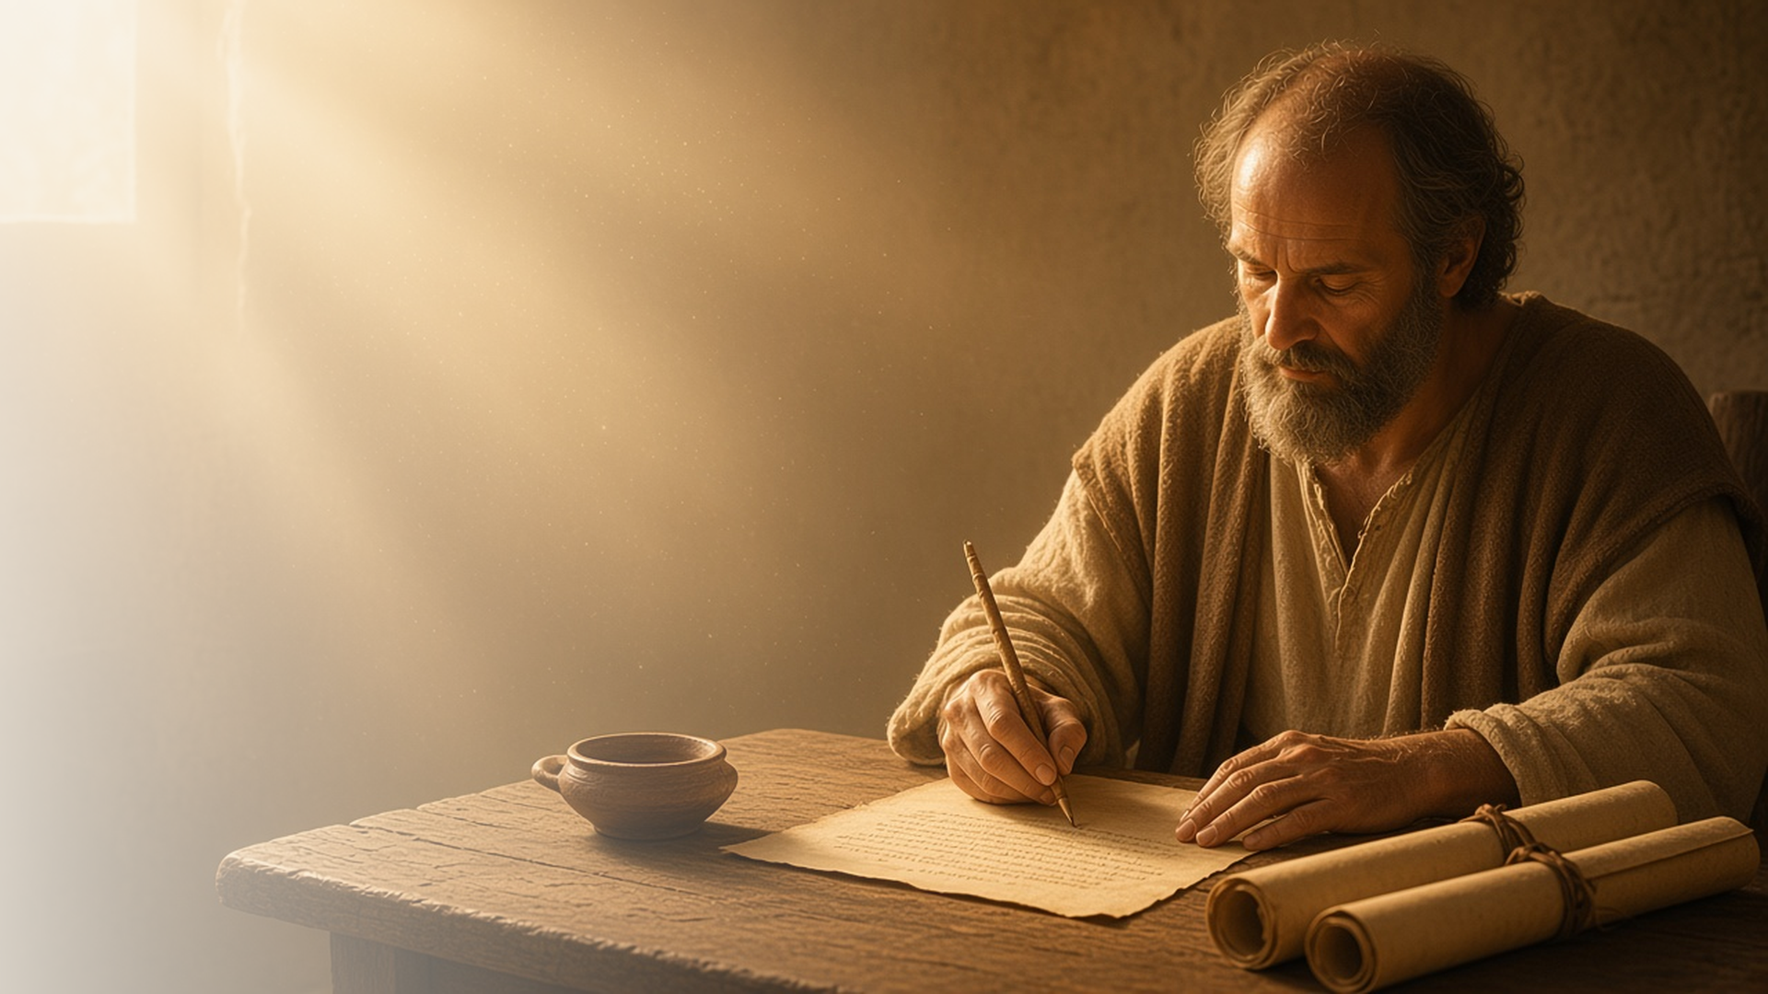
COME, FOLLOW ME · NEW TESTAMENT 2027
The Power of God
unto Salvation
August 2–8
Romans 1–6
Notes:
TEACHING
Paul's letter to the Romans is his fullest explanation of the gospel of Jesus Christ. In chapters 1–6 he declares that he is not ashamed of the gospel, teaches that all have sinned and need a Savior, and testifies that through Christ's grace we can be justified, reconciled to God, and raised through baptism to walk in newness of life.
SCRIPTURE (KJV)
Romans 1:16–17
16 For I am not ashamed of the gospel of Christ: for it is the power of God unto salvation to every one that believeth; to the Jew first, and also to the Greek.
17 For therein is the righteousness of God revealed from faith to faith: as it is written, The just shall live by faith.
DISCUSSION
• What does it mean to you that the gospel is "the power of God unto salvation"?
• Where have you felt the Savior's grace this week?

Slide 2
ROMANS 1:15–17
Not ashamed
The gospel is God’s power to save everyone who believes.
“For I am not ashamed of the gospel of Christ: for it is the power of God unto salvation to every one that believeth.”
ROMANS 1:16
Notes:
TEACHING
Paul longed to preach in Rome, the capital of the world, and declared that he was not ashamed of the gospel. It is not just good advice but the power of God to save all who believe. Discuss what helps us share the gospel with confidence rather than embarrassment.
SCRIPTURE (KJV)
Romans 1:15–17
15 So, as much as in me is, I am ready to preach the gospel to you that are at Rome also.
16 For I am not ashamed of the gospel of Christ: for it is the power of God unto salvation to every one that believeth; to the Jew first, and also to the Greek.
17 For therein is the righteousness of God revealed from faith to faith: as it is written, The just shall live by faith.
DISCUSSION (questions quoted from the manual)
• “How did he show that he was “not ashamed of the gospel of Christ”? (see, for example, Acts 16:16–34; 17:16–32; 26:12–32).”
• “Can you think of times when you, like Paul, felt unashamed of the Savior’s gospel?”
• “What helped you feel that way?”

Slide 3
ROMANS 2:17–29
Circumcision of the heart
True discipleship is an inward change, not an outward show.
“But he is a Jew, which is one inwardly; and circumcision is that of the heart.”
ROMANS 2:29
Notes:
TEACHING
Paul challenged those who relied on the law and outward signs while not living what they taught. True belonging to God's covenant people is inward, a change of heart that motivates outward action. Invite class members to consider how their inward commitment to Christ shapes what they do.
SCRIPTURE (KJV)
Romans 2:17–29
17 Behold, thou art called a Jew, and restest in the law, and makest thy boast of God,
18 And knowest his will, and approvest the things that are more excellent, being instructed out of the law;
19 And art confident that thou thyself art a guide of the blind, a light of them which are in darkness,
20 An instructor of the foolish, a teacher of babes, which hast the form of knowledge and of the truth in the law.
21 Thou therefore which teachest another, teachest thou not thyself? thou that preachest a man should not steal, dost thou steal?
22 Thou that sayest a man should not commit adultery, dost thou commit adultery? thou that abhorrest idols, dost thou commit sacrilege?
23 Thou that makest thy boast of the law, through breaking the law dishonourest thou God?
24 For the name of God is blasphemed among the Gentiles through you, as it is written.
25 For circumcision verily profiteth, if thou keep the law: but if thou be a breaker of the law, thy circumcision is made uncircumcision.
26 Therefore if the uncircumcision keep the righteousness of the law, shall not his uncircumcision be counted for circumcision?
27 And shall not uncircumcision which is by nature, if it fulfil the law, judge thee, who by the letter and circumcision dost transgress the law?
28 For he is not a Jew, which is one outwardly; neither is that circumcision, which is outward in the flesh:
29 But he is a Jew, which is one inwardly; and circumcision is that of the heart, in the spirit, and not in the letter; whose praise is not of men, but of God.
Restoration scripture (public-domain text: bcbooks/scriptures-json)
Alma 25:15–16 (Book of Mormon)
15 Yea, and they did keep the law of Moses; for it was expedient that they should keep the law of Moses as yet, for it was not all fulfilled. But notwithstanding the law of Moses, they did look forward to the coming of Christ, considering that the law of Moses was a type of his coming, and believing that they must keep those outward performances until the time that he should be revealed unto them.
16 Now they did not suppose that salvation came by the law of Moses; but the law of Moses did serve to strengthen their faith in Christ; and thus they did retain a hope through faith, unto eternal salvation, relying upon the spirit of prophecy, which spake of those things to come.
DISCUSSION (questions quoted from the manual)
• “Are your outward actions, such as taking the sacrament or attending the temple, strengthening your faith in Christ? (see Alma 25:15–16).”
• “What has helped you align your outward actions with “the heart [and] the spirit” of the gospel? (Romans 2:29).”

Slide 4
ROMANS 3:10–31; 5
Reconciled to God
We all fall short, and Christ makes peace with God possible.
“Therefore being justified by faith, we have peace with God through our Lord Jesus Christ.”
ROMANS 5:1
Notes:
TEACHING
Paul teaches that all have sinned and come short of the glory of God; no one can earn salvation alone. Yet while we were still sinners, Christ died for us, and through Him we are reconciled to God and have peace. Discuss what it feels like to be reconciled, at peace with God, through the Savior.
SCRIPTURE (KJV)
Romans 3:23–24
23 For all have sinned, and come short of the glory of God;
24 Being justified freely by his grace through the redemption that is in Christ Jesus:
Romans 5:1
1 Therefore being justified by faith, we have peace with God through our Lord Jesus Christ:
Romans 5:8–11
8 But God commendeth his love toward us, in that, while we were yet sinners, Christ died for us.
9 Much more then, being now justified by his blood, we shall be saved from wrath through him.
10 For if, when we were enemies, we were reconciled to God by the death of his Son, much more, being reconciled, we shall be saved by his life.
11 And not only so, but we also joy in God through our Lord Jesus Christ, by whom we have now received the atonement.
DISCUSSION (questions quoted from the manual)
• “Why do you think he emphasized the point that “all have sinned”? (Romans 3:23).”
• “What hopeful messages do you find in Romans 3:24–31 and Romans 5?”
• “What does this representation teach you about Jesus Christ?”

Slide 5
ROMANS 3–6
Justified freely by His grace
His grace forgives sin and gives power to do better.
“Being justified freely by his grace through the redemption that is in Christ Jesus.”
ROMANS 3:24
Notes:
TEACHING
Grace is the Savior's enabling gift. It forgives us when we repent and strengthens us to do what we could not do alone. Paul makes clear that grace is not permission to keep sinning but power to live a new life. Invite class members to share how they have felt both the forgiving and strengthening power of His grace.
SCRIPTURE (KJV)
Romans 3:21–28
21 But now the righteousness of God without the law is manifested, being witnessed by the law and the prophets;
22 Even the righteousness of God which is by faith of Jesus Christ unto all and upon all them that believe: for there is no difference:
23 For all have sinned, and come short of the glory of God;
24 Being justified freely by his grace through the redemption that is in Christ Jesus:
25 Whom God hath set forth to be a propitiation through faith in his blood, to declare his righteousness for the remission of sins that are past, through the forbearance of God;
26 To declare, I say, at this time his righteousness: that he might be just, and the justifier of him which believeth in Jesus.
27 Where is boasting then? It is excluded. By what law? of works? Nay: but by the law of faith.
28 Therefore we conclude that a man is justified by faith without the deeds of the law.
Romans 6:14
14 For sin shall not have dominion over you: for ye are not under the law, but under grace.
DISCUSSION (questions quoted from the manual)
• “How do you think Paul would respond to these views? (See, for example, Romans 3:20–31; 4:16 [see the Joseph Smith Translation in footnote a ]; 5:1–2; 6:1–2, 21–23).”
• “What additional truths do you learn about works and grace from the following resources?”

Slide 6
ROMANS 6
Newness of life
Baptism buries the old life and raises a new one in Christ.
“Even so we also should walk in newness of life.”
ROMANS 6:4
Notes:
TEACHING
Paul compares baptism to burial and resurrection: the old self is buried with Christ, and we rise to walk in newness of life. Each week the sacrament renews that covenant. Discuss what it means to keep walking in newness of life long after the day of baptism.
SCRIPTURE (KJV)
Romans 6:3–11
3 Know ye not, that so many of us as were baptized into Jesus Christ were baptized into his death?
4 Therefore we are buried with him by baptism into death: that like as Christ was raised up from the dead by the glory of the Father, even so we also should walk in newness of life.
5 For if we have been planted together in the likeness of his death, we shall be also in the likeness of his resurrection:
6 Knowing this, that our old man is crucified with him, that the body of sin might be destroyed, that henceforth we should not serve sin.
7 For he that is dead is freed from sin.
8 Now if we be dead with Christ, we believe that we shall also live with him:
9 Knowing that Christ being raised from the dead dieth no more; death hath no more dominion over him.
10 For in that he died, he died unto sin once: but in that he liveth, he liveth unto God.
11 Likewise reckon ye also yourselves to be dead indeed unto sin, but alive unto God through Jesus Christ our Lord.
DISCUSSION (questions quoted from the manual)
• “What do you learn from this chapter about the symbolism of baptism?”
• “What statements in Romans 6 describe how following the Savior has helped you “walk in newness of life”? (verse 4).”

Slide 7
ROMANS 5:8
“While we were yet sinners, Christ died for us.”
Share the gospel without shame with someone this week.
Notes:
TEACHING
God's love does not wait for us to become worthy; Christ died for us while we were yet sinners. Close by inviting class members to share that good news confidently with someone this week.
SCRIPTURE (KJV)
Romans 5:6–8
6 For when we were yet without strength, in due time Christ died for the ungodly.
7 For scarcely for a righteous man will one die: yet peradventure for a good man some would even dare to die.
8 But God commendeth his love toward us, in that, while we were yet sinners, Christ died for us.
DISCUSSION
• How does Romans 5:8 change the way you see yourself?
• With whom could you share this good news?

