Slide 1
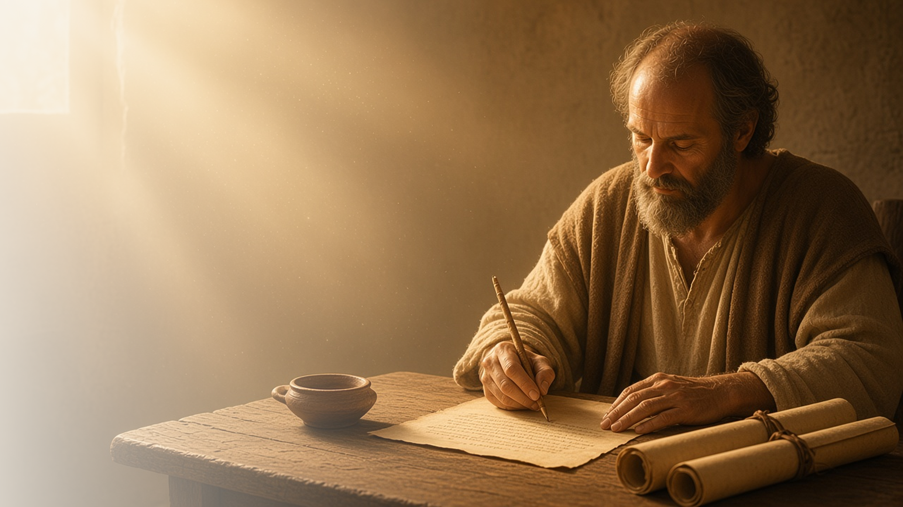
COME, FOLLOW ME · FOR CHILDREN
The Power of God
unto Salvation
August 2–8
Romans 1–6
Notes:
TEACHING
This week children learn that they do not need to be ashamed of the gospel, that everyone needs Jesus Christ to be forgiven, and that baptism begins a new life as a follower of Jesus.
SCRIPTURE (KJV)
Romans 6:3–4
3 Know ye not, that so many of us as were baptized into Jesus Christ were baptized into his death?
4 Therefore we are buried with him by baptism into death: that like as Christ was raised up from the dead by the glory of the Father, even so we also should walk in newness of life.
DISCUSSION
• What do you love about the gospel?
• What happens when we are baptized?

Slide 2
ROMANS 1:16–17
Not ashamed of the gospel
I can be happy to share what I believe about Jesus.
“For I am not ashamed of the gospel of Christ.”
ROMANS 1:16
Notes:
TEACHING
Explain that ashamed means embarrassed. Paul was never embarrassed about Jesus and His gospel; he was happy to tell everyone. Help children practice sharing one thing they believe about Jesus.
SCRIPTURE (KJV)
Romans 1:16
16 For I am not ashamed of the gospel of Christ: for it is the power of God unto salvation to every one that believeth; to the Jew first, and also to the Greek.
DISCUSSION (questions quoted from the manual)
• “How do we act when we’re ashamed?”
• “How do we act when we’re not ashamed?”
• “What can we do to show that we’re not ashamed of Jesus and His gospel?”
• “What can we do to show that we have faith in Jesus Christ?”

Slide 3
ROMANS 3:23–24
We all need Jesus
Everyone makes mistakes, and Jesus helps us be forgiven.
“For all have sinned, and come short of the glory of God.”
ROMANS 3:23
Notes:
TEACHING
Explain that everyone makes mistakes, even grown-ups. Jesus loves us and made it possible for us to be forgiven when we repent. Talk about how it feels to say sorry and be forgiven.
SCRIPTURE (KJV)
Romans 3:23–24
23 For all have sinned, and come short of the glory of God;
24 Being justified freely by his grace through the redemption that is in Christ Jesus:
DISCUSSION (questions quoted from the manual)
• “What can we do together with the Savior that we cannot do by ourselves?”

Slide 4
ROMANS 6:1–11
Baptism begins a new life
When I am baptized, I promise to follow Jesus.
“Even so we also should walk in newness of life.”
ROMANS 6:4
Notes:
TEACHING
Show a picture of a baptism. Explain that when we are baptized, it is like starting a brand-new life following Jesus. Talk about promises we make at baptism and how children can prepare.
SCRIPTURE (KJV)
Romans 6:3–4
3 Know ye not, that so many of us as were baptized into Jesus Christ were baptized into his death?
4 Therefore we are buried with him by baptism into death: that like as Christ was raised up from the dead by the glory of the Father, even so we also should walk in newness of life.
DISCUSSION (questions quoted from the manual)
• “How is being baptized similar to death and resurrection?”
• “How has your baptism covenant helped you become more like Jesus Christ?”

Slide 5
ROMANS 1:16
“For I am not ashamed of the gospel of Christ.”
Tell a friend one thing you love about the gospel.
Notes:
TEACHING
Paul was not ashamed of the gospel. Invite children to tell a friend one thing they love about it.
SCRIPTURE (KJV)
Romans 1:16
16 For I am not ashamed of the gospel of Christ: for it is the power of God unto salvation to every one that believeth; to the Jew first, and also to the Greek.
DISCUSSION
• What do you love about the gospel?
• Who will you tell?

