Slide 1
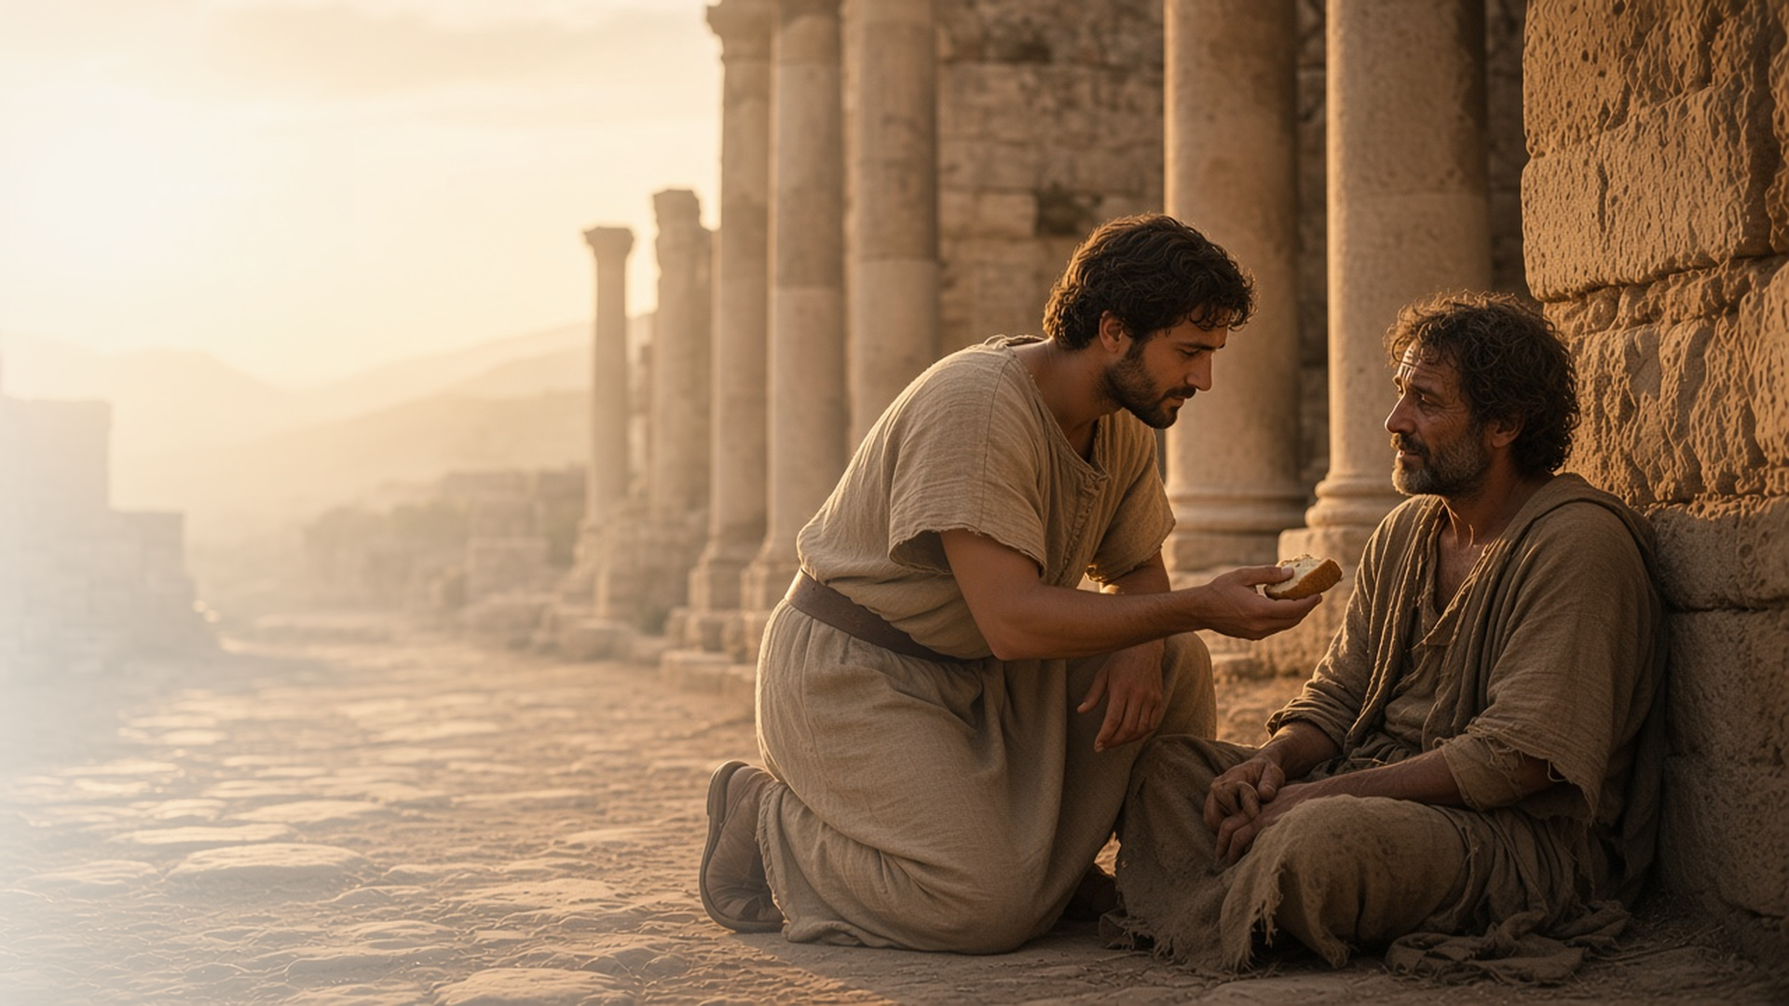
COME, FOLLOW ME · NEW TESTAMENT 2027
Overcome Evil
with Good
August 9–15
Romans 7–16
Notes:
TEACHING
In Romans 7–16 Paul describes the inner struggle between flesh and Spirit and testifies that Christ can deliver us. He teaches that we are children of God and joint-heirs with Christ, that nothing can separate us from His love, and that Saints present their lives as a living sacrifice, put on Christ, seek peace, and overcome evil with good.
SCRIPTURE (KJV)
Romans 12:21
21 Be not overcome of evil, but overcome evil with good.
DISCUSSION
• Where in your life could you overcome evil with good?
• Which promise in Romans 8 means the most to you?

Slide 2
ROMANS 7:14–25; 8:1–14
After the Spirit
Christ helps us win the struggle between flesh and Spirit.
“There is therefore now no condemnation to them which are in Christ Jesus, who walk not after the flesh, but after the Spirit.”
ROMANS 8:1
Notes:
TEACHING
Paul honestly describes the struggle of wanting to do good and still falling short: "O wretched man that I am!" His answer is Jesus Christ, who frees us from condemnation and helps us walk after the Spirit. Discuss how the Savior helps us in our own daily struggles.
SCRIPTURE (KJV)
Romans 7:18–25
18 For I know that in me (that is, in my flesh,) dwelleth no good thing: for to will is present with me; but how to perform that which is good I find not.
19 For the good that I would I do not: but the evil which I would not, that I do.
20 Now if I do that I would not, it is no more I that do it, but sin that dwelleth in me.
21 I find then a law, that, when I would do good, evil is present with me.
22 For I delight in the law of God after the inward man:
23 But I see another law in my members, warring against the law of my mind, and bringing me into captivity to the law of sin which is in my members.
24 O wretched man that I am! who shall deliver me from the body of this death?
25 I thank God through Jesus Christ our Lord. So then with the mind I myself serve the law of God; but with the flesh the law of sin.
Romans 8:1–6
1 There is therefore now no condemnation to them which are in Christ Jesus, who walk not after the flesh, but after the Spirit.
2 For the law of the Spirit of life in Christ Jesus hath made me free from the law of sin and death.
3 For what the law could not do, in that it was weak through the flesh, God sending his own Son in the likeness of sinful flesh, and for sin, condemned sin in the flesh:
4 That the righteousness of the law might be fulfilled in us, who walk not after the flesh, but after the Spirit.
5 For they that are after the flesh do mind the things of the flesh; but they that are after the Spirit the things of the Spirit.
6 For to be carnally minded is death; but to be spiritually minded is life and peace.
DISCUSSION (questions quoted from the manual)
• “Have you ever felt frustrated because, even though you want to obey the commandments, you continue to sin?”
• “How has He helped you overcome the “sin that dwelleth in [you]” so that “the Spirit of God [can] dwell in you”? (Romans 7:20; 8:9).”

Slide 3
ROMANS 8:16–28
Joint-heirs with Christ
As God’s children, we can inherit all that He has.
“And if children, then heirs; heirs of God, and joint-heirs with Christ.”
ROMANS 8:17
Notes:
TEACHING
The Spirit witnesses that we are children of God, and as His children we are heirs, joint-heirs with Christ. Present sufferings are not worth comparing with the glory to come, and all things work together for good to those who love God. Invite class members to consider how this identity shapes their choices.
SCRIPTURE (KJV)
Romans 8:16–18
16 The Spirit itself beareth witness with our spirit, that we are the children of God:
17 And if children, then heirs; heirs of God, and joint-heirs with Christ; if so be that we suffer with him, that we may be also glorified together.
18 For I reckon that the sufferings of this present time are not worthy to be compared with the glory which shall be revealed in us.
Romans 8:28
28 And we know that all things work together for good to them that love God, to them who are the called according to his purpose.
DISCUSSION (questions quoted from the manual)
• “What do you find there that affects how you think about suffering?”
• “What does it mean to you to be a joint-heir with Christ?”
• “Which aspects of God’s plan give you hope and patience in your trials? (see verses 18, 22–25).”
• “What experiences have taught you that “all things work together for good to them that love God”? (verse 28).”
• “What do God’s promises teach you about who He is and how He feels about you?”

Slide 4
ROMANS 8:31–39
Nothing can separate us
Nothing can separate us from the love of God in Christ.
“Who shall separate us from the love of Christ?”
ROMANS 8:35
Notes:
TEACHING
Paul lists everything that might seem to cut us off from God: tribulation, persecution, famine, death, powers, things present and to come. None of them can separate us from His love. Discuss when this promise has sustained class members, or how it might.
SCRIPTURE (KJV)
Romans 8:31–39
31 What shall we then say to these things? If God be for us, who can be against us?
32 He that spared not his own Son, but delivered him up for us all, how shall he not with him also freely give us all things?
33 Who shall lay any thing to the charge of God’s elect? It is God that justifieth.
34 Who is he that condemneth? It is Christ that died, yea rather, that is risen again, who is even at the right hand of God, who also maketh intercession for us.
35 Who shall separate us from the love of Christ? shall tribulation, or distress, or persecution, or famine, or nakedness, or peril, or sword?
36 As it is written, For thy sake we are killed all the day long; we are accounted as sheep for the slaughter.
37 Nay, in all these things we are more than conquerors through him that loved us.
38 For I am persuaded, that neither death, nor life, nor angels, nor principalities, nor powers, nor things present, nor things to come,
39 Nor height, nor depth, nor any other creature, shall be able to separate us from the love of God, which is in Christ Jesus our Lord.
DISCUSSION (questions quoted from the manual)
• “How did He make His love known to you, even when you were experiencing adversity?”
• “How did your adversity help you turn to Him?”

Slide 5
ROMANS 12–16
A living sacrifice
Saints present their whole lives to God.
“Present your bodies a living sacrifice, holy, acceptable unto God.”
ROMANS 12:1
Notes:
TEACHING
Paul's final chapters turn from doctrine to daily life. Saints offer themselves as a living sacrifice, are transformed by renewing their minds, love without hypocrisy, bless those who persecute them, and live peaceably. Invite class members to choose one of Paul's practical counsels to focus on.
SCRIPTURE (KJV)
Romans 12:1–2
1 I beseech you therefore, brethren, by the mercies of God, that ye present your bodies a living sacrifice, holy, acceptable unto God, which is your reasonable service.
2 And be not conformed to this world: but be ye transformed by the renewing of your mind, that ye may prove what is that good, and acceptable, and perfect, will of God.
Romans 12:9–18
9 Let love be without dissimulation. Abhor that which is evil; cleave to that which is good.
10 Be kindly affectioned one to another with brotherly love; in honour preferring one another;
11 Not slothful in business; fervent in spirit; serving the Lord;
12 Rejoicing in hope; patient in tribulation; continuing instant in prayer;
13 Distributing to the necessity of saints; given to hospitality.
14 Bless them which persecute you: bless, and curse not.
15 Rejoice with them that do rejoice, and weep with them that weep.
16 Be of the same mind one toward another. Mind not high things, but condescend to men of low estate. Be not wise in your own conceits.
17 Recompense to no man evil for evil. Provide things honest in the sight of all men.
18 If it be possible, as much as lieth in you, live peaceably with all men.
DISCUSSION (questions quoted from the manual)
• “What could you do to apply these principles in your life?”
• “How could Heavenly Father help guide your efforts?”

Slide 6
ROMANS 13:12–14
Put on Christ
Cast off darkness and put on the armour of light.
“But put ye on the Lord Jesus Christ, and make not provision for the flesh, to fulfil the lusts thereof.”
ROMANS 13:14
Notes:
TEACHING
Paul compares discipleship to getting dressed for the day: cast off the works of darkness and put on the armour of light; put on the Lord Jesus Christ. Discuss what it looks like to put on Christ each morning, in our attitudes, words, and actions.
SCRIPTURE (KJV)
Romans 13:12–14
12 The night is far spent, the day is at hand: let us therefore cast off the works of darkness, and let us put on the armour of light.
13 Let us walk honestly, as in the day; not in rioting and drunkenness, not in chambering and wantonness, not in strife and envying.
14 But put ye on the Lord Jesus Christ, and make not provision for the flesh, to fulfil the lusts thereof.
DISCUSSION (questions quoted from the manual)
• “How does keeping your baptismal and temple covenants bring you strength, protection, and power?”
• “How is putting on Jesus Christ like putting on an “armour of light”? (verse 12).”
• “Christ?”

Slide 7
ROMANS 14:13–21
Things which make for peace
We choose not to judge, but to build each other up.
“Let us therefore follow after the things which make for peace, and things wherewith one may edify another.”
ROMANS 14:19
Notes:
TEACHING
Roman Saints disagreed over food and holy days. Paul counseled them not to judge one another or put a stumbling block in a brother's way, but to follow after the things that make for peace and edify one another. Invite class members to consider how to apply this when members see things differently.
SCRIPTURE (KJV)
Romans 14:13–21
13 Let us not therefore judge one another any more: but judge this rather, that no man put a stumblingblock or an occasion to fall in his brother’s way.
14 I know, and am persuaded by the Lord Jesus, that there is nothing unclean of itself: but to him that esteemeth any thing to be unclean, to him it is unclean.
15 But if thy brother be grieved with thy meat, now walkest thou not charitably. Destroy not him with thy meat, for whom Christ died.
16 Let not then your good be evil spoken of:
17 For the kingdom of God is not meat and drink; but righteousness, and peace, and joy in the Holy Ghost.
18 For he that in these things serveth Christ is acceptable to God, and approved of men.
19 Let us therefore follow after the things which make for peace, and things wherewith one may edify another.
20 For meat destroy not the work of God. All things indeed are pure; but it is evil for that man who eateth with offence.
21 It is good neither to eat flesh, nor to drink wine, nor any thing whereby thy brother stumbleth, or is offended, or is made weak.
DISCUSSION (questions quoted from the manual)
• “How can you “follow after the things which make for peace” (verse 19) at such times?”
• “Oaks’s message “Following Christ”? (Liahona, Nov. 2024, 23–26).”

Slide 8
ROMANS 12:21
“Be not overcome of evil,
but overcome evil with good.”
Answer one unkindness this week with good.
Notes:
TEACHING
Paul's counsel is the title of this lesson: do not be overcome by evil, but overcome evil with good. Close by inviting class members to answer one unkindness this week with goodness.
SCRIPTURE (KJV)
Romans 12:17–21
17 Recompense to no man evil for evil. Provide things honest in the sight of all men.
18 If it be possible, as much as lieth in you, live peaceably with all men.
19 Dearly beloved, avenge not yourselves, but rather give place unto wrath: for it is written, Vengeance is mine; I will repay, saith the Lord.
20 Therefore if thine enemy hunger, feed him; if he thirst, give him drink: for in so doing thou shalt heap coals of fire on his head.
21 Be not overcome of evil, but overcome evil with good.
DISCUSSION
• Where might the Lord want you to return good for evil?
• How has someone's goodness changed you?

