Slide 1
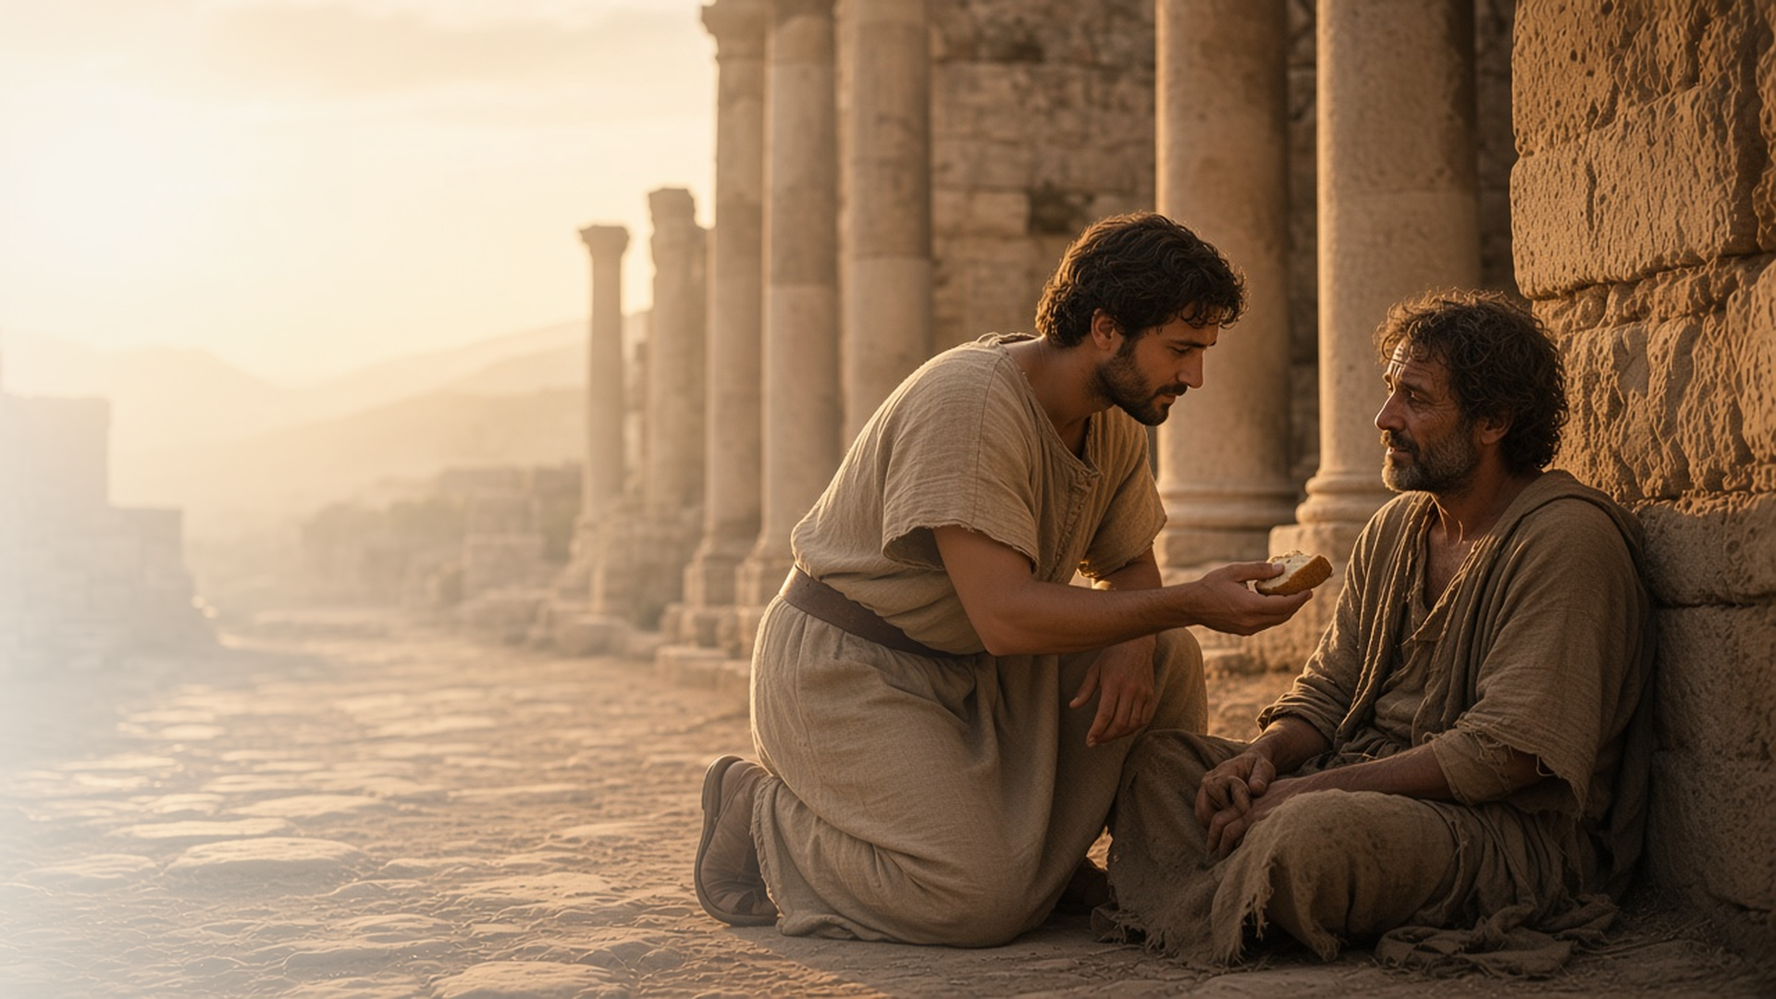
COME, FOLLOW ME · FOR CHILDREN
Overcome Evil
with Good
August 9–15
Romans 7–16
Notes:
TEACHING
This week children learn that Heavenly Father wants to give them everything He has because they are His children, that nothing can separate them from God's love, that faith comes by hearing the word of God, and that we should not judge one another.
SCRIPTURE (KJV)
Romans 8:38–39
38 For I am persuaded, that neither death, nor life, nor angels, nor principalities, nor powers, nor things present, nor things to come,
39 Nor height, nor depth, nor any other creature, shall be able to separate us from the love of God, which is in Christ Jesus our Lord.
DISCUSSION
• What can separate us from God's love?
• How can you be kind instead of judging?

Slide 2
ROMANS 8:16–18
Heavenly Father shares all He has
Because I am His child, He wants to give me everything.
“The Spirit itself beareth witness with our spirit, that we are the children of God.”
ROMANS 8:16
Notes:
TEACHING
Explain that an heir is someone who receives what their parent has. Because we are children of God, Heavenly Father wants to share everything He has with us. Help children feel how much He loves them.
SCRIPTURE (KJV)
Romans 8:16–17
16 The Spirit itself beareth witness with our spirit, that we are the children of God:
17 And if children, then heirs; heirs of God, and joint-heirs with Christ; if so be that we suffer with him, that we may be also glorified together.
DISCUSSION (questions quoted from the manual)
• “What does Heavenly Father have that He could give us?”
• “How can we show Heavenly Father that we want to be His heirs?”
• “What does this song teach about how we can prepare to receive God’s blessings?”

Slide 3
ROMANS 8:35–39
Nothing can stop God’s love
Nothing can separate me from God’s love.
“Nor height, nor depth, nor any other creature, shall be able to separate us from the love of God, which is in Christ Jesus our Lord.”
ROMANS 8:39
Notes:
TEACHING
Read Romans 8:38–39 and let children name things that cannot separate us from God's love: not height, not depth, not anything. No matter what happens, Heavenly Father and Jesus love us.
SCRIPTURE (KJV)
Romans 8:38–39
38 For I am persuaded, that neither death, nor life, nor angels, nor principalities, nor powers, nor things present, nor things to come,
39 Nor height, nor depth, nor any other creature, shall be able to separate us from the love of God, which is in Christ Jesus our Lord.
DISCUSSION (questions quoted from the manual)
• (The manual gives no direct questions for this section.)
Suggested: When might you need to remember that God always loves you?

Slide 4
ROMANS 10:17
Faith comes by hearing
Hearing God’s word helps my faith grow.
“So then faith cometh by hearing, and hearing by the word of God.”
ROMANS 10:17
Notes:
TEACHING
Read a short favorite scripture story together. Explain that when we listen to God's word, our faith in Jesus grows, like a plant that is watered.
SCRIPTURE (KJV)
Romans 10:17
17 So then faith cometh by hearing, and hearing by the word of God.
DISCUSSION (questions quoted from the manual)
• (The manual gives no direct questions for this section.)
Suggested: Where can you hear the word of God this week?

Slide 5
ROMANS 14:10, 13
Let us not judge
I can be kind instead of judging others.
“Let us not therefore judge one another any more.”
ROMANS 14:13
Notes:
TEACHING
Talk about how it feels when someone thinks something unkind about us without knowing us. Paul taught that we should not judge each other. Jesus wants us to be kind and help each other instead.
SCRIPTURE (KJV)
Romans 14:10–13
10 But why dost thou judge thy brother? or why dost thou set at nought thy brother? for we shall all stand before the judgment seat of Christ.
11 For it is written, As I live, saith the Lord, every knee shall bow to me, and every tongue shall confess to God.
12 So then every one of us shall give account of himself to God.
13 Let us not therefore judge one another any more: but judge this rather, that no man put a stumblingblock or an occasion to fall in his brother’s way.
DISCUSSION (questions quoted from the manual)
• “What does it mean to judge someone?”
• “Why should we be careful about judging others?”

Slide 6
ROMANS 12:21
“Be not overcome of evil,
but overcome evil with good.”
When someone is unkind, choose to be kind.
Notes:
TEACHING
We can overcome evil with good. Invite children to choose kindness when someone is unkind this week.
SCRIPTURE (KJV)
Romans 12:21
21 Be not overcome of evil, but overcome evil with good.
DISCUSSION
• What can you do when someone is unkind?
• How does Jesus want us to treat others?

