Slide 1
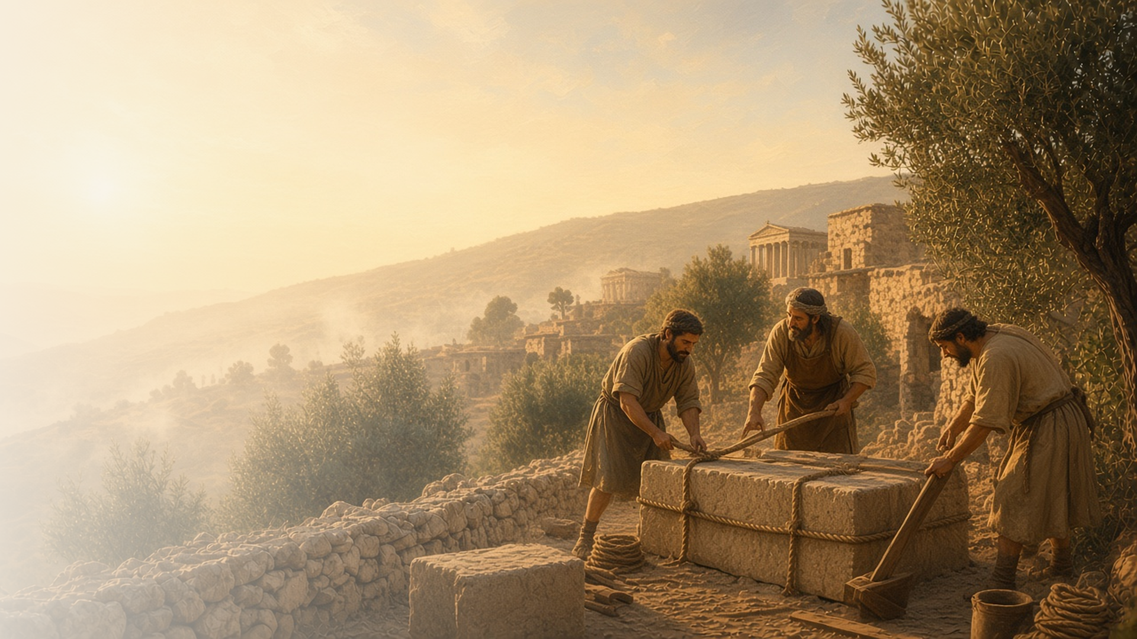
COME, FOLLOW ME · NEW TESTAMENT 2027
Be Perfectly
Joined Together
August 16–22
1 Corinthians 1–7
Notes:
TEACHING
The Corinthian Saints were divided into factions, impressed by worldly wisdom, and confused about moral purity. Paul pleads with them to be perfectly joined together, teaches that God's wisdom is greater than the world's and is understood only by the Spirit, reminds them that Jesus Christ is the only true foundation, and teaches that their bodies are temples of the Holy Ghost.
SCRIPTURE (KJV)
1 Corinthians 1:10
10 Now I beseech you, brethren, by the name of our Lord Jesus Christ, that ye all speak the same thing, and that there be no divisions among you; but that ye be perfectly joined together in the same mind and in the same judgment.
DISCUSSION
• What divides people today, even in the Church?
• What helps your family or ward feel united?

Slide 2
1 CORINTHIANS 1:10–17; 3:1–11
No divisions among you
Paul pleaded with the Saints to be united in Christ.
“That there be no divisions among you; but that ye be perfectly joined together in the same mind.”
1 CORINTHIANS 1:10
Notes:
TEACHING
Some Corinthians said they followed Paul, others Apollos or Cephas. Paul asked, "Is Christ divided?" He reminded them that leaders only plant and water; God gives the increase. Unity comes from centering on Christ rather than on personalities or preferences. Discuss what helps members be joined together.
SCRIPTURE (KJV)
1 Corinthians 1:10–13
10 Now I beseech you, brethren, by the name of our Lord Jesus Christ, that ye all speak the same thing, and that there be no divisions among you; but that ye be perfectly joined together in the same mind and in the same judgment.
11 For it hath been declared unto me of you, my brethren, by them which are of the house of Chloe, that there are contentions among you.
12 Now this I say, that every one of you saith, I am of Paul; and I of Apollos; and I of Cephas; and I of Christ.
13 Is Christ divided? was Paul crucified for you? or were ye baptized in the name of Paul?
1 Corinthians 3:3–7
3 For ye are yet carnal: for whereas there is among you envying, and strife, and divisions, are ye not carnal, and walk as men?
4 For while one saith, I am of Paul; and another, I am of Apollos; are ye not carnal?
5 Who then is Paul, and who is Apollos, but ministers by whom ye believed, even as the Lord gave to every man?
6 I have planted, Apollos watered; but God gave the increase.
7 So then neither is he that planteth any thing, neither he that watereth; but God that giveth the increase.
DISCUSSION (questions quoted from the manual)
• “Have you ever belonged to a club, group, team, or other organization that had a great sense of unity?”
• “Why did this group feel so united?”
• “What insights do you gain about how to achieve unity in your family or ward?”
• “How does this analogy help you better understand unity?”
• “In what sense are we “God’s building”? (1 Corinthians 3:9).”

Slide 3
1 CORINTHIANS 1:17–31; 2; 3:18–20
The wisdom of God
God’s wisdom is greater than the world’s.
“Because the foolishness of God is wiser than men; and the weakness of God is stronger than men.”
1 CORINTHIANS 1:25
Notes:
TEACHING
To many in Corinth, the message of a crucified Savior seemed foolish. Paul taught that God's foolishness is wiser than men and His weakness stronger. He chose the weak things of the world to confound the mighty. Invite class members to consider when trusting God's wisdom over the world's has blessed them.
SCRIPTURE (KJV)
1 Corinthians 1:18–25
18 For the preaching of the cross is to them that perish foolishness; but unto us which are saved it is the power of God.
19 For it is written, I will destroy the wisdom of the wise, and will bring to nothing the understanding of the prudent.
20 Where is the wise? where is the scribe? where is the disputer of this world? hath not God made foolish the wisdom of this world?
21 For after that in the wisdom of God the world by wisdom knew not God, it pleased God by the foolishness of preaching to save them that believe.
22 For the Jews require a sign, and the Greeks seek after wisdom:
23 But we preach Christ crucified, unto the Jews a stumblingblock, and unto the Greeks foolishness;
24 But unto them which are called, both Jews and Greeks, Christ the power of God, and the wisdom of God.
25 Because the foolishness of God is wiser than men; and the weakness of God is stronger than men.
1 Corinthians 3:18–20
18 Let no man deceive himself. If any man among you seemeth to be wise in this world, let him become a fool, that he may be wise.
19 For the wisdom of this world is foolishness with God. For it is written, He taketh the wise in their own craftiness.
20 And again, The Lord knoweth the thoughts of the wise, that they are vain.
DISCUSSION (questions quoted from the manual)
• “How is it different from the “wisdom of God”? (1 Corinthians 1:21).”
• “What do these verses teach about being wise?”
• “What are things about the gospel that might seem foolish to some people?”
• “How do these things demonstrate the wisdom of God?”

Slide 4
1 CORINTHIANS 2:9–16
Spiritually discerned
We understand the things of God by the Holy Ghost.
“Even so the things of God knoweth no man, but the Spirit of God.”
1 CORINTHIANS 2:11
Notes:
TEACHING
Paul teaches that eye has not seen nor ear heard what God has prepared for those who love Him, but He reveals it by His Spirit. The natural man cannot receive the things of God because they are spiritually discerned. Discuss how to rely on the Holy Ghost, not only reason, to understand spiritual truth.
SCRIPTURE (KJV)
1 Corinthians 2:9–14
9 But as it is written, Eye hath not seen, nor ear heard, neither have entered into the heart of man, the things which God hath prepared for them that love him.
10 But God hath revealed them unto us by his Spirit: for the Spirit searcheth all things, yea, the deep things of God.
11 For what man knoweth the things of a man, save the spirit of man which is in him? even so the things of God knoweth no man, but the Spirit of God.
12 Now we have received, not the spirit of the world, but the spirit which is of God; that we might know the things that are freely given to us of God.
13 Which things also we speak, not in the words which man’s wisdom teacheth, but which the Holy Ghost teacheth; comparing spiritual things with spiritual.
14 But the natural man receiveth not the things of the Spirit of God: for they are foolishness unto him: neither can he know them, because they are spiritually discerned.
DISCUSSION (questions quoted from the manual)
• “If you wanted to learn more about something like automotive mechanics or modern architecture, how would you do it?”
• “According to 1 Corinthians 2:9–16, how is learning “the things of God” different from learning the “things of a man”?”
• “Why must we have the Holy Ghost in order to understand the things of God?”
• “After reading these verses, what do you feel you should do to understand spiritual things more fully?”

Slide 5
1 CORINTHIANS 6:9–20
Your body is a temple
Our bodies are sacred gifts, bought with a price.
“Know ye not that your body is the temple of the Holy Ghost which is in you, which ye have of God, and ye are not your own?”
1 CORINTHIANS 6:19
Notes:
TEACHING
In a city known for immorality, Paul taught that the body is the temple of the Holy Ghost. We are not our own; we were bought with a price, the Savior's sacrifice. Discuss how seeing the body as sacred shapes choices about chastity, health, and how we treat others.
SCRIPTURE (KJV)
1 Corinthians 6:18–20
18 Flee fornication. Every sin that a man doeth is without the body; but he that committeth fornication sinneth against his own body.
19 What? know ye not that your body is the temple of the Holy Ghost which is in you, which ye have of God, and ye are not your own?
20 For ye are bought with a price: therefore glorify God in your body, and in your spirit, which are God’s.
Restoration scripture (public-domain text: bcbooks/scriptures-json)
Doctrine and Covenants 18:10–13 (Doctrine and Covenants)
10 Remember the worth of souls is great in the sight of God;
11 For, behold, the Lord your Redeemer suffered death in the flesh; wherefore he suffered the pain of all men, that all men might repent and come unto him.
12 And he hath risen again from the dead, that he might bring all men unto him, on conditions of repentance.
13 And how great is his joy in the soul that repenteth!
DISCUSSION (questions quoted from the manual)
• “What do you find in 1 Corinthians 6:9–20 that could help you explain to others why you want to live a chaste life?”
• “Why are temples sacred?”
• “How is my body like a temple?”
• “What do you think it means to be “bought with a price”? (verse 20; see also Doctrine and Covenants 18:10–13).”
• “What can I do to treat my body like a temple? (For ideas, see “Your Body Is Sacred,” in For the Strength of Youth: A Guide for Making Choices, 50–56.)”

Slide 6
1 CORINTHIANS 1:10
“But that ye be perfectly joined together
in the same mind.”
Do one thing this week to build unity in your ward or family.
Notes:
TEACHING
Paul's plea is the title of this lesson. Close by inviting class members to do one specific thing this week to build unity in their family or ward.
SCRIPTURE (KJV)
1 Corinthians 1:10
10 Now I beseech you, brethren, by the name of our Lord Jesus Christ, that ye all speak the same thing, and that there be no divisions among you; but that ye be perfectly joined together in the same mind and in the same judgment.
DISCUSSION
• What is one thing you can do to help your ward feel united?
• How does focusing on Christ reduce division?

