Slide 1
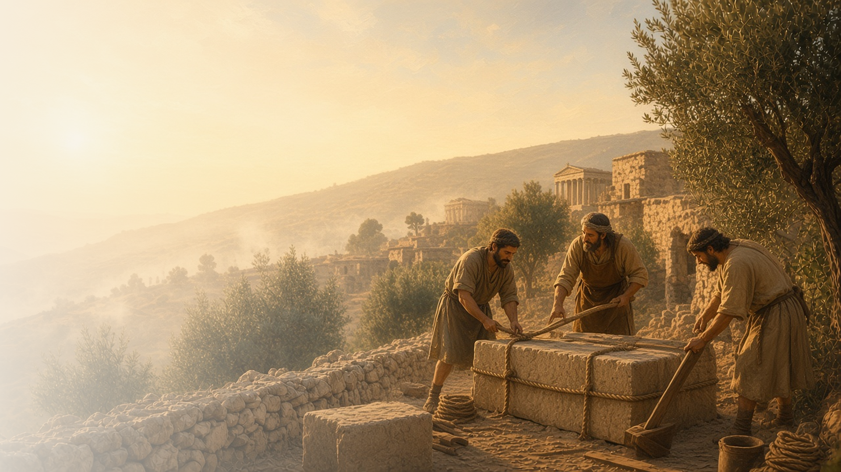
COME, FOLLOW ME · FOR CHILDREN
Be Perfectly
Joined Together
August 16–22
1 Corinthians 1–7
Notes:
TEACHING
This week children learn that being wise means trusting God's wisdom, that the Holy Ghost teaches truth, that Jesus Christ is our foundation, and that their bodies are like temples.
SCRIPTURE (KJV)
1 Corinthians 3:11
11 For other foundation can no man lay than that is laid, which is Jesus Christ.
DISCUSSION
• Why do buildings need a strong foundation?
• How is Jesus our foundation?

Slide 2
1 CORINTHIANS 1:23–25
Trust God’s wisdom
God knows more than anyone, so I can trust Him.
“Because the foolishness of God is wiser than men; and the weakness of God is stronger than men.”
1 CORINTHIANS 1:25
Notes:
TEACHING
Ask children who is the wisest person they know. Explain that Heavenly Father knows even more than anyone on earth. Being truly wise means trusting what He teaches, even when others think differently.
SCRIPTURE (KJV)
1 Corinthians 1:25
25 Because the foolishness of God is wiser than men; and the weakness of God is stronger than men.
DISCUSSION (questions quoted from the manual)
• (The manual gives no direct questions for this section.)
Suggested: When can you trust Heavenly Father's way, even if it is hard?

Slide 3
1 CORINTHIANS 2:11–14
The Holy Ghost teaches me
The Holy Ghost helps me know what is true.
“Now we have received, not the spirit of the world, but the spirit which is of God.”
1 CORINTHIANS 2:12
Notes:
TEACHING
Explain that some things we learn with our eyes and ears, but the things of God we learn through the Holy Ghost. Share how you feel when the Holy Ghost tells you something is true.
SCRIPTURE (KJV)
1 Corinthians 2:11–12
11 For what man knoweth the things of a man, save the spirit of man which is in him? even so the things of God knoweth no man, but the Spirit of God.
12 Now we have received, not the spirit of the world, but the spirit which is of God; that we might know the things that are freely given to us of God.
DISCUSSION (questions quoted from the manual)
• (The manual gives no direct questions for this section.)
Suggested: How do you feel when the Holy Ghost helps you know something is true?

Slide 4
1 CORINTHIANS 3:10–11
Jesus is my foundation
I build my life on Jesus, like a strong foundation.
“For other foundation can no man lay than that is laid, which is Jesus Christ.”
1 CORINTHIANS 3:11
Notes:
TEACHING
Build two towers of blocks, one on a solid base and one on something wobbly. Which stands best? Paul taught that Jesus is our foundation. When we build our lives on Him, we are strong.
SCRIPTURE (KJV)
1 Corinthians 3:10–11
10 According to the grace of God which is given unto me, as a wise masterbuilder, I have laid the foundation, and another buildeth thereon. But let every man take heed how he buildeth thereupon.
11 For other foundation can no man lay than that is laid, which is Jesus Christ.
DISCUSSION (questions quoted from the manual)
• “How do we do that?”

Slide 5
1 CORINTHIANS 6:19–20
My body is like a temple
I take care of my body because it is a gift from God.
“Know ye not that your body is the temple of the Holy Ghost which is in you.”
1 CORINTHIANS 6:19
Notes:
TEACHING
Show a picture of a temple and talk about how we keep temples clean and beautiful. Paul said our bodies are like temples. Talk about ways to take care of our bodies: eating healthy food, resting, and being modest and clean.
SCRIPTURE (KJV)
1 Corinthians 6:19–20
19 What? know ye not that your body is the temple of the Holy Ghost which is in you, which ye have of God, and ye are not your own?
20 For ye are bought with a price: therefore glorify God in your body, and in your spirit, which are God’s.
DISCUSSION (questions quoted from the manual)
• “How do we show that temples are sacred to us?”
• “How do we show that our bodies are sacred to us?”

Slide 6
1 CORINTHIANS 3:11
“For other foundation can no man lay
than that is laid, which is Jesus Christ.”
Build something this week and remember Jesus is your foundation.
Notes:
TEACHING
Jesus is our foundation. Invite children to build something this week and remember Him.
SCRIPTURE (KJV)
1 Corinthians 3:11
11 For other foundation can no man lay than that is laid, which is Jesus Christ.
DISCUSSION
• What will you build?
• How can you build your life on Jesus?

