Slide 1
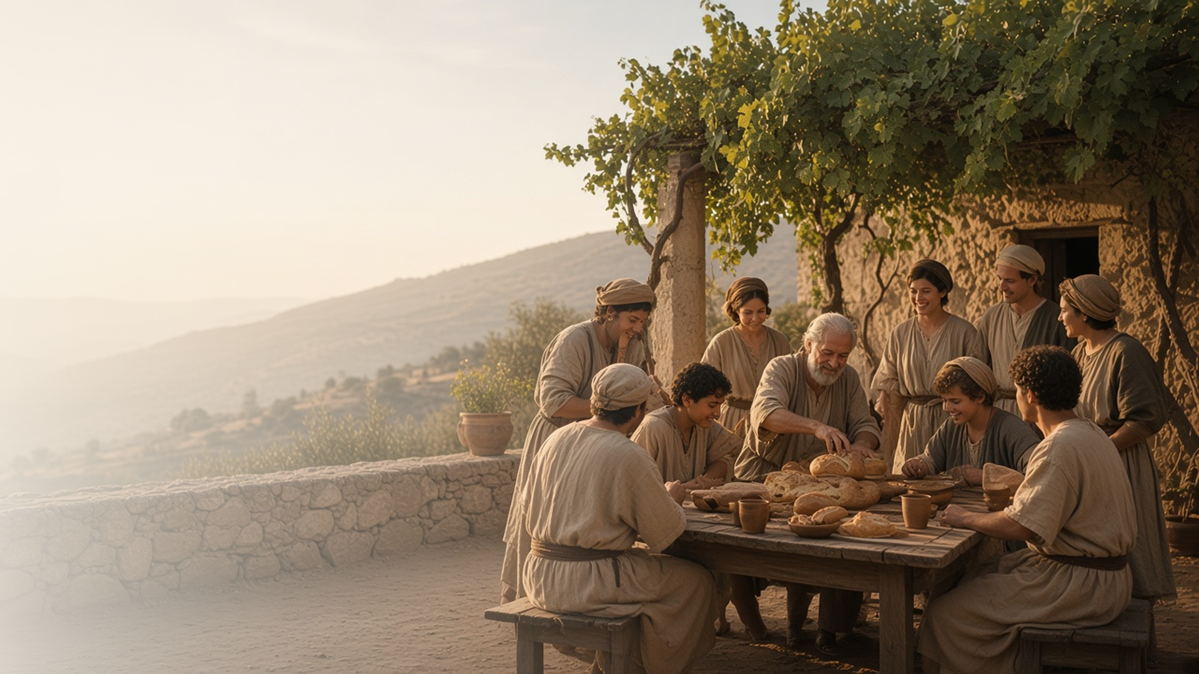
COME, FOLLOW ME · NEW TESTAMENT 2027
Ye Are the
Body of Christ
August 23–29
1 Corinthians 8–13
Notes:
TEACHING
Paul compares the Church to a human body: many members, each needed, all joined to Christ. In these chapters he teaches that God provides a way to escape temptation, that the sacrament makes us one, that men and women need each other in the Lord, that spiritual gifts are given to bless everyone, and that charity, the pure love of Christ, never fails.
SCRIPTURE (KJV)
1 Corinthians 12:12–14
12 For as the body is one, and hath many members, and all the members of that one body, being many, are one body: so also is Christ.
13 For by one Spirit are we all baptized into one body, whether we be Jews or Gentiles, whether we be bond or free; and have been all made to drink into one Spirit.
14 For the body is not one member, but many.
DISCUSSION
• Which part of "the body" do you feel you are right now?
• How have you felt needed, or helped someone else feel needed?

Slide 2
1 CORINTHIANS 10:1–13
A way to escape
God never lets us be tempted beyond what we can bear.
“But will with the temptation also make a way to escape, that ye may be able to bear it.”
1 CORINTHIANS 10:13
Notes:
TEACHING
Paul reminded the Corinthians of ancient Israel, who were blessed yet fell into sin, and warned against overconfidence. Then he gave a promise: temptation is common to all, but God is faithful and will provide a way to escape. Discuss practical ways class members have found the escape God provides.
SCRIPTURE (KJV)
1 Corinthians 10:12–13
12 Wherefore let him that thinketh he standeth take heed lest he fall.
13 There hath no temptation taken you but such as is common to man: but God is faithful, who will not suffer you to be tempted above that ye are able; but will with the temptation also make a way to escape, that ye may be able to bear it.
DISCUSSION (questions quoted from the manual)
• “What are some temptations that are “common to man” (1 Corinthians 10:13) today?”
• “What kinds of “escape” from temptation has God given you?”
• “What do you learn about God from these verses?”

Slide 3
1 CORINTHIANS 10:16–17; 11:16–30
One bread, one body
Partaking the sacrament together makes us one in Christ.
“For we being many are one bread, and one body: for we are all partakers of that one bread.”
1 CORINTHIANS 10:17
Notes:
TEACHING
Some Corinthians were treating the Lord's supper casually, even selfishly. Paul reminded them of what Jesus said and did that night, and taught that sharing one bread makes us one body. Invite class members to consider how the sacrament can unite a ward, not just bless individuals.
SCRIPTURE (KJV)
1 Corinthians 10:16–17
16 The cup of blessing which we bless, is it not the communion of the blood of Christ? The bread which we break, is it not the communion of the body of Christ?
17 For we being many are one bread, and one body: for we are all partakers of that one bread.
1 Corinthians 11:23–28
23 For I have received of the Lord that which also I delivered unto you, That the Lord Jesus the same night in which he was betrayed took bread:
24 And when he had given thanks, he brake it, and said, Take, eat: this is my body, which is broken for you: this do in remembrance of me.
25 After the same manner also he took the cup, when he had supped, saying, This cup is the new testament in my blood: this do ye, as oft as ye drink it, in remembrance of me.
26 For as often as ye eat this bread, and drink this cup, ye do shew the Lord’s death till he come.
27 Wherefore whosoever shall eat this bread, and drink this cup of the Lord, unworthily, shall be guilty of the body and blood of the Lord.
28 But let a man examine himself, and so let him eat of that bread, and drink of that cup.
DISCUSSION (questions quoted from the manual)
• “How does the sacrament help “many” become “one” in Christ? (1 Corinthians 10:17).”
• “What helps you “examine [your]self” during the sacrament? (1 Corinthians 11:28).”
• “Based on what you’ve read, what do you feel inspired to do to improve your experience with the sacrament?”

Slide 4
1 CORINTHIANS 11:11–12
Neither without the other
In the Lord, men and women need each other.
“Nevertheless neither is the man without the woman, neither the woman without the man, in the Lord.”
1 CORINTHIANS 11:11
Notes:
TEACHING
In a culture with sharp divisions between men and women, Paul taught that in the Lord neither is complete without the other, and all things are of God. Discuss how men and women complement and strengthen each other in families and in the Church.
SCRIPTURE (KJV)
1 Corinthians 11:11–12
11 Nevertheless neither is the man without the woman, neither the woman without the man, in the Lord.
12 For as the woman is of the man, even so is the man also by the woman; but all things of God.
DISCUSSION (questions quoted from the manual)
• “How would you summarize that truth?”
• “How should this truth influence a marriage?”
• “How should it affect the way we serve in the Church?”

Slide 5
1 CORINTHIANS 12
Every member is needed
Like parts of a body, each member has a needed role.
“Now ye are the body of Christ, and members in particular.”
1 CORINTHIANS 12:27
Notes:
TEACHING
Paul pictures the Church as a body: the foot cannot say it is not part of the body because it is not a hand, and the eye cannot tell the hand it is not needed. The members that seem weaker are necessary. Discuss how to help every member feel needed, especially those who feel on the edges.
SCRIPTURE (KJV)
1 Corinthians 12:12–27
12 For as the body is one, and hath many members, and all the members of that one body, being many, are one body: so also is Christ.
13 For by one Spirit are we all baptized into one body, whether we be Jews or Gentiles, whether we be bond or free; and have been all made to drink into one Spirit.
14 For the body is not one member, but many.
15 If the foot shall say, Because I am not the hand, I am not of the body; is it therefore not of the body?
16 And if the ear shall say, Because I am not the eye, I am not of the body; is it therefore not of the body?
17 If the whole body were an eye, where were the hearing? If the whole were hearing, where were the smelling?
18 But now hath God set the members every one of them in the body, as it hath pleased him.
19 And if they were all one member, where were the body?
20 But now are they many members, yet but one body.
21 And the eye cannot say unto the hand, I have no need of thee: nor again the head to the feet, I have no need of you.
22 Nay, much more those members of the body, which seem to be more feeble, are necessary:
23 And those members of the body, which we think to be less honourable, upon these we bestow more abundant honour; and our uncomely parts have more abundant comeliness.
24 For our comely parts have no need: but God hath tempered the body together, having given more abundant honour to that part which lacked:
25 That there should be no schism in the body; but that the members should have the same care one for another.
26 And whether one member suffer, all the members suffer with it; or one member be honoured, all the members rejoice with it.
27 Now ye are the body of Christ, and members in particular.
DISCUSSION (questions quoted from the manual)
• “Have you ever been in a situation where you felt like you didn’t fit in?”
• “What did people do—or what do you wish they’d done—to help you?”
• “What did you do—or what do you wish you’d done—to help?”
• “How might Paul’s teachings about spiritual gifts help in these situations? (see verses 1–11)”
• “What spiritual gifts have you noticed in yourself and others? (Consider those Paul mentions, as well as others you’ve noticed.) How have these gifts blessed God’s children?”
• “How do Paul’s teachings about “the body of Christ” (verses 12–30) affect the way you see yourself?”
(+2 more in the manual)

Slide 6
1 CORINTHIANS 13
The greatest of these
Christlike love is greater than every other gift.
“Charity suffereth long, and is kind; charity envieth not; charity vaunteth not itself, is not puffed up.”
1 CORINTHIANS 13:4
Notes:
TEACHING
After describing spiritual gifts, Paul shows a more excellent way. Without charity, even prophecy, knowledge, and great sacrifice profit nothing. Charity is patient, kind, not envious or proud, and it never fails. Invite class members to read verses 4–7 replacing "charity" with the Savior's name, then with their own.
SCRIPTURE (KJV)
1 Corinthians 13:1–8
1 Though I speak with the tongues of men and of angels, and have not charity, I am become as sounding brass, or a tinkling cymbal.
2 And though I have the gift of prophecy, and understand all mysteries, and all knowledge; and though I have all faith, so that I could remove mountains, and have not charity, I am nothing.
3 And though I bestow all my goods to feed the poor, and though I give my body to be burned, and have not charity, it profiteth me nothing.
4 Charity suffereth long, and is kind; charity envieth not; charity vaunteth not itself, is not puffed up,
5 Doth not behave itself unseemly, seeketh not her own, is not easily provoked, thinketh no evil;
6 Rejoiceth not in iniquity, but rejoiceth in the truth;
7 Beareth all things, believeth all things, hopeth all things, endureth all things.
8 Charity never faileth: but whether there be prophecies, they shall fail; whether there be tongues, they shall cease; whether there be knowledge, it shall vanish away.
1 Corinthians 13:13
13 And now abideth faith, hope, charity, these three; but the greatest of these is charity.
DISCUSSION (questions quoted from the manual)
• “In your opinion, what makes charity “the greatest” spiritual gift? (1 Corinthians 13:13).”
• “How have you come to know that “charity never faileth”? (verse 8).”
• “Why are we “nothing” without it? (verses 2–3; see also 1 Corinthians 8:1–3).”
• “What does this mean?”
• “What does it look like?”
• “When have I seen an example of this?”
(+2 more in the manual)

Slide 7
1 CORINTHIANS 13:9–12
Face to face
Today we see in part; someday we will understand fully.
“For now we see through a glass, darkly; but then face to face.”
1 CORINTHIANS 13:12
Notes:
TEACHING
Paul admits that our knowledge now is partial, like seeing a dim reflection in an ancient mirror. Someday we will know even as we are known. This humility allows faith and patience with unanswered questions. Discuss how this promise helps when we do not understand everything.
SCRIPTURE (KJV)
1 Corinthians 13:9–12
9 For we know in part, and we prophesy in part.
10 But when that which is perfect is come, then that which is in part shall be done away.
11 When I was a child, I spake as a child, I understood as a child, I thought as a child: but when I became a man, I put away childish things.
12 For now we see through a glass, darkly; but then face to face: now I know in part; but then shall I know even as also I am known.
DISCUSSION (questions quoted from the manual)
• “Why is looking at someone “face to face” better than looking “through a glass, darkly”? (1 Corinthians 13:12).”
• “What does this comparison teach you about spiritual sight?”

Slide 8
1 CORINTHIANS 13:8
“Charity never faileth.”
Pray this week for charity, and act on what you feel.
Notes:
TEACHING
Of all the gifts, charity is the one that endures. Close by inviting class members to pray for charity this week and act on the impressions they receive.
SCRIPTURE (KJV)
1 Corinthians 13:8
8 Charity never faileth: but whether there be prophecies, they shall fail; whether there be tongues, they shall cease; whether there be knowledge, it shall vanish away.
1 Corinthians 13:13
13 And now abideth faith, hope, charity, these three; but the greatest of these is charity.
DISCUSSION
• Who in your life most needs your Christlike love right now?
• How has someone else's charity blessed you?

