Slide 1
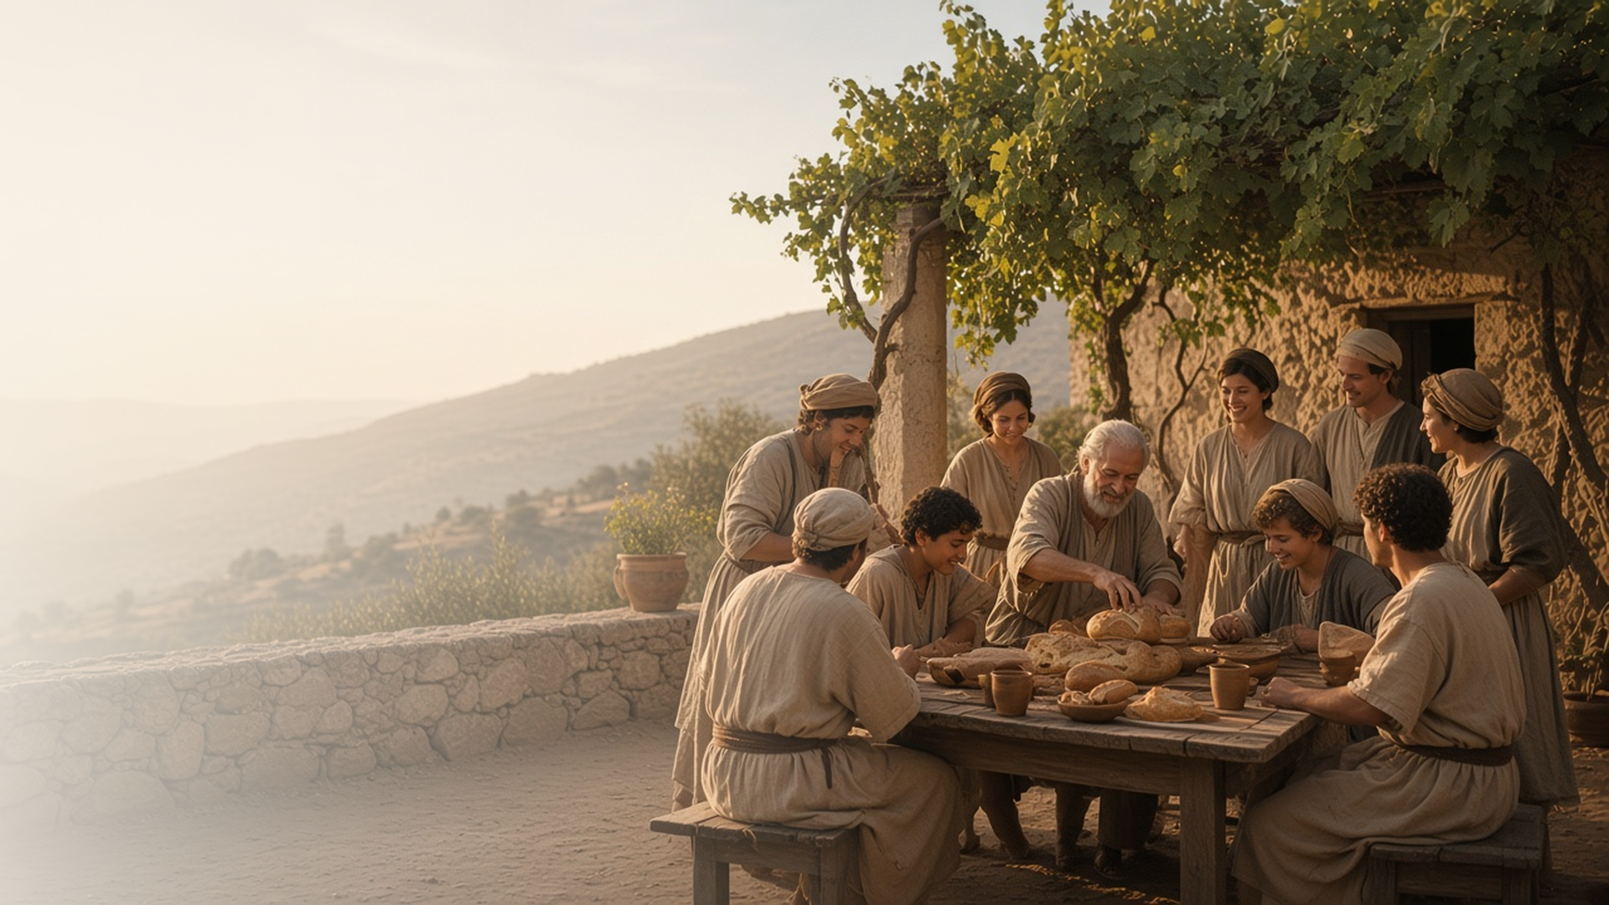
COME, FOLLOW ME · FOR CHILDREN
Ye Are the
Body of Christ
August 23–29
1 Corinthians 8–13
Notes:
TEACHING
This week children learn that the sacrament points their minds to the Savior, that Heavenly Father has blessed them with spiritual gifts, that every member is needed in the Savior's Church, and that they can love others as Jesus does.
SCRIPTURE (KJV)
1 Corinthians 12:27
27 Now ye are the body of Christ, and members in particular.
DISCUSSION
• What does a body need to work well?
• How are you needed in the Church?

Slide 2
1 CORINTHIANS 11:23–29
The sacrament points to Jesus
The bread and water help me think about Jesus.
“This do in remembrance of me.”
1 CORINTHIANS 11:24
Notes:
TEACHING
Show a picture of the sacrament. Explain that the bread helps us remember Jesus's body and the water helps us remember His blood. Help children think of something about Jesus to remember during the sacrament.
SCRIPTURE (KJV)
1 Corinthians 11:23–25
23 For I have received of the Lord that which also I delivered unto you, That the Lord Jesus the same night in which he was betrayed took bread:
24 And when he had given thanks, he brake it, and said, Take, eat: this is my body, which is broken for you: this do in remembrance of me.
25 After the same manner also he took the cup, when he had supped, saying, This cup is the new testament in my blood: this do ye, as oft as ye drink it, in remembrance of me.
DISCUSSION (questions quoted from the manual)
• “When we partake of the sacrament, what helps us think about our relationship with the Lord and how He is helping us live our baptismal covenant?”
• “According to 1 Corinthians 11:23–29, what does the Lord want us to think about?”

Slide 3
1 CORINTHIANS 12:1–11
I have spiritual gifts
Heavenly Father gives everyone gifts to bless others.
“But the manifestation of the Spirit is given to every man to profit withal.”
1 CORINTHIANS 12:7
Notes:
TEACHING
Wrap a small box like a present. Explain that Heavenly Father gives each of us spiritual gifts, like kindness, faith, or teaching. Help children notice gifts in each other.
SCRIPTURE (KJV)
1 Corinthians 12:4, 7–8, 11
4 Now there are diversities of gifts, but the same Spirit.
7 But the manifestation of the Spirit is given to every man to profit withal.
8 For to one is given by the Spirit the word of wisdom; to another the word of knowledge by the same Spirit;
11 But all these worketh that one and the selfsame Spirit, dividing to every man severally as he will.
Full passage: 1 Corinthians 12:4–11
DISCUSSION (questions quoted from the manual)
• “How can we use these gifts to bless Heavenly Father’s children?”

Slide 4
1 CORINTHIANS 12:12–27
Everyone is needed
Like hands and feet, every person in the Church matters.
“And the eye cannot say unto the hand, I have no need of thee: nor again the head to the feet, I have no need of you.”
1 CORINTHIANS 12:21
Notes:
TEACHING
Play a game where children try to do something without using their hands, then without their eyes. Every part of the body is needed. In the same way, everyone is needed in Jesus's Church, including children.
SCRIPTURE (KJV)
1 Corinthians 12:14, 18, 21
14 For the body is not one member, but many.
18 But now hath God set the members every one of them in the body, as it hath pleased him.
21 And the eye cannot say unto the hand, I have no need of thee: nor again the head to the feet, I have no need of you.
Full passage: 1 Corinthians 12:14–21
DISCUSSION (questions quoted from the manual)
• “What would that body be unable to do?”
• “Why do we need every body part—including small parts like toes?”

Slide 5
1 CORINTHIANS 13
I can love like Jesus
Charity is the kind of love Jesus has for everyone.
“Charity suffereth long, and is kind.”
1 CORINTHIANS 13:4
Notes:
TEACHING
Explain that charity is the pure love of Christ. Read verse 4 and talk about what being patient and kind looks like at home and school. Help children choose a way to show charity this week.
SCRIPTURE (KJV)
1 Corinthians 13:4–7
4 Charity suffereth long, and is kind; charity envieth not; charity vaunteth not itself, is not puffed up,
5 Doth not behave itself unseemly, seeketh not her own, is not easily provoked, thinketh no evil;
6 Rejoiceth not in iniquity, but rejoiceth in the truth;
7 Beareth all things, believeth all things, hopeth all things, endureth all things.
DISCUSSION (questions quoted from the manual)
• “What can we do to show love for others?”

Slide 6
1 CORINTHIANS 12:27
“Now ye are the body of Christ,
and members in particular.”
Help someone feel needed at church this week.
Notes:
TEACHING
Everyone is part of the body of Christ. Invite children to help someone feel needed at church this week.
SCRIPTURE (KJV)
1 Corinthians 12:27
27 Now ye are the body of Christ, and members in particular.
DISCUSSION
• Who can you help feel welcome?
• What can you do to help at church?

