Slide 1
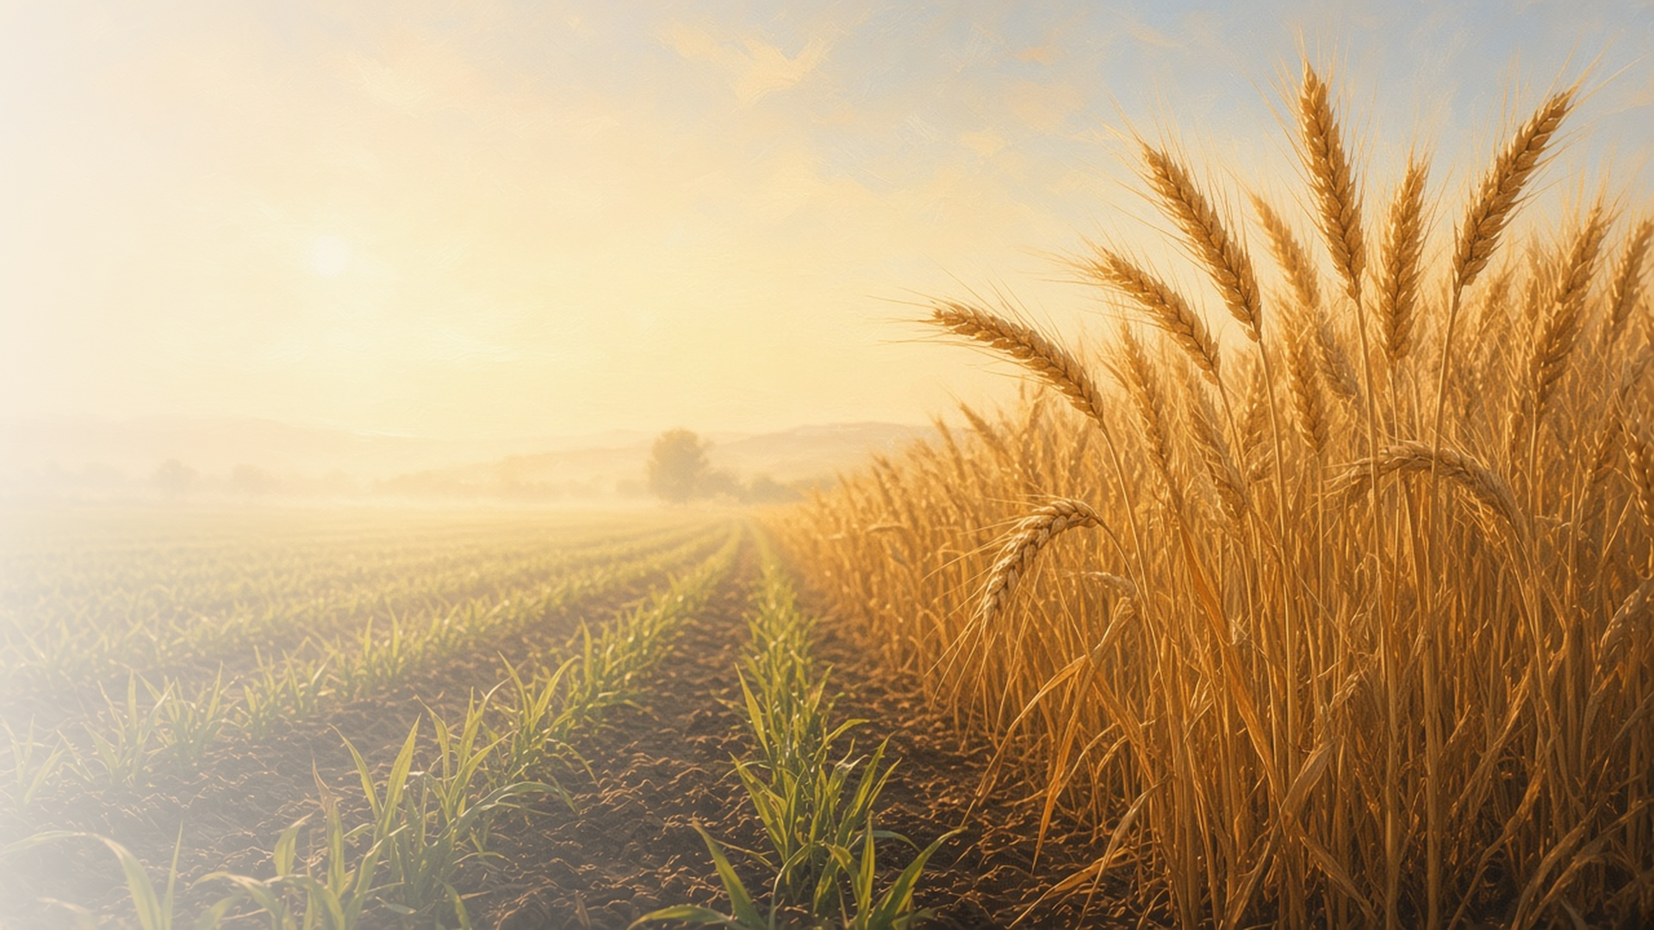
COME, FOLLOW ME · NEW TESTAMENT 2027
In Christ Shall All
Be Made Alive
August 30–September 5
1 Corinthians 14–16
Notes:
TEACHING
Paul closes his first letter to the Corinthians with counsel about worship meetings and a powerful witness of the Resurrection. Because Christ rose as the firstfruits, all will be made alive. Paul points to baptism for the dead as evidence of belief in the Resurrection, and teaches that resurrected bodies differ in glory like the sun, moon, and stars.
SCRIPTURE (KJV)
1 Corinthians 15:20–22
20 But now is Christ risen from the dead, and become the firstfruits of them that slept.
21 For since by man came death, by man came also the resurrection of the dead.
22 For as in Adam all die, even so in Christ shall all be made alive.
DISCUSSION
• How does the Resurrection change the way you face death and loss?
• What difference does it make that Christ is the "firstfruits"?

Slide 2
1 CORINTHIANS 14
Unto edifying
Church meetings should build up everyone who attends.
“Let all things be done unto edifying.”
1 CORINTHIANS 14:26
Notes:
TEACHING
Some Corinthians prized speaking in tongues for show. Paul taught that spiritual gifts in meetings should edify, or build up, the whole Church, and that everything should be done decently and in order. Discuss how each of us can help make our meetings edifying for others.
SCRIPTURE (KJV)
1 Corinthians 14:12
12 Even so ye, forasmuch as ye are zealous of spiritual gifts, seek that ye may excel to the edifying of the church.
1 Corinthians 14:26
26 How is it then, brethren? when ye come together, every one of you hath a psalm, hath a doctrine, hath a tongue, hath a revelation, hath an interpretation. Let all things be done unto edifying.
1 Corinthians 14:40
40 Let all things be done decently and in order.
DISCUSSION (questions quoted from the manual)
• “What do you think it means to “excel to the edifying of the church”? (verse 12).”
• “What does verse 26 suggest to you about your role in “edifying”?”
• “What experiences have taught you that “God is not the author of confusion, but of peace”? (verse 33).”

Slide 3
1 CORINTHIANS 14:34–35
All may learn and be comforted
Paul’s words fit his day; women’s voices are vital in the Church.
“For ye may all prophesy one by one, that all may learn, and all may be comforted.”
1 CORINTHIANS 14:31
Notes:
TEACHING
The manual explains that expectations for women in Paul's day differed, and that whatever 1 Corinthians 14:34–35 meant then, it does not mean women cannot speak and lead in the Church today. It cites the Joseph Smith Translation of 1 Corinthians 14:34 (named only; not quoted) and President Russell M. Nelson's call for women's voices. Verse 31 reminds us that all may learn and all may be comforted.
SCRIPTURE (KJV)
1 Corinthians 14:31
31 For ye may all prophesy one by one, that all may learn, and all may be comforted.
1 Corinthians 14:34–35
34 Let your women keep silence in the churches: for it is not permitted unto them to speak; but they are commanded to be under obedience, as also saith the law.
35 And if they will learn any thing, let them ask their husbands at home: for it is a shame for women to speak in the church.
DISCUSSION (questions quoted from the manual)
• (The manual gives no direct questions for this section.)
Suggested: How are the voices and leadership of women blessing your ward and family?

Slide 4
1 CORINTHIANS 15:1–34, 53–58
If Christ be not raised
Without the Resurrection, our faith would be in vain.
“But now is Christ risen from the dead, and become the firstfruits of them that slept.”
1 CORINTHIANS 15:20
Notes:
TEACHING
Paul lists witnesses of the risen Christ, including more than five hundred at once and finally himself. Then he reasons: if Christ is not risen, our preaching and faith are vain. But now is Christ risen, the firstfruits, and as in Adam all die, so in Christ all will be made alive. Invite class members to complete the thought: because Christ was resurrected, I…
SCRIPTURE (KJV)
1 Corinthians 15:3–8
3 For I delivered unto you first of all that which I also received, how that Christ died for our sins according to the scriptures;
4 And that he was buried, and that he rose again the third day according to the scriptures:
5 And that he was seen of Cephas, then of the twelve:
6 After that, he was seen of above five hundred brethren at once; of whom the greater part remain unto this present, but some are fallen asleep.
7 After that, he was seen of James; then of all the apostles.
8 And last of all he was seen of me also, as of one born out of due time.
1 Corinthians 15:12–22
12 Now if Christ be preached that he rose from the dead, how say some among you that there is no resurrection of the dead?
13 But if there be no resurrection of the dead, then is Christ not risen:
14 And if Christ be not risen, then is our preaching vain, and your faith is also vain.
15 Yea, and we are found false witnesses of God; because we have testified of God that he raised up Christ: whom he raised not up, if so be that the dead rise not.
16 For if the dead rise not, then is not Christ raised:
17 And if Christ be not raised, your faith is vain; ye are yet in your sins.
18 Then they also which are fallen asleep in Christ are perished.
19 If in this life only we have hope in Christ, we are of all men most miserable.
20 But now is Christ risen from the dead, and become the firstfruits of them that slept.
21 For since by man came death, by man came also the resurrection of the dead.
22 For as in Adam all die, even so in Christ shall all be made alive.
DISCUSSION (questions quoted from the manual)
• (The manual gives no direct questions for this section.)
Suggested: If Jesus Christ had not been resurrected, what would be different for you?

Slide 5
1 CORINTHIANS 15:29
Baptism for the dead
Paul pointed to ordinances performed for those who had died.
“Else what shall they do which are baptized for the dead, if the dead rise not at all? why are they then baptized for the dead?”
1 CORINTHIANS 15:29
Notes:
TEACHING
Paul's argument assumes the Corinthian Saints knew of baptism for the dead: why perform it if the dead do not rise? Latter-day Saints offer this and other temple ordinances for ancestors because we believe in the Resurrection and in a merciful God who gives every person the chance to receive the gospel.
SCRIPTURE (KJV)
1 Corinthians 15:29
29 Else what shall they do which are baptized for the dead, if the dead rise not at all? why are they then baptized for the dead?
DISCUSSION (questions quoted from the manual)
• “Why is baptism for the dead a good argument in favor of the Resurrection?”
• “How would you explain to someone why we do baptisms for the dead?”
• “How has temple and family history work strengthened your faith in the Resurrection?”

Slide 6
1 CORINTHIANS 15:35–54
A spiritual body
Resurrected bodies differ in glory, like the sun, moon, and stars.
“So also is the resurrection of the dead. It is sown in corruption; it is raised in incorruption.”
1 CORINTHIANS 15:42
Notes:
TEACHING
Some asked what kind of body the dead would have. Paul compared the body to a seed that is sown and rises in a new form, and described celestial and terrestrial bodies differing in glory as the sun, moon, and stars. Resurrected bodies are incorruptible, glorious, and powerful.
SCRIPTURE (KJV)
1 Corinthians 15:35–44
35 But some man will say, How are the dead raised up? and with what body do they come?
36 Thou fool, that which thou sowest is not quickened, except it die:
37 And that which thou sowest, thou sowest not that body that shall be, but bare grain, it may chance of wheat, or of some other grain:
38 But God giveth it a body as it hath pleased him, and to every seed his own body.
39 All flesh is not the same flesh: but there is one kind of flesh of men, another flesh of beasts, another of fishes, and another of birds.
40 There are also celestial bodies, and bodies terrestrial: but the glory of the celestial is one, and the glory of the terrestrial is another.
41 There is one glory of the sun, and another glory of the moon, and another glory of the stars: for one star differeth from another star in glory.
42 So also is the resurrection of the dead. It is sown in corruption; it is raised in incorruption:
43 It is sown in dishonour; it is raised in glory: it is sown in weakness; it is raised in power:
44 It is sown a natural body; it is raised a spiritual body. There is a natural body, and there is a spiritual body.
DISCUSSION (questions quoted from the manual)
• “What does this revelation to the Prophet Joseph Smith add to your understanding? (see also Joseph Smith Translation, 1 Corinthians 15:40 [in 1 Corinthians 15:40, footnote a ]).”
• “Why are these truths valuable to you?”

Slide 7
1 CORINTHIANS 15:57
“But thanks be to God, which giveth
us the victory through our Lord Jesus Christ.”
Find one ancestor’s name to take to the temple.
Notes:
TEACHING
Paul ends his witness with thanksgiving for the victory Christ gives, and urges the Saints to be steadfast, knowing their labor is not in vain. Close by inviting class members to find one ancestor who needs temple ordinances.
SCRIPTURE (KJV)
1 Corinthians 15:55–58
55 O death, where is thy sting? O grave, where is thy victory?
56 The sting of death is sin; and the strength of sin is the law.
57 But thanks be to God, which giveth us the victory through our Lord Jesus Christ.
58 Therefore, my beloved brethren, be ye stedfast, unmovable, always abounding in the work of the Lord, forasmuch as ye know that your labour is not in vain in the Lord.
DISCUSSION
• How does the Savior's victory give meaning to your labor in the Lord?
• What could you do this week for an ancestor?

