Slide 1
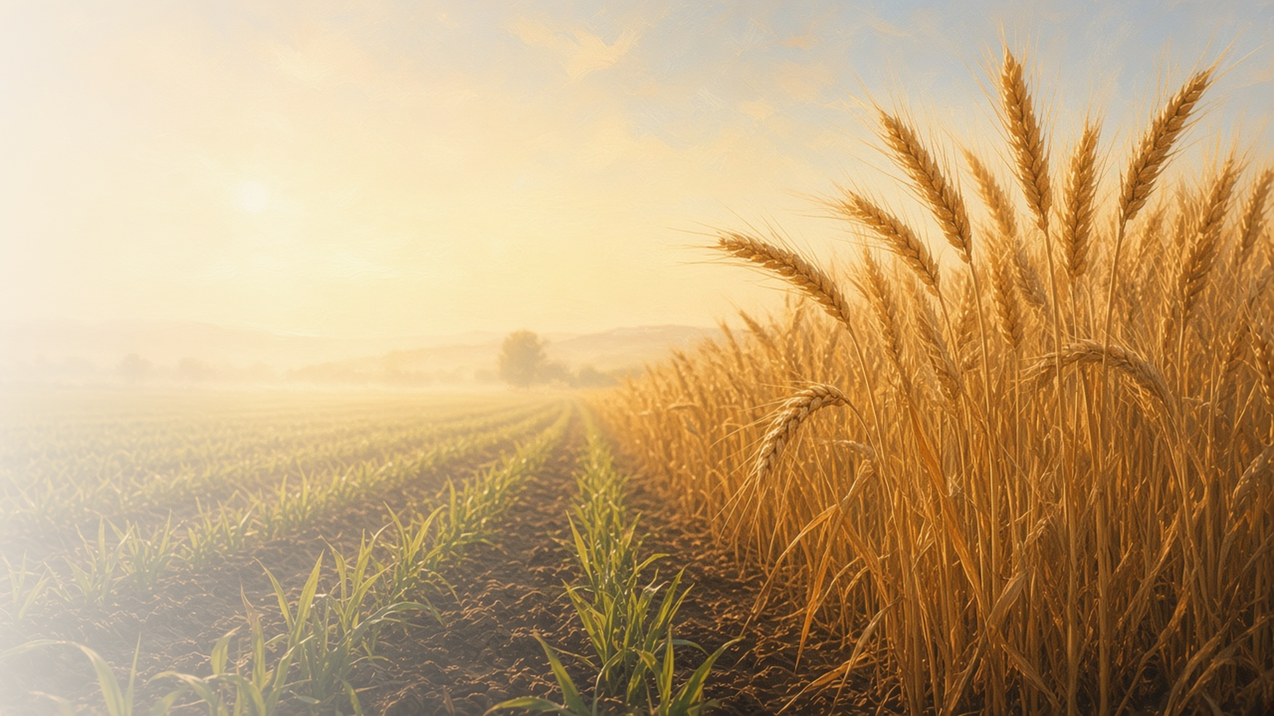
COME, FOLLOW ME · FOR CHILDREN
In Christ Shall All
Be Made Alive
August 30–September 5
1 Corinthians 14–16
Notes:
TEACHING
This week children learn that because Jesus Christ was resurrected they will be too, that they can receive a celestial body, and that they can be baptized for their ancestors in the temple because of Jesus Christ.
SCRIPTURE (KJV)
1 Corinthians 15:22
22 For as in Adam all die, even so in Christ shall all be made alive.
DISCUSSION
• What does it mean to be resurrected?
• Why do we do baptisms for the dead in the temple?

Slide 2
1 CORINTHIANS 15:12–22
I will be resurrected too
Because Jesus rose again, I will live again.
“For as in Adam all die, even so in Christ shall all be made alive.”
1 CORINTHIANS 15:22
Notes:
TEACHING
Use a glove: the hand is like our spirit and the glove like our body. When we die they separate, and when we are resurrected they come back together forever. Because Jesus was resurrected, everyone will be.
SCRIPTURE (KJV)
1 Corinthians 15:20–22
20 But now is Christ risen from the dead, and become the firstfruits of them that slept.
21 For since by man came death, by man came also the resurrection of the dead.
22 For as in Adam all die, even so in Christ shall all be made alive.
DISCUSSION (questions quoted from the manual)
• “You and your children might read together 1 Corinthians 15:12–22, searching for answers to the question “What would happen if there were no resurrection?””
• “They could also sing “Did Jesus Really Live Again?” (Children’s Songbook, 64).”

Slide 3
1 CORINTHIANS 15:21–22; 40–42
A celestial body
Heavenly Father wants me to receive a glorious body.
“There are also celestial bodies, and bodies terrestrial.”
1 CORINTHIANS 15:40
Notes:
TEACHING
Show pictures of the sun, moon, and stars. Paul used them to describe different kinds of resurrected bodies. Heavenly Father wants each of us to receive the brightest, like the sun, and to live with Him again.
SCRIPTURE (KJV)
1 Corinthians 15:40–42
40 There are also celestial bodies, and bodies terrestrial: but the glory of the celestial is one, and the glory of the terrestrial is another.
41 There is one glory of the sun, and another glory of the moon, and another glory of the stars: for one star differeth from another star in glory.
42 So also is the resurrection of the dead. It is sown in corruption; it is raised in incorruption:
DISCUSSION (questions quoted from the manual)
• “Do you have any objects that could help your children understand what Paul taught about “corruptible” and “incorruptible” bodies? (see 1 Corinthians 15:52–54).”

Slide 4
1 CORINTHIANS 15:29
Baptism for my ancestors
In the temple, I can be baptized for people who have died.
“Else what shall they do which are baptized for the dead, if the dead rise not at all?”
1 CORINTHIANS 15:29
Notes:
TEACHING
Show a picture of a temple baptismal font. Explain that some people died without being baptized, and in the temple we can be baptized for them. Look at a family photo or family tree and talk about ancestors who could be blessed.
SCRIPTURE (KJV)
1 Corinthians 15:29
29 Else what shall they do which are baptized for the dead, if the dead rise not at all? why are they then baptized for the dead?
DISCUSSION (questions quoted from the manual)
• “Who helps them?”

Slide 5
1 CORINTHIANS 15:22
“For as in Adam all die,
even so in Christ shall all be made alive.”
Thank Jesus that you will live again.
Notes:
TEACHING
Because of Jesus, everyone will live again. Invite children to thank Jesus in their prayers this week.
SCRIPTURE (KJV)
1 Corinthians 15:22
22 For as in Adam all die, even so in Christ shall all be made alive.
DISCUSSION
• Who do you want to see again someday?
• How can you thank Jesus?

