Slide 1
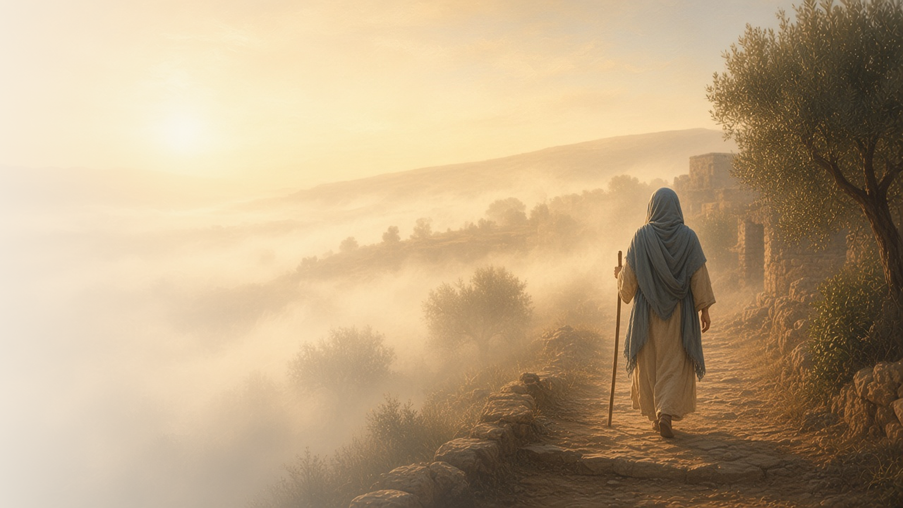
COME, FOLLOW ME · NEW TESTAMENT 2027
Be Ye Reconciled
to God
September 6–12
2 Corinthians 1–7
Notes:
TEACHING
Second Corinthians is Paul's most personal letter. He writes of being troubled on every side yet not distressed, of the God of all comfort who comforts us so we can comfort others, of forgiving a repentant member, of walking by faith, and of godly sorrow that leads to real change. At its heart is the plea: be ye reconciled to God, through Christ who makes us new creatures.
SCRIPTURE (KJV)
2 Corinthians 5:17–20
17 Therefore if any man be in Christ, he is a new creature: old things are passed away; behold, all things are become new.
18 And all things are of God, who hath reconciled us to himself by Jesus Christ, and hath given to us the ministry of reconciliation;
19 To wit, that God was in Christ, reconciling the world unto himself, not imputing their trespasses unto them; and hath committed unto us the word of reconciliation.
20 Now then we are ambassadors for Christ, as though God did beseech you by us: we pray you in Christ’s stead, be ye reconciled to God.
DISCUSSION
• What does it mean to you to be reconciled to God?
• When have you been comforted so that you could comfort someone else?

Slide 2
2 CORINTHIANS 1:3–5; 4:6–10, 17–18; 7:4–7
Troubled, yet not distressed
In trials, Christ gives hope that our affliction is but for a moment.
“We are troubled on every side, yet not distressed; we are perplexed, but not in despair.”
2 CORINTHIANS 4:8
Notes:
TEACHING
Paul knew trouble: persecution, perplexity, and being cast down. Yet he was not destroyed, because the God of all comfort sustained him, and he saw present affliction as light and brief compared with the eternal weight of glory. Discuss how the Savior gives hope in trials that do not quickly end.
SCRIPTURE (KJV)
2 Corinthians 1:3–5
3 Blessed be God, even the Father of our Lord Jesus Christ, the Father of mercies, and the God of all comfort;
4 Who comforteth us in all our tribulation, that we may be able to comfort them which are in any trouble, by the comfort wherewith we ourselves are comforted of God.
5 For as the sufferings of Christ abound in us, so our consolation also aboundeth by Christ.
2 Corinthians 4:8–10
8 We are troubled on every side, yet not distressed; we are perplexed, but not in despair;
9 Persecuted, but not forsaken; cast down, but not destroyed;
10 Always bearing about in the body the dying of the Lord Jesus, that the life also of Jesus might be made manifest in our body.
2 Corinthians 4:17–18
17 For our light affliction, which is but for a moment, worketh for us a far more exceeding and eternal weight of glory;
18 While we look not at the things which are seen, but at the things which are not seen: for the things which are seen are temporal; but the things which are not seen are eternal.
DISCUSSION (questions quoted from the manual)
• “So, after all he had suffered, why was he also “not distressed” and “not in despair” but instead “filled with comfort”? (2 Corinthians 4:8–9; 7:4).”
• “What do you learn from his experiences that might help you find comfort in your challenges?”
• “How do you feel inspired to comfort others during their times of need?”

Slide 3
2 CORINTHIANS 2:5–11
Forgive and comfort
Paul urged the Saints to forgive one who had repented.
“So that contrariwise ye ought rather to forgive him, and comfort him.”
2 CORINTHIANS 2:7
Notes:
TEACHING
A member who had caused grief had been disciplined and had repented. Paul now asked the Saints to forgive and comfort him and to confirm their love, so he would not be overwhelmed by sorrow and so Satan would gain no advantage. Forgiveness is a gift we both give and receive.
SCRIPTURE (KJV)
2 Corinthians 2:5–11
5 But if any have caused grief, he hath not grieved me, but in part: that I may not overcharge you all.
6 Sufficient to such a man is this punishment, which was inflicted of many.
7 So that contrariwise ye ought rather to forgive him, and comfort him, lest perhaps such a one should be swallowed up with overmuch sorrow.
8 Wherefore I beseech you that ye would confirm your love toward him.
9 For to this end also did I write, that I might know the proof of you, whether ye be obedient in all things.
10 To whom ye forgive any thing, I forgive also: for if I forgave any thing, to whom I forgave it, for your sakes forgave I it in the person of Christ;
11 Lest Satan should get an advantage of us: for we are not ignorant of his devices.
DISCUSSION (questions quoted from the manual)
• “Why is it important to forgive others? (see verses 7, 10–11).”
• “How have you been blessed by giving or receiving forgiveness?”
• “Who needs forgiveness from you?”
• “How can you “confirm your love” to them? (see verse 8).”

Slide 4
2 CORINTHIANS 5:6–8
Walk by faith
We walk by faith, not by what we can see.
“For we walk by faith, not by sight.”
2 CORINTHIANS 5:7
Notes:
TEACHING
Paul longed for the day he would be present with the Lord, but in the meantime he walked by faith rather than sight. Faith acts on what is true but not yet seen. Invite class members to share how they have walked by faith when they could not see the outcome.
SCRIPTURE (KJV)
2 Corinthians 5:6–8
6 Therefore we are always confident, knowing that, whilst we are at home in the body, we are absent from the Lord:
7 (For we walk by faith, not by sight:)
8 We are confident, I say, and willing rather to be absent from the body, and to be present with the Lord.
DISCUSSION (questions quoted from the manual)
• “How is it possible to walk confidently when we can’t see?”
• “How have you noticed the Lord helping you when you walk by faith?”
• “How are you striving to walk with the Savior through your trials?”

Slide 5
2 CORINTHIANS 5:14–21
A new creature
Through Christ’s Atonement, we can be reconciled to God.
“Therefore if any man be in Christ, he is a new creature: old things are passed away; behold, all things are become new.”
2 CORINTHIANS 5:17
Notes:
TEACHING
The love of Christ compelled Paul. Because Christ died for all, those in Him become new creatures; old things pass away. God reconciles us to Himself through Christ and gives us the ministry of reconciliation, inviting everyone to be reconciled to Him.
SCRIPTURE (KJV)
2 Corinthians 5:14–21
14 For the love of Christ constraineth us; because we thus judge, that if one died for all, then were all dead:
15 And that he died for all, that they which live should not henceforth live unto themselves, but unto him which died for them, and rose again.
16 Wherefore henceforth know we no man after the flesh: yea, though we have known Christ after the flesh, yet now henceforth know we him no more.
17 Therefore if any man be in Christ, he is a new creature: old things are passed away; behold, all things are become new.
18 And all things are of God, who hath reconciled us to himself by Jesus Christ, and hath given to us the ministry of reconciliation;
19 To wit, that God was in Christ, reconciling the world unto himself, not imputing their trespasses unto them; and hath committed unto us the word of reconciliation.
20 Now then we are ambassadors for Christ, as though God did beseech you by us: we pray you in Christ’s stead, be ye reconciled to God.
21 For he hath made him to be sin for us, who knew no sin; that we might be made the righteousness of God in him.
DISCUSSION (questions quoted from the manual)
• “How are you becoming “a new creature” by being reconciled to God? (verse 17).”
• “In what ways have you seen this process in others?”
• “How has Christ invited you to participate in “the ministry of reconciliation”? (verse 18).”
• “In what ways can you be an “[ambassador] for Christ”? (verse 20).”

Slide 6
2 CORINTHIANS 7:8–11
Godly sorrow
Godly sorrow leads to repentance and lasting change.
“For godly sorrow worketh repentance to salvation not to be repented of: but the sorrow of the world worketh death.”
2 CORINTHIANS 7:10
Notes:
TEACHING
Paul's earlier letter had made the Saints sorry, and he rejoiced, not that they grieved but that their sorrow led to repentance. Godly sorrow turns us toward God and brings change; worldly sorrow only regrets consequences. Verse 11 describes the fruits of real repentance: carefulness, clearing, zeal, and desire.
SCRIPTURE (KJV)
2 Corinthians 7:8–11
8 For though I made you sorry with a letter, I do not repent, though I did repent: for I perceive that the same epistle hath made you sorry, though it were but for a season.
9 Now I rejoice, not that ye were made sorry, but that ye sorrowed to repentance: for ye were made sorry after a godly manner, that ye might receive damage by us in nothing.
10 For godly sorrow worketh repentance to salvation not to be repented of: but the sorrow of the world worketh death.
11 For behold this selfsame thing, that ye sorrowed after a godly sort, what carefulness it wrought in you, yea, what clearing of yourselves, yea, what indignation, yea, what fear, yea, what vehement desire, yea, what zeal, yea, what revenge! In all things ye have approved yourselves to be clear in this matter.
DISCUSSION (questions quoted from the manual)
• “Why is godly sorrow necessary to receive the blessings of Jesus Christ’s Atonement?”
• “How is godly sorrow different from embarrassment or shame?”
• “How has godly sorrow helped you find joy?”

Slide 7
2 CORINTHIANS 5:20
“Be ye reconciled to God.”
Take one step this week toward reconciliation with God or others.
Notes:
TEACHING
Paul pleads on Christ's behalf: be reconciled to God. Close by inviting class members to take one step this week toward reconciliation, with God or with someone else.
SCRIPTURE (KJV)
2 Corinthians 5:18–21
18 And all things are of God, who hath reconciled us to himself by Jesus Christ, and hath given to us the ministry of reconciliation;
19 To wit, that God was in Christ, reconciling the world unto himself, not imputing their trespasses unto them; and hath committed unto us the word of reconciliation.
20 Now then we are ambassadors for Christ, as though God did beseech you by us: we pray you in Christ’s stead, be ye reconciled to God.
21 For he hath made him to be sin for us, who knew no sin; that we might be made the righteousness of God in him.
DISCUSSION
• What step toward reconciliation is the Lord inviting you to take?
• How has the Savior made you new?

