Slide 1
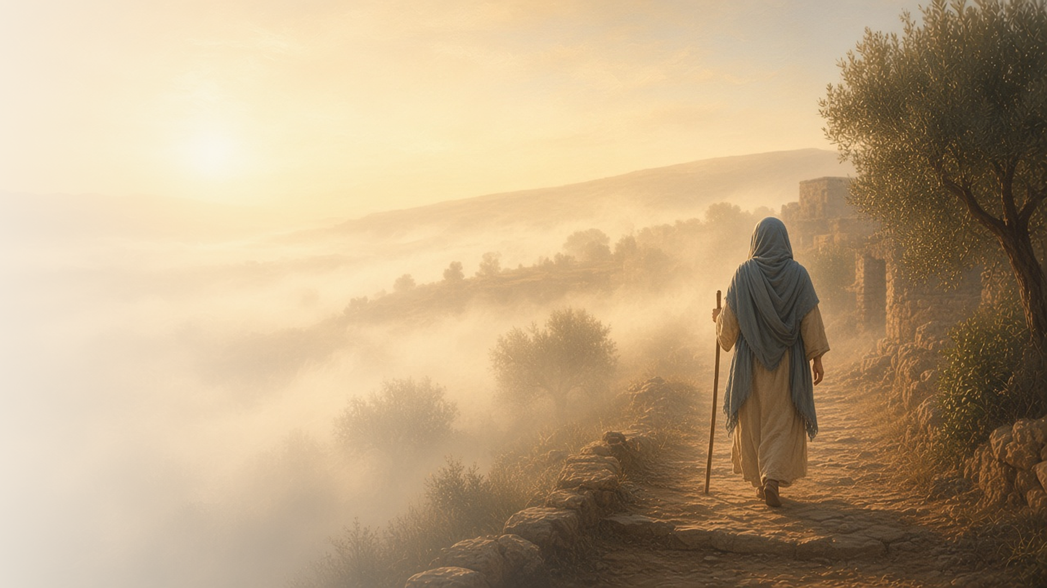
COME, FOLLOW ME · FOR CHILDREN
Be Ye Reconciled
to God
September 6–12
2 Corinthians 1–7
Notes:
TEACHING
This week children learn that God comforts them and they can comfort others, that they can forgive, that they can walk by faith and not by sight, and that Jesus Christ can help them change.
SCRIPTURE (KJV)
2 Corinthians 5:7
7 (For we walk by faith, not by sight:)
DISCUSSION
• How does God comfort you?
• What does it mean to walk by faith?

Slide 2
2 CORINTHIANS 1:3–4
God comforts me
God comforts me, and I can comfort others.
“Who comforteth us in all our tribulation, that we may be able to comfort them which are in any trouble.”
2 CORINTHIANS 1:4
Notes:
TEACHING
Ask children what helps them feel better when they are sad. Explain that Heavenly Father comforts us, and then we can comfort others. Practice what to say or do when a friend is sad.
SCRIPTURE (KJV)
2 Corinthians 1:3–4
3 Blessed be God, even the Father of our Lord Jesus Christ, the Father of mercies, and the God of all comfort;
4 Who comforteth us in all our tribulation, that we may be able to comfort them which are in any trouble, by the comfort wherewith we ourselves are comforted of God.
DISCUSSION (questions quoted from the manual)
• “How can we comfort them with the comfort God has given us?”

Slide 3
2 CORINTHIANS 2:7–8, 10
I can forgive
Paul asked the Saints to forgive and love someone.
“Wherefore I beseech you that ye would confirm your love toward him.”
2 CORINTHIANS 2:8
Notes:
TEACHING
Explain that someone had made a mistake and was sorry, and Paul asked everyone to forgive him and show him love. Talk about how forgiving helps both people feel better, and how Jesus helps us forgive.
SCRIPTURE (KJV)
2 Corinthians 2:7–8
7 So that contrariwise ye ought rather to forgive him, and comfort him, lest perhaps such a one should be swallowed up with overmuch sorrow.
8 Wherefore I beseech you that ye would confirm your love toward him.
DISCUSSION (questions quoted from the manual)
• “How do we help people know that we forgive them? (see verse 8).”
• “Why is it important for us to forgive others?”

Slide 4
2 CORINTHIANS 5:6–7
Walk by faith, not by sight
I can follow Jesus even when I can’t see Him.
“For we walk by faith, not by sight.”
2 CORINTHIANS 5:7
Notes:
TEACHING
Lead a blindfolded child safely across the room with your voice. Explain that we can't see Jesus, but we can follow Him by faith, trusting His words and the Holy Ghost.
SCRIPTURE (KJV)
2 Corinthians 5:7
7 (For we walk by faith, not by sight:)
DISCUSSION (questions quoted from the manual)
• “How does the Savior help us walk by faith? (See Carl B.”
• “What do we learn about walking by faith from these stories?”

Slide 5
2 CORINTHIANS 5:17
Jesus can help me change
With Jesus, I can become a new person.
“If any man be in Christ, he is a new creature.”
2 CORINTHIANS 5:17
Notes:
TEACHING
Show a seed and a flower, or a caterpillar and a butterfly. Explain that Jesus can help us change and become better, like something becoming new. Talk about one way each child wants to grow.
SCRIPTURE (KJV)
2 Corinthians 5:17
17 Therefore if any man be in Christ, he is a new creature: old things are passed away; behold, all things are become new.
DISCUSSION (questions quoted from the manual)
• (The manual gives no direct questions for this section.)
Suggested: What is one way Jesus can help you become better?

Slide 6
2 CORINTHIANS 5:7
“For we walk by faith, not by sight.”
Show your faith this week by saying your prayers each day.
Notes:
TEACHING
We walk by faith. Invite children to show their faith by praying every day this week.
SCRIPTURE (KJV)
2 Corinthians 5:7
7 (For we walk by faith, not by sight:)
DISCUSSION
• When will you say your prayers?
• What can you ask Heavenly Father for?

