Slide 1
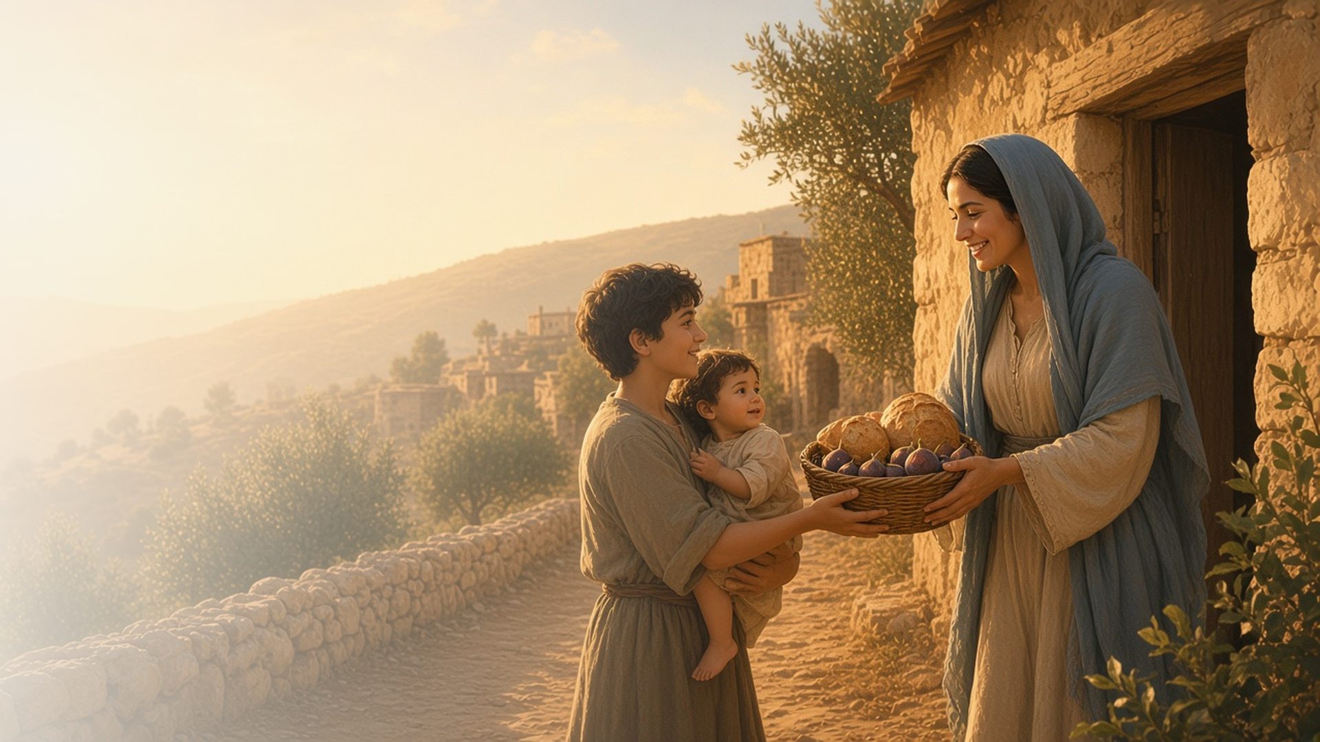
COME, FOLLOW ME · NEW TESTAMENT 2027
God Loveth a
Cheerful Giver
September 13–19
2 Corinthians 8–13
Notes:
TEACHING
In 2 Corinthians 8–13 Paul asks the Saints to give generously to struggling members in Jerusalem, teaching that God loves a cheerful giver. He counsels them to bring every thought into obedience to Christ, warns against being drawn from the simplicity that is in Christ, shares how the Lord's grace was sufficient for his own weakness, and invites them to examine themselves.
SCRIPTURE (KJV)
2 Corinthians 9:6–8
6 But this I say, He which soweth sparingly shall reap also sparingly; and he which soweth bountifully shall reap also bountifully.
7 Every man according as he purposeth in his heart, so let him give; not grudgingly, or of necessity: for God loveth a cheerful giver.
8 And God is able to make all grace abound toward you; that ye, always having all sufficiency in all things, may abound to every good work:
DISCUSSION
• What makes giving cheerful rather than grudging?
• When has the Lord's grace made you strong in weakness?

Slide 2
2 CORINTHIANS 8:1–15; 9:6–15
A cheerful giver
Generous giving blesses both the giver and the receiver.
“Not grudgingly, or of necessity: for God loveth a cheerful giver.”
2 CORINTHIANS 9:7
Notes:
TEACHING
Paul held up the Macedonian Saints, who gave beyond their means out of deep poverty, and pointed to Christ, who became poor for our sakes. Those who sow bountifully reap bountifully, and God loves a cheerful giver. Discuss how fast offerings, service, and time can be given cheerfully.
SCRIPTURE (KJV)
2 Corinthians 8:1–9
1 Moreover, brethren, we do you to wit of the grace of God bestowed on the churches of Macedonia;
2 How that in a great trial of affliction the abundance of their joy and their deep poverty abounded unto the riches of their liberality.
3 For to their power, I bear record, yea, and beyond their power they were willing of themselves;
4 Praying us with much intreaty that we would receive the gift, and take upon us the fellowship of the ministering to the saints.
5 And this they did, not as we hoped, but first gave their own selves to the Lord, and unto us by the will of God.
6 Insomuch that we desired Titus, that as he had begun, so he would also finish in you the same grace also.
7 Therefore, as ye abound in every thing, in faith, and utterance, and knowledge, and in all diligence, and in your love to us, see that ye abound in this grace also.
8 I speak not by commandment, but by occasion of the forwardness of others, and to prove the sincerity of your love.
9 For ye know the grace of our Lord Jesus Christ, that, though he was rich, yet for your sakes he became poor, that ye through his poverty might be rich.
2 Corinthians 9:6–8
6 But this I say, He which soweth sparingly shall reap also sparingly; and he which soweth bountifully shall reap also bountifully.
7 Every man according as he purposeth in his heart, so let him give; not grudgingly, or of necessity: for God loveth a cheerful giver.
8 And God is able to make all grace abound toward you; that ye, always having all sufficiency in all things, may abound to every good work:
DISCUSSION (questions quoted from the manual)
• “Holland’s message “Are We Not All Beggars?” (Ensign or Liahona, Nov. 2014, 41).”
• “A song like “Have I Done Any Good?” (Hymns, no. 223) might also inspire you.”

Slide 3
2 CORINTHIANS 10:3–6
Every thought to Christ
With His help, we bring our thoughts into obedience.
“Bringing into captivity every thought to the obedience of Christ.”
2 CORINTHIANS 10:5
Notes:
TEACHING
Paul describes spiritual warfare fought not with worldly weapons but with power from God, casting down whatever exalts itself against the knowledge of God and bringing every thought into obedience to Christ. Invite class members to share what helps them direct their thoughts toward the Savior.
SCRIPTURE (KJV)
2 Corinthians 10:3–6
3 For though we walk in the flesh, we do not war after the flesh:
4 (For the weapons of our warfare are not carnal, but mighty through God to the pulling down of strong holds;)
5 Casting down imaginations, and every high thing that exalteth itself against the knowledge of God, and bringing into captivity every thought to the obedience of Christ;
6 And having in a readiness to revenge all disobedience, when your obedience is fulfilled.
DISCUSSION (questions quoted from the manual)
• “What “strong holds … against the knowledge of God” need to be pulled down in my life?”
• “What are “the weapons of … warfare” that God has given me to accomplish this?”
• “What does it mean to bring “into captivity every thought to the obedience of Christ”?”

Slide 4
2 CORINTHIANS 11:1–4
The simplicity in Christ
Keep the gospel centered on Christ, not on distractions.
“So your minds should be corrupted from the simplicity that is in Christ.”
2 CORINTHIANS 11:3
Notes:
TEACHING
Paul feared that the Corinthians, like Eve beguiled by the serpent, would be drawn away from the simplicity that is in Christ by teachers preaching "another Jesus." The gospel at its core is simple: faith in Christ, repentance, covenants, and enduring. Discuss what complicates the gospel for us and how to return to its center.
SCRIPTURE (KJV)
2 Corinthians 11:1–4
1 Would to God ye could bear with me a little in my folly: and indeed bear with me.
2 For I am jealous over you with godly jealousy: for I have espoused you to one husband, that I may present you as a chaste virgin to Christ.
3 But I fear, lest by any means, as the serpent beguiled Eve through his subtilty, so your minds should be corrupted from the simplicity that is in Christ.
4 For if he that cometh preacheth another Jesus, whom we have not preached, or if ye receive another spirit, which ye have not received, or another gospel, which ye have not accepted, ye might well bear with him.
Restoration scripture (public-domain text: bcbooks/scriptures-json)
2 Nephi 33:6 (Book of Mormon)
6 I glory in plainness; I glory in truth; I glory in my Jesus, for he hath redeemed my soul from hell.
Jacob 4:14 (Book of Mormon)
14 But behold, the Jews were a stiffnecked people; and they despised the words of plainness, and killed the prophets, and sought for things that they could not understand. Wherefore, because of their blindness, which blindness came by looking beyond the mark, they must needs fall; for God hath taken away his plainness from them, and delivered unto them many things which they cannot understand, because they desired it. And because they desired it God hath done it, that they may stumble.
DISCUSSION (questions quoted from the manual)
• “What does that phrase mean to you?”
• “How have you found simplicity in Christ and His gospel?”
• “How might your mind “be corrupted from [His] simplicity”?”
• “What else do you learn from 2 Nephi 33:6 and Jacob 4:14?”
• “What would you write?”
• “What do you feel inspired to do to “simplify your approach to discipleship”?”

Slide 5
2 CORINTHIANS 12:5–10
My grace is sufficient
Paul’s thorn remained, and the Lord’s grace made him strong.
“My grace is sufficient for thee: for my strength is made perfect in weakness.”
2 CORINTHIANS 12:9
Notes:
TEACHING
Paul pleaded three times for the Lord to remove his thorn in the flesh. The Lord did not remove it but promised that His grace was sufficient and His strength made perfect in weakness. Paul learned to glory in infirmities because Christ's power rested on him. Invite class members to consider how the Lord has strengthened them in weakness.
SCRIPTURE (KJV)
2 Corinthians 12:7–10
7 And lest I should be exalted above measure through the abundance of the revelations, there was given to me a thorn in the flesh, the messenger of Satan to buffet me, lest I should be exalted above measure.
8 For this thing I besought the Lord thrice, that it might depart from me.
9 And he said unto me, My grace is sufficient for thee: for my strength is made perfect in weakness. Most gladly therefore will I rather glory in my infirmities, that the power of Christ may rest upon me.
10 Therefore I take pleasure in infirmities, in reproaches, in necessities, in persecutions, in distresses for Christ’s sake: for when I am weak, then am I strong.
DISCUSSION (questions quoted from the manual)
• “What possible insights do you gain from these verses about prayers that seem to be unanswered?”
• “What do you learn about Jesus Christ?”
• “What does it mean to you that His “grace is sufficient” for you?”
• “Why did Paul “glory in” or “take pleasure in infirmities”? (verses 9–10).”
• “As you look back on your life, can you think of any “glorious” things that resulted from difficult times in your past?”

Slide 6
2 CORINTHIANS 13:5
Examine yourselves
Honest self-examination keeps us anchored in the faith.
“Examine yourselves, whether ye be in the faith; prove your own selves.”
2 CORINTHIANS 13:5
Notes:
TEACHING
Paul closes by inviting the Saints to examine whether they are truly in the faith, and to know that Christ is in them. His final counsel is to be perfect, of good comfort, of one mind, and to live in peace. Discuss simple ways to examine our discipleship regularly, such as during the sacrament.
SCRIPTURE (KJV)
2 Corinthians 13:5
5 Examine yourselves, whether ye be in the faith; prove your own selves. Know ye not your own selves, how that Jesus Christ is in you, except ye be reprobates?
2 Corinthians 13:11
11 Finally, brethren, farewell. Be perfect, be of good comfort, be of one mind, live in peace; and the God of love and peace shall be with you.
DISCUSSION (questions quoted from the manual)
• “How do you know if you are “in the faith”?”
• “What opportunities do you have to “examine” yourself spiritually?”

Slide 7
2 CORINTHIANS 9:15
“Thanks be unto God for his unspeakable gift.”
Give something this week, cheerfully and quietly.
Notes:
TEACHING
Paul ends his appeal for giving with thanks for God's unspeakable gift, His Son. All our giving responds to His. Close by inviting class members to give something this week, cheerfully and quietly.
SCRIPTURE (KJV)
2 Corinthians 9:12–15
12 For the administration of this service not only supplieth the want of the saints, but is abundant also by many thanksgivings unto God;
13 Whiles by the experiment of this ministration they glorify God for your professed subjection unto the gospel of Christ, and for your liberal distribution unto them, and unto all men;
14 And by their prayer for you, which long after you for the exceeding grace of God in you.
15 Thanks be unto God for his unspeakable gift.
DISCUSSION
• What will you give this week?
• How does remembering God's gift change the way you give?

