Slide 1
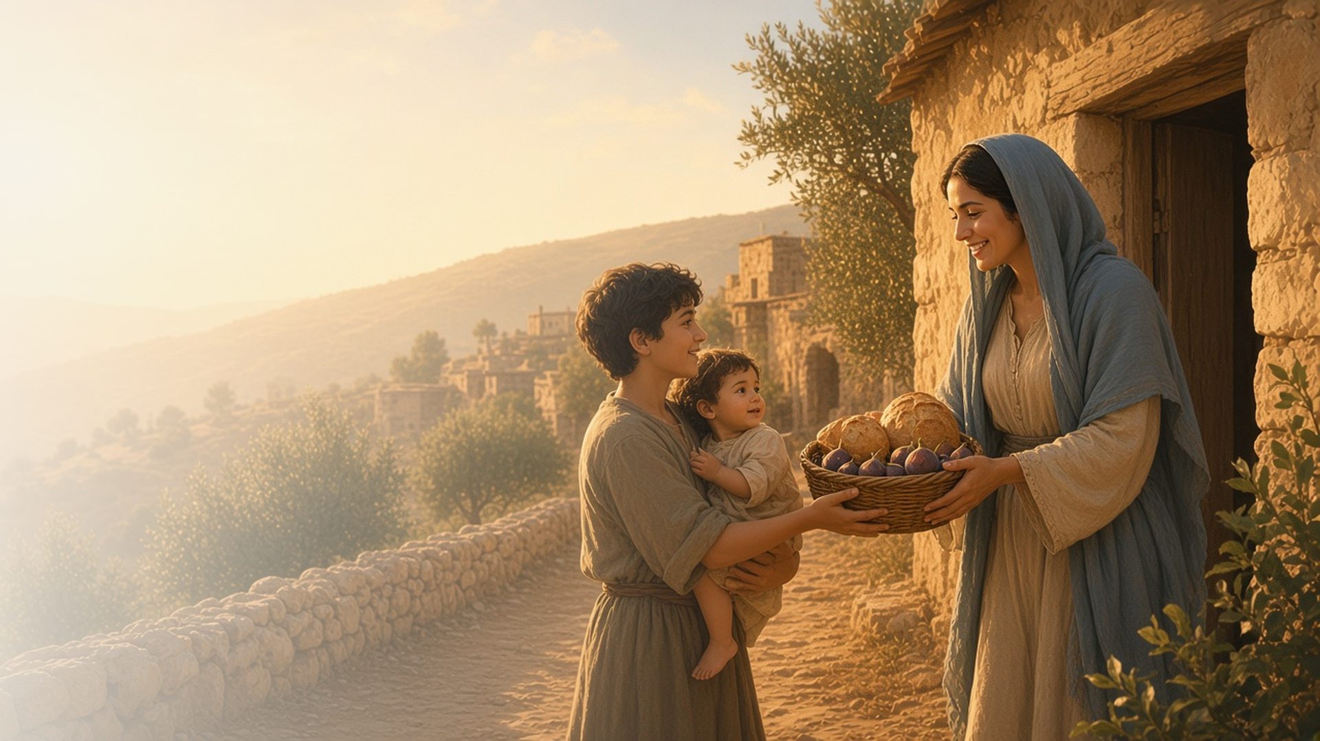
COME, FOLLOW ME · FOR CHILDREN
God Loveth a
Cheerful Giver
September 13–19
2 Corinthians 8–13
Notes:
TEACHING
This week children learn that they can be cheerful givers, that Jesus can help them win their battle against sin, and that Jesus can make them strong even when trials make them feel weak.
SCRIPTURE (KJV)
2 Corinthians 9:7
7 Every man according as he purposeth in his heart, so let him give; not grudgingly, or of necessity: for God loveth a cheerful giver.
DISCUSSION
• What does it mean to be a cheerful giver?
• How can Jesus make you strong?

Slide 2
2 CORINTHIANS 9:6–9
I can be a cheerful giver
I can share happily with others.
“For God loveth a cheerful giver.”
2 CORINTHIANS 9:7
Notes:
TEACHING
Act out sharing a toy with a frown and then with a smile. Ask which one Heavenly Father loves. Talk about things children can share, like toys, time, and kind words, and how giving cheerfully feels.
SCRIPTURE (KJV)
2 Corinthians 9:6–7
6 But this I say, He which soweth sparingly shall reap also sparingly; and he which soweth bountifully shall reap also bountifully.
7 Every man according as he purposeth in his heart, so let him give; not grudgingly, or of necessity: for God loveth a cheerful giver.
DISCUSSION (questions quoted from the manual)
• (The manual gives no direct questions for this section.)
Suggested: What can you share with someone this week, with a smile?

Slide 3
2 CORINTHIANS 10:3–7
Jesus helps me fight sin
Jesus helps me choose good thoughts and actions.
“Bringing into captivity every thought to the obedience of Christ.”
2 CORINTHIANS 10:5
Notes:
TEACHING
Explain that sometimes it is hard to choose the right. Paul taught that Jesus helps us win that battle. Help children think of a good thought, song, or scripture they can use when they feel tempted.
SCRIPTURE (KJV)
2 Corinthians 10:3–5
3 For though we walk in the flesh, we do not war after the flesh:
4 (For the weapons of our warfare are not carnal, but mighty through God to the pulling down of strong holds;)
5 Casting down imaginations, and every high thing that exalteth itself against the knowledge of God, and bringing into captivity every thought to the obedience of Christ;
DISCUSSION (questions quoted from the manual)
• “How could you teach your children about our “warfare” against sin?”
• “What are the spiritual “weapons” we use to win our spiritual battles?”

Slide 4
2 CORINTHIANS 12:7–10
Jesus makes me strong
When I feel weak, Jesus can make me strong.
“For when I am weak, then am I strong.”
2 CORINTHIANS 12:10
Notes:
TEACHING
Explain that Paul had a hard problem that didn't go away, but Jesus made him strong. Jesus can help us when things are hard too. Share a time when you felt Jesus help you.
SCRIPTURE (KJV)
2 Corinthians 12:9–10
9 And he said unto me, My grace is sufficient for thee: for my strength is made perfect in weakness. Most gladly therefore will I rather glory in my infirmities, that the power of Christ may rest upon me.
10 Therefore I take pleasure in infirmities, in reproaches, in necessities, in persecutions, in distresses for Christ’s sake: for when I am weak, then am I strong.
DISCUSSION (questions quoted from the manual)
• “What did Paul learn from his experience?”
• “What words or phrases are repeated?”
• “What do we learn about Jesus Christ from these verses?”
• “What do we learn about weakness?”

Slide 5
2 CORINTHIANS 9:7
“For God loveth a cheerful giver.”
Share something you love with someone this week.
Notes:
TEACHING
God loves a cheerful giver. Invite children to share something they love this week.
SCRIPTURE (KJV)
2 Corinthians 9:7
7 Every man according as he purposeth in his heart, so let him give; not grudgingly, or of necessity: for God loveth a cheerful giver.
DISCUSSION
• What will you share?
• How do you feel when you share?

