Slide 1
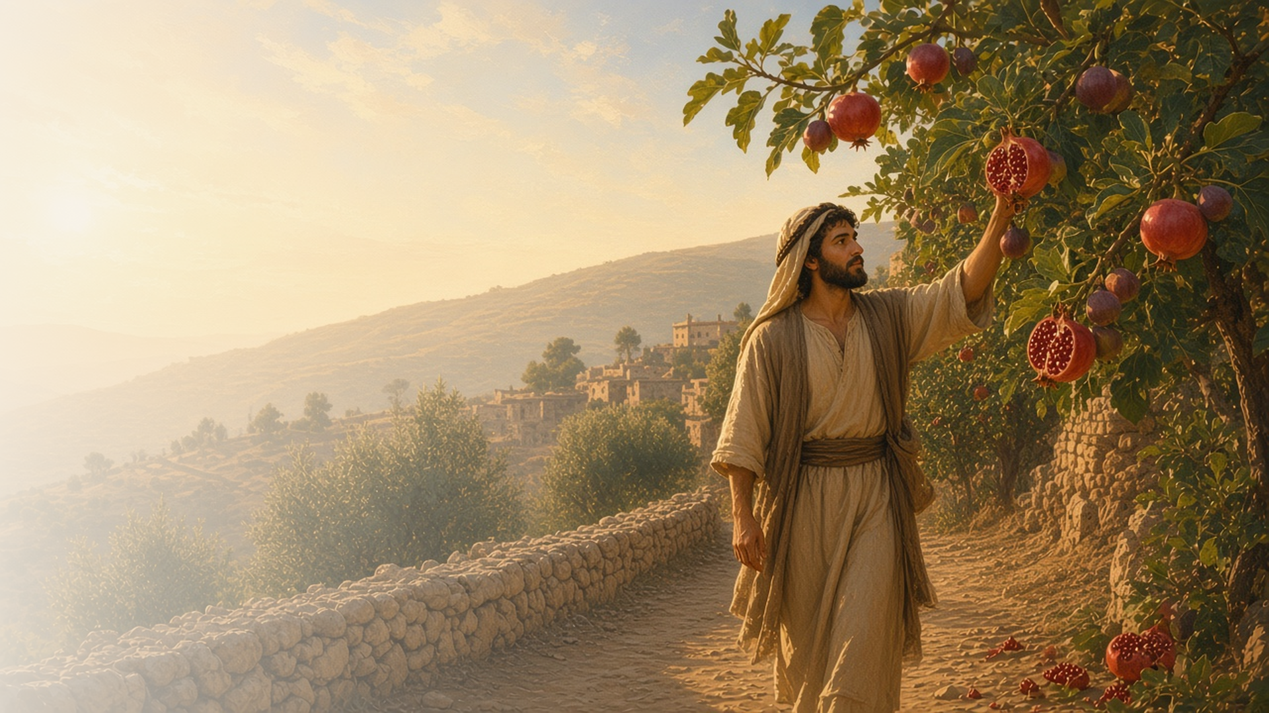
COME, FOLLOW ME · NEW TESTAMENT 2027
Walk in
the Spirit
September 20–26
Galatians
Notes:
TEACHING
Some Galatian Saints were turning back to the law of Moses as the way to salvation. Paul answered that Jesus Christ makes us free, that the just live by faith, and that through Him we become heirs of the Father. He invites us to walk in the Spirit, sow to the Spirit and reap its fruit, and bear one another's burdens.
SCRIPTURE (KJV)
Galatians 5:22–25
22 But the fruit of the Spirit is love, joy, peace, longsuffering, gentleness, goodness, faith,
23 Meekness, temperance: against such there is no law.
24 And they that are Christ’s have crucified the flesh with the affections and lusts.
25 If we live in the Spirit, let us also walk in the Spirit.
DISCUSSION
• Which fruit of the Spirit do you most want to grow?
• How does Christ make you free?

Slide 2
GALATIANS 1:6–7; 3:1–5; 4:8–21; 5:1, 13–14
Christ makes me free
Christ frees us from sin and from empty traditions.
“Stand fast therefore in the liberty wherewith Christ hath made us free, and be not entangled again with the yoke of bondage.”
GALATIANS 5:1
Notes:
TEACHING
Paul marveled that the Galatians were turning to "another gospel" so soon. Returning to the law as the means of salvation was like returning to bondage. Christ had made them free, and that liberty is meant for serving one another in love, not indulging the flesh. Discuss what freedom in Christ looks like day to day.
SCRIPTURE (KJV)
Galatians 1:6–7
6 I marvel that ye are so soon removed from him that called you into the grace of Christ unto another gospel:
7 Which is not another; but there be some that trouble you, and would pervert the gospel of Christ.
Galatians 5:1
1 Stand fast therefore in the liberty wherewith Christ hath made us free, and be not entangled again with the yoke of bondage.
Galatians 5:13–14
13 For, brethren, ye have been called unto liberty; only use not liberty for an occasion to the flesh, but by love serve one another.
14 For all the law is fulfilled in one word, even in this; Thou shalt love thy neighbour as thyself.
DISCUSSION (questions quoted from the manual)
• “For this reason, it might be good to begin your study of Galatians with questions like these: What was Paul’s purpose in writing this epistle?”
• “What problem was he trying to solve?”
• “How might Paul’s concerns apply to you?”
• “What might be preventing you from experiencing the freedom that the gospel offers?”
• “According to Galatians 5:1, 13–14, how can you find freedom from these attitudes and actions?”
• “How have the Savior and His gospel “made [you] free”? (Galatians 5:1).”

Slide 3
GALATIANS 2:20
Christ liveth in me
Paul’s old self was crucified; Christ now lived in him.
“I am crucified with Christ: nevertheless I live; yet not I, but Christ liveth in me.”
GALATIANS 2:20
Notes:
TEACHING
Paul describes discipleship as dying to the old self and letting Christ live in him. His life is now lived by faith in the Son of God, who loved him and gave Himself for him. Invite class members to ponder what it would mean for Christ to live in them more fully.
SCRIPTURE (KJV)
Galatians 2:20
20 I am crucified with Christ: nevertheless I live; yet not I, but Christ liveth in me: and the life which I now live in the flesh I live by the faith of the Son of God, who loved me, and gave himself for me.
DISCUSSION (questions quoted from the manual)
• “What do you think it means to be “crucified with Christ”?”
• “How is your life different when He lives “in [you]”?”

Slide 4
GALATIANS 3:11
The just shall live by faith
We are made right with God through faith in Christ.
“The just shall live by faith.”
GALATIANS 3:11
Notes:
TEACHING
Paul quotes Habakkuk: the just shall live by faith. The law served as a schoolmaster to bring people to Christ, but justification comes through faith in Him. Living by faith means trusting Christ continually and letting that trust shape our choices.
SCRIPTURE (KJV)
Galatians 3:11
11 But that no man is justified by the law in the sight of God, it is evident: for, The just shall live by faith.
Galatians 3:24–26
24 Wherefore the law was our schoolmaster to bring us unto Christ, that we might be justified by faith.
25 But after that faith is come, we are no longer under a schoolmaster.
26 For ye are all the children of God by faith in Christ Jesus.
DISCUSSION (questions quoted from the manual)
• “What does it look like, in your life, to “live by faith”?”
• “How is it different from living in other ways?”

Slide 5
GALATIANS 4:1–7
No more a servant, but a son
Through Christ, we become heirs of the Father.
“Wherefore thou art no more a servant, but a son; and if a son, then an heir of God through Christ.”
GALATIANS 4:7
Notes:
TEACHING
Paul compares an heir who is still a child to a servant until the appointed time. Through Christ we receive adoption, the Spirit cries "Abba, Father," and we become heirs of God. Discuss how seeing ourselves as heirs rather than servants changes our relationship with God.
SCRIPTURE (KJV)
Galatians 4:4–7
4 But when the fulness of the time was come, God sent forth his Son, made of a woman, made under the law,
5 To redeem them that were under the law, that we might receive the adoption of sons.
6 And because ye are sons, God hath sent forth the Spirit of his Son into your hearts, crying, Abba, Father.
7 Wherefore thou art no more a servant, but a son; and if a son, then an heir of God through Christ.
DISCUSSION (questions quoted from the manual)
• “What opportunities or potential does a king’s child have that a servant does not?”
• “What do these verses teach about your relationship with Heavenly Father?”

Slide 6
GALATIANS 5:13–26; 6:7–10
The fruit of the Spirit
What we sow to the Spirit, we reap in love, joy, and peace.
“But the fruit of the Spirit is love, joy, peace, longsuffering, gentleness, goodness, faith.”
GALATIANS 5:22
Notes:
TEACHING
Paul contrasts the works of the flesh with the fruit of the Spirit: love, joy, peace, longsuffering, gentleness, goodness, faith, meekness, and temperance. Whatever we sow, we reap. Invite class members to choose one fruit of the Spirit and identify a way to sow toward it.
SCRIPTURE (KJV)
Galatians 5:16–25
16 This I say then, Walk in the Spirit, and ye shall not fulfil the lust of the flesh.
17 For the flesh lusteth against the Spirit, and the Spirit against the flesh: and these are contrary the one to the other: so that ye cannot do the things that ye would.
18 But if ye be led of the Spirit, ye are not under the law.
19 Now the works of the flesh are manifest, which are these; Adultery, fornication, uncleanness, lasciviousness,
20 Idolatry, witchcraft, hatred, variance, emulations, wrath, strife, seditions, heresies,
21 Envyings, murders, drunkenness, revellings, and such like: of the which I tell you before, as I have also told you in time past, that they which do such things shall not inherit the kingdom of God.
22 But the fruit of the Spirit is love, joy, peace, longsuffering, gentleness, goodness, faith,
23 Meekness, temperance: against such there is no law.
24 And they that are Christ’s have crucified the flesh with the affections and lusts.
25 If we live in the Spirit, let us also walk in the Spirit.
Galatians 6:7–10
7 Be not deceived; God is not mocked: for whatsoever a man soweth, that shall he also reap.
8 For he that soweth to his flesh shall of the flesh reap corruption; but he that soweth to the Spirit shall of the Spirit reap life everlasting.
9 And let us not be weary in well doing: for in due season we shall reap, if we faint not.
10 As we have therefore opportunity, let us do good unto all men, especially unto them who are of the household of faith.
DISCUSSION (questions quoted from the manual)
• “For example, how can you weaken “the works of the flesh” (verses 19–21) and nourish “the fruit of the Spirit”? (verses 22–23).”
• “What seeds can you sow in order to reap the fruit of the Spirit?”
• “What is the Lord’s message to you in these verses?”

Slide 7
GALATIANS 6:1–2
Bear one another’s burdens
Lifting others is how we fulfill the law of Christ.
“Bear ye one another’s burdens, and so fulfil the law of Christ.”
GALATIANS 6:2
Notes:
TEACHING
Paul counsels spiritual members to restore those who have stumbled with meekness, remembering their own weakness, and to bear one another's burdens. This fulfills the law of Christ. Discuss practical ways to help carry someone's burden this week.
SCRIPTURE (KJV)
Galatians 6:1–2
1 Brethren, if a man be overtaken in a fault, ye which are spiritual, restore such an one in the spirit of meekness; considering thyself, lest thou also be tempted.
2 Bear ye one another’s burdens, and so fulfil the law of Christ.
DISCUSSION (questions quoted from the manual)
• “What do you think Paul might mean by “the law of Christ”? (verse 2).”
• “And how does bearing each other’s burdens fulfill it?”

Slide 8
GALATIANS 5:25
“If we live in the Spirit,
let us also walk in the Spirit.”
Choose one fruit of the Spirit to cultivate this week.
Notes:
TEACHING
If we live by the Spirit, Paul says, let us also walk by it. Close by inviting class members to choose one fruit of the Spirit to cultivate this week.
SCRIPTURE (KJV)
Galatians 5:25
25 If we live in the Spirit, let us also walk in the Spirit.
Galatians 6:9
9 And let us not be weary in well doing: for in due season we shall reap, if we faint not.
DISCUSSION
• Which fruit of the Spirit will you focus on?
• What will you sow to help it grow?

