Slide 1
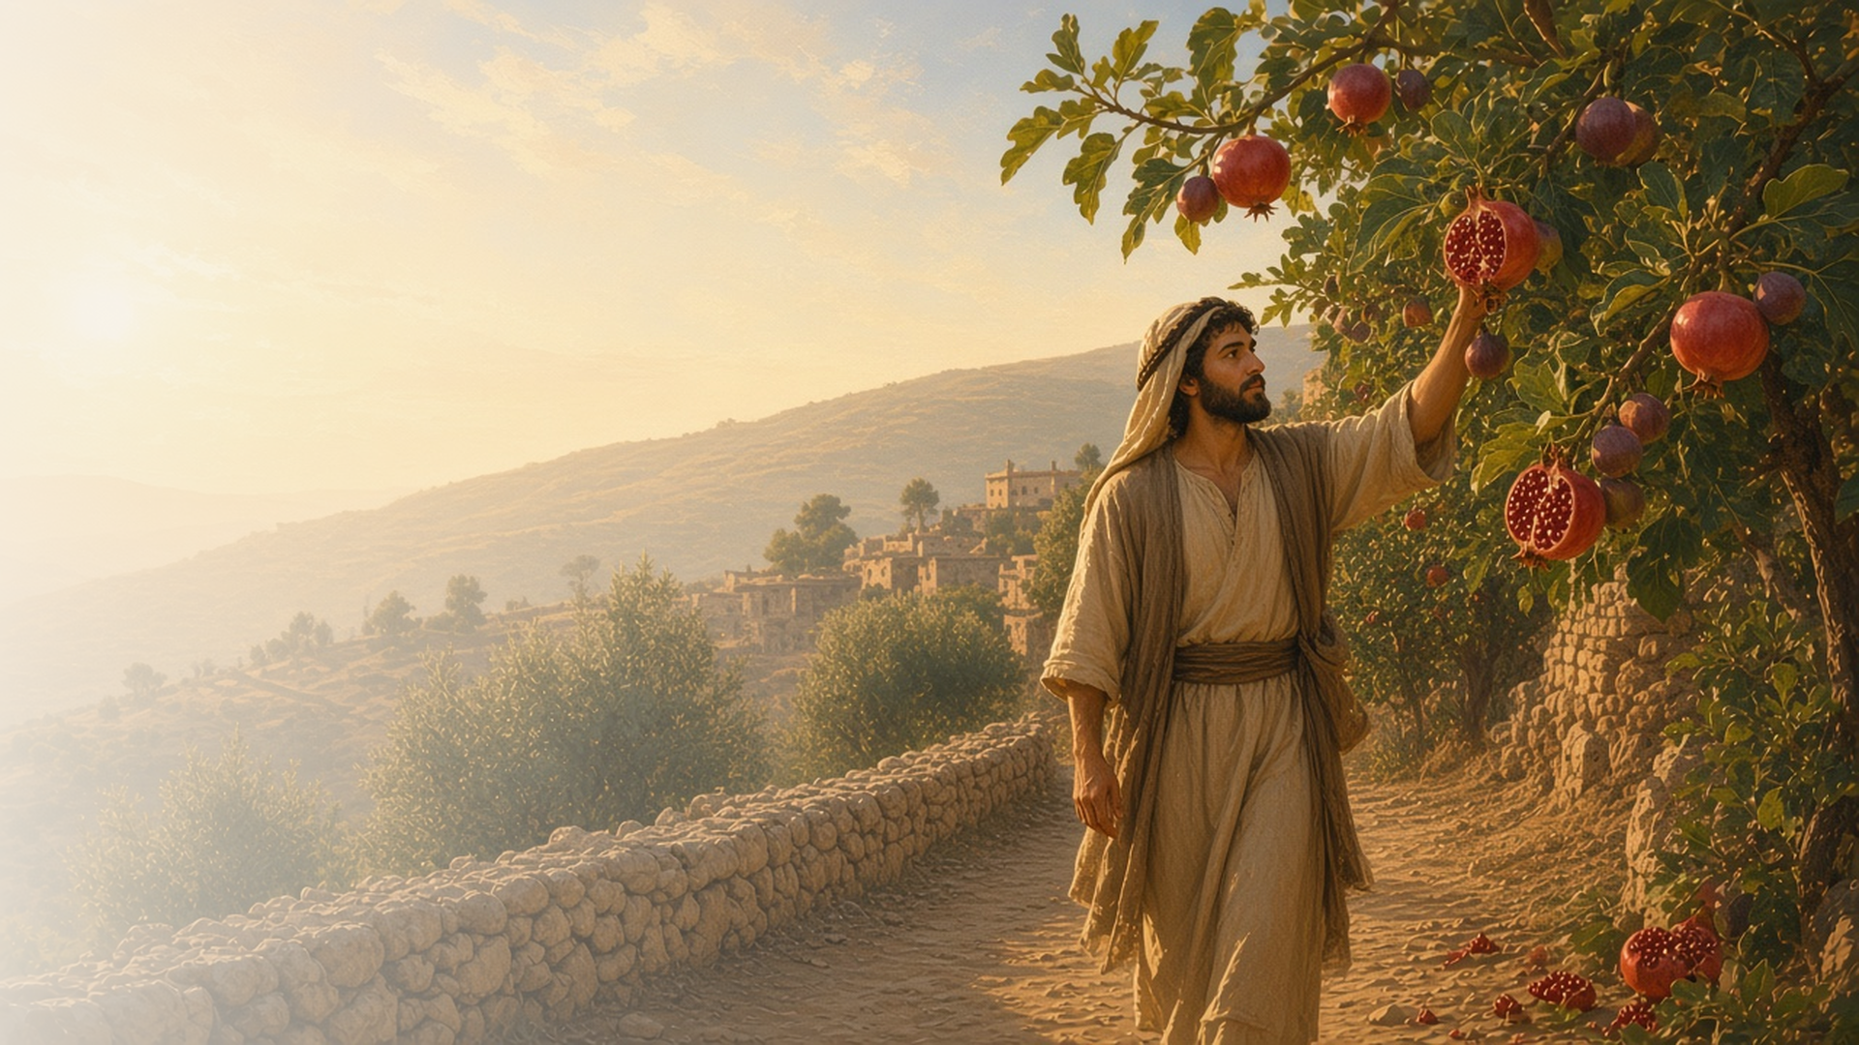
COME, FOLLOW ME · FOR CHILDREN
Walk in
the Spirit
September 20–26
Galatians
Notes:
TEACHING
This week children learn that baptism makes us one in Christ, that they can walk in the Spirit, that they can recognize the Spirit by its fruit, and that they reap what they sow.
SCRIPTURE (KJV)
Galatians 5:22–23
22 But the fruit of the Spirit is love, joy, peace, longsuffering, gentleness, goodness, faith,
23 Meekness, temperance: against such there is no law.
DISCUSSION
• What are the fruits of the Spirit?
• How can you walk in the Spirit?

Slide 2
GALATIANS 3:26–29
One in Christ
When we are baptized, we all belong to Jesus.
“For as many of you as have been baptized into Christ have put on Christ.”
GALATIANS 3:27
Notes:
TEACHING
Explain that when people are baptized, they become part of Jesus's family, no matter where they are from. Everyone who is baptized belongs to Jesus together.
SCRIPTURE (KJV)
Galatians 3:26–28
26 For ye are all the children of God by faith in Christ Jesus.
27 For as many of you as have been baptized into Christ have put on Christ.
28 There is neither Jew nor Greek, there is neither bond nor free, there is neither male nor female: for ye are all one in Christ Jesus.
DISCUSSION (questions quoted from the manual)
• (The manual gives no direct questions for this section.)
Suggested: How can you help others feel part of Jesus's family?

Slide 3
GALATIANS 5:16
I can walk in the Spirit
I can listen to the Holy Ghost every day.
“Walk in the Spirit.”
GALATIANS 5:16
Notes:
TEACHING
Take a short walk together and talk about how walking in the Spirit means letting the Holy Ghost guide our choices all day long. Talk about times the Holy Ghost might help us.
SCRIPTURE (KJV)
Galatians 5:16
16 This I say then, Walk in the Spirit, and ye shall not fulfil the lust of the flesh.
DISCUSSION (questions quoted from the manual)
• (The manual gives no direct questions for this section.)
Suggested: When can you listen to the Holy Ghost this week?

Slide 4
GALATIANS 5:22–23
The fruit of the Spirit
Love, joy, and peace show the Spirit is with me.
“But the fruit of the Spirit is love, joy, peace.”
GALATIANS 5:22
Notes:
TEACHING
Draw a tree and add fruit labeled love, joy, peace, and gentleness. Explain that when we feel these things, the Holy Ghost is with us.
SCRIPTURE (KJV)
Galatians 5:22–23
22 But the fruit of the Spirit is love, joy, peace, longsuffering, gentleness, goodness, faith,
23 Meekness, temperance: against such there is no law.
DISCUSSION (questions quoted from the manual)
• (The manual gives no direct questions for this section.)
Suggested: When have you felt love, joy, or peace from the Spirit?

Slide 5
GALATIANS 6:7–9
I reap what I sow
Good choices grow good blessings, like seeds in a garden.
“For whatsoever a man soweth, that shall he also reap.”
GALATIANS 6:7
Notes:
TEACHING
Show different seeds and ask what each will grow. Explain that our choices are like seeds: kind choices grow happy blessings.
SCRIPTURE (KJV)
Galatians 6:7–9
7 Be not deceived; God is not mocked: for whatsoever a man soweth, that shall he also reap.
8 For he that soweth to his flesh shall of the flesh reap corruption; but he that soweth to the Spirit shall of the Spirit reap life everlasting.
9 And let us not be weary in well doing: for in due season we shall reap, if we faint not.
DISCUSSION (questions quoted from the manual)
• (The manual gives no direct questions for this section.)
Suggested: What good seed can you plant with your choices this week?

Slide 6
GALATIANS 6:9
“And let us not be weary in well doing:
for in due season we shall reap, if we faint not.”
Plant one good seed this week with a kind act.
Notes:
TEACHING
If we keep doing good, we will reap blessings. Invite children to plant a good seed with a kind act this week.
SCRIPTURE (KJV)
Galatians 6:9
9 And let us not be weary in well doing: for in due season we shall reap, if we faint not.
DISCUSSION
• What kind act will you do?
• How does doing good make you feel?

