Slide 1
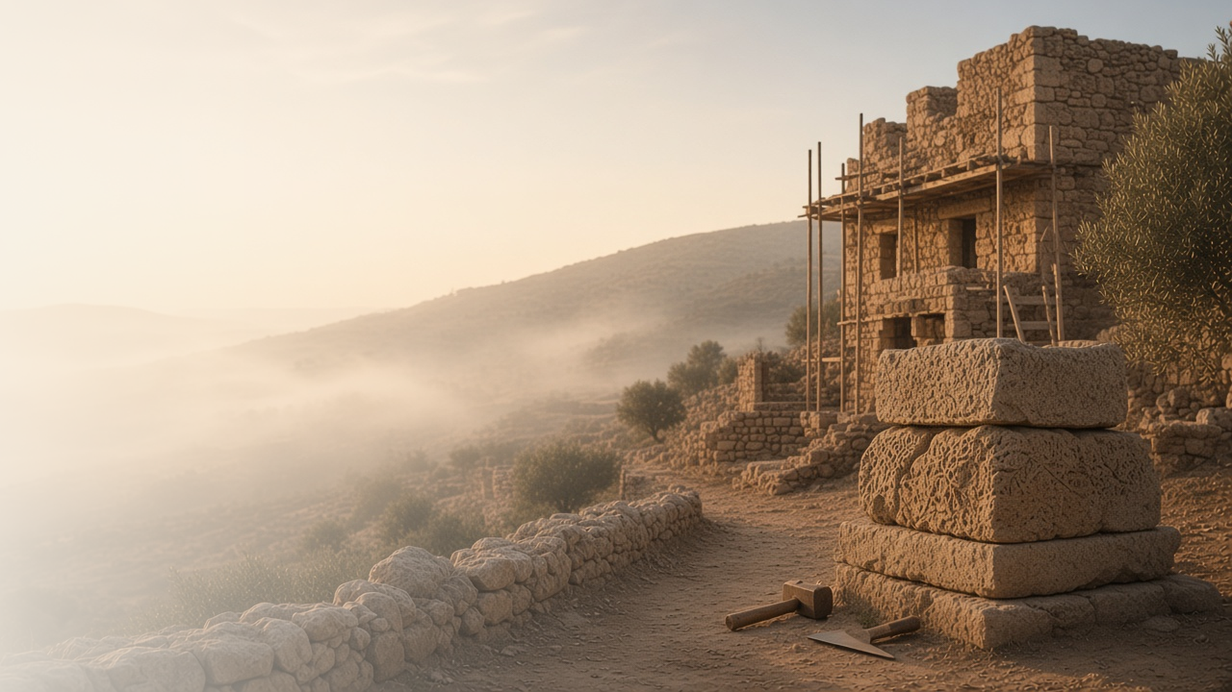
COME, FOLLOW ME · NEW TESTAMENT 2027
Gather Together in One
All Things in Christ
September 27–October 3
Ephesians
Notes:
TEACHING
Ephesians testifies that in the dispensation of the fulness of times, God will gather together all things in Christ. Paul teaches that the Church is built on the foundation of apostles and prophets with Christ as the chief corner stone, that Christ's love can strengthen families, and that the whole armour of God protects us against evil. This week falls on general conference weekend, and the manual invites listening for how prophets and apostles fulfill these purposes.
SCRIPTURE (KJV)
Ephesians 1:10
10 That in the dispensation of the fulness of times he might gather together in one all things in Christ, both which are in heaven, and which are on earth; even in him:
DISCUSSION
• What does it mean to you that God is gathering all things in Christ?
• What will you listen for in general conference this weekend?

Slide 2
EPHESIANS 1:10
The fulness of times
In the last dispensation, God gathers all things in Christ.
“That in the dispensation of the fulness of times he might gather together in one all things in Christ.”
EPHESIANS 1:10
Notes:
TEACHING
Paul foresaw a dispensation of the fulness of times when God would gather together in one all things in Christ, in heaven and on earth. Latter-day Saints see this gathering in the Restoration: the gospel, priesthood keys, temple work for the living and the dead, and the gathering of Israel. Discuss how we take part in that gathering.
SCRIPTURE (KJV)
Ephesians 1:9–10
9 Having made known unto us the mystery of his will, according to his good pleasure which he hath purposed in himself:
10 That in the dispensation of the fulness of times he might gather together in one all things in Christ, both which are in heaven, and which are on earth; even in him:
DISCUSSION (questions quoted from the manual)
• “Why do you think our time is called “the dispensation of the fulness of times”?”
• “What might it mean to “gather together in one all things in Christ”?”

Slide 3
EPHESIANS 2:19–22; 3:1–7; 4:4–8, 11–16
The chief corner stone
The Church is built on apostles and prophets, with Christ at its center.
“And are built upon the foundation of the apostles and prophets, Jesus Christ himself being the chief corner stone.”
EPHESIANS 2:20
Notes:
TEACHING
Paul pictures the Church as a building: strangers become fellow citizens, built on the foundation of apostles and prophets, with Jesus Christ as the chief corner stone. The Lord gave apostles, prophets, and others to perfect the Saints and keep them from being tossed by every wind of doctrine. Invite class members to listen in general conference for how prophets help us grow in unity.
SCRIPTURE (KJV)
Ephesians 2:19–22
19 Now therefore ye are no more strangers and foreigners, but fellowcitizens with the saints, and of the household of God;
20 And are built upon the foundation of the apostles and prophets, Jesus Christ himself being the chief corner stone;
21 In whom all the building fitly framed together groweth unto an holy temple in the Lord:
22 In whom ye also are builded together for an habitation of God through the Spirit.
Ephesians 4:11–14
11 And he gave some, apostles; and some, prophets; and some, evangelists; and some, pastors and teachers;
12 For the perfecting of the saints, for the work of the ministry, for the edifying of the body of Christ:
13 Till we all come in the unity of the faith, and of the knowledge of the Son of God, unto a perfect man, unto the measure of the stature of the fulness of Christ:
14 That we henceforth be no more children, tossed to and fro, and carried about with every wind of doctrine, by the sleight of men, and cunning craftiness, whereby they lie in wait to deceive;
DISCUSSION (questions quoted from the manual)
• “If someone asked you why we need prophets and apostles, what would you say?”
• “For example, how do they help you not be “carried about with every wind of doctrine”?”
• “How do they help us grow “in the unity of the faith, and of the knowledge of the Son of God”?”
• “How is Jesus Christ like a cornerstone for His Church?”
• “How is He like a cornerstone for your life?”

Slide 4
EPHESIANS 5:21–33; 6:1–4
As Christ loved the church
His example of love and sacrifice can strengthen our families.
“Husbands, love your wives, even as Christ also loved the church, and gave himself for it.”
EPHESIANS 5:25
Notes:
TEACHING
Paul begins with mutual submission, then holds up Christ's self-giving love for the Church as the pattern for husbands, and counsels children to honor parents and fathers not to provoke their children. The common thread is following the Savior's example of love and sacrifice in the home.
SCRIPTURE (KJV)
Ephesians 5:21–25
21 Submitting yourselves one to another in the fear of God.
22 Wives, submit yourselves unto your own husbands, as unto the Lord.
23 For the husband is the head of the wife, even as Christ is the head of the church: and he is the saviour of the body.
24 Therefore as the church is subject unto Christ, so let the wives be to their own husbands in every thing.
25 Husbands, love your wives, even as Christ also loved the church, and gave himself for it;
Ephesians 6:1–4
1 Children, obey your parents in the Lord: for this is right.
2 Honour thy father and mother; (which is the first commandment with promise;)
3 That it may be well with thee, and thou mayest live long on the earth.
4 And, ye fathers, provoke not your children to wrath: but bring them up in the nurture and admonition of the Lord.
DISCUSSION (questions quoted from the manual)
• “How does Christ show His love for the people of His Church?”
• “What does this imply about how spouses, as equal partners, should treat each other?”
• “What other messages do you find for yourself in these verses?”
• “What do you think it means to be raised “in the nurture and admonition of the Lord”?”

Slide 5
EPHESIANS 6:10–18
The whole armour of God
God’s armour protects us against spiritual danger.
“Put on the whole armour of God, that ye may be able to stand against the wiles of the devil.”
EPHESIANS 6:11
Notes:
TEACHING
Paul likens spiritual protection to a Roman soldier's armour: loins girt with truth, the breastplate of righteousness, feet shod with the gospel of peace, the shield of faith, the helmet of salvation, and the sword of the Spirit, the word of God, all joined with prayer. Discuss how each piece is put on daily.
SCRIPTURE (KJV)
Ephesians 6:10–18
10 Finally, my brethren, be strong in the Lord, and in the power of his might.
11 Put on the whole armour of God, that ye may be able to stand against the wiles of the devil.
12 For we wrestle not against flesh and blood, but against principalities, against powers, against the rulers of the darkness of this world, against spiritual wickedness in high places.
13 Wherefore take unto you the whole armour of God, that ye may be able to withstand in the evil day, and having done all, to stand.
14 Stand therefore, having your loins girt about with truth, and having on the breastplate of righteousness;
15 And your feet shod with the preparation of the gospel of peace;
16 Above all, taking the shield of faith, wherewith ye shall be able to quench all the fiery darts of the wicked.
17 And take the helmet of salvation, and the sword of the Spirit, which is the word of God:
18 Praying always with all prayer and supplication in the Spirit, and watching thereunto with all perseverance and supplication for all saints;
DISCUSSION (questions quoted from the manual)
• “How do you surround yourself with truth?”
• ““Breastplate of righteousness”: What does a breastplate protect?”
• “How has righteousness protected you?”
• ““Feet shod with the preparation of the gospel of peace”: What could feet symbolize?”
• ““Shield of faith”: How has your faith shielded you from Satan’s “fiery darts”?”
• ““Helmet of salvation”: What does a helmet protect?”
(+2 more in the manual)

Slide 6
EPHESIANS 4:13
“Till we all come in the unity of the faith,
and of the knowledge of the Son of God.”
Listen to general conference for ways prophets help us grow.
Notes:
TEACHING
Paul taught that apostles and prophets are given until we all come to the unity of the faith. This week is general conference weekend. Close by inviting class members to listen for how the Lord's servants help us grow in faith and unity.
SCRIPTURE (KJV)
Ephesians 4:11–14
11 And he gave some, apostles; and some, prophets; and some, evangelists; and some, pastors and teachers;
12 For the perfecting of the saints, for the work of the ministry, for the edifying of the body of Christ:
13 Till we all come in the unity of the faith, and of the knowledge of the Son of God, unto a perfect man, unto the measure of the stature of the fulness of Christ:
14 That we henceforth be no more children, tossed to and fro, and carried about with every wind of doctrine, by the sleight of men, and cunning craftiness, whereby they lie in wait to deceive;
DISCUSSION
• What do you hope to hear in general conference?
• How have prophets and apostles helped you stay steady?

