Slide 1
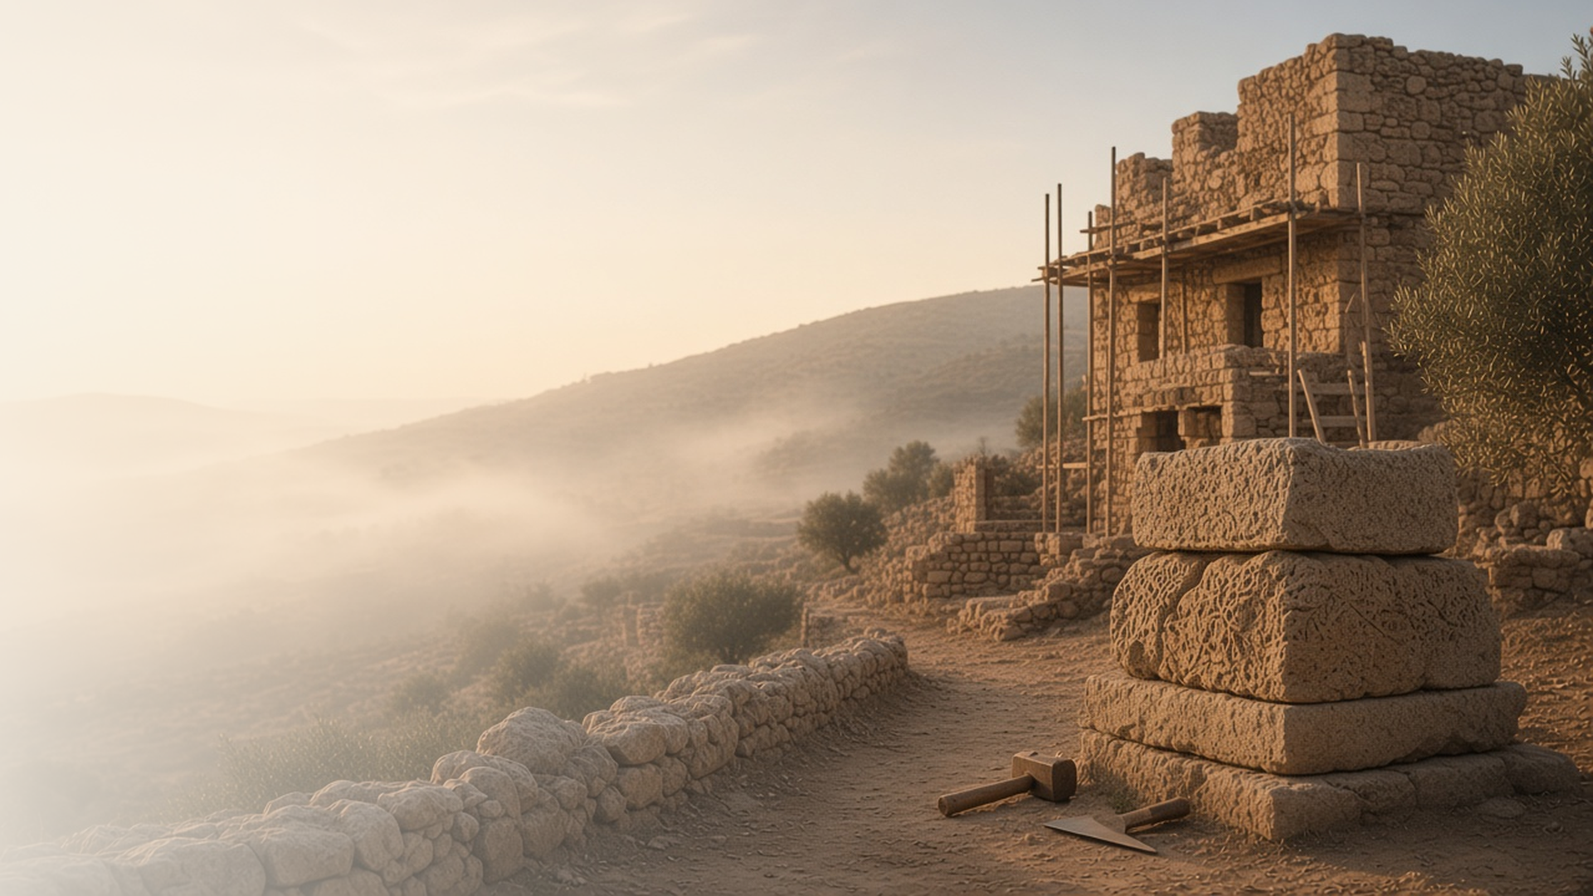
COME, FOLLOW ME · FOR CHILDREN
Gather Together in One
All Things in Christ
September 27–October 3
Ephesians
Notes:
TEACHING
This week children learn that Jesus Christ's Church is founded on prophets and apostles with Jesus as the chief cornerstone, that Heavenly Father wants them to obey their parents, and that the armour of God can protect them from evil. This week is general conference weekend.
SCRIPTURE (KJV)
Ephesians 2:19–20
19 Now therefore ye are no more strangers and foreigners, but fellowcitizens with the saints, and of the household of God;
20 And are built upon the foundation of the apostles and prophets, Jesus Christ himself being the chief corner stone;
DISCUSSION
• Who leads Jesus's Church today?
• What can you listen for in general conference?

Slide 2
EPHESIANS 2:20–22; 4:11–14
Built on prophets and apostles
Jesus is the chief cornerstone of His Church.
“Jesus Christ himself being the chief corner stone.”
EPHESIANS 2:20
Notes:
TEACHING
Build a church with blocks, starting with one important corner block for Jesus. Explain that a cornerstone holds the building together and that apostles and prophets are the foundation. Listen to general conference and add a block each time an apostle talks about Jesus.
SCRIPTURE (KJV)
Ephesians 2:19–22
19 Now therefore ye are no more strangers and foreigners, but fellowcitizens with the saints, and of the household of God;
20 And are built upon the foundation of the apostles and prophets, Jesus Christ himself being the chief corner stone;
21 In whom all the building fitly framed together groweth unto an holy temple in the Lord:
22 In whom ye also are builded together for an habitation of God through the Spirit.
DISCUSSION (questions quoted from the manual)
• “How are Jesus and His Apostles like a strong foundation for us in His Church?”

Slide 3
EPHESIANS 6:1–3
I can obey my parents
Heavenly Father wants me to honour my father and mother.
“Children, obey your parents in the Lord: for this is right.”
EPHESIANS 6:1
Notes:
TEACHING
Talk about ways children can obey and honor their parents, like listening, helping, and speaking kindly. Explain that Heavenly Father gave this commandment with a promise of blessings.
SCRIPTURE (KJV)
Ephesians 6:1–3
1 Children, obey your parents in the Lord: for this is right.
2 Honour thy father and mother; (which is the first commandment with promise;)
3 That it may be well with thee, and thou mayest live long on the earth.
DISCUSSION (questions quoted from the manual)
• (The manual gives no direct questions for this section.)
Suggested: What is one way you can obey your parents this week?

Slide 4
EPHESIANS 6:10–18
The armour of God
God’s armour helps keep me spiritually safe.
“Put on the whole armour of God.”
EPHESIANS 6:11
Notes:
TEACHING
Make simple paper armour pieces: a helmet, breastplate, shield, and sword. Explain what each stands for, such as faith for the shield and the scriptures for the sword. We put on God's armour by praying, reading scriptures, and choosing the right.
SCRIPTURE (KJV)
Ephesians 6:13–17
13 Wherefore take unto you the whole armour of God, that ye may be able to withstand in the evil day, and having done all, to stand.
14 Stand therefore, having your loins girt about with truth, and having on the breastplate of righteousness;
15 And your feet shod with the preparation of the gospel of peace;
16 Above all, taking the shield of faith, wherewith ye shall be able to quench all the fiery darts of the wicked.
17 And take the helmet of salvation, and the sword of the Spirit, which is the word of God:
DISCUSSION (questions quoted from the manual)
• “How do we put on the armor of God?”

Slide 5
EPHESIANS 6:11
“Put on the whole armour of God, that ye may
be able to stand against the wiles of the devil.”
Each morning this week, put on your armour of God.
Notes:
TEACHING
God's armour keeps us safe. Invite children to put on their armour each morning by praying and choosing the right.
SCRIPTURE (KJV)
Ephesians 6:11
11 Put on the whole armour of God, that ye may be able to stand against the wiles of the devil.
DISCUSSION
• How will you put on God's armour each morning?
• Which piece of armour is your favorite?

