Slide 1
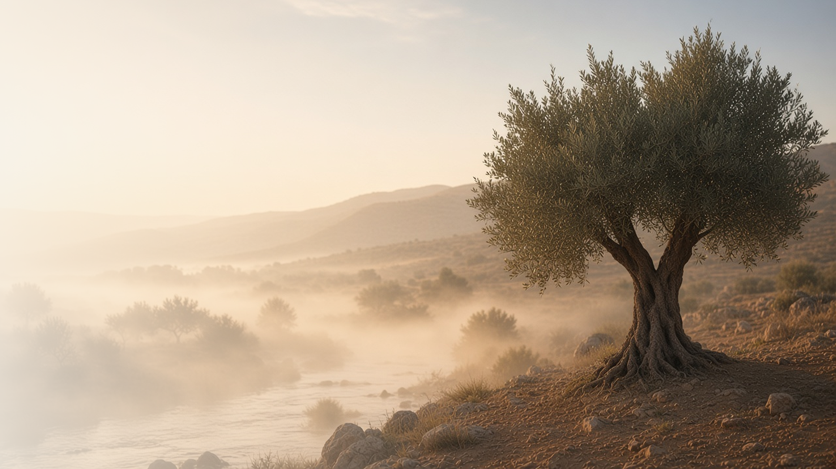
COME, FOLLOW ME · NEW TESTAMENT 2027
I Can Do All Things
Through Christ Which
Strengtheneth Me
October 4–10
Philippians; Colossians
Notes:
TEACHING
Paul wrote to the Philippians and Colossians while a prisoner, yet these letters overflow with joy and confidence in Christ. He testifies that God finishes the good work He begins in us, that knowing Christ is worth any sacrifice, that we can be content and strong in any circumstance through Him, and that covenants root us in Christ as we put on a new life.
SCRIPTURE (KJV)
Philippians 4:11–13
11 Not that I speak in respect of want: for I have learned, in whatsoever state I am, therewith to be content.
12 I know both how to be abased, and I know how to abound: every where and in all things I am instructed both to be full and to be hungry, both to abound and to suffer need.
13 I can do all things through Christ which strengtheneth me.
DISCUSSION
• How can Paul write about joy from a prison?
• Where do you need Christ's strength this week?

Slide 2
PHILIPPIANS 1:6; 2:12–13
A good work in you
God, who began a good work in us, will finish it.
“Being confident of this very thing, that he which hath begun a good work in you will perform it until the day of Jesus Christ.”
PHILIPPIANS 1:6
Notes:
TEACHING
Paul was confident that God, who had begun a good work in the Philippians, would carry it through. He also asked them to work out their salvation with fear and trembling, for it is God who works in them to will and to do. Discuss how God's work in us and our own effort fit together.
SCRIPTURE (KJV)
Philippians 1:6
6 Being confident of this very thing, that he which hath begun a good work in you will perform it until the day of Jesus Christ:
Philippians 2:12–13
12 Wherefore, my beloved, as ye have always obeyed, not as in my presence only, but now much more in my absence, work out your own salvation with fear and trembling.
13 For it is God which worketh in you both to will and to do of his good pleasure.
DISCUSSION (questions quoted from the manual)
• “What does Philippians 2:13 add to your understanding?”
• “How is “God [working] in you”?”

Slide 3
PHILIPPIANS 3:4–14
Worth every sacrifice
Paul counted all things loss to win Christ.
“I press toward the mark for the prize of the high calling of God in Christ Jesus.”
PHILIPPIANS 3:14
Notes:
TEACHING
Paul had impressive credentials, yet counted them as loss compared with the excellency of knowing Christ. Forgetting what was behind, he pressed toward the mark. Invite class members to consider what they have given up for Christ, and what they have gained.
SCRIPTURE (KJV)
Philippians 3:7–14
7 But what things were gain to me, those I counted loss for Christ.
8 Yea doubtless, and I count all things but loss for the excellency of the knowledge of Christ Jesus my Lord: for whom I have suffered the loss of all things, and do count them but dung, that I may win Christ,
9 And be found in him, not having mine own righteousness, which is of the law, but that which is through the faith of Christ, the righteousness which is of God by faith:
10 That I may know him, and the power of his resurrection, and the fellowship of his sufferings, being made conformable unto his death;
11 If by any means I might attain unto the resurrection of the dead.
12 Not as though I had already attained, either were already perfect: but I follow after, if that I may apprehend that for which also I am apprehended of Christ Jesus.
13 Brethren, I count not myself to have apprehended: but this one thing I do, forgetting those things which are behind, and reaching forth unto those things which are before,
14 I press toward the mark for the prize of the high calling of God in Christ Jesus.
DISCUSSION (questions quoted from the manual)
• “How did Paul feel about his sacrifices? (see verses 8, 13–14).”
• “What have you sacrificed for the gospel of Jesus Christ?”
• “What have you received?”
• “Are there any sacrifices you feel inspired to make to become a more dedicated disciple of the Savior?”

Slide 4
PHILIPPIANS 4:1–13
Content in every state
Christ gives joy and strength in any circumstance.
“For I have learned, in whatsoever state I am, therewith to be content.”
PHILIPPIANS 4:11
Notes:
TEACHING
Paul invited the Saints to rejoice always, to take everything to God in prayer, and to receive the peace that passes understanding. He had learned to be content whether he had plenty or little. Discuss how the Savior helps us find joy and contentment when circumstances do not change.
SCRIPTURE (KJV)
Philippians 4:4–13
4 Rejoice in the Lord alway: and again I say, Rejoice.
5 Let your moderation be known unto all men. The Lord is at hand.
6 Be careful for nothing; but in every thing by prayer and supplication with thanksgiving let your requests be made known unto God.
7 And the peace of God, which passeth all understanding, shall keep your hearts and minds through Christ Jesus.
8 Finally, brethren, whatsoever things are true, whatsoever things are honest, whatsoever things are just, whatsoever things are pure, whatsoever things are lovely, whatsoever things are of good report; if there be any virtue, and if there be any praise, think on these things.
9 Those things, which ye have both learned, and received, and heard, and seen in me, do: and the God of peace shall be with you.
10 But I rejoiced in the Lord greatly, that now at the last your care of me hath flourished again; wherein ye were also careful, but ye lacked opportunity.
11 Not that I speak in respect of want: for I have learned, in whatsoever state I am, therewith to be content.
12 I know both how to be abased, and I know how to abound: every where and in all things I am instructed both to be full and to be hungry, both to abound and to suffer need.
13 I can do all things through Christ which strengtheneth me.
DISCUSSION (questions quoted from the manual)
• “What do you find in Paul’s words that gives you courage?”
• “What reasons do you have to rejoice because of Jesus Christ?”

Slide 5
COLOSSIANS 1:12–23; 2:2–8
Rooted in Him
Covenants keep us rooted, built up, and settled in Christ.
“Rooted and built up in him, and stablished in the faith, as ye have been taught, abounding therein with thanksgiving.”
COLOSSIANS 2:7
Notes:
TEACHING
Paul warned the Colossians against philosophies that would spoil them and urged them to stay grounded and settled, rooted and built up in Christ. Like roots, covenants anchor us and draw nourishment to us. Invite class members to share how their covenants keep them steady.
SCRIPTURE (KJV)
Colossians 1:21–23
21 And you, that were sometime alienated and enemies in your mind by wicked works, yet now hath he reconciled
22 In the body of his flesh through death, to present you holy and unblameable and unreproveable in his sight:
23 If ye continue in the faith grounded and settled, and be not moved away from the hope of the gospel, which ye have heard, and which was preached to every creature which is under heaven; whereof I Paul am made a minister;
Colossians 2:6–8
6 As ye have therefore received Christ Jesus the Lord, so walk ye in him:
7 Rooted and built up in him, and stablished in the faith, as ye have been taught, abounding therein with thanksgiving.
8 Beware lest any man spoil you through philosophy and vain deceit, after the tradition of men, after the rudiments of the world, and not after Christ.
Restoration scripture (public-domain text: bcbooks/scriptures-json)
Helaman 5:12 (Book of Mormon)
12 And now, my sons, remember, remember that it is upon the rock of our Redeemer, who is Christ, the Son of God, that ye must build your foundation; that when the devil shall send forth his mighty winds, yea, his shafts in the whirlwind, yea, when all his hail and his mighty storm shall beat upon you, it shall have no power over you to drag you down to the gulf of misery and endless wo, because of the rock upon which ye are built, which is a sure foundation, a foundation whereon if men build they cannot fall.
Ether 12:4 (Book of Mormon)
4 Wherefore, whoso believeth in God might with surety hope for a better world, yea, even a place at the right hand of God, which hope cometh of faith, maketh an anchor to the souls of men, which would make them sure and steadfast, always abounding in good works, being led to glorify God.
DISCUSSION (questions quoted from the manual)
• “How do your covenants bring you closer to Jesus Christ?”
• “What do you know about Him because of those covenants?”
• “How does being “rooted and built up” in Jesus Christ strengthen you against adversity? (see Colossians 2:7–8; see also Helaman 5:12; Ether 12:4).”
• “How can you review, remember, or renew your covenants more often?”

Slide 6
COLOSSIANS 3:1–17
Put on the new man
Living the gospel helps us put off the old and become new.
“And above all these things put on charity, which is the bond of perfectness.”
COLOSSIANS 3:14
Notes:
TEACHING
Paul uses the image of changing clothes: put off anger, malice, and lying, and put on mercy, kindness, humility, meekness, and long-suffering, above all charity. Let the peace of God rule in your hearts. Invite class members to choose one quality to put on this week.
SCRIPTURE (KJV)
Colossians 3:1–17
1 If ye then be risen with Christ, seek those things which are above, where Christ sitteth on the right hand of God.
2 Set your affection on things above, not on things on the earth.
3 For ye are dead, and your life is hid with Christ in God.
4 When Christ, who is our life, shall appear, then shall ye also appear with him in glory.
5 Mortify therefore your members which are upon the earth; fornication, uncleanness, inordinate affection, evil concupiscence, and covetousness, which is idolatry:
6 For which things’ sake the wrath of God cometh on the children of disobedience:
7 In the which ye also walked some time, when ye lived in them.
8 But now ye also put off all these; anger, wrath, malice, blasphemy, filthy communication out of your mouth.
9 Lie not one to another, seeing that ye have put off the old man with his deeds;
10 And have put on the new man, which is renewed in knowledge after the image of him that created him:
11 Where there is neither Greek nor Jew, circumcision nor uncircumcision, Barbarian, Scythian, bond nor free: but Christ is all, and in all.
12 Put on therefore, as the elect of God, holy and beloved, bowels of mercies, kindness, humbleness of mind, meekness, longsuffering;
13 Forbearing one another, and forgiving one another, if any man have a quarrel against any: even as Christ forgave you, so also do ye.
14 And above all these things put on charity, which is the bond of perfectness.
15 And let the peace of God rule in your hearts, to the which also ye are called in one body; and be ye thankful.
16 Let the word of Christ dwell in you richly in all wisdom; teaching and admonishing one another in psalms and hymns and spiritual songs, singing with grace in your hearts to the Lord.
17 And whatsoever ye do in word or deed, do all in the name of the Lord Jesus, giving thanks to God and the Father by him.
DISCUSSION (questions quoted from the manual)
• “For example, how can you “seek those things which are above”?”
• “How do the Savior and His gospel renew you?”
• “What else do these verses inspire you to do?”

Slide 7
PHILIPPIANS 4:13
“I can do all things through Christ
which strengtheneth me.”
Name one hard thing this week and face it with Christ’s strength.
Notes:
TEACHING
Paul's famous declaration comes right after he describes learning contentment in both want and plenty. Christ's strength is not only for great achievements but for faithful endurance. Close by inviting class members to face one hard thing this week with His strength.
SCRIPTURE (KJV)
Philippians 4:13
13 I can do all things through Christ which strengtheneth me.
DISCUSSION
• What hard thing will you face with His strength?
• When have you felt Christ strengthen you?

