Slide 1
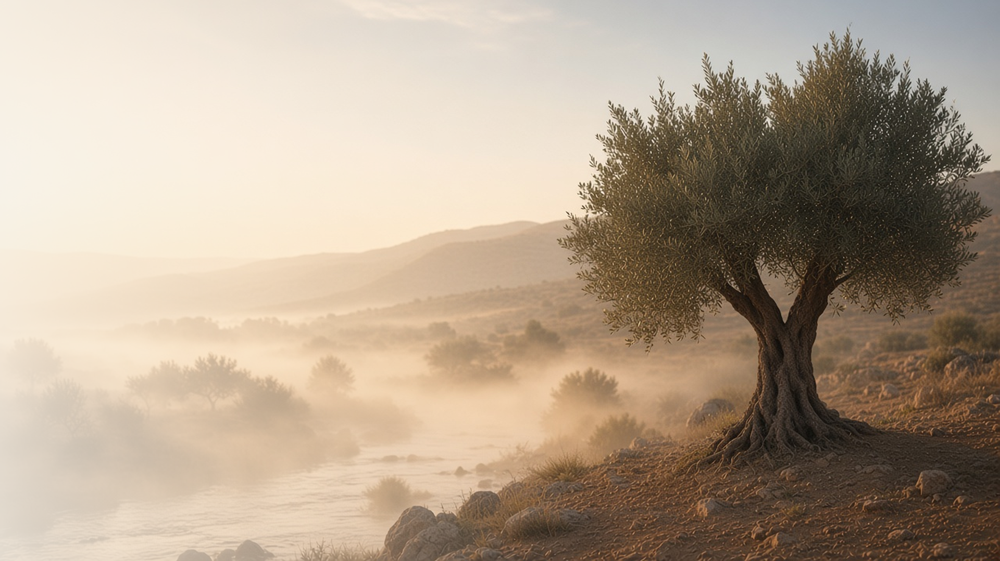
COME, FOLLOW ME · FOR CHILDREN
I Can Do All Things
Through Christ Which
Strengtheneth Me
October 4–10
Philippians; Colossians
Notes:
TEACHING
This week children learn that with faith in Jesus Christ they can be happy even during hard times, that they can think about things that are true and good, and that their covenants help them stay rooted in Jesus.
SCRIPTURE (KJV)
Philippians 4:13
13 I can do all things through Christ which strengtheneth me.
DISCUSSION
• What can Jesus help you do?
• How can you be happy when things are hard?

Slide 2
PHILIPPIANS 4:4–13
Happy in hard times
With Jesus, I can have joy even when things are hard.
“Rejoice in the Lord alway: and again I say, Rejoice.”
PHILIPPIANS 4:4
Notes:
TEACHING
Explain that Paul was in prison when he wrote these words, but he still felt joy because of Jesus. Talk about hard things children face and how Jesus can help them feel peace and happiness.
SCRIPTURE (KJV)
Philippians 4:4–7
4 Rejoice in the Lord alway: and again I say, Rejoice.
5 Let your moderation be known unto all men. The Lord is at hand.
6 Be careful for nothing; but in every thing by prayer and supplication with thanksgiving let your requests be made known unto God.
7 And the peace of God, which passeth all understanding, shall keep your hearts and minds through Christ Jesus.
DISCUSSION (questions quoted from the manual)
• “How can our faith in Jesus Christ help us with something hard in our lives right now?”

Slide 3
PHILIPPIANS 4:8
I can think good thoughts
I can think about things that are true, kind, and lovely.
“Whatsoever things are true, whatsoever things are honest, whatsoever things are just, whatsoever things are pure.”
PHILIPPIANS 4:8
Notes:
TEACHING
Read Philippians 4:8 and make a list of good things to think about: true, honest, pure, and lovely things. Talk about what to do when a bad thought comes, like singing a Primary song.
SCRIPTURE (KJV)
Philippians 4:8
8 Finally, brethren, whatsoever things are true, whatsoever things are honest, whatsoever things are just, whatsoever things are pure, whatsoever things are lovely, whatsoever things are of good report; if there be any virtue, and if there be any praise, think on these things.
DISCUSSION (questions quoted from the manual)
• “Why should we “think on” these things?”
• “How can we “seek after” them?”

Slide 4
COLOSSIANS 1:23; 2:6–7
Rooted in Jesus
My covenants help me stay close to Jesus, like roots.
“Rooted and built up in him.”
COLOSSIANS 2:7
Notes:
TEACHING
Show a plant with its roots. Roots hold a plant steady in wind and help it drink water. Our baptism covenant and keeping the commandments are like roots that keep us close to Jesus.
SCRIPTURE (KJV)
Colossians 2:6–7
6 As ye have therefore received Christ Jesus the Lord, so walk ye in him:
7 Rooted and built up in him, and stablished in the faith, as ye have been taught, abounding therein with thanksgiving.
DISCUSSION (questions quoted from the manual)
• “How are our covenants with God like the roots of a tree?”
• “How does keeping our covenants help us withstand spiritual storms, such as temptations and hard times?”

Slide 5
PHILIPPIANS 4:13
“I can do all things through Christ
which strengtheneth me.”
When something is hard, remember Jesus can help you.
Notes:
TEACHING
Jesus can help us do hard things. Invite children to remember this verse when something is hard this week.
SCRIPTURE (KJV)
Philippians 4:13
13 I can do all things through Christ which strengtheneth me.
DISCUSSION
• What hard thing can Jesus help you with?
• How can you remember this verse?

