Slide 1
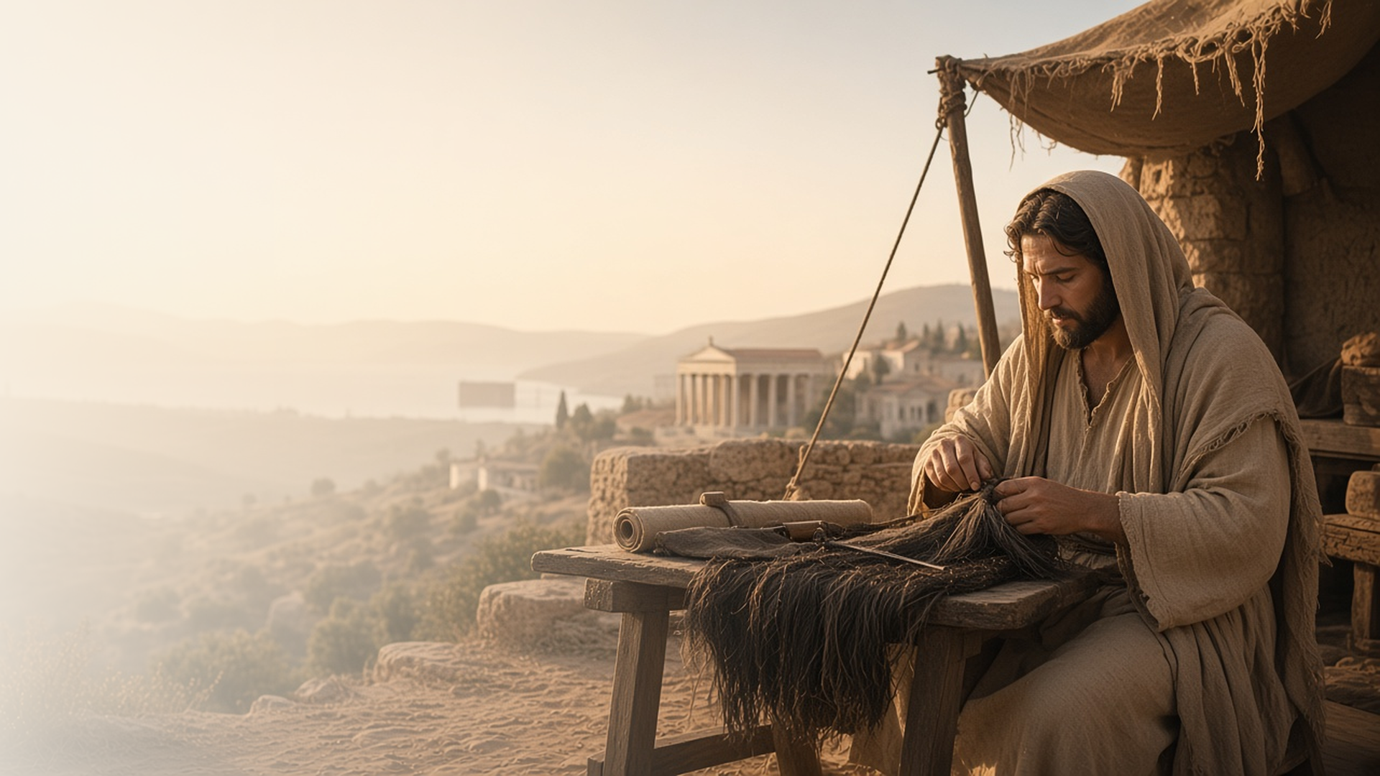
COME, FOLLOW ME · NEW TESTAMENT 2027
Perfect That Which Is
Lacking in Your Faith
October 11–17
1 and 2 Thessalonians
Notes:
TEACHING
Paul's letters to the Thessalonians are among his earliest. He recalls serving them with gentleness and sincerity, prays that they will increase in love and holiness, counsels them to work with their own hands, comforts them about the Second Coming, and warns that a falling away must come first. Throughout, he longs to help perfect what is lacking in their faith.
SCRIPTURE (KJV)
1 Thessalonians 3:10–13
10 Night and day praying exceedingly that we might see your face, and might perfect that which is lacking in your faith?
11 Now God himself and our Father, and our Lord Jesus Christ, direct our way unto you.
12 And the Lord make you to increase and abound in love one toward another, and toward all men, even as we do toward you:
13 To the end he may stablish your hearts unblameable in holiness before God, even our Father, at the coming of our Lord Jesus Christ with all his saints.
DISCUSSION
• What might be lacking in your faith, and how could it be strengthened?
• How do these letters help you prepare for the Second Coming?

Slide 2
1 THESSALONIANS 1:1–5; 2:1–13
Gentle among you
Paul served the Saints with sincerity, like a nursing mother.
“But we were gentle among you, even as a nurse cherisheth her children.”
1 THESSALONIANS 2:7
Notes:
TEACHING
Paul reminded the Thessalonians that he came not with flattery or for gain but in sincerity, gentle as a nurse cherishing her children, and that they received his words as the word of God. Discuss how the Lord's servants, and each of us in callings and ministering, can serve with that kind of sincerity and love.
SCRIPTURE (KJV)
1 Thessalonians 1:5
5 For our gospel came not unto you in word only, but also in power, and in the Holy Ghost, and in much assurance; as ye know what manner of men we were among you for your sake.
1 Thessalonians 2:7–13
7 But we were gentle among you, even as a nurse cherisheth her children:
8 So being affectionately desirous of you, we were willing to have imparted unto you, not the gospel of God only, but also our own souls, because ye were dear unto us.
9 For ye remember, brethren, our labour and travail: for labouring night and day, because we would not be chargeable unto any of you, we preached unto you the gospel of God.
10 Ye are witnesses, and God also, how holily and justly and unblameably we behaved ourselves among you that believe:
11 As ye know how we exhorted and comforted and charged every one of you, as a father doth his children,
12 That ye would walk worthy of God, who hath called you unto his kingdom and glory.
13 For this cause also thank we God without ceasing, because, when ye received the word of God which ye heard of us, ye received it not as the word of men, but as it is in truth, the word of God, which effectually worketh also in you that believe.
DISCUSSION (questions quoted from the manual)
• “When have you seen these principles make a difference in the Lord’s work?”

Slide 3
1 THESSALONIANS 3:9–13; 4:1–12
Increase more and more
As we follow Christ, He makes our hearts holy.
“And the Lord make you to increase and abound in love one toward another, and toward all men, even as we do toward you.”
1 THESSALONIANS 3:12
Notes:
TEACHING
Paul prayed that the Lord would make the Saints increase in love and establish their hearts unblameable in holiness. He urged them to abound more and more and taught that God has called us to holiness, including sexual purity. Holiness is a gradual work the Savior does with us.
SCRIPTURE (KJV)
1 Thessalonians 3:12–13
12 And the Lord make you to increase and abound in love one toward another, and toward all men, even as we do toward you:
13 To the end he may stablish your hearts unblameable in holiness before God, even our Father, at the coming of our Lord Jesus Christ with all his saints.
1 Thessalonians 4:1–7
1 Furthermore then we beseech you, brethren, and exhort you by the Lord Jesus, that as ye have received of us how ye ought to walk and to please God, so ye would abound more and more.
2 For ye know what commandments we gave you by the Lord Jesus.
3 For this is the will of God, even your sanctification, that ye should abstain from fornication:
4 That every one of you should know how to possess his vessel in sanctification and honour;
5 Not in the lust of concupiscence, even as the Gentiles which know not God:
6 That no man go beyond and defraud his brother in any matter: because that the Lord is the avenger of all such, as we also have forewarned you and testified.
7 For God hath not called us unto uncleanness, but unto holiness.
DISCUSSION (questions quoted from the manual)
• “What do you learn from these verses about words like “holiness” and “sanctification”?”
• “How can you receive the Savior’s sanctifying power?”
• “What role do ordinances and covenants play in our efforts to become more holy?”
• “What does it take to become holy?”
• “Nelson suggested asking, “What would a holy [person] do?” (“One Question That Can Change Your Life” [worldwide devotional for young adults, May 15, 2022], Gospel Library).”
• “How might you apply this question in your effort to become holy through the Savior’s power?”

Slide 4
1 THESSALONIANS 4:10–12; 2 THESSALONIANS 3:7–13
Work with your own hands
The Lord wants us to work, provide, and help those in need.
“And that ye study to be quiet, and to do your own business, and to work with your own hands, as we commanded you.”
1 THESSALONIANS 4:11
Notes:
TEACHING
Some Thessalonians apparently stopped working while waiting for the Second Coming. Paul reminded them that he had worked night and day so as not to burden anyone, and taught that if any would not work, neither should he eat. Self-reliance lets us provide for ourselves and lift others.
SCRIPTURE (KJV)
1 Thessalonians 4:10–12
10 And indeed ye do it toward all the brethren which are in all Macedonia: but we beseech you, brethren, that ye increase more and more;
11 And that ye study to be quiet, and to do your own business, and to work with your own hands, as we commanded you;
12 That ye may walk honestly toward them that are without, and that ye may have lack of nothing.
2 Thessalonians 3:7–13
7 For yourselves know how ye ought to follow us: for we behaved not ourselves disorderly among you;
8 Neither did we eat any man’s bread for nought; but wrought with labour and travail night and day, that we might not be chargeable to any of you:
9 Not because we have not power, but to make ourselves an ensample unto you to follow us.
10 For even when we were with you, this we commanded you, that if any would not work, neither should he eat.
11 For we hear that there are some which walk among you disorderly, working not at all, but are busybodies.
12 Now them that are such we command and exhort by our Lord Jesus Christ, that with quietness they work, and eat their own bread.
13 But ye, brethren, be not weary in well doing.
DISCUSSION (questions quoted from the manual)
• “What are the consequences of idleness?”
• “What are the blessings of work?”
• “What do you think Paul meant by the words “quiet” and “quietness”? (1 Thessalonians 4:11; 2 Thessalonians 3:12).”

Slide 5
1 THESSALONIANS 4:16–18; 5:1–10; 2 THESSALONIANS 1:4–10
Children of light
Watchful, faithful Saints need not fear His coming.
“Ye are all the children of light, and the children of the day: we are not of the night, nor of darkness.”
1 THESSALONIANS 5:5
Notes:
TEACHING
Paul comforted Saints grieving for loved ones: the dead in Christ will rise first. The day of the Lord will come like a thief in the night, but not for children of light who watch and stay sober, wearing the breastplate of faith and love and the helmet of hope.
SCRIPTURE (KJV)
1 Thessalonians 4:16–18
16 For the Lord himself shall descend from heaven with a shout, with the voice of the archangel, and with the trump of God: and the dead in Christ shall rise first:
17 Then we which are alive and remain shall be caught up together with them in the clouds, to meet the Lord in the air: and so shall we ever be with the Lord.
18 Wherefore comfort one another with these words.
1 Thessalonians 5:1–8
1 But of the times and the seasons, brethren, ye have no need that I write unto you.
2 For yourselves know perfectly that the day of the Lord so cometh as a thief in the night.
3 For when they shall say, Peace and safety; then sudden destruction cometh upon them, as travail upon a woman with child; and they shall not escape.
4 But ye, brethren, are not in darkness, that that day should overtake you as a thief.
5 Ye are all the children of light, and the children of the day: we are not of the night, nor of darkness.
6 Therefore let us not sleep, as do others; but let us watch and be sober.
7 For they that sleep sleep in the night; and they that be drunken are drunken in the night.
8 But let us, who are of the day, be sober, putting on the breastplate of faith and love; and for an helmet, the hope of salvation.
DISCUSSION (questions quoted from the manual)
• “What additional truths do you learn from 1 Thessalonians 4:16–18; 5:1–10; 2 Thessalonians 1:4–10?”
• “What are you prompted to do to watch and prepare for the Savior’s coming?”

Slide 6
2 THESSALONIANS 2
A falling away first
Paul foretold an apostasy before the Second Coming.
“Let no man deceive you by any means: for that day shall not come, except there come a falling away first.”
2 THESSALONIANS 2:3
Notes:
TEACHING
Some thought the day of Christ was already at hand. Paul corrected them: that day would not come until there was first a falling away. Latter-day Saints see in this prophecy the Great Apostasy that preceded the Restoration of the gospel. Discuss how understanding the apostasy deepens gratitude for the Restoration.
SCRIPTURE (KJV)
2 Thessalonians 2:1–3
1 Now we beseech you, brethren, by the coming of our Lord Jesus Christ, and by our gathering together unto him,
2 That ye be not soon shaken in mind, or be troubled, neither by spirit, nor by word, nor by letter as from us, as that the day of Christ is at hand.
3 Let no man deceive you by any means: for that day shall not come, except there come a falling away first, and that man of sin be revealed, the son of perdition;
DISCUSSION (questions quoted from the manual)
• “In 2 Thessalonians 2, what does Paul suggest about how personal apostasy can happen? (see verses 9–10).”
• “How does he suggest we can avoid it? (see verses 15–17).”

Slide 7
1 THESSALONIANS 3:10
“That we might see your face, and might perfect
that which is lacking in your faith?”
Choose one way to strengthen your faith this week.
Notes:
TEACHING
Paul prayed night and day for the chance to perfect what was lacking in the Thessalonians' faith. Close by inviting class members to choose one way to strengthen their faith this week.
SCRIPTURE (KJV)
1 Thessalonians 3:9–13
9 For what thanks can we render to God again for you, for all the joy wherewith we joy for your sakes before our God;
10 Night and day praying exceedingly that we might see your face, and might perfect that which is lacking in your faith?
11 Now God himself and our Father, and our Lord Jesus Christ, direct our way unto you.
12 And the Lord make you to increase and abound in love one toward another, and toward all men, even as we do toward you:
13 To the end he may stablish your hearts unblameable in holiness before God, even our Father, at the coming of our Lord Jesus Christ with all his saints.
DISCUSSION
• What will you do this week to strengthen your faith?
• How can you help strengthen someone else's faith?

