Slide 1
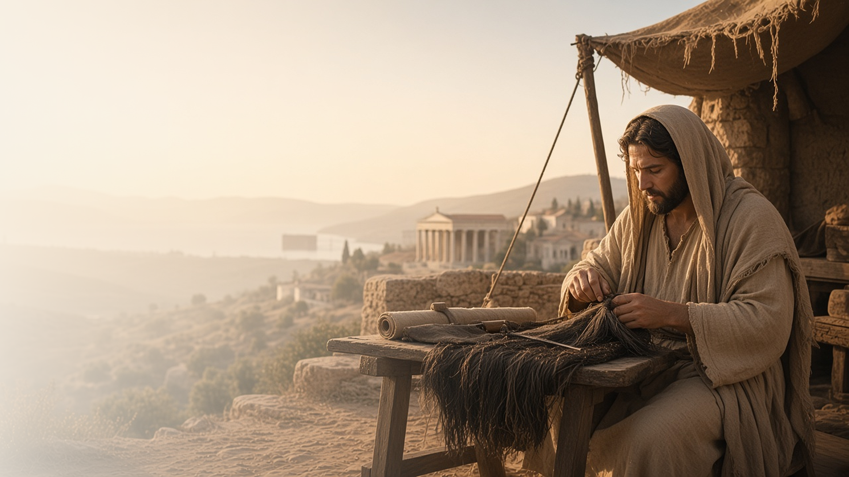
COME, FOLLOW ME · FOR CHILDREN
Perfect That Which Is
Lacking in Your Faith
October 11–17
1 and 2 Thessalonians
Notes:
TEACHING
This week children learn that they can prepare for the Second Coming by following God's commandments, that Paul foretold an apostasy before Jesus comes again, and that Heavenly Father wants them to learn to work.
SCRIPTURE (KJV)
1 Thessalonians 5:5–6
5 Ye are all the children of light, and the children of the day: we are not of the night, nor of darkness.
6 Therefore let us not sleep, as do others; but let us watch and be sober.
DISCUSSION
• How can we get ready for Jesus to come again?
• Why is it good to learn to work?

Slide 2
1 THESSALONIANS 5:1–6
I can be ready for Jesus
Keeping the commandments helps me prepare for Him.
“Therefore let us not sleep, as do others; but let us watch and be sober.”
1 THESSALONIANS 5:6
Notes:
TEACHING
Explain that nobody knows exactly when Jesus will come again. Paul taught that we can be ready, like someone awake and watching. Help children list commandments that help them get ready.
SCRIPTURE (KJV)
1 Thessalonians 5:2, 5–6
2 For yourselves know perfectly that the day of the Lord so cometh as a thief in the night.
5 Ye are all the children of light, and the children of the day: we are not of the night, nor of darkness.
6 Therefore let us not sleep, as do others; but let us watch and be sober.
Full passage: 1 Thessalonians 5:1–6
DISCUSSION (questions quoted from the manual)
• “How did you get ready?”
• “How did you know when it was almost time?”
• “How could they prepare for His visit?”

Slide 3
2 THESSALONIANS 2:1–3
Paul foretold an apostasy
Some people would turn away from Jesus’s truth for a time.
“Let no man deceive you by any means.”
2 THESSALONIANS 2:3
Notes:
TEACHING
Build a small tower of blocks labeled with gospel truths, then remove some to show what happened when people lost truths after the Apostles died. Explain that Heavenly Father and Jesus restored those truths through the Prophet Joseph Smith.
SCRIPTURE (KJV)
2 Thessalonians 2:1–3
1 Now we beseech you, brethren, by the coming of our Lord Jesus Christ, and by our gathering together unto him,
2 That ye be not soon shaken in mind, or be troubled, neither by spirit, nor by word, nor by letter as from us, as that the day of Christ is at hand.
3 Let no man deceive you by any means: for that day shall not come, except there come a falling away first, and that man of sin be revealed, the son of perdition;
DISCUSSION (questions quoted from the manual)
• (The manual gives no direct questions for this section.)
Suggested: Why are you grateful that Jesus restored His Church?

Slide 4
2 THESSALONIANS 3:7–13
I can learn to work
Heavenly Father wants me to work and help others.
“But ye, brethren, be not weary in well doing.”
2 THESSALONIANS 3:13
Notes:
TEACHING
Tell how Paul worked hard making tents so he could provide for himself. Talk about jobs children can do at home and how working helps them and their families.
SCRIPTURE (KJV)
2 Thessalonians 3:10, 13
10 For even when we were with you, this we commanded you, that if any would not work, neither should he eat.
13 But ye, brethren, be not weary in well doing.
Full passage: 2 Thessalonians 3:10–13
Restoration scripture (public-domain text: bcbooks/scriptures-json)
Doctrine and Covenants 64:33–34 (Doctrine and Covenants)
33 Wherefore, be not weary in well-doing, for ye are laying the foundation of a great work. And out of small things proceedeth that which is great.
34 Behold, the Lord requireth the heart and a willing mind; and the willing and obedient shall eat the good of the land of Zion in these last days.
DISCUSSION (questions quoted from the manual)
• “Why does Heavenly Father want us to work?”
• “What would happen if we never learned to work hard?”
• “How did they feel when they completed it?”
• “What does it mean to “be not weary in well doing”? (2 Thessalonians 3:13; see also Doctrine and Covenants 64:33–34).”

Slide 5
2 THESSALONIANS 3:13
“But ye, brethren, be not weary in well doing.”
Help with one job at home this week, cheerfully.
Notes:
TEACHING
Paul taught us not to get tired of doing good. Invite children to help with one job at home this week.
SCRIPTURE (KJV)
2 Thessalonians 3:13
13 But ye, brethren, be not weary in well doing.
DISCUSSION
• What job can you help with?
• How does working help your family?

