Slide 1
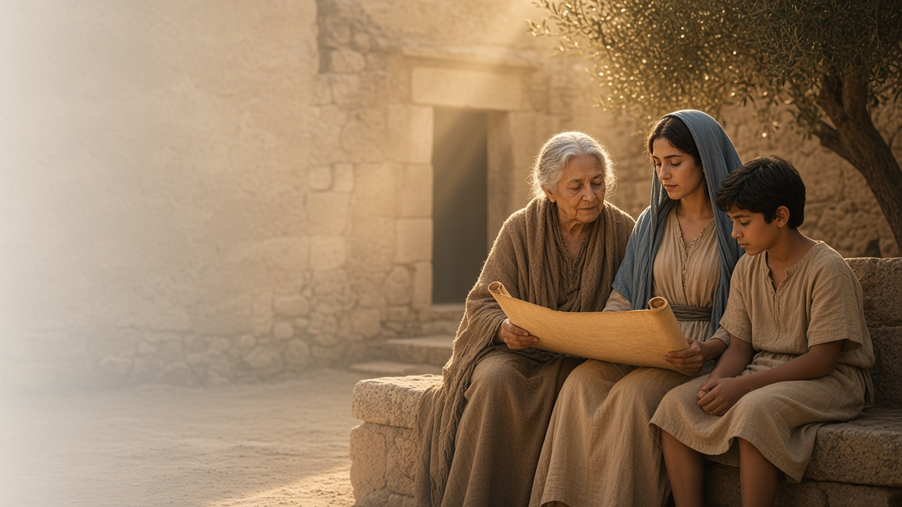
COME, FOLLOW ME · NEW TESTAMENT 2027
Be Thou an
Example of
the Believers
October 18–24
1 and 2 Timothy; Titus; Philemon
Notes:
TEACHING
Paul's letters to Timothy and Titus counsel younger leaders, and his short letter to Philemon pleads for a runaway servant. Paul testifies of the Savior's abundant grace, urges Timothy to be an example and not neglect his gift, warns of perilous last days and points to the scriptures, reminds him that God gives power and love rather than fear, and asks Philemon to receive Onesimus as a brother.
SCRIPTURE (KJV)
1 Timothy 4:12
12 Let no man despise thy youth; but be thou an example of the believers, in word, in conversation, in charity, in spirit, in faith, in purity.
DISCUSSION
• Who has been an example of the believers for you?
• Which of Paul's counsels to Timothy do you need most?

Slide 2
1 TIMOTHY 1:12–16; TITUS 2:13–14; 3:3–7
Grace abundant
Paul, once a persecutor, testified of Christ’s abundant grace.
“That Christ Jesus came into the world to save sinners; of whom I am chief.”
1 TIMOTHY 1:15
Notes:
TEACHING
Paul never forgot that he had been a blasphemer and persecutor, yet he obtained mercy, and the grace of the Lord was exceeding abundant. He saw himself as a pattern of how far the Savior's grace can reach. Discuss what Paul's example teaches about anyone's ability to change through Christ.
SCRIPTURE (KJV)
1 Timothy 1:12–16
12 And I thank Christ Jesus our Lord, who hath enabled me, for that he counted me faithful, putting me into the ministry;
13 Who was before a blasphemer, and a persecutor, and injurious: but I obtained mercy, because I did it ignorantly in unbelief.
14 And the grace of our Lord was exceeding abundant with faith and love which is in Christ Jesus.
15 This is a faithful saying, and worthy of all acceptation, that Christ Jesus came into the world to save sinners; of whom I am chief.
16 Howbeit for this cause I obtained mercy, that in me first Jesus Christ might shew forth all longsuffering, for a pattern to them which should hereafter believe on him to life everlasting.
Titus 3:3–7
3 For we ourselves also were sometimes foolish, disobedient, deceived, serving divers lusts and pleasures, living in malice and envy, hateful, and hating one another.
4 But after that the kindness and love of God our Saviour toward man appeared,
5 Not by works of righteousness which we have done, but according to his mercy he saved us, by the washing of regeneration, and renewing of the Holy Ghost;
6 Which he shed on us abundantly through Jesus Christ our Saviour;
7 That being justified by his grace, we should be made heirs according to the hope of eternal life.
DISCUSSION (questions quoted from the manual)
• “What experiences have taught you that His grace is “abundant,” or plentiful?”
• “What do you learn from Titus 2:13–14; 3:3–7 about the effect the Savior’s grace can have on your life?”

Slide 3
1 TIMOTHY 4:10–16; TITUS 2:7–8
An example of the believers
Timothy was young, yet could lead by example.
“Let no man despise thy youth; but be thou an example of the believers.”
1 TIMOTHY 4:12
Notes:
TEACHING
Timothy was young for his responsibilities. Paul told him not to let anyone despise his youth but to be an example in word, conduct, charity, spirit, faith, and purity, and to give attention to reading and doctrine. Invite class members to consider which of these areas they want to strengthen.
SCRIPTURE (KJV)
1 Timothy 4:10–16
10 For therefore we both labour and suffer reproach, because we trust in the living God, who is the Saviour of all men, specially of those that believe.
11 These things command and teach.
12 Let no man despise thy youth; but be thou an example of the believers, in word, in conversation, in charity, in spirit, in faith, in purity.
13 Till I come, give attendance to reading, to exhortation, to doctrine.
14 Neglect not the gift that is in thee, which was given thee by prophecy, with the laying on of the hands of the presbytery.
15 Meditate upon these things; give thyself wholly to them; that thy profiting may appear to all.
16 Take heed unto thyself, and unto the doctrine; continue in them: for in doing this thou shalt both save thyself, and them that hear thee.
Titus 2:7–8
7 In all things shewing thyself a pattern of good works: in doctrine shewing uncorruptness, gravity, sincerity,
8 Sound speech, that cannot be condemned; that he that is of the contrary part may be ashamed, having no evil thing to say of you.
DISCUSSION (questions quoted from the manual)
• “Do your friends and acquaintances know that you believe in Jesus Christ?”
• “What counsel do you find in 1 Timothy 4:10–16; Titus 2:7–8 that inspires you to share your belief in Christ?”
• “For each one, you might ask yourself, “What does it look like to be an example of the believers in this way?”
• “Who has been an example in this way to me?””

Slide 4
1 TIMOTHY 4:14; 2 TIMOTHY 1:6
Neglect not the gift
We stir up the gifts God has given us.
“Neglect not the gift that is in thee.”
1 TIMOTHY 4:14
Notes:
TEACHING
Timothy had received a gift by prophecy and the laying on of hands. Paul urged him not to neglect it but to stir it up, like fanning embers into flame. Gifts and callings from God grow as we use them. Discuss what helps us stir up the gifts we have received.
SCRIPTURE (KJV)
1 Timothy 4:14
14 Neglect not the gift that is in thee, which was given thee by prophecy, with the laying on of the hands of the presbytery.
2 Timothy 1:6
6 Wherefore I put thee in remembrance that thou stir up the gift of God, which is in thee by the putting on of my hands.
DISCUSSION (questions quoted from the manual)
• “What gifts have you been given through “the laying on of the hands,” such as through receiving priesthood blessings or being set apart for a calling?”
• “What gifts have you noticed in others?”
• “What does it mean to you to “neglect not” those gifts?”
• “How can you “stir up” those gifts? (2 Timothy 1:6).”

Slide 5
2 TIMOTHY 1:5; 3:1–5, 12–17
Perilous times
In the last days, scripture and faith keep us safe.
“All scripture is given by inspiration of God, and is profitable for doctrine.”
2 TIMOTHY 3:16
Notes:
TEACHING
Paul described perilous last days in which people would be lovers of self and of pleasure, having a form of godliness but denying its power. His remedy for Timothy was the faith of his grandmother Lois and mother Eunice and the holy scriptures he had known from childhood.
SCRIPTURE (KJV)
2 Timothy 1:5
5 When I call to remembrance the unfeigned faith that is in thee, which dwelt first in thy grandmother Lois, and thy mother Eunice; and I am persuaded that in thee also.
2 Timothy 3:1–5
1 This know also, that in the last days perilous times shall come.
2 For men shall be lovers of their own selves, covetous, boasters, proud, blasphemers, disobedient to parents, unthankful, unholy,
3 Without natural affection, trucebreakers, false accusers, incontinent, fierce, despisers of those that are good,
4 Traitors, heady, highminded, lovers of pleasures more than lovers of God;
5 Having a form of godliness, but denying the power thereof: from such turn away.
2 Timothy 3:14–17
14 But continue thou in the things which thou hast learned and hast been assured of, knowing of whom thou hast learned them;
15 And that from a child thou hast known the holy scriptures, which are able to make thee wise unto salvation through faith which is in Christ Jesus.
16 All scripture is given by inspiration of God, and is profitable for doctrine, for reproof, for correction, for instruction in righteousness:
17 That the man of God may be perfect, throughly furnished unto all good works.
DISCUSSION (questions quoted from the manual)
• “What made him confident that Timothy could be safe spiritually? (see also 2 Timothy 1:5).”
• “Who have been like Lois and Eunice in your life—people who taught you the scriptures and built your faith in Jesus Christ?”
• “Which scripture passages have helped you during difficult times?”

Slide 6
2 TIMOTHY 1:7
Not the spirit of fear
God gives us power, love, and a sound mind.
“For God hath not given us the spirit of fear; but of power, and of love, and of a sound mind.”
2 TIMOTHY 1:7
Notes:
TEACHING
Paul wrote to Timothy from prison near the end of his life, reminding him that fear does not come from God. God gives power, love, and a sound mind, so Timothy need not be ashamed of his testimony. Invite class members to share how faith has helped them replace fear.
SCRIPTURE (KJV)
2 Timothy 1:7–8
7 For God hath not given us the spirit of fear; but of power, and of love, and of a sound mind.
8 Be not thou therefore ashamed of the testimony of our Lord, nor of me his prisoner: but be thou partaker of the afflictions of the gospel according to the power of God;
DISCUSSION (questions quoted from the manual)
• “What experiences have taught you the truth in 2 Timothy 1:7?”
• “What other messages of hope and encouragement does the Lord have for you in 2 Timothy?”

Slide 7
PHILEMON
More than a servant
Paul asked Philemon to welcome Onesimus as a brother.
“Not now as a servant, but above a servant, a brother beloved.”
PHILEMON 1:16
Notes:
TEACHING
Onesimus had run away from his master Philemon and been converted through Paul. Paul sent him back with a letter asking Philemon to receive him as a beloved brother and to charge any debt to Paul's account, a small picture of what Christ does for us. Discuss how the gospel changes the way we treat one another.
SCRIPTURE (KJV)
Philemon 1:10–18
10 I beseech thee for my son Onesimus, whom I have begotten in my bonds:
11 Which in time past was to thee unprofitable, but now profitable to thee and to me:
12 Whom I have sent again: thou therefore receive him, that is, mine own bowels:
13 Whom I would have retained with me, that in thy stead he might have ministered unto me in the bonds of the gospel:
14 But without thy mind would I do nothing; that thy benefit should not be as it were of necessity, but willingly.
15 For perhaps he therefore departed for a season, that thou shouldest receive him for ever;
16 Not now as a servant, but above a servant, a brother beloved, specially to me, but how much more unto thee, both in the flesh, and in the Lord?
17 If thou count me therefore a partner, receive him as myself.
18 If he hath wronged thee, or oweth thee ought, put that on mine account;
DISCUSSION (questions quoted from the manual)
• “How do these perspectives affect the way you read the letter?”
• “Verses 1–7: What do words like “fellowlabourer” and “fellowsoldier” suggest to you about relationships among followers of Christ?”
• “When have you felt “refreshed by” a brother or sister in Christ?”
• “Verse 16: What does it mean to be “a brother [or sister] beloved … in the Lord”?”
• “Do you know someone you need to receive in this way?”
• “Verses 17–21: What was Paul willing to do for Onesimus?”
(+1 more in the manual)

Slide 8
1 TIMOTHY 4:12
“Be thou an example of the believers,
in word, in conversation, in charity.”
Choose one area this week to be an example of the believers.
Notes:
TEACHING
Paul's counsel to young Timothy applies to all of us. Close by inviting class members to choose one area, word, conduct, charity, spirit, faith, or purity, to focus on this week.
SCRIPTURE (KJV)
1 Timothy 4:12
12 Let no man despise thy youth; but be thou an example of the believers, in word, in conversation, in charity, in spirit, in faith, in purity.
DISCUSSION
• Which area will you focus on?
• Whose example has strengthened you?

