Slide 1
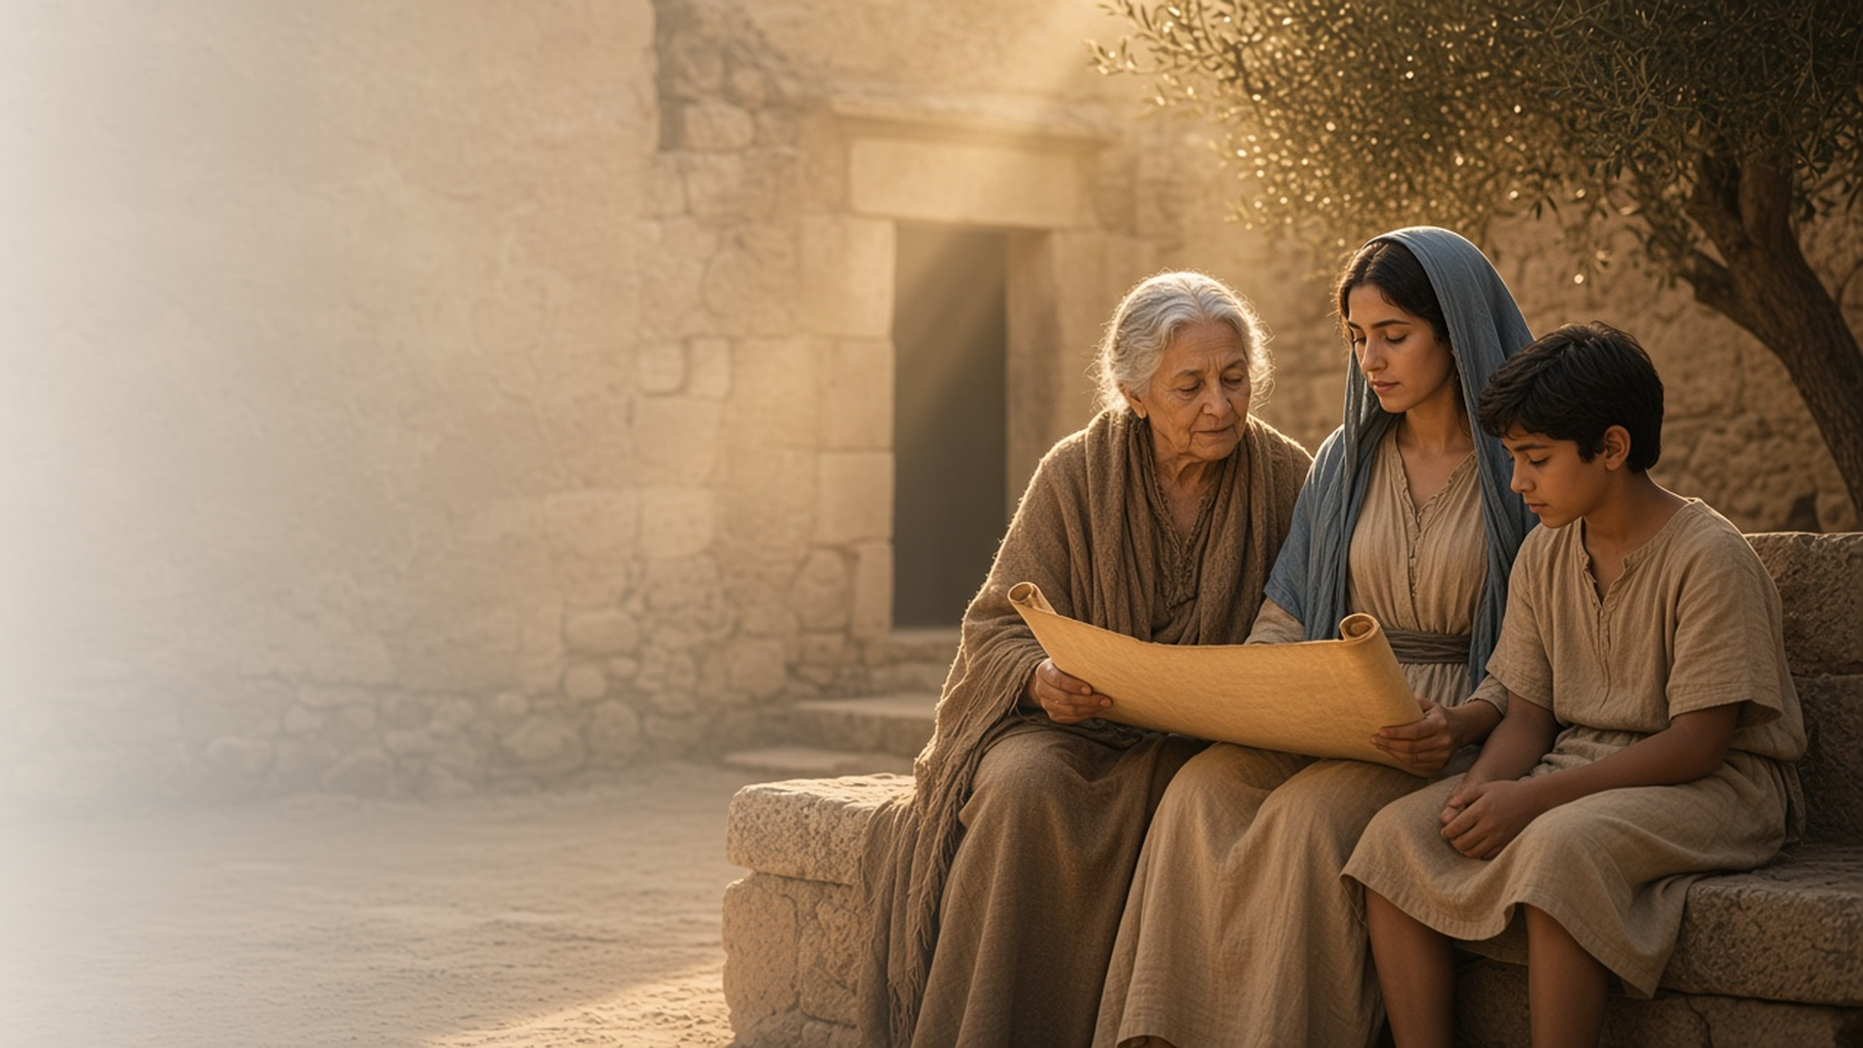
COME, FOLLOW ME · FOR CHILDREN
Be Thou an
Example of
the Believers
October 18–24
1 and 2 Timothy; Titus; Philemon
Notes:
TEACHING
This week children learn that they can be examples of the believers, that God gives them power and love instead of fear, and that Heavenly Father gave them the scriptures to help them learn truth.
SCRIPTURE (KJV)
2 Timothy 3:14–15
14 But continue thou in the things which thou hast learned and hast been assured of, knowing of whom thou hast learned them;
15 And that from a child thou hast known the holy scriptures, which are able to make thee wise unto salvation through faith which is in Christ Jesus.
DISCUSSION
• How can you be an example?
• How do the scriptures help you?

Slide 2
1 TIMOTHY 4:12
I can be an example
Even children can be examples of believing in Jesus.
“Be thou an example of the believers.”
1 TIMOTHY 4:12
Notes:
TEACHING
Explain that Timothy was young, and Paul told him he could still be an example. Talk about ways children can be examples in what they say, how they treat others, and how they show faith.
SCRIPTURE (KJV)
1 Timothy 4:12
12 Let no man despise thy youth; but be thou an example of the believers, in word, in conversation, in charity, in spirit, in faith, in purity.
DISCUSSION (questions quoted from the manual)
• “How is being a good example like shining a light for others?”

Slide 3
2 TIMOTHY 1:7
Power and love, not fear
God helps me be brave when I feel afraid.
“For God hath not given us the spirit of fear; but of power, and of love, and of a sound mind.”
2 TIMOTHY 1:7
Notes:
TEACHING
Ask children what makes them feel afraid. Read 2 Timothy 1:7 and explain that Heavenly Father gives us power and love to help us be brave. We can pray when we feel scared.
SCRIPTURE (KJV)
2 Timothy 1:7
7 For God hath not given us the spirit of fear; but of power, and of love, and of a sound mind.
DISCUSSION (questions quoted from the manual)
• (The manual gives no direct questions for this section.)
Suggested: What can you do when you feel afraid?

Slide 4
2 TIMOTHY 3:14–17
The scriptures teach me truth
Timothy learned the scriptures as a child.
“And that from a child thou hast known the holy scriptures.”
2 TIMOTHY 3:15
Notes:
TEACHING
Tell how Timothy's grandmother and mother taught him the scriptures when he was little. Show your scriptures and share a favorite story. Help children plan a time to read scriptures with their family.
SCRIPTURE (KJV)
2 Timothy 3:14–15
14 But continue thou in the things which thou hast learned and hast been assured of, knowing of whom thou hast learned them;
15 And that from a child thou hast known the holy scriptures, which are able to make thee wise unto salvation through faith which is in Christ Jesus.
DISCUSSION (questions quoted from the manual)
• “Maybe your children could pick a picture and tell the story. (You can find pictures in the Gospel Art Book and in Come, Follow Me materials.) How do these stories help us have faith in Jesus Christ?”

Slide 5
2 TIMOTHY 3:15
“And that from a child thou hast known
the holy scriptures.”
Read a scripture story with your family this week.
Notes:
TEACHING
Timothy learned the scriptures as a child. Invite children to read a scripture story with their family this week.
SCRIPTURE (KJV)
2 Timothy 3:15
15 And that from a child thou hast known the holy scriptures, which are able to make thee wise unto salvation through faith which is in Christ Jesus.
DISCUSSION
• What scripture story will you read?
• What do you like about the scriptures?

