Slide 1
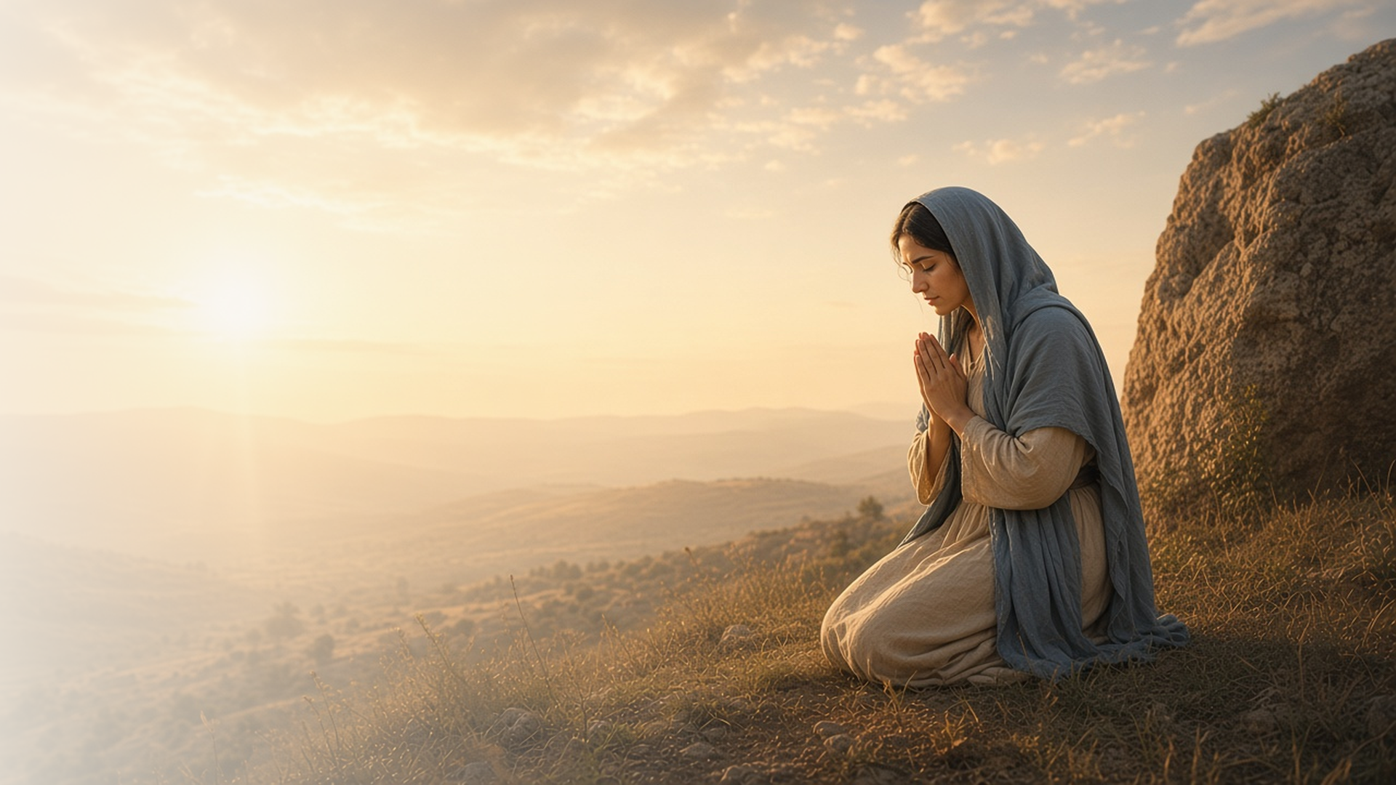
COME, FOLLOW ME · NEW TESTAMENT 2027
Come Boldly
unto the Throne
of Grace
October 25–31
Hebrews 1–6
Notes:
TEACHING
Hebrews was written to Jewish Christians tempted to return to old ways. It teaches the greatness of Jesus Christ through His names and titles, testifies that He suffered so He can understand and help us, invites us to enter God's rest by not hardening our hearts, and teaches that those who serve must be called of God. Because our High Priest understands us, we can come boldly to the throne of grace.
SCRIPTURE (KJV)
Hebrews 4:14–16
14 Seeing then that we have a great high priest, that is passed into the heavens, Jesus the Son of God, let us hold fast our profession.
15 For we have not an high priest which cannot be touched with the feeling of our infirmities; but was in all points tempted like as we are, yet without sin.
16 Let us therefore come boldly unto the throne of grace, that we may obtain mercy, and find grace to help in time of need.
DISCUSSION
• What does it mean to you to come "boldly" to God?
• Which title of Christ in Hebrews speaks to you?

Slide 2
HEBREWS 1–5
Names and titles of Christ
Hebrews calls Jesus Heir, Creator, Captain, and High Priest.
“To make the captain of their salvation perfect through sufferings.”
HEBREWS 2:10
Notes:
TEACHING
The first chapters of Hebrews are full of titles for Jesus: heir of all things, the brightness of God's glory, the express image of His person, the captain of our salvation, the Apostle and High Priest of our profession. Invite class members to list titles they find and what each teaches about Him.
SCRIPTURE (KJV)
Hebrews 1:1–3
1 God, who at sundry times and in divers manners spake in time past unto the fathers by the prophets,
2 Hath in these last days spoken unto us by his Son, whom he hath appointed heir of all things, by whom also he made the worlds;
3 Who being the brightness of his glory, and the express image of his person, and upholding all things by the word of his power, when he had by himself purged our sins, sat down on the right hand of the Majesty on high;
Hebrews 2:9–10
9 But we see Jesus, who was made a little lower than the angels for the suffering of death, crowned with glory and honour; that he by the grace of God should taste death for every man.
10 For it became him, for whom are all things, and by whom are all things, in bringing many sons unto glory, to make the captain of their salvation perfect through sufferings.
Hebrews 3:1
1 Wherefore, holy brethren, partakers of the heavenly calling, consider the Apostle and High Priest of our profession, Christ Jesus;
DISCUSSION (questions quoted from the manual)
• “What does this name or title teach me about Jesus Christ’s roles in my life?”
• “What does it reveal about His attributes?”

Slide 3
HEBREWS 2:9–18; 4:12–16; 5:7–8
Touched with our infirmities
Jesus suffered all things so He can help us when we suffer.
“For we have not an high priest which cannot be touched with the feeling of our infirmities.”
HEBREWS 4:15
Notes:
TEACHING
Hebrews teaches that Jesus was made like His brethren, tempted in all points yet without sin, and learned obedience by the things He suffered. Because He has felt our infirmities, He is able to succour us. Discuss how knowing He understands changes the way we pray.
SCRIPTURE (KJV)
Hebrews 2:17–18
17 Wherefore in all things it behoved him to be made like unto his brethren, that he might be a merciful and faithful high priest in things pertaining to God, to make reconciliation for the sins of the people.
18 For in that he himself hath suffered being tempted, he is able to succour them that are tempted.
Hebrews 4:14–16
14 Seeing then that we have a great high priest, that is passed into the heavens, Jesus the Son of God, let us hold fast our profession.
15 For we have not an high priest which cannot be touched with the feeling of our infirmities; but was in all points tempted like as we are, yet without sin.
16 Let us therefore come boldly unto the throne of grace, that we may obtain mercy, and find grace to help in time of need.
Hebrews 5:7–8
7 Who in the days of his flesh, when he had offered up prayers and supplications with strong crying and tears unto him that was able to save him from death, and was heard in that he feared;
8 Though he were a Son, yet learned he obedience by the things which he suffered;
DISCUSSION (questions quoted from the manual)
• “Have you ever felt that no one understood what you were going through?”
• “Or maybe you’ve felt that you didn’t deserve God’s love or help because of your mistakes?”
• “What do you find in Hebrews 2:9–18; 4:12–16; 5:7–8 that strengthens your confidence that Jesus Christ can help you and is willing to?”
• “What does it mean to you to “come boldly unto the throne of grace” and seek mercy? (Hebrews 4:16).”

Slide 4
HEBREWS 3:7–19; 4:1–11
Enter into His rest
God invites us not to harden our hearts, but to enter His rest.
“To day if ye will hear his voice, harden not your hearts.”
HEBREWS 3:15
Notes:
TEACHING
Hebrews recalls Israel in the wilderness, who hardened their hearts and could not enter the promised land. God's rest is still offered: peace in this life and the fulness of His glory hereafter. Invite class members to consider what softens their hearts to hear His voice today.
SCRIPTURE (KJV)
Hebrews 3:7–15
7 Wherefore (as the Holy Ghost saith, To day if ye will hear his voice,
8 Harden not your hearts, as in the provocation, in the day of temptation in the wilderness:
9 When your fathers tempted me, proved me, and saw my works forty years.
10 Wherefore I was grieved with that generation, and said, They do alway err in their heart; and they have not known my ways.
11 So I sware in my wrath, They shall not enter into my rest.)
12 Take heed, brethren, lest there be in any of you an evil heart of unbelief, in departing from the living God.
13 But exhort one another daily, while it is called To day; lest any of you be hardened through the deceitfulness of sin.
14 For we are made partakers of Christ, if we hold the beginning of our confidence stedfast unto the end;
15 While it is said, To day if ye will hear his voice, harden not your hearts, as in the provocation.
Hebrews 4:9–11
9 There remaineth therefore a rest to the people of God.
10 For he that is entered into his rest, he also hath ceased from his own works, as God did from his.
11 Let us labour therefore to enter into that rest, lest any man fall after the same example of unbelief.
DISCUSSION (questions quoted from the manual)
• “How did the Israelites turn away from the Lord? (see Hebrews 3:8–11).”
• “What are the consequences of having a hard heart?”
• “How can you tell when your heart is becoming hardened, and what can you do about it?”
• “What does it mean to “enter into [God’s] rest”? (Look for possible meanings in President Russell M.”
• “Nelson’s message “Overcome the World and Find Rest” [ Liahona, Nov. 2022, 95–98].) Why would someone choose not to enter into His rest? (see Hebrews 4:1–11).”
• “How can you show that you want to enter into His rest?”

Slide 5
HEBREWS 5:1–5
Called of God
Those who serve in His kingdom are called, as was Aaron.
“And no man taketh this honour unto himself, but he that is called of God, as was Aaron.”
HEBREWS 5:4
Notes:
TEACHING
A high priest is chosen to act for others in things pertaining to God, and no one takes that honor on himself; he must be called of God, as Aaron was. Even Christ was called by the Father. Discuss how this principle applies to callings and priesthood service in the Church today.
SCRIPTURE (KJV)
Hebrews 5:1–5
1 For every high priest taken from among men is ordained for men in things pertaining to God, that he may offer both gifts and sacrifices for sins:
2 Who can have compassion on the ignorant, and on them that are out of the way; for that he himself also is compassed with infirmity.
3 And by reason hereof he ought, as for the people, so also for himself, to offer for sins.
4 And no man taketh this honour unto himself, but he that is called of God, as was Aaron.
5 So also Christ glorified not himself to be made an high priest; but he that said unto him, Thou art my Son, to day have I begotten thee.
DISCUSSION (questions quoted from the manual)
• “What do you learn about Christ in verses 1–5?”
• “How might these verses, along with Hebrews 5:1–5, guide your service in the Church of Jesus Christ?”

Slide 6
HEBREWS 4:16
“Let us therefore come boldly
unto the throne of grace.”
Bring one need to the throne of grace in prayer this week.
Notes:
TEACHING
Because our High Priest understands us, we need not approach God timidly. Close by inviting class members to bring one specific need to the Lord in prayer this week.
SCRIPTURE (KJV)
Hebrews 4:16
16 Let us therefore come boldly unto the throne of grace, that we may obtain mercy, and find grace to help in time of need.
DISCUSSION
• What need will you bring to the Lord?
• How has His grace helped you in time of need?

