Slide 1
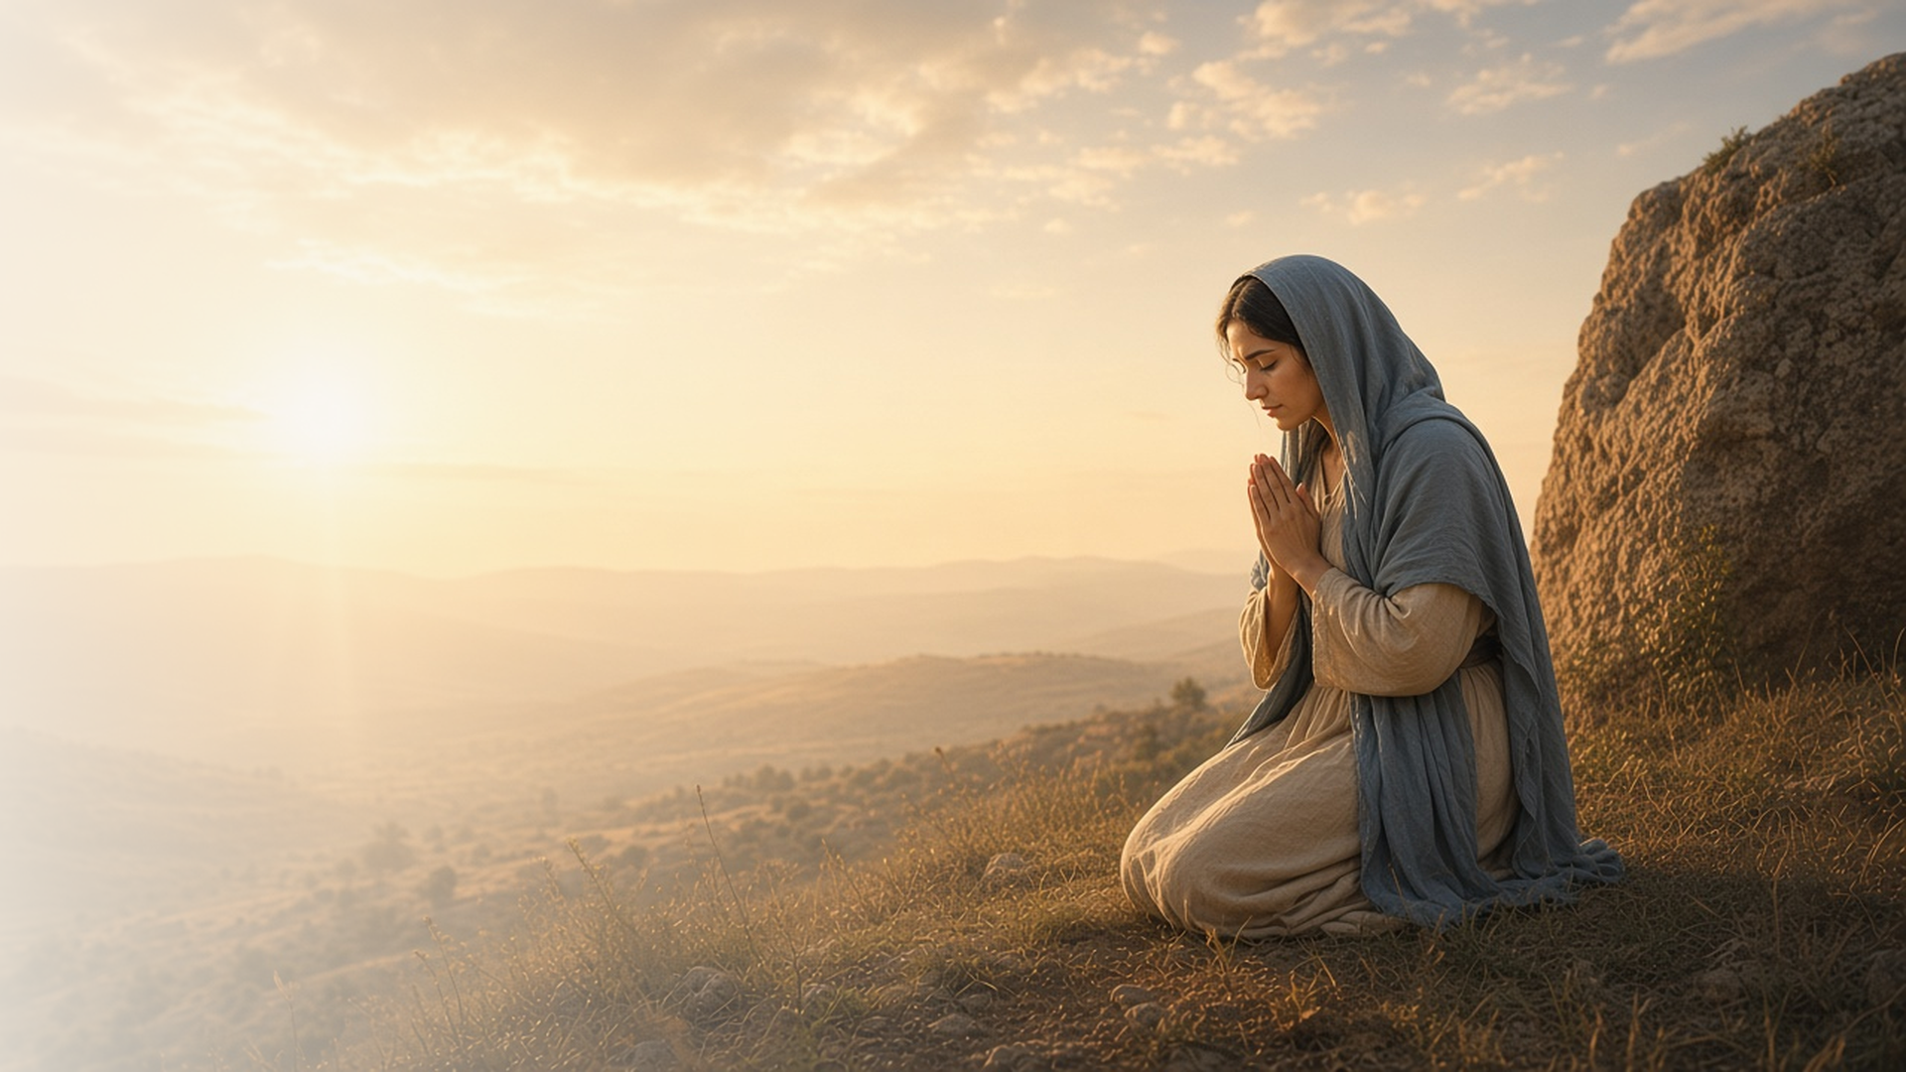
COME, FOLLOW ME · FOR CHILDREN
Come Boldly
unto the Throne
of Grace
October 25–31
Hebrews 1–6
Notes:
TEACHING
This week children learn that they believe in Jesus Christ, that they receive Heavenly Father's blessings as they do not harden their hearts, that they can turn to Jesus for help, and that a person must be called of God to do His work.
SCRIPTURE (KJV)
Hebrews 4:16
16 Let us therefore come boldly unto the throne of grace, that we may obtain mercy, and find grace to help in time of need.
DISCUSSION
• When can we pray to Heavenly Father?
• How does Jesus help us?

Slide 2
HEBREWS 1:1–10; 2:8–10, 17–18
I believe in Jesus Christ
Jesus is the Son of God, who made the world.
“Hath in these last days spoken unto us by his Son, whom he hath appointed heir of all things, by whom also he made the worlds.”
HEBREWS 1:2
Notes:
TEACHING
Show pictures of nature and explain that Jesus created the world under Heavenly Father's direction. Help children share what they believe about Jesus.
SCRIPTURE (KJV)
Hebrews 1:1–3
1 God, who at sundry times and in divers manners spake in time past unto the fathers by the prophets,
2 Hath in these last days spoken unto us by his Son, whom he hath appointed heir of all things, by whom also he made the worlds;
3 Who being the brightness of his glory, and the express image of his person, and upholding all things by the word of his power, when he had by himself purged our sins, sat down on the right hand of the Majesty on high;
DISCUSSION (questions quoted from the manual)
• (The manual gives no direct questions for this section.)
Suggested: What do you believe about Jesus?

Slide 3
HEBREWS 3:7–19
Harden not your heart
A soft heart helps me receive Heavenly Father’s blessings.
“To day if ye will hear his voice, harden not your hearts.”
HEBREWS 3:15
Notes:
TEACHING
Compare a hard rock and soft clay: which can be shaped? A soft heart is willing to listen and obey. Talk about ways to keep our hearts soft, like praying and being kind.
SCRIPTURE (KJV)
Hebrews 3:15
15 While it is said, To day if ye will hear his voice, harden not your hearts, as in the provocation.
DISCUSSION (questions quoted from the manual)
• “What can we do to soften our hearts?”

Slide 4
HEBREWS 4:14–16
Jesus can help me
I can pray to Heavenly Father for help anytime.
“That we may obtain mercy, and find grace to help in time of need.”
HEBREWS 4:16
Notes:
TEACHING
Explain that Jesus knows how we feel because He lived on earth and had hard times too. We can pray anytime and ask for help. Share a time when prayer helped you.
SCRIPTURE (KJV)
Hebrews 4:14–16
14 Seeing then that we have a great high priest, that is passed into the heavens, Jesus the Son of God, let us hold fast our profession.
15 For we have not an high priest which cannot be touched with the feeling of our infirmities; but was in all points tempted like as we are, yet without sin.
16 Let us therefore come boldly unto the throne of grace, that we may obtain mercy, and find grace to help in time of need.
DISCUSSION (questions quoted from the manual)
• “Why do we go to these people?”
• “What “rocks” do we carry?”
• “How does Jesus help us?”

Slide 5
HEBREWS 5:1–4
Called of God
People are called by God to do His work.
“And no man taketh this honour unto himself, but he that is called of God, as was Aaron.”
HEBREWS 5:4
Notes:
TEACHING
Talk about callings people have in your ward, like teachers and leaders. Explain that they are called by God through inspiration to their leaders, just as Aaron was called long ago.
SCRIPTURE (KJV)
Hebrews 5:4
4 And no man taketh this honour unto himself, but he that is called of God, as was Aaron.
DISCUSSION (questions quoted from the manual)
• “For example, how does a teacher, doctor, or political leader get the authority to do their jobs?”
• “How does God give us authority to do His work in His Church?”

Slide 6
HEBREWS 4:16
“Let us therefore come boldly
unto the throne of grace.”
Pray to Heavenly Father about something that matters to you.
Notes:
TEACHING
We can pray to Heavenly Father anytime. Invite children to pray about something that matters to them this week.
SCRIPTURE (KJV)
Hebrews 4:16
16 Let us therefore come boldly unto the throne of grace, that we may obtain mercy, and find grace to help in time of need.
DISCUSSION
• What will you pray about?
• How do you feel after you pray?

