Slide 1
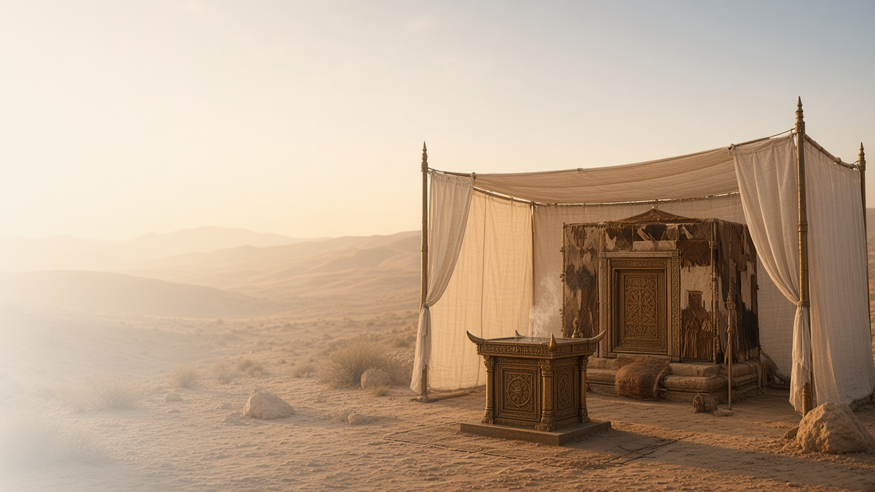
COME, FOLLOW ME · NEW TESTAMENT 2027
An High Priest
of Good Things
to Come
November 1–7
Hebrews 7–13
Notes:
TEACHING
Hebrews 7–13 presents Jesus Christ as the great High Priest after the order of Melchizedek, the Mediator of a better covenant, and the fulfillment of the tabernacle and its ordinances. Chapter 11 celebrates men and women who trusted God's promises by faith, and chapter 12 teaches that the Lord's chastening is a sign of His love.
SCRIPTURE (KJV)
Hebrews 9:11–12
11 But Christ being come an high priest of good things to come, by a greater and more perfect tabernacle, not made with hands, that is to say, not of this building;
12 Neither by the blood of goats and calves, but by his own blood he entered in once into the holy place, having obtained eternal redemption for us.
DISCUSSION
• How does the tabernacle point you to Christ?
• Whose example of faith in Hebrews 11 inspires you?

Slide 2
HEBREWS 7
After the order of Melchizedek
Melchizedek, king of peace, pointed to Christ, our High Priest.
“Wherefore he is able also to save them to the uttermost that come unto God by him.”
HEBREWS 7:25
Notes:
TEACHING
Melchizedek, king of Salem and priest of the most high God, blessed Abraham and received his tithes. Hebrews presents him as a type of Christ, whose priesthood is eternal. Because Jesus lives forever to make intercession, He can save to the uttermost. The higher priesthood bears Melchizedek's name and points us to the Savior.
SCRIPTURE (KJV)
Hebrews 7:1–3
1 For this Melchisedec, king of Salem, priest of the most high God, who met Abraham returning from the slaughter of the kings, and blessed him;
2 To whom also Abraham gave a tenth part of all; first being by interpretation King of righteousness, and after that also King of Salem, which is, King of peace;
3 Without father, without mother, without descent, having neither beginning of days, nor end of life; but made like unto the Son of God; abideth a priest continually.
Hebrews 7:24–27
24 But this man, because he continueth ever, hath an unchangeable priesthood.
25 Wherefore he is able also to save them to the uttermost that come unto God by him, seeing he ever liveth to make intercession for them.
26 For such an high priest became us, who is holy, harmless, undefiled, separate from sinners, and made higher than the heavens;
27 Who needeth not daily, as those high priests, to offer up sacrifice, first for his own sins, and then for the people’s: for this he did once, when he offered up himself.
DISCUSSION (questions quoted from the manual)
• “How have they pointed you to the Savior?”
• “What have they taught you about Him?”

Slide 3
HEBREWS 8:6–13; 9:14–15
Mediator of a better covenant
Christ stands between us and justice, offering mercy.
“He is the mediator of a better covenant, which was established upon better promises.”
HEBREWS 8:6
Notes:
TEACHING
A mediator stands between two parties to bring them together. Jesus is the Mediator of the new covenant, in which God writes His laws in our hearts and remembers our sins no more. Through His blood He purges our conscience so we can serve the living God. Discuss what it means to have Christ as our Mediator.
SCRIPTURE (KJV)
Hebrews 8:6–10
6 But now hath he obtained a more excellent ministry, by how much also he is the mediator of a better covenant, which was established upon better promises.
7 For if that first covenant had been faultless, then should no place have been sought for the second.
8 For finding fault with them, he saith, Behold, the days come, saith the Lord, when I will make a new covenant with the house of Israel and with the house of Judah:
9 Not according to the covenant that I made with their fathers in the day when I took them by the hand to lead them out of the land of Egypt; because they continued not in my covenant, and I regarded them not, saith the Lord.
10 For this is the covenant that I will make with the house of Israel after those days, saith the Lord; I will put my laws into their mind, and write them in their hearts: and I will be to them a God, and they shall be to me a people:
Hebrews 9:14–15
14 How much more shall the blood of Christ, who through the eternal Spirit offered himself without spot to God, purge your conscience from dead works to serve the living God?
15 And for this cause he is the mediator of the new testament, that by means of death, for the redemption of the transgressions that were under the first testament, they which are called might receive the promise of eternal inheritance.
DISCUSSION (questions quoted from the manual)
• “What are the “better promises” the Lord offers you through His covenants? (Hebrews 8:6).”
• “How have you come to know that the Savior is your Mediator?”
• “How has the Lord put His covenant in your mind?”
• “How has He written it in your heart? (see Hebrews 8:10).”

Slide 4
HEBREWS 9; 10:1–22
The way into the holiest
Temple ordinances, ancient and modern, point to Christ.
“Let us draw near with a true heart in full assurance of faith.”
HEBREWS 10:22
Notes:
TEACHING
Hebrews explains that the tabernacle's holy places and sacrifices were shadows of Christ. Once a year the high priest entered the Holy of Holies; Christ entered heaven itself with His own blood and opened the way for us. Latter-day temple ordinances likewise point to Him. Invite class members to share how temple worship draws them near to Christ.
SCRIPTURE (KJV)
Hebrews 9:11–14
11 But Christ being come an high priest of good things to come, by a greater and more perfect tabernacle, not made with hands, that is to say, not of this building;
12 Neither by the blood of goats and calves, but by his own blood he entered in once into the holy place, having obtained eternal redemption for us.
13 For if the blood of bulls and of goats, and the ashes of an heifer sprinkling the unclean, sanctifieth to the purifying of the flesh:
14 How much more shall the blood of Christ, who through the eternal Spirit offered himself without spot to God, purge your conscience from dead works to serve the living God?
Hebrews 10:19–22
19 Having therefore, brethren, boldness to enter into the holiest by the blood of Jesus,
20 By a new and living way, which he hath consecrated for us, through the veil, that is to say, his flesh;
21 And having an high priest over the house of God;
22 Let us draw near with a true heart in full assurance of faith, having our hearts sprinkled from an evil conscience, and our bodies washed with pure water.
DISCUSSION (questions quoted from the manual)
• “What do you find in these verses that reminds you of the Savior’s atoning sacrifice?”
• “How do today’s ordinances remind you of Christ’s Atonement?”
• “How do these ordinances strengthen your relationship with Him?”

Slide 5
HEBREWS 11
The substance of things hoped for
The faithful trusted God’s promises, even from afar.
“Now faith is the substance of things hoped for, the evidence of things not seen.”
HEBREWS 11:1
Notes:
TEACHING
Hebrews 11 lists Abel, Enoch, Noah, Abraham, Sarah, Moses, Rahab, and many others who acted on God's promises, some dying without receiving them but seeing them afar off. Faith is trusting God's promises enough to act before we see their fulfillment. Discuss which example of faith speaks most to class members.
SCRIPTURE (KJV)
Hebrews 11:1
1 Now faith is the substance of things hoped for, the evidence of things not seen.
Hebrews 11:6–13
6 But without faith it is impossible to please him: for he that cometh to God must believe that he is, and that he is a rewarder of them that diligently seek him.
7 By faith Noah, being warned of God of things not seen as yet, moved with fear, prepared an ark to the saving of his house; by the which he condemned the world, and became heir of the righteousness which is by faith.
8 By faith Abraham, when he was called to go out into a place which he should after receive for an inheritance, obeyed; and he went out, not knowing whither he went.
9 By faith he sojourned in the land of promise, as in a strange country, dwelling in tabernacles with Isaac and Jacob, the heirs with him of the same promise:
10 For he looked for a city which hath foundations, whose builder and maker is God.
11 Through faith also Sara herself received strength to conceive seed, and was delivered of a child when she was past age, because she judged him faithful who had promised.
12 Therefore sprang there even of one, and him as good as dead, so many as the stars of the sky in multitude, and as the sand which is by the sea shore innumerable.
13 These all died in faith, not having received the promises, but having seen them afar off, and were persuaded of them, and embraced them, and confessed that they were strangers and pilgrims on the earth.
DISCUSSION (questions quoted from the manual)
• “If you had to define faith in a single sentence, what would you say?”
• “What do the people mentioned in this chapter teach you about faith in the Lord?”
• “How did the people mentioned in this chapter show that they felt an “assurance of things hoped for”? (Joseph Smith Translation, Hebrews 11:1 [in Hebrews 11:1, footnote b ]).”
• “When have you exercised faith in promises that have not yet been fulfilled? (see verse 13).”
• “What do you find in these scriptural examples that inspires you to trust God’s promises and live by faith?”

Slide 6
HEBREWS 12:5–11
Whom the Lord loveth
The Lord’s correction is evidence of His love.
“For whom the Lord loveth he chasteneth, and scourgeth every son whom he receiveth.”
HEBREWS 12:6
Notes:
TEACHING
Hebrews compares God's chastening to a loving parent's correction. It is not pleasant at the time, but afterward it yields the peaceable fruit of righteousness. Invite class members to consider how the Lord's correction has helped them grow.
SCRIPTURE (KJV)
Hebrews 12:5–11
5 And ye have forgotten the exhortation which speaketh unto you as unto children, My son, despise not thou the chastening of the Lord, nor faint when thou art rebuked of him:
6 For whom the Lord loveth he chasteneth, and scourgeth every son whom he receiveth.
7 If ye endure chastening, God dealeth with you as with sons; for what son is he whom the father chasteneth not?
8 But if ye be without chastisement, whereof all are partakers, then are ye bastards, and not sons.
9 Furthermore we have had fathers of our flesh which corrected us, and we gave them reverence: shall we not much rather be in subjection unto the Father of spirits, and live?
10 For they verily for a few days chastened us after their own pleasure; but he for our profit, that we might be partakers of his holiness.
11 Now no chastening for the present seemeth to be joyous, but grievous: nevertheless afterward it yieldeth the peaceable fruit of righteousness unto them which are exercised thereby.
Restoration scripture (public-domain text: bcbooks/scriptures-json)
Ether 3:2–4, 6, 9, 13–15 (Book of Mormon)
2 O Lord, thou hast said that we must be encompassed about by the floods. Now behold, O Lord, and do not be angry with thy servant because of his weakness before thee; for we know that thou art holy and dwellest in the heavens, and that we are unworthy before thee; because of the fall our natures have become evil continually; nevertheless, O Lord, thou hast given us a commandment that we must call upon thee, that from thee we may receive according to our desires.
3 Behold, O Lord, thou hast smitten us because of our iniquity, and hast driven us forth, and for these many years we have been in the wilderness; nevertheless, thou hast been merciful unto us. O Lord, look upon me in pity, and turn away thine anger from this thy people, and suffer not that they shall go forth across this raging deep in darkness; but behold these things which I have molten out of the rock.
4 And I know, O Lord, that thou hast all power, and can do whatsoever thou wilt for the benefit of man; therefore touch these stones, O Lord, with thy finger, and prepare them that they may shine forth in darkness; and they shall shine forth unto us in the vessels which we have prepared, that we may have light while we shall cross the sea.
6 And it came to pass that when the brother of Jared had said these words, behold, the Lord stretched forth his hand and touched the stones one by one with his finger. And the veil was taken from off the eyes of the brother of Jared, and he saw the finger of the Lord; and it was as the finger of a man, like unto flesh and blood; and the brother of Jared fell down before the Lord, for he was struck with fear.
9 And the Lord said unto him: Because of thy faith thou hast seen that I shall take upon me flesh and blood; and never has man come before me with such exceeding faith as thou hast; for were it not so ye could not have seen my finger. Sawest thou more than this?
13 And when he had said these words, behold, the Lord showed himself unto him, and said: Because thou knowest these things ye are redeemed from the fall; therefore ye are brought back into my presence; therefore I show myself unto you.
14 Behold, I am he who was prepared from the foundation of the world to redeem my people. Behold, I am Jesus Christ. I am the Father and the Son. In me shall all mankind have life, and that eternally, even they who shall believe on my name; and they shall become my sons and my daughters.
15 And never have I showed myself unto man whom I have created, for never has man believed in me as thou hast. Seest thou that ye are created after mine own image? Yea, even all men were created in the beginning after mine own image.
Full passage: Ether 3:1–16
Doctrine and Covenants 3:10 (Doctrine and Covenants)
10 But remember, God is merciful; therefore, repent of that which thou hast done which is contrary to the commandment which I gave you, and thou art still chosen, and art again called to the work;
Doctrine and Covenants 95:1 (Doctrine and Covenants)
1 Verily, thus saith the Lord unto you whom I love, and whom I love I also chasten that their sins may be forgiven, for with the chastisement I prepare a way for their deliverance in all things out of temptation, and I have loved you—
DISCUSSION (questions quoted from the manual)
• “As you read verses 5–11, what do you find that helps you “endure chastening”?”
• “How did His correction bring “the peaceable fruit of righteousness”? (Hebrews 12:11; see also Ether 3:1–16; Doctrine and Covenants 3:10; 95:1).”
• “How can you show that you “despise not … chastening”?”

Slide 7
HEBREWS 12:2
“Looking unto Jesus the author
and finisher of our faith.”
Look to Jesus this week as the finisher of your faith.
Notes:
TEACHING
After the great roll call of faith, Hebrews invites us to run our own race with patience, looking unto Jesus, who both begins and completes our faith. Close by inviting class members to look to Him this week.
SCRIPTURE (KJV)
Hebrews 12:1–2
1 Wherefore seeing we also are compassed about with so great a cloud of witnesses, let us lay aside every weight, and the sin which doth so easily beset us, and let us run with patience the race that is set before us,
2 Looking unto Jesus the author and finisher of our faith; who for the joy that was set before him endured the cross, despising the shame, and is set down at the right hand of the throne of God.
DISCUSSION
• What helps you keep looking to Jesus?
• What weight might you lay aside to run your race?

