Slide 1
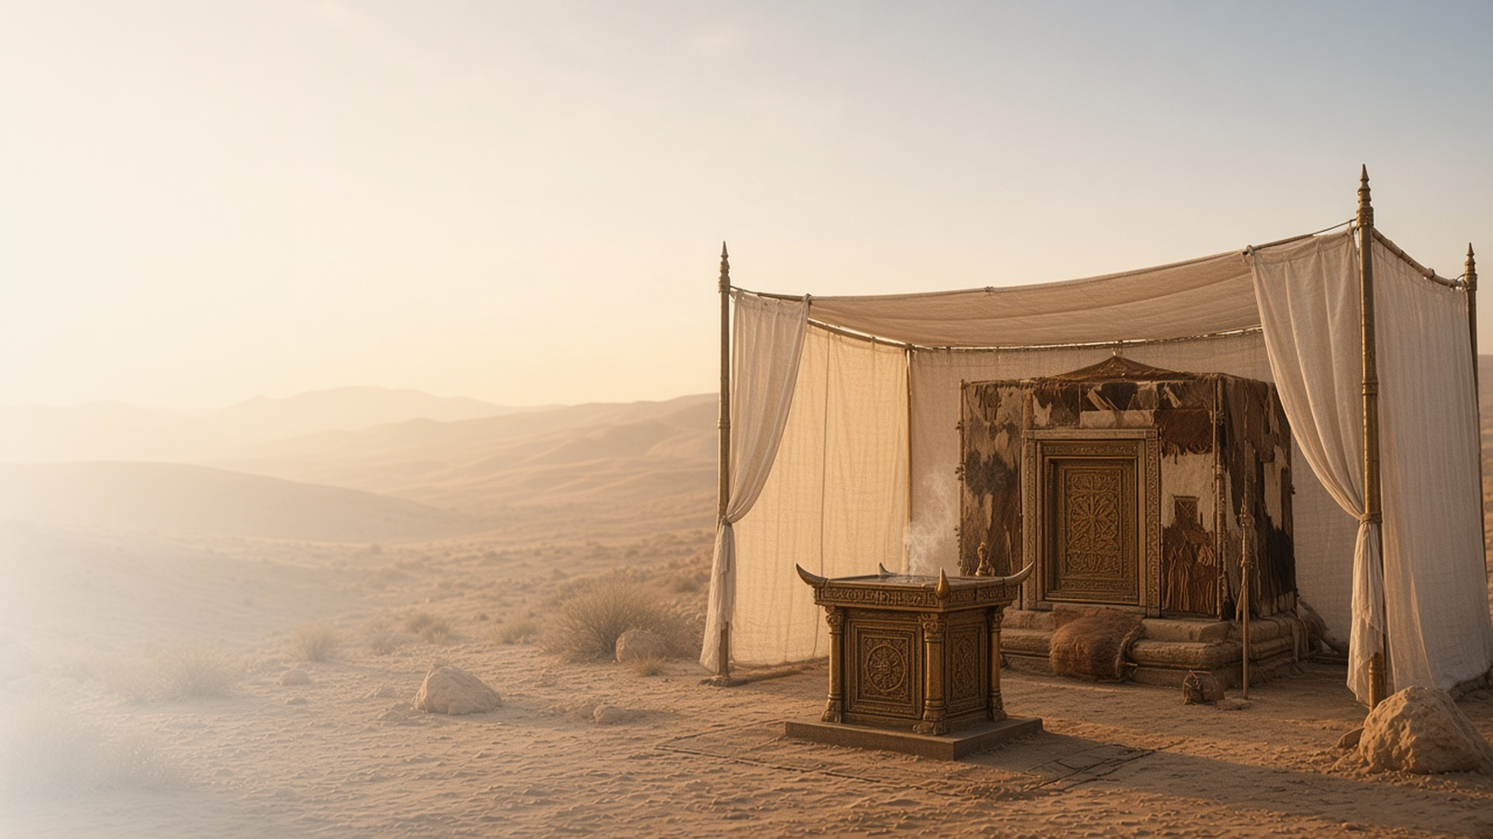
COME, FOLLOW ME · FOR CHILDREN
An High Priest
of Good Things
to Come
November 1–7
Hebrews 7–13
Notes:
TEACHING
This week children learn that God blesses them through His priesthood ordinances, that Jesus Christ can work miracles as they show faith in Him, and that Heavenly Father and Jesus Christ will help them and never leave them.
SCRIPTURE (KJV)
Hebrews 13:5–6
5 Let your conversation be without covetousness; and be content with such things as ye have: for he hath said, I will never leave thee, nor forsake thee.
6 So that we may boldly say, The Lord is my helper, and I will not fear what man shall do unto me.
DISCUSSION
• What priesthood ordinances have you seen?
• How do you know Jesus will never leave you?

Slide 2
HEBREWS 7:1–6
Priesthood blessings
God blesses me through priesthood ordinances.
“Who met Abraham returning from the slaughter of the kings, and blessed him.”
HEBREWS 7:1
Notes:
TEACHING
Tell how Melchizedek, a priest of God, blessed Abraham. Talk about priesthood ordinances children know, such as baptism, the sacrament, and blessings, and how they bring us closer to Heavenly Father.
SCRIPTURE (KJV)
Hebrews 7:1–2
1 For this Melchisedec, king of Salem, priest of the most high God, who met Abraham returning from the slaughter of the kings, and blessed him;
2 To whom also Abraham gave a tenth part of all; first being by interpretation King of righteousness, and after that also King of Salem, which is, King of peace;
DISCUSSION (questions quoted from the manual)
• “Do your children know who Melchizedek was?”
• “How does Heavenly Father bless us through these priesthood ordinances?”

Slide 3
HEBREWS 11
Miracles through faith
People in the scriptures showed faith, and God worked miracles.
“But without faith it is impossible to please him.”
HEBREWS 11:6
Notes:
TEACHING
Tell short stories from Hebrews 11, like Noah building the ark or Israel crossing the Red Sea. These people had faith, and God did miracles. Help children think of ways they can show faith.
SCRIPTURE (KJV)
Hebrews 11:6
6 But without faith it is impossible to please him: for he that cometh to God must believe that he is, and that he is a rewarder of them that diligently seek him.
Hebrews 11:29–30
29 By faith they passed through the Red sea as by dry land: which the Egyptians assaying to do were drowned.
30 By faith the walls of Jericho fell down, after they were compassed about seven days.
DISCUSSION (questions quoted from the manual)
• “You can also find stories about these people in Old Testament Stories.) How did these people show they had faith in the Lord?”
• “What miracles happened because of their faith?”
• “How can we follow their examples?”
• “What are the “mountains” in our lives?”
• “How does the Savior help us move them?”

Slide 4
HEBREWS 13:5–6
He will never leave me
Heavenly Father and Jesus will always help me.
“I will never leave thee, nor forsake thee.”
HEBREWS 13:5
Notes:
TEACHING
Explain that forsake means leave alone. Heavenly Father and Jesus promise they will never leave us. Share a time when you felt they were with you.
SCRIPTURE (KJV)
Hebrews 13:5–6
5 Let your conversation be without covetousness; and be content with such things as ye have: for he hath said, I will never leave thee, nor forsake thee.
6 So that we may boldly say, The Lord is my helper, and I will not fear what man shall do unto me.
DISCUSSION (questions quoted from the manual)
• “How do you know when He is with you?”
• “What can we ask the Lord to help us with?”

Slide 5
HEBREWS 13:6
“The Lord is my helper.”
When you need help, remember: the Lord is my helper.
Notes:
TEACHING
The Lord is our helper. Invite children to remember this when they need help this week.
SCRIPTURE (KJV)
Hebrews 13:6
6 So that we may boldly say, The Lord is my helper, and I will not fear what man shall do unto me.
DISCUSSION
• When might you need help?
• How does the Lord help you?

