Slide 1
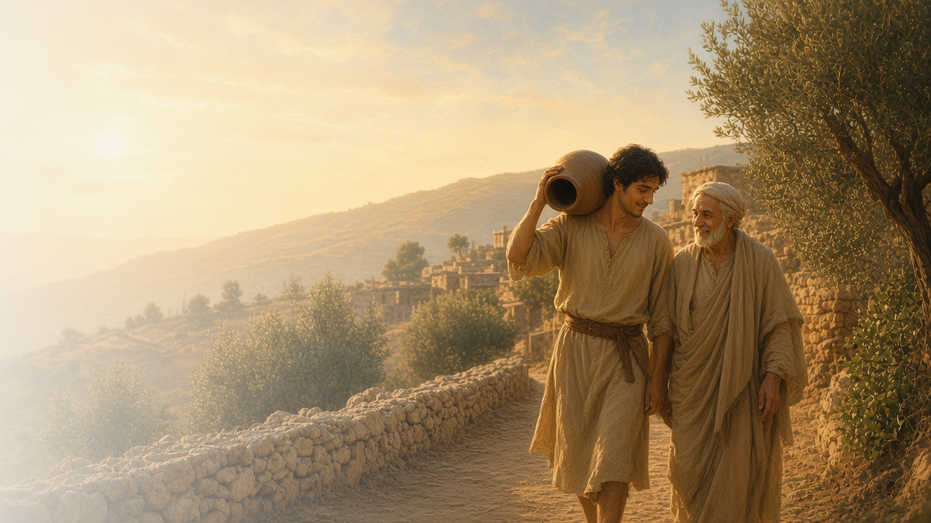
COME, FOLLOW ME · NEW TESTAMENT 2027
Be Ye Doers
of the Word, and
Not Hearers Only
November 8–14
James
Notes:
TEACHING
The epistle of James is practical and direct. James teaches that trials can perfect patience, that faith without works is dead, that God gives wisdom liberally to those who ask in faith, that pure religion cares for widows and orphans, that the tongue can bless or curse, and that true disciples love all people regardless of their circumstances. His theme: be doers of the word, not hearers only.
SCRIPTURE (KJV)
James 1:22–25
22 But be ye doers of the word, and not hearers only, deceiving your own selves.
23 For if any be a hearer of the word, and not a doer, he is like unto a man beholding his natural face in a glass:
24 For he beholdeth himself, and goeth his way, and straightway forgetteth what manner of man he was.
25 But whoso looketh into the perfect law of liberty, and continueth therein, he being not a forgetful hearer, but a doer of the work, this man shall be blessed in his deed.
DISCUSSION
• Which of James's teachings is hardest for you to do?
• What is one thing you have heard that you need to do?

Slide 2
JAMES 1:2–4; 5:7–11
Patience’s perfect work
Trials can build patience when we let them.
“But let patience have her perfect work, that ye may be perfect and entire, wanting nothing.”
JAMES 1:4
Notes:
TEACHING
James invites us to count it joy when our faith is tried, because trials work patience, and patience can make us whole and complete. He points to farmers waiting for rain, the prophets, and Job. Discuss what helps us let patience do its work rather than resisting it.
SCRIPTURE (KJV)
James 1:2–4
2 My brethren, count it all joy when ye fall into divers temptations;
3 Knowing this, that the trying of your faith worketh patience.
4 But let patience have her perfect work, that ye may be perfect and entire, wanting nothing.
James 5:7–11
7 Be patient therefore, brethren, unto the coming of the Lord. Behold, the husbandman waiteth for the precious fruit of the earth, and hath long patience for it, until he receive the early and latter rain.
8 Be ye also patient; stablish your hearts: for the coming of the Lord draweth nigh.
9 Grudge not one against another, brethren, lest ye be condemned: behold, the judge standeth before the door.
10 Take, my brethren, the prophets, who have spoken in the name of the Lord, for an example of suffering affliction, and of patience.
11 Behold, we count them happy which endure. Ye have heard of the patience of Job, and have seen the end of the Lord; that the Lord is very pitiful, and of tender mercy.
DISCUSSION (questions quoted from the manual)
• “What did you learn from this experience?”
• “What would you say is the “perfect work” of patience? (James 1:4).”
• “Who has been “an example … of patience” for you? (James 5:10).”
• “What experiences with patience have revealed the Lord’s “tender mercy” to you? (James 5:11).”

Slide 3
JAMES 1:3–8, 21–25; 2:14–26; 4:17
Faith without works
True faith shows itself in what we do.
“Even so faith, if it hath not works, is dead, being alone.”
JAMES 2:17
Notes:
TEACHING
James compares a hearer who does not act to someone who glances in a mirror and forgets what he saw. Faith that does nothing for a hungry brother is dead. Works do not replace faith; they show it is alive. Invite class members to consider what their actions reveal about their faith.
SCRIPTURE (KJV)
James 1:22–25
22 But be ye doers of the word, and not hearers only, deceiving your own selves.
23 For if any be a hearer of the word, and not a doer, he is like unto a man beholding his natural face in a glass:
24 For he beholdeth himself, and goeth his way, and straightway forgetteth what manner of man he was.
25 But whoso looketh into the perfect law of liberty, and continueth therein, he being not a forgetful hearer, but a doer of the work, this man shall be blessed in his deed.
James 2:14–18
14 What doth it profit, my brethren, though a man say he hath faith, and have not works? can faith save him?
15 If a brother or sister be naked, and destitute of daily food,
16 And one of you say unto them, Depart in peace, be ye warmed and filled; notwithstanding ye give them not those things which are needful to the body; what doth it profit?
17 Even so faith, if it hath not works, is dead, being alone.
18 Yea, a man may say, Thou hast faith, and I have works: shew me thy faith without thy works, and I will shew thee my faith by my works.
James 4:17
17 Therefore to him that knoweth to do good, and doeth it not, to him it is sin.
DISCUSSION (questions quoted from the manual)
• “Why does faith require works?”
• “Why do works require faith?”
• “What does it mean to have faith in Jesus Christ?”
• “What can you do to show your faith in Jesus Christ?”

Slide 4
JAMES 1:5–6
Ask of God
God gives liberally to all who ask in faith.
“If any of you lack wisdom, let him ask of God, that giveth to all men liberally, and upbraideth not; and it shall be given him.”
JAMES 1:5
Notes:
TEACHING
James promises that God gives wisdom liberally and does not scold us for asking, if we ask in faith, nothing wavering. This verse led young Joseph Smith to pray in the grove (Joseph Smith—History 1:11–13). Discuss how this promise has blessed class members' own prayers.
SCRIPTURE (KJV)
James 1:5–6
5 If any of you lack wisdom, let him ask of God, that giveth to all men liberally, and upbraideth not; and it shall be given him.
6 But let him ask in faith, nothing wavering. For he that wavereth is like a wave of the sea driven with the wind and tossed.
Restoration scripture (public-domain text: bcbooks/scriptures-json)
Joseph Smith—History 1:10–17 (Pearl of Great Price)
10 In the midst of this war of words and tumult of opinions, I often said to myself: What is to be done? Who of all these parties are right; or, are they all wrong together? If any one of them be right, which is it, and how shall I know it?
11 While I was laboring under the extreme difficulties caused by the contests of these parties of religionists, I was one day reading the Epistle of James, first chapter and fifth verse, which reads: If any of you lack wisdom, let him ask of God, that giveth to all men liberally, and upbraideth not; and it shall be given him.
12 Never did any passage of scripture come with more power to the heart of man than this did at this time to mine. It seemed to enter with great force into every feeling of my heart. I reflected on it again and again, knowing that if any person needed wisdom from God, I did; for how to act I did not know, and unless I could get more wisdom than I then had, I would never know; for the teachers of religion of the different sects understood the same passages of scripture so differently as to destroy all confidence in settling the question by an appeal to the Bible.
13 At length I came to the conclusion that I must either remain in darkness and confusion, or else I must do as James directs, that is, ask of God. I at length came to the determination to "ask of God," concluding that if he gave wisdom to them that lacked wisdom, and would give liberally, and not upbraid, I might venture.
14 So, in accordance with this, my determination to ask of God, I retired to the woods to make the attempt. It was on the morning of a beautiful, clear day, early in the spring of eighteen hundred and twenty. It was the first time in my life that I had made such an attempt, for amidst all my anxieties I had never as yet made the attempt to pray vocally.
15 After I had retired to the place where I had previously designed to go, having looked around me, and finding myself alone, I kneeled down and began to offer up the desires of my heart to God. I had scarcely done so, when immediately I was seized upon by some power which entirely overcame me, and had such an astonishing influence over me as to bind my tongue so that I could not speak. Thick darkness gathered around me, and it seemed to me for a time as if I were doomed to sudden destruction.
16 But, exerting all my powers to call upon God to deliver me out of the power of this enemy which had seized upon me, and at the very moment when I was ready to sink into despair and abandon myself to destruction—not to an imaginary ruin, but to the power of some actual being from the unseen world, who had such marvelous power as I had never before felt in any being—just at this moment of great alarm, I saw a pillar of light exactly over my head, above the brightness of the sun, which descended gradually until it fell upon me.
17 It no sooner appeared than I found myself delivered from the enemy which held me bound. When the light rested upon me I saw two Personages, whose brightness and glory defy all description, standing above me in the air. One of them spake unto me, calling me by name and said, pointing to the other—This is My Beloved Son. Hear Him!
Joseph Smith—History 1:26 (Pearl of Great Price)
26 I had now got my mind satisfied so far as the sectarian world was concerned—that it was not my duty to join with any of them, but to continue as I was until further directed. I had found the testimony of James to be true—that a man who lacked wisdom might ask of God, and obtain, and not be upbraided.
DISCUSSION (questions quoted from the manual)
• “What influence has James 1:5–6 had in your life?”
• “What has Joseph Smith’s experience with these verses taught you about finding answers to your own questions? (see Joseph Smith—History 1:10–17).”
• “What experiences have taught you that “the testimony of James [is] true”? (Joseph Smith—History 1:26).”

Slide 5
JAMES 1:26–27
Pure religion
Caring for widows and orphans is religion in action.
“Pure religion and undefiled before God and the Father is this, To visit the fatherless and widows in their affliction.”
JAMES 1:27
Notes:
TEACHING
James defines pure religion simply: visit the fatherless and widows in their affliction, and keep yourself unspotted from the world. Religion is measured not only by what we believe or attend but by how we care for those in need. Invite class members to think of someone in affliction they could visit.
SCRIPTURE (KJV)
James 1:26–27
26 If any man among you seem to be religious, and bridleth not his tongue, but deceiveth his own heart, this man’s religion is vain.
27 Pure religion and undefiled before God and the Father is this, To visit the fatherless and widows in their affliction, and to keep himself unspotted from the world.
DISCUSSION (questions quoted from the manual)
• “What can you do to make your practice of religion more authentic?”

Slide 6
JAMES 1:26; 3:1–18
Taming the tongue
Our words can wound or heal; Christ helps us bridle them.
“Out of the same mouth proceedeth blessing and cursing. My brethren, these things ought not so to be.”
JAMES 3:10
Notes:
TEACHING
James compares the tongue to a horse's bit, a ship's rudder, and a small spark that sets a forest ablaze. Out of the same mouth come blessing and cursing, and it ought not to be so. Discuss how to use our words, spoken and written, to bless rather than wound.
SCRIPTURE (KJV)
James 1:26
26 If any man among you seem to be religious, and bridleth not his tongue, but deceiveth his own heart, this man’s religion is vain.
James 3:2–10
2 For in many things we offend all. If any man offend not in word, the same is a perfect man, and able also to bridle the whole body.
3 Behold, we put bits in the horses’ mouths, that they may obey us; and we turn about their whole body.
4 Behold also the ships, which though they be so great, and are driven of fierce winds, yet are they turned about with a very small helm, whithersoever the governor listeth.
5 Even so the tongue is a little member, and boasteth great things. Behold, how great a matter a little fire kindleth!
6 And the tongue is a fire, a world of iniquity: so is the tongue among our members, that it defileth the whole body, and setteth on fire the course of nature; and it is set on fire of hell.
7 For every kind of beasts, and of birds, and of serpents, and of things in the sea, is tamed, and hath been tamed of mankind:
8 But the tongue can no man tame; it is an unruly evil, full of deadly poison.
9 Therewith bless we God, even the Father; and therewith curse we men, which are made after the similitude of God.
10 Out of the same mouth proceedeth blessing and cursing. My brethren, these things ought not so to be.
DISCUSSION (questions quoted from the manual)
• “What do you learn from each comparison?”

Slide 7
JAMES 2:1–9
No respect of persons
True disciples love all people, rich or poor.
“If ye fulfil the royal law according to the scripture, Thou shalt love thy neighbour as thyself, ye do well.”
JAMES 2:8
Notes:
TEACHING
James describes a congregation that gives a rich visitor the best seat and tells a poor one to stand. Such favoritism breaks the royal law to love our neighbor as ourselves. Invite class members to consider how they can make everyone feel equally welcome.
SCRIPTURE (KJV)
James 2:1–9
1 My brethren, have not the faith of our Lord Jesus Christ, the Lord of glory, with respect of persons.
2 For if there come unto your assembly a man with a gold ring, in goodly apparel, and there come in also a poor man in vile raiment;
3 And ye have respect to him that weareth the gay clothing, and say unto him, Sit thou here in a good place; and say to the poor, Stand thou there, or sit here under my footstool:
4 Are ye not then partial in yourselves, and are become judges of evil thoughts?
5 Hearken, my beloved brethren, Hath not God chosen the poor of this world rich in faith, and heirs of the kingdom which he hath promised to them that love him?
6 But ye have despised the poor. Do not rich men oppress you, and draw you before the judgment seats?
7 Do not they blaspheme that worthy name by the which ye are called?
8 If ye fulfil the royal law according to the scripture, Thou shalt love thy neighbour as thyself, ye do well:
9 But if ye have respect to persons, ye commit sin, and are convinced of the law as transgressors.
DISCUSSION (questions quoted from the manual)
• (The manual gives no direct questions for this section.)
Suggested: How can you help every person who comes to church feel welcome and valued?

Slide 8
JAMES 1:22
“But be ye doers of the word,
and not hearers only.”
Choose one teaching you’ve heard and do it this week.
Notes:
TEACHING
James's invitation is the title of this lesson. Close by inviting class members to choose one teaching they have recently heard and act on it this week.
SCRIPTURE (KJV)
James 1:22–25
22 But be ye doers of the word, and not hearers only, deceiving your own selves.
23 For if any be a hearer of the word, and not a doer, he is like unto a man beholding his natural face in a glass:
24 For he beholdeth himself, and goeth his way, and straightway forgetteth what manner of man he was.
25 But whoso looketh into the perfect law of liberty, and continueth therein, he being not a forgetful hearer, but a doer of the work, this man shall be blessed in his deed.
DISCUSSION
• What teaching will you act on?
• How will you remember to do it?

