Slide 1
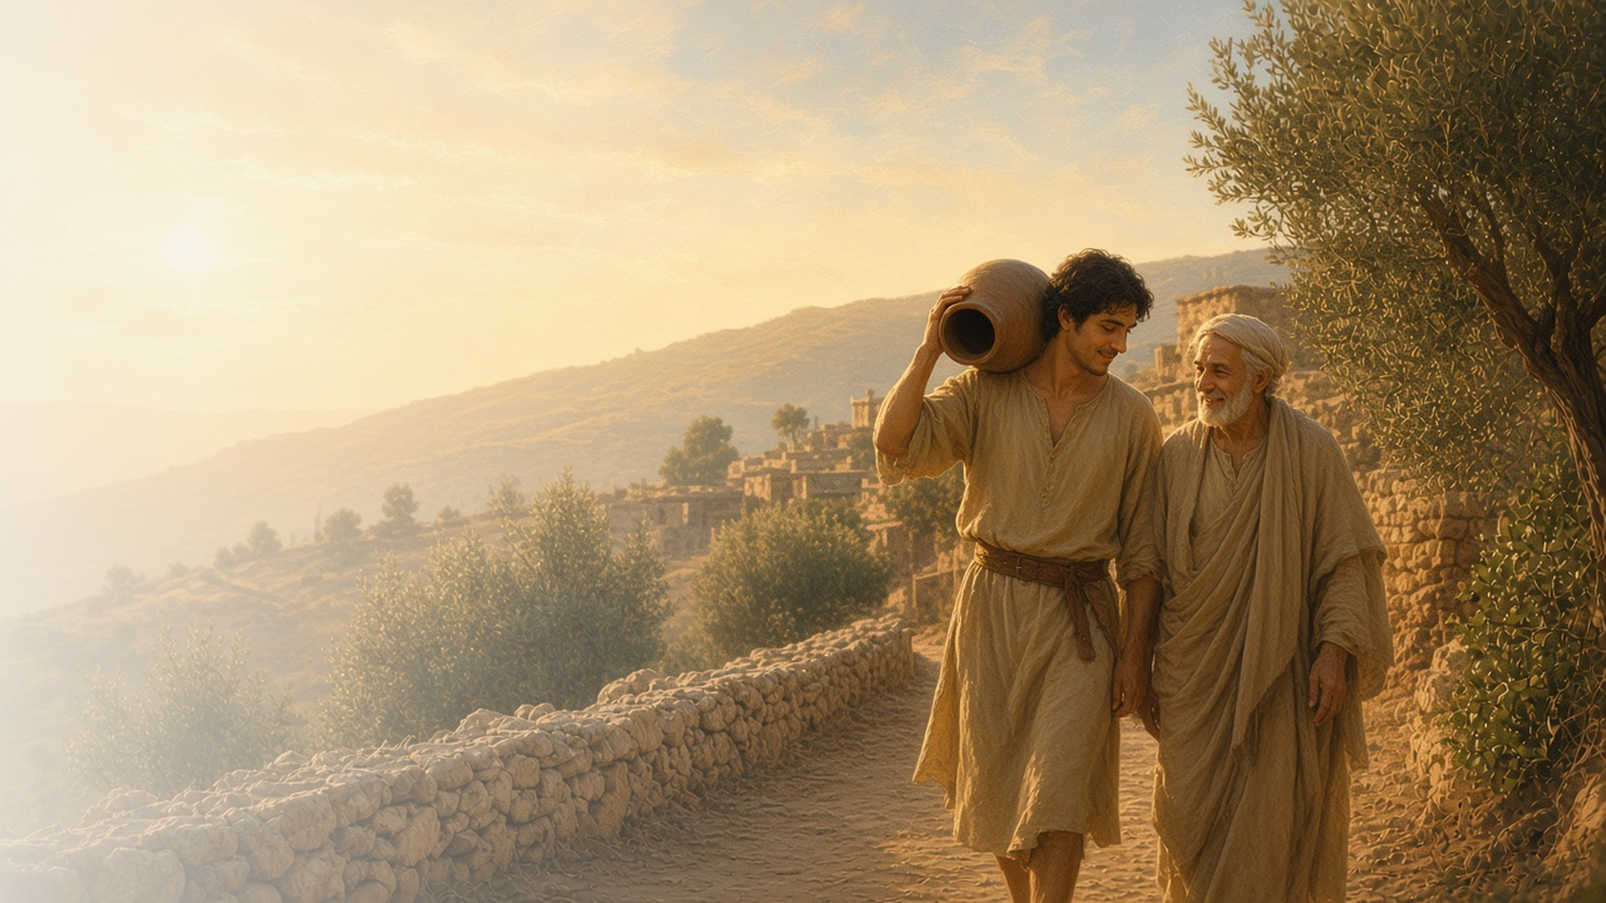
COME, FOLLOW ME · FOR CHILDREN
Be Ye Doers
of the Word, and
Not Hearers Only
November 8–14
James
Notes:
TEACHING
This week children learn that they can ask Heavenly Father to help them know what is true, that faith without works is dead, that they can speak with kindness, and that receiving God's blessings requires patience.
SCRIPTURE (KJV)
James 1:5
5 If any of you lack wisdom, let him ask of God, that giveth to all men liberally, and upbraideth not; and it shall be given him.
DISCUSSION
• What can you ask Heavenly Father?
• How can you be a doer of the word?

Slide 2
JAMES 1:5–6
I can ask Heavenly Father
If I want to know what is true, I can pray and ask.
“If any of you lack wisdom, let him ask of God.”
JAMES 1:5
Notes:
TEACHING
Explain that Joseph Smith read this verse when he was a boy and decided to pray (Joseph Smith—History 1:11–13). Heavenly Father answered him, and He will answer us too. Practice how to ask Heavenly Father a question in prayer.
SCRIPTURE (KJV)
James 1:5
5 If any of you lack wisdom, let him ask of God, that giveth to all men liberally, and upbraideth not; and it shall be given him.
Restoration scripture (public-domain text: bcbooks/scriptures-json)
Joseph Smith—History 1:11–13 (Pearl of Great Price)
11 While I was laboring under the extreme difficulties caused by the contests of these parties of religionists, I was one day reading the Epistle of James, first chapter and fifth verse, which reads: If any of you lack wisdom, let him ask of God, that giveth to all men liberally, and upbraideth not; and it shall be given him.
12 Never did any passage of scripture come with more power to the heart of man than this did at this time to mine. It seemed to enter with great force into every feeling of my heart. I reflected on it again and again, knowing that if any person needed wisdom from God, I did; for how to act I did not know, and unless I could get more wisdom than I then had, I would never know; for the teachers of religion of the different sects understood the same passages of scripture so differently as to destroy all confidence in settling the question by an appeal to the Bible.
13 At length I came to the conclusion that I must either remain in darkness and confusion, or else I must do as James directs, that is, ask of God. I at length came to the determination to "ask of God," concluding that if he gave wisdom to them that lacked wisdom, and would give liberally, and not upbraid, I might venture.
DISCUSSION (questions quoted from the manual)
• (The manual gives no direct questions for this section.)
Suggested: What question can you ask Heavenly Father in prayer?

Slide 3
JAMES 1:22–27; 2:14–18
Doers of the word
I show my faith by doing what Jesus teaches.
“But be ye doers of the word, and not hearers only.”
JAMES 1:22
Notes:
TEACHING
Play a game: say an action and have children do it, then just listen without doing. Explain that Jesus wants us to do what He teaches, not just hear it. Talk about one teaching to do this week.
SCRIPTURE (KJV)
James 1:22
22 But be ye doers of the word, and not hearers only, deceiving your own selves.
James 2:17
17 Even so faith, if it hath not works, is dead, being alone.
DISCUSSION (questions quoted from the manual)
• “How are these objects like belief without works?”
• “For instance, how do they keep their baptismal covenant?”
• “Do they know someone who is sick or lonely who they might visit?”
• “How could they serve their families?”

Slide 4
JAMES 3:1–13
I can speak kindly
My words can help others feel happy.
“Out of the same mouth proceedeth blessing and cursing.”
JAMES 3:10
Notes:
TEACHING
Talk about how kind words and unkind words make people feel. James taught that our mouths should be used for blessing. Practice saying kind things to each other.
SCRIPTURE (KJV)
James 3:9–10
9 Therewith bless we God, even the Father; and therewith curse we men, which are made after the similitude of God.
10 Out of the same mouth proceedeth blessing and cursing. My brethren, these things ought not so to be.
DISCUSSION (questions quoted from the manual)
• “How can your children learn that their words have power, for good or bad?”

Slide 5
JAMES 5:7–11
Patience brings blessings
Like a farmer waiting for rain, I can be patient.
“Behold, the husbandman waiteth for the precious fruit of the earth.”
JAMES 5:7
Notes:
TEACHING
Plant a seed in a cup and talk about how long it takes to grow. A farmer has to be patient. Heavenly Father's blessings sometimes take time too.
SCRIPTURE (KJV)
James 5:7–8
7 Be patient therefore, brethren, unto the coming of the Lord. Behold, the husbandman waiteth for the precious fruit of the earth, and hath long patience for it, until he receive the early and latter rain.
8 Be ye also patient; stablish your hearts: for the coming of the Lord draweth nigh.
DISCUSSION (questions quoted from the manual)
• “Why do we need patience when we grow plants?”
• “What would happen if we tried to pull on the seedling to make it grow faster?”
• “How does God bless us for being patient?”

Slide 6
JAMES 1:22
“But be ye doers of the word,
and not hearers only.”
Do one thing Jesus taught, not just hear it.
Notes:
TEACHING
We can be doers of the word. Invite children to do one thing Jesus taught this week.
SCRIPTURE (KJV)
James 1:22
22 But be ye doers of the word, and not hearers only, deceiving your own selves.
DISCUSSION
• What will you do?
• How does doing what Jesus taught help you?

