Slide 1
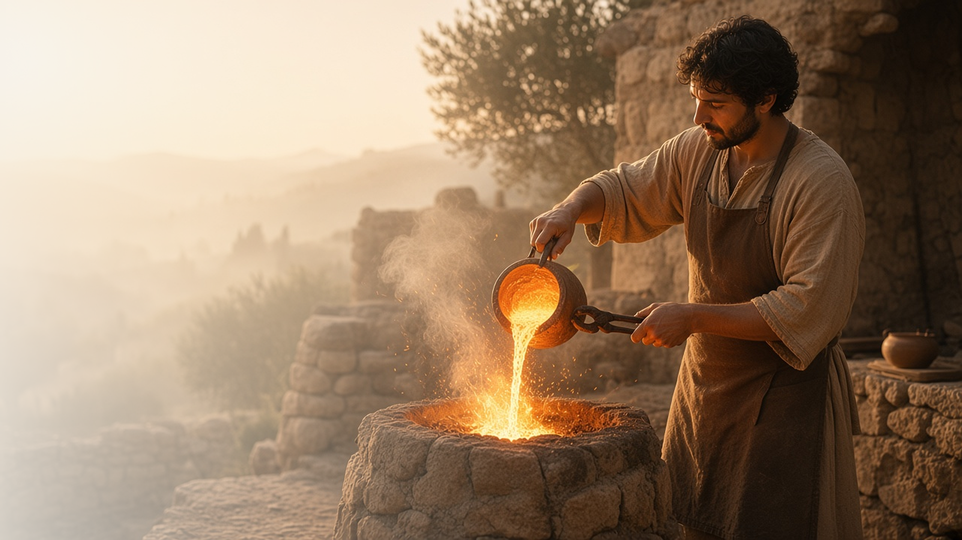
COME, FOLLOW ME · NEW TESTAMENT 2027
Rejoice with Joy
Unspeakable and
Full of Glory
November 15–21
1 and 2 Peter
Notes:
TEACHING
Peter wrote to Saints facing persecution. He testifies that Christ offers joy in trials, that the Saints are a chosen and peculiar people, that they should always be ready to give a reason for their hope, that the gospel is preached even to the dead, that Christ has given exceeding great and precious promises, and that Apostles are eyewitnesses of His majesty.
SCRIPTURE (KJV)
1 Peter 1:6–8
6 Wherein ye greatly rejoice, though now for a season, if need be, ye are in heaviness through manifold temptations:
7 That the trial of your faith, being much more precious than of gold that perisheth, though it be tried with fire, might be found unto praise and honour and glory at the appearing of Jesus Christ:
8 Whom having not seen, ye love; in whom, though now ye see him not, yet believing, ye rejoice with joy unspeakable and full of glory:
DISCUSSION
• How can trials and joy exist together?
• What is the reason for the hope that is in you?

Slide 2
1 PETER 1:3–9; 2:19–24; 3:14–17; 4:12–19; 5:7, 10
Joy in trials
Trials refine faith like gold in the fire.
“That the trial of your faith, being much more precious than of gold that perisheth, though it be tried with fire.”
1 PETER 1:7
Notes:
TEACHING
Peter compares the trial of faith to gold refined by fire: more precious than gold, and purified through heat. He told Saints not to think fiery trials strange, to rejoice as partakers of Christ's sufferings, and to cast all their care on Him. Discuss how the Savior has brought joy through a trial.
SCRIPTURE (KJV)
1 Peter 1:3–9
3 Blessed be the God and Father of our Lord Jesus Christ, which according to his abundant mercy hath begotten us again unto a lively hope by the resurrection of Jesus Christ from the dead,
4 To an inheritance incorruptible, and undefiled, and that fadeth not away, reserved in heaven for you,
5 Who are kept by the power of God through faith unto salvation ready to be revealed in the last time.
6 Wherein ye greatly rejoice, though now for a season, if need be, ye are in heaviness through manifold temptations:
7 That the trial of your faith, being much more precious than of gold that perisheth, though it be tried with fire, might be found unto praise and honour and glory at the appearing of Jesus Christ:
8 Whom having not seen, ye love; in whom, though now ye see him not, yet believing, ye rejoice with joy unspeakable and full of glory:
9 Receiving the end of your faith, even the salvation of your souls.
1 Peter 4:12–13
12 Beloved, think it not strange concerning the fiery trial which is to try you, as though some strange thing happened unto you:
13 But rejoice, inasmuch as ye are partakers of Christ’s sufferings; that, when his glory shall be revealed, ye may be glad also with exceeding joy.
1 Peter 5:7
7 Casting all your care upon him; for he careth for you.
1 Peter 5:10
10 But the God of all grace, who hath called us unto his eternal glory by Christ Jesus, after that ye have suffered a while, make you perfect, stablish, strengthen, settle you.
DISCUSSION (questions quoted from the manual)
• “Some might even wonder, “If I’m living the gospel, why am I suffering?””
• “What is it about the gospel of Jesus Christ that gives you joy, even during hard times?”

Slide 3
1 PETER 1:13–23; 2:1–12
A peculiar people
Saints are a chosen people, called out of darkness into light.
“But ye are a chosen generation, a royal priesthood, an holy nation, a peculiar people.”
1 PETER 2:9
Notes:
TEACHING
Peter calls the Saints lively stones built into a spiritual house, a royal priesthood, an holy nation, a peculiar people, meaning a people belonging to God. That identity carries a purpose: to show forth His praises and live honestly so others glorify God. Discuss what it means to be part of the people of God.
SCRIPTURE (KJV)
1 Peter 2:5–12
5 Ye also, as lively stones, are built up a spiritual house, an holy priesthood, to offer up spiritual sacrifices, acceptable to God by Jesus Christ.
6 Wherefore also it is contained in the scripture, Behold, I lay in Sion a chief corner stone, elect, precious: and he that believeth on him shall not be confounded.
7 Unto you therefore which believe he is precious: but unto them which be disobedient, the stone which the builders disallowed, the same is made the head of the corner,
8 And a stone of stumbling, and a rock of offence, even to them which stumble at the word, being disobedient: whereunto also they were appointed.
9 But ye are a chosen generation, a royal priesthood, an holy nation, a peculiar people; that ye should shew forth the praises of him who hath called you out of darkness into his marvellous light:
10 Which in time past were not a people, but are now the people of God: which had not obtained mercy, but now have obtained mercy.
11 Dearly beloved, I beseech you as strangers and pilgrims, abstain from fleshly lusts, which war against the soul;
12 Having your conversation honest among the Gentiles: that, whereas they speak against you as evildoers, they may by your good works, which they shall behold, glorify God in the day of visitation.
DISCUSSION (questions quoted from the manual)
• “What does it mean to be “the people of God”? (1 Peter 2:10).”
• “How does God feel about you?”
• “How does He expect His people to live?”

Slide 4
1 PETER 3:15
A reason of the hope
Be ready to explain, with meekness, why you hope in Christ.
“Be ready always to give an answer to every man that asketh you a reason of the hope that is in you.”
1 PETER 3:15
Notes:
TEACHING
Peter asked the Saints to be ready always to answer anyone who asks the reason for their hope, with meekness and fear. Invite class members to put their own reason for hope into a sentence or two, and to think about when they might share it.
SCRIPTURE (KJV)
1 Peter 3:14–17
14 But and if ye suffer for righteousness’ sake, happy are ye: and be not afraid of their terror, neither be troubled;
15 But sanctify the Lord God in your hearts: and be ready always to give an answer to every man that asketh you a reason of the hope that is in you with meekness and fear:
16 Having a good conscience; that, whereas they speak evil of you, as of evildoers, they may be ashamed that falsely accuse your good conversation in Christ.
17 For it is better, if the will of God be so, that ye suffer for well doing, than for evil doing.
DISCUSSION (questions quoted from the manual)
• “What is the “reason of the hope that is in you”? (1 Peter 3:15).”
• “What other questions might people ask you about your faith in Jesus Christ?”

Slide 5
1 PETER 3:18–20; 4:1–6
Preached to the dead
God’s plan gives every soul a chance to hear the gospel.
“For for this cause was the gospel preached also to them that are dead.”
1 PETER 4:6
Notes:
TEACHING
Peter taught that Christ preached to the spirits in prison and that the gospel is preached to the dead. Modern revelation in Doctrine and Covenants 138 expands this teaching. God's plan is both just and merciful, offering the gospel to all His children.
SCRIPTURE (KJV)
1 Peter 3:18–20
18 For Christ also hath once suffered for sins, the just for the unjust, that he might bring us to God, being put to death in the flesh, but quickened by the Spirit:
19 By which also he went and preached unto the spirits in prison;
20 Which sometime were disobedient, when once the longsuffering of God waited in the days of Noah, while the ark was a preparing, wherein few, that is, eight souls were saved by water.
1 Peter 4:6
6 For for this cause was the gospel preached also to them that are dead, that they might be judged according to men in the flesh, but live according to God in the spirit.
Restoration scripture (public-domain text: bcbooks/scriptures-json)
Doctrine and Covenants 138:6, 10–11, 18–19, 29–30, 32–34, 57–58 (Doctrine and Covenants)
6 I opened the Bible and read the third and fourth chapters of the first epistle of Peter, and as I read I was greatly impressed, more than I had ever been before, with the following passages:
10 "For for this cause was the gospel preached also to them that are dead, that they might be judged according to men in the flesh, but live according to God in the spirit." (1 Peter 4:6.)
11 As I pondered over these things which are written, the eyes of my understanding were opened, and the Spirit of the Lord rested upon me, and I saw the hosts of the dead, both small and great.
18 While this vast multitude waited and conversed, rejoicing in the hour of their deliverance from the chains of death, the Son of God appeared, declaring liberty to the captives who had been faithful;
19 And there he preached to them the everlasting gospel, the doctrine of the resurrection and the redemption of mankind from the fall, and from individual sins on conditions of repentance.
29 And as I wondered, my eyes were opened, and my understanding quickened, and I perceived that the Lord went not in person among the wicked and the disobedient who had rejected the truth, to teach them;
30 But behold, from among the righteous, he organized his forces and appointed messengers, clothed with power and authority, and commissioned them to go forth and carry the light of the gospel to them that were in darkness, even to all the spirits of men; and thus was the gospel preached to the dead.
32 Thus was the gospel preached to those who had died in their sins, without a knowledge of the truth, or in transgression, having rejected the prophets.
33 These were taught faith in God, repentance from sin, vicarious baptism for the remission of sins, the gift of the Holy Ghost by the laying on of hands,
34 And all other principles of the gospel that were necessary for them to know in order to qualify themselves that they might be judged according to men in the flesh, but live according to God in the spirit.
57 I beheld that the faithful elders of this dispensation, when they depart from mortal life, continue their labors in the preaching of the gospel of repentance and redemption, through the sacrifice of the Only Begotten Son of God, among those who are in darkness and under the bondage of sin in the great world of the spirits of the dead.
58 The dead who repent will be redeemed, through obedience to the ordinances of the house of God,
Full passage: Doctrine and Covenants 138
DISCUSSION (questions quoted from the manual)
• “After reading 1 Peter 3:18–20; 4:1–6, how would you respond to this concern?”
• “What do you learn about God and His plan from this revelation?”

Slide 6
2 PETER 1:1–11
Precious promises
Christ’s promises help us become partakers of the divine nature.
“Whereby are given unto us exceeding great and precious promises: that by these ye might be partakers of the divine nature.”
2 PETER 1:4
Notes:
TEACHING
Peter lists qualities to add to faith: virtue, knowledge, temperance, patience, godliness, brotherly kindness, and charity. Through Christ's precious promises we can become partakers of the divine nature and make our calling and election sure. Invite class members to choose one quality to add this week.
SCRIPTURE (KJV)
2 Peter 1:3–11
3 According as his divine power hath given unto us all things that pertain unto life and godliness, through the knowledge of him that hath called us to glory and virtue:
4 Whereby are given unto us exceeding great and precious promises: that by these ye might be partakers of the divine nature, having escaped the corruption that is in the world through lust.
5 And beside this, giving all diligence, add to your faith virtue; and to virtue knowledge;
6 And to knowledge temperance; and to temperance patience; and to patience godliness;
7 And to godliness brotherly kindness; and to brotherly kindness charity.
8 For if these things be in you, and abound, they make you that ye shall neither be barren nor unfruitful in the knowledge of our Lord Jesus Christ.
9 But he that lacketh these things is blind, and cannot see afar off, and hath forgotten that he was purged from his old sins.
10 Wherefore the rather, brethren, give diligence to make your calling and election sure: for if ye do these things, ye shall never fall:
11 For so an entrance shall be ministered unto you abundantly into the everlasting kingdom of our Lord and Saviour Jesus Christ.
DISCUSSION (questions quoted from the manual)
• “What are the “exceeding great and precious promises” the Lord has given you?”

Slide 7
2 PETER 1:16–21
Eyewitnesses of His majesty
Peter testified of what he had seen and heard on the mount.
“But were eyewitnesses of his majesty.”
2 PETER 1:16
Notes:
TEACHING
Peter reminded the Saints that he had not followed cunningly devised fables; he had been an eyewitness on the holy mount and heard the Father's voice. Apostles today are special witnesses of Christ. Discuss how their witness strengthens ours.
SCRIPTURE (KJV)
2 Peter 1:16–21
16 For we have not followed cunningly devised fables, when we made known unto you the power and coming of our Lord Jesus Christ, but were eyewitnesses of his majesty.
17 For he received from God the Father honour and glory, when there came such a voice to him from the excellent glory, This is my beloved Son, in whom I am well pleased.
18 And this voice which came from heaven we heard, when we were with him in the holy mount.
19 We have also a more sure word of prophecy; whereunto ye do well that ye take heed, as unto a light that shineth in a dark place, until the day dawn, and the day star arise in your hearts:
20 Knowing this first, that no prophecy of the scripture is of any private interpretation.
21 For the prophecy came not in old time by the will of man: but holy men of God spake as they were moved by the Holy Ghost.
DISCUSSION (questions quoted from the manual)
• “What do you learn from 2 Peter 1:16–21 about Apostles?”
• “What gives you confidence to follow living Apostles today?”

Slide 8
1 PETER 1:8
“Yet believing, ye rejoice
with joy unspeakable and full of glory.”
Share with someone this week a reason for your hope.
Notes:
TEACHING
Though they had not seen Christ, Peter's readers loved Him and rejoiced with joy unspeakable. Close by inviting class members to share the reason for their hope with someone this week.
SCRIPTURE (KJV)
1 Peter 1:8–9
8 Whom having not seen, ye love; in whom, though now ye see him not, yet believing, ye rejoice with joy unspeakable and full of glory:
9 Receiving the end of your faith, even the salvation of your souls.
DISCUSSION
• What gives you joy in Christ right now?
• With whom could you share your hope?

