Slide 1
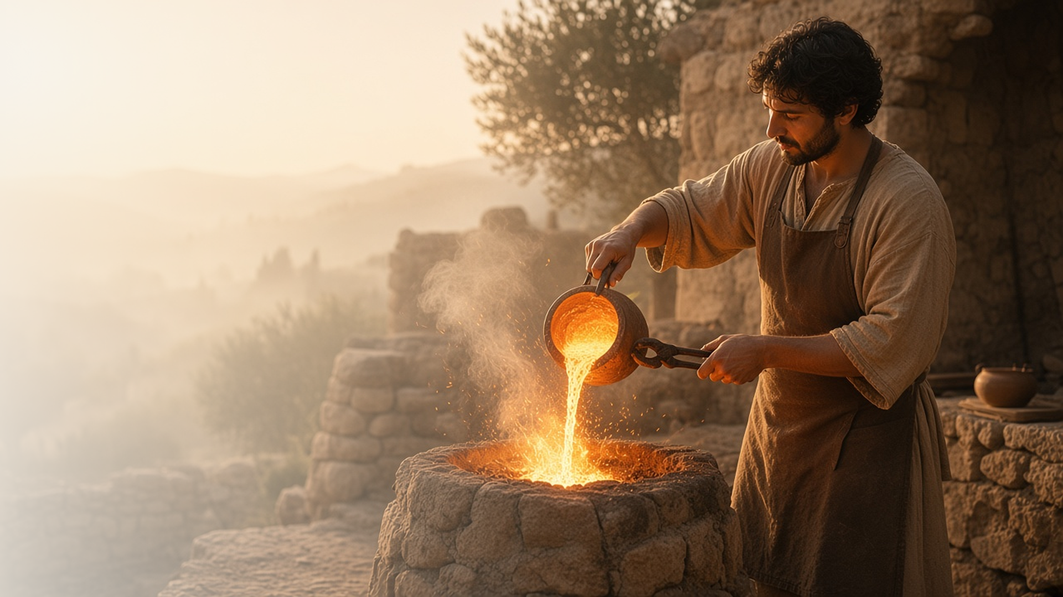
COME, FOLLOW ME · FOR CHILDREN
Rejoice with Joy
Unspeakable and
Full of Glory
November 15–21
1 and 2 Peter
Notes:
TEACHING
This week children learn that Jesus can help them find joy even during hard times, that Heavenly Father wants them to be examples, that they can always be ready to share the gospel, and that spirits in the spirit world learn about the gospel.
SCRIPTURE (KJV)
1 Peter 3:15
15 But sanctify the Lord God in your hearts: and be ready always to give an answer to every man that asketh you a reason of the hope that is in you with meekness and fear:
DISCUSSION
• How can Jesus help you feel happy?
• How can you share the gospel?

Slide 2
1 PETER 1:6–7; 3:12–17; 4:13–14, 16
Joy in hard times
Jesus can help me feel joy even when life is hard.
“Wherein ye greatly rejoice, though now for a season, if need be, ye are in heaviness through manifold temptations.”
1 PETER 1:6
Notes:
TEACHING
Explain that the people Peter wrote to were having hard times, yet they could still rejoice because of Jesus. Talk about something hard and how Jesus can help us feel joy anyway.
SCRIPTURE (KJV)
1 Peter 1:6–7
6 Wherein ye greatly rejoice, though now for a season, if need be, ye are in heaviness through manifold temptations:
7 That the trial of your faith, being much more precious than of gold that perisheth, though it be tried with fire, might be found unto praise and honour and glory at the appearing of Jesus Christ:
DISCUSSION (questions quoted from the manual)
• (The manual gives no direct questions for this section.)
Suggested: How can Jesus help you feel happy when something is hard?

Slide 3
1 PETER 2:9–12
I can be an example
My good works can help others glorify God.
“But ye are a chosen generation.”
1 PETER 2:9
Notes:
TEACHING
Explain that Heavenly Father has chosen us to help others see His light. When we are kind and honest, people can see what it means to follow Jesus. Help children think of a good example they can set.
SCRIPTURE (KJV)
1 Peter 2:9–12
9 But ye are a chosen generation, a royal priesthood, an holy nation, a peculiar people; that ye should shew forth the praises of him who hath called you out of darkness into his marvellous light:
10 Which in time past were not a people, but are now the people of God: which had not obtained mercy, but now have obtained mercy.
11 Dearly beloved, I beseech you as strangers and pilgrims, abstain from fleshly lusts, which war against the soul;
12 Having your conversation honest among the Gentiles: that, whereas they speak against you as evildoers, they may by your good works, which they shall behold, glorify God in the day of visitation.
DISCUSSION (questions quoted from the manual)
• “How does Heavenly Father want us to stand out?”

Slide 4
1 PETER 3:15
Ready to share
I can always be ready to tell others about Jesus.
“Be ready always to give an answer to every man.”
1 PETER 3:15
Notes:
TEACHING
Practice answering simple questions a friend might ask, like "Why do you go to church?" or "Who is Jesus?" Help children feel ready and happy to share.
SCRIPTURE (KJV)
1 Peter 3:15
15 But sanctify the Lord God in your hearts: and be ready always to give an answer to every man that asketh you a reason of the hope that is in you with meekness and fear:
DISCUSSION (questions quoted from the manual)
• “How did you answer?”
• “What can we do to “be ready always” to share the gospel?”

Slide 5
1 PETER 3:18–20; 4:6
The gospel for those who died
People in the spirit world can learn about Jesus.
“For for this cause was the gospel preached also to them that are dead.”
1 PETER 4:6
Notes:
TEACHING
Explain that when people die, their spirits go to the spirit world, and those who did not know about Jesus can learn there. Doctrine and Covenants 138 teaches more about this. Talk about how temple work helps them.
SCRIPTURE (KJV)
1 Peter 3:19
19 By which also he went and preached unto the spirits in prison;
Full passage: 1 Peter 3:18–19
1 Peter 4:6
6 For for this cause was the gospel preached also to them that are dead, that they might be judged according to men in the flesh, but live according to God in the spirit.
Restoration scripture (public-domain text: bcbooks/scriptures-json)
Doctrine and Covenants 138:19, 32 (Doctrine and Covenants)
19 And there he preached to them the everlasting gospel, the doctrine of the resurrection and the redemption of mankind from the fall, and from individual sins on conditions of repentance.
32 Thus was the gospel preached to those who had died in their sins, without a knowledge of the truth, or in transgression, having rejected the prophets.
Full passage: Doctrine and Covenants 138
DISCUSSION (questions quoted from the manual)
• (The manual gives no direct questions for this section.)
Suggested: How can we help people in the spirit world?

Slide 6
1 PETER 5:7
“Casting all your care upon him;
for he careth for you.”
Tell Heavenly Father your worries in prayer this week.
Notes:
TEACHING
Heavenly Father cares for us. Invite children to tell Him their worries in prayer this week.
SCRIPTURE (KJV)
1 Peter 5:7
7 Casting all your care upon him; for he careth for you.
DISCUSSION
• What worries can you tell Heavenly Father?
• How do you feel after you pray?

