Slide 1
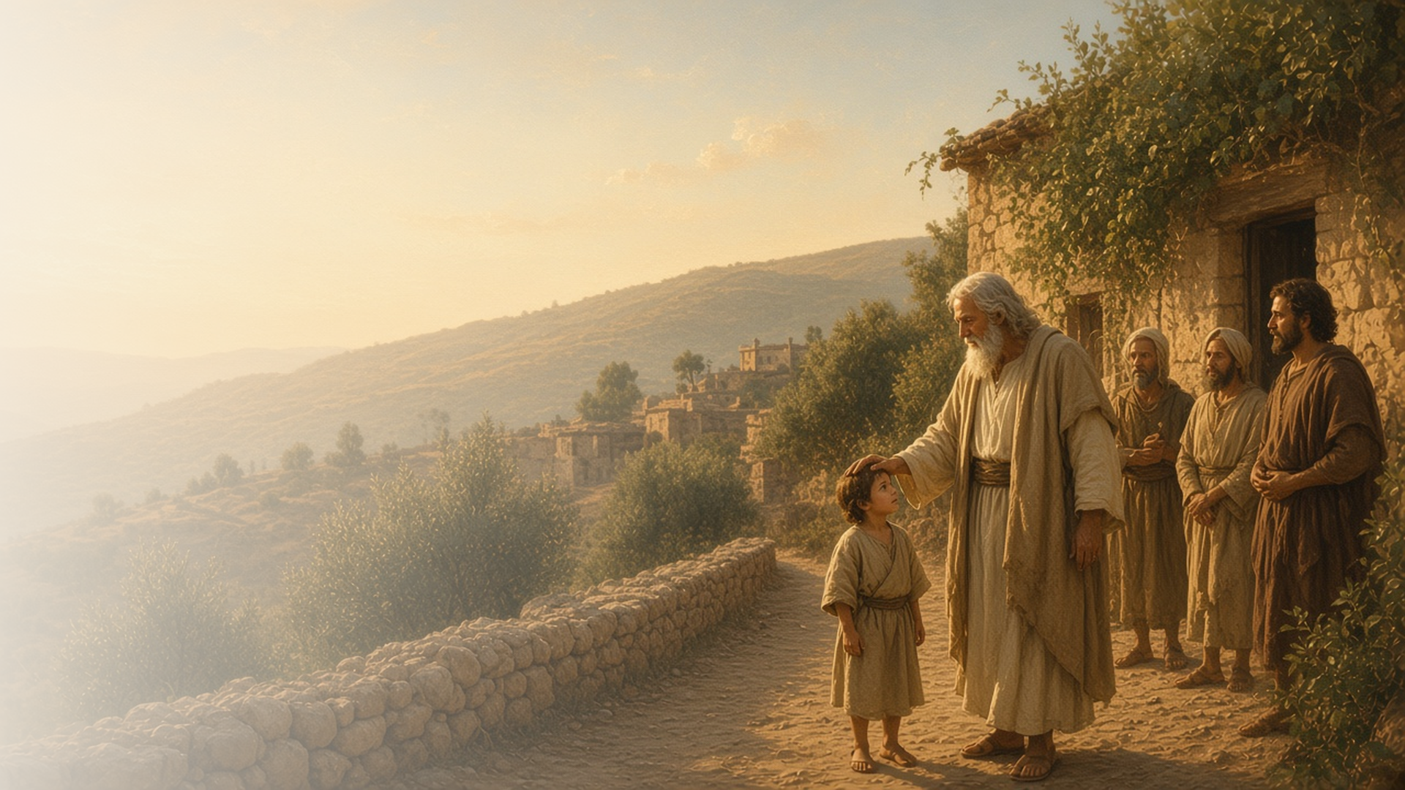
COME, FOLLOW ME · NEW TESTAMENT 2027
God Is Love
November 22–28
1–3 John; Jude
Notes:
TEACHING
The letters of John, written late in his life, return again and again to two truths: God is light, and God is love. John testifies that Jesus is our Advocate with the Father, that there is safety in abiding in the doctrine of Christ, and that we can become like Him. His shorter letters and Jude's urge the Saints to walk in truth and build up their faith.
SCRIPTURE (KJV)
1 John 4:7–11
7 Beloved, let us love one another: for love is of God; and every one that loveth is born of God, and knoweth God.
8 He that loveth not knoweth not God; for God is love.
9 In this was manifested the love of God toward us, because that God sent his only begotten Son into the world, that we might live through him.
10 Herein is love, not that we loved God, but that he loved us, and sent his Son to be the propitiation for our sins.
11 Beloved, if God so loved us, we ought also to love one another.
DISCUSSION
• How have you come to know that God is love?
• What does it mean to you that Jesus is your Advocate?

Slide 2
1 JOHN
God is light; God is love
John taught that God is light and that God is love.
“He that loveth not knoweth not God; for God is love.”
1 JOHN 4:8
Notes:
TEACHING
John's message is simple and profound: God is light, with no darkness at all, and God is love. Love is not only something God does but who He is, shown most of all in sending His Son. Invite class members to look for John's descriptions of light and love and what they reveal about God.
SCRIPTURE (KJV)
1 John 1:5–7
5 This then is the message which we have heard of him, and declare unto you, that God is light, and in him is no darkness at all.
6 If we say that we have fellowship with him, and walk in darkness, we lie, and do not the truth:
7 But if we walk in the light, as he is in the light, we have fellowship one with another, and the blood of Jesus Christ his Son cleanseth us from all sin.
1 John 4:7–10
7 Beloved, let us love one another: for love is of God; and every one that loveth is born of God, and knoweth God.
8 He that loveth not knoweth not God; for God is love.
9 In this was manifested the love of God toward us, because that God sent his only begotten Son into the world, that we might live through him.
10 Herein is love, not that we loved God, but that he loved us, and sent his Son to be the propitiation for our sins.
DISCUSSION (questions quoted from the manual)
• “If you were to choose one or two words to describe God, what would they be?”
• “What similarities do you see between what the Savior taught and what 1 John teaches about the light and love of God?”
• “What experiences have taught you that God is light and love?”
• “What insights do you gain from “The Lord Is My Light”? (Hymns, no. 89).”

Slide 3
1 JOHN 2:1–2
An advocate with the Father
Jesus pleads our cause and is the propitiation for our sins.
“And if any man sin, we have an advocate with the Father, Jesus Christ the righteous.”
1 JOHN 2:1
Notes:
TEACHING
An advocate speaks on someone else's behalf. John teaches that when we sin, Jesus Christ the righteous pleads our cause, and that He is the propitiation, the atoning sacrifice, for our sins and the sins of the whole world. Discuss how this understanding brings hope when we fall short.
SCRIPTURE (KJV)
1 John 2:1–2
1 My little children, these things write I unto you, that ye sin not. And if any man sin, we have an advocate with the Father, Jesus Christ the righteous:
2 And he is the propitiation for our sins: and not for ours only, but also for the sins of the whole world.
DISCUSSION (questions quoted from the manual)
• “What does an advocate do?”
• “How does Jesus Christ fill that role for you?”
• “What do you learn about Jesus Christ from this message?”

Slide 4
1 JOHN 2; 3:24; 4:1–16; 2 JOHN 1:7–11
Abide in the doctrine
Safety comes from abiding in true doctrine of Christ.
“He that abideth in the doctrine of Christ, he hath both the Father and the Son.”
2 JOHN 1:9
Notes:
TEACHING
Some in John's day denied that Jesus had come in the flesh. John urged the Saints to try the spirits and to let what they had heard from the beginning abide in them. Those who abide in the doctrine of Christ have both the Father and the Son. Discuss how to recognize and hold to true doctrine today.
SCRIPTURE (KJV)
1 John 2:24
24 Let that therefore abide in you, which ye have heard from the beginning. If that which ye have heard from the beginning shall remain in you, ye also shall continue in the Son, and in the Father.
1 John 4:1–3
1 Beloved, believe not every spirit, but try the spirits whether they are of God: because many false prophets are gone out into the world.
2 Hereby know ye the Spirit of God: Every spirit that confesseth that Jesus Christ is come in the flesh is of God:
3 And every spirit that confesseth not that Jesus Christ is come in the flesh is not of God: and this is that spirit of antichrist, whereof ye have heard that it should come; and even now already is it in the world.
2 John 1:9
9 Whosoever transgresseth, and abideth not in the doctrine of Christ, hath not God. He that abideth in the doctrine of Christ, he hath both the Father and the Son.
DISCUSSION (questions quoted from the manual)
• “What do you think it means to abide in God and His doctrine? (see 2 John 1:9).”
• “What does it mean to you to have God abide in you?”
• “How has this helped you recognize and resist deception? (see 1 John 2:18–28; 4:1–16; 2 John 1:7–11).”

Slide 5
1 JOHN 2:24–29; 3:1–3
We shall be like him
As children of God, we can become like Jesus Christ.
“But we know that, when he shall appear, we shall be like him; for we shall see him as he is.”
1 JOHN 3:2
Notes:
TEACHING
John marvels at the love that makes us the sons and daughters of God. We do not yet know fully what we will be, but when He appears we shall be like Him, and everyone with this hope purifies himself. Invite class members to consider how this hope changes daily choices.
SCRIPTURE (KJV)
1 John 3:1–3
1 Behold, what manner of love the Father hath bestowed upon us, that we should be called the sons of God: therefore the world knoweth us not, because it knew him not.
2 Beloved, now are we the sons of God, and it doth not yet appear what we shall be: but we know that, when he shall appear, we shall be like him; for we shall see him as he is.
3 And every man that hath this hope in him purifieth himself, even as he is pure.
DISCUSSION (questions quoted from the manual)
• “Does the goal of becoming Christlike ever seem too lofty to you?”
• “What do you find in 1 John 2:24–29; 3:1–3 that gives you confidence and comfort as a disciple of Jesus Christ?”

Slide 6
3 JOHN 1:1–4
Walk in truth
Joy comes from helping others walk in truth.
“I have no greater joy than to hear that my children walk in truth.”
3 JOHN 1:4
Notes:
TEACHING
John's brief letter to Gaius expresses a teacher's and parent's deepest joy: hearing that his children walk in truth. Discuss the joy of helping family members, friends, or those we minister to stay on the covenant path.
SCRIPTURE (KJV)
3 John 1:1–4
1 The elder unto the wellbeloved Gaius, whom I love in the truth.
2 Beloved, I wish above all things that thou mayest prosper and be in health, even as thy soul prospereth.
3 For I rejoiced greatly, when the brethren came and testified of the truth that is in thee, even as thou walkest in the truth.
4 I have no greater joy than to hear that my children walk in truth.
DISCUSSION (questions quoted from the manual)
• “When have you experienced the joy described in 3 John 1:4?”

Slide 7
JUDE
Build up your faith
Jude urged the Saints to build up their holy faith.
“But ye, beloved, building up yourselves on your most holy faith, praying in the Holy Ghost.”
JUDE 1:20
Notes:
TEACHING
Jude warned of ungodly men creeping in among the Saints, and urged believers to build up themselves on their most holy faith, pray in the Holy Ghost, keep themselves in the love of God, and have compassion on others. His closing praises the God who is able to keep us from falling.
SCRIPTURE (KJV)
Jude 1:20–25
20 But ye, beloved, building up yourselves on your most holy faith, praying in the Holy Ghost,
21 Keep yourselves in the love of God, looking for the mercy of our Lord Jesus Christ unto eternal life.
22 And of some have compassion, making a difference:
23 And others save with fear, pulling them out of the fire; hating even the garment spotted by the flesh.
24 Now unto him that is able to keep you from falling, and to present you faultless before the presence of his glory with exceeding joy,
25 To the only wise God our Saviour, be glory and majesty, dominion and power, both now and ever. Amen.
DISCUSSION (questions quoted from the manual)
• “What else do you learn from Jude 1:10–19 about people who fight against God and His work?”
• “What do you learn from verses 20–25 about keeping your faith in Jesus Christ strong?”

Slide 8
1 JOHN 4:19
“We love him, because he first loved us.”
Show God’s love to someone this week in a concrete way.
Notes:
TEACHING
Our love for God and others is a response to His love. John adds that we cannot claim to love God while hating a brother. Close by inviting class members to show God's love to someone this week in a concrete way.
SCRIPTURE (KJV)
1 John 4:19–21
19 We love him, because he first loved us.
20 If a man say, I love God, and hateth his brother, he is a liar: for he that loveth not his brother whom he hath seen, how can he love God whom he hath not seen?
21 And this commandment have we from him, That he who loveth God love his brother also.
DISCUSSION
• How has God's love changed you?
• Whom will you love more fully this week?

