Slide 1
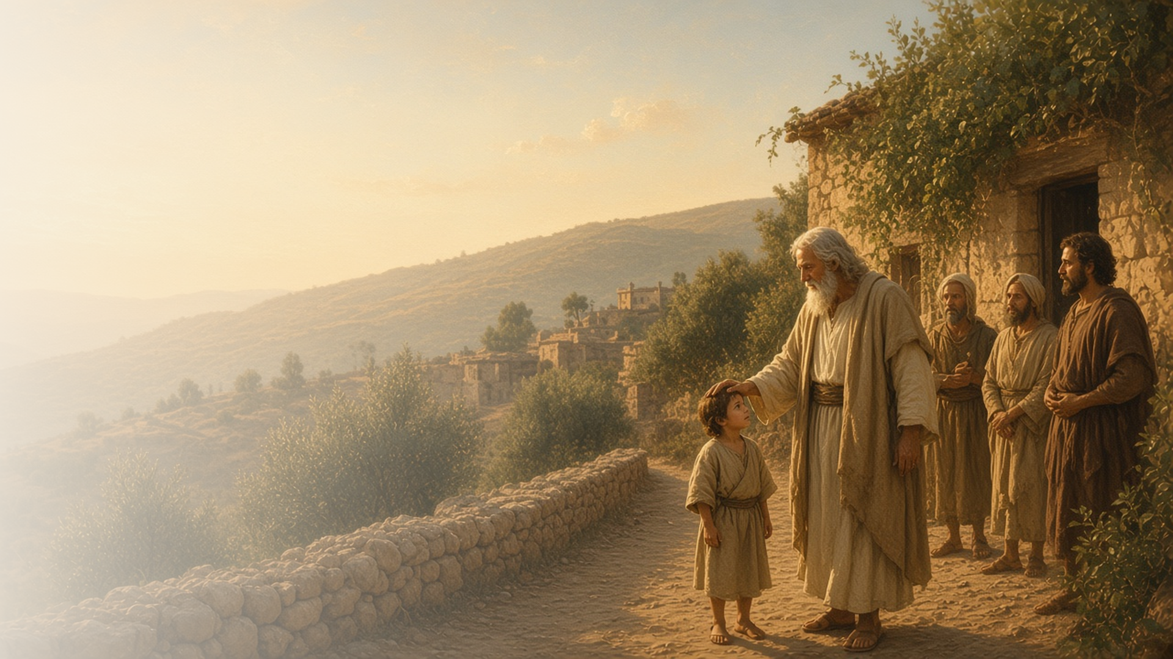
COME, FOLLOW ME · FOR CHILDREN
God Is Love
November 22–28
1–3 John; Jude
Notes:
TEACHING
This week children learn that God is their light, that they keep God's commandments because they love Him, that because God loves us we should love one another, and that they will walk in truth.
SCRIPTURE (KJV)
1 John 4:11
11 Beloved, if God so loved us, we ought also to love one another.
DISCUSSION
• How does Heavenly Father show His love?
• How can you show love to others?

Slide 2
1 JOHN 1:5–7; 2:8–11
God is my light
Heavenly Father helps me walk in the light.
“God is light, and in him is no darkness at all.”
1 JOHN 1:5
Notes:
TEACHING
Turn off the lights, then turn on a flashlight. Light helps us see where to go. Heavenly Father is like a light that helps us choose the right way.
SCRIPTURE (KJV)
1 John 1:5–7
5 This then is the message which we have heard of him, and declare unto you, that God is light, and in him is no darkness at all.
6 If we say that we have fellowship with him, and walk in darkness, we lie, and do not the truth:
7 But if we walk in the light, as he is in the light, we have fellowship one with another, and the blood of Jesus Christ his Son cleanseth us from all sin.
DISCUSSION (questions quoted from the manual)
• (The manual gives no direct questions for this section.)
Suggested: How does Heavenly Father help you know the right way to go?

Slide 3
1 JOHN 2:3–5; 5:2–3
I keep His commandments
I keep the commandments because I love God.
“For this is the love of God, that we keep his commandments: and his commandments are not grievous.”
1 JOHN 5:3
Notes:
TEACHING
Ask children why they obey their parents. Explain that we keep God's commandments because we love Him, and His commandments make us happy.
SCRIPTURE (KJV)
1 John 5:2–3
2 By this we know that we love the children of God, when we love God, and keep his commandments.
3 For this is the love of God, that we keep his commandments: and his commandments are not grievous.
DISCUSSION (questions quoted from the manual)
• “Gong’s wife, Susan, once asked some children, “How do you know your parents and families love you?” (“Love Is Spoken Here,””
• “Then they could ponder, “How does God know that I love Him?””

Slide 4
1 JOHN 4:7–11, 20–21
Love one another
Because God loves us, we should love each other.
“Beloved, if God so loved us, we ought also to love one another.”
1 JOHN 4:11
Notes:
TEACHING
Cut out paper hearts and write the names of people children can love and help. Because Heavenly Father loves us so much, we want to share that love with others.
SCRIPTURE (KJV)
1 John 4:7–11
7 Beloved, let us love one another: for love is of God; and every one that loveth is born of God, and knoweth God.
8 He that loveth not knoweth not God; for God is love.
9 In this was manifested the love of God toward us, because that God sent his only begotten Son into the world, that we might live through him.
10 Herein is love, not that we loved God, but that he loved us, and sent his Son to be the propitiation for our sins.
11 Beloved, if God so loved us, we ought also to love one another.
DISCUSSION (questions quoted from the manual)
• “How might this person feel?”
• “How can we help them feel God’s love?”

Slide 5
3 JOHN 1:3–4
I will walk in truth
I can follow what is true every day.
“I have no greater joy than to hear that my children walk in truth.”
3 JOHN 1:4
Notes:
TEACHING
Explain that walking in truth means living what is true, like being honest and following Jesus. John felt great joy when people did this. Talk about how parents and teachers feel when children choose the right.
SCRIPTURE (KJV)
3 John 1:3–4
3 For I rejoiced greatly, when the brethren came and testified of the truth that is in thee, even as thou walkest in the truth.
4 I have no greater joy than to hear that my children walk in truth.
DISCUSSION (questions quoted from the manual)
• (The manual gives no direct questions for this section.)
Suggested: What is one way you can walk in truth this week?

Slide 6
1 JOHN 4:8
“For God is love.”
Show love to someone in your family every day this week.
Notes:
TEACHING
God is love. Invite children to show love to someone in their family every day this week.
SCRIPTURE (KJV)
1 John 4:8
8 He that loveth not knoweth not God; for God is love.
DISCUSSION
• How will you show love?
• How does it feel to be loved?

