Slide 1
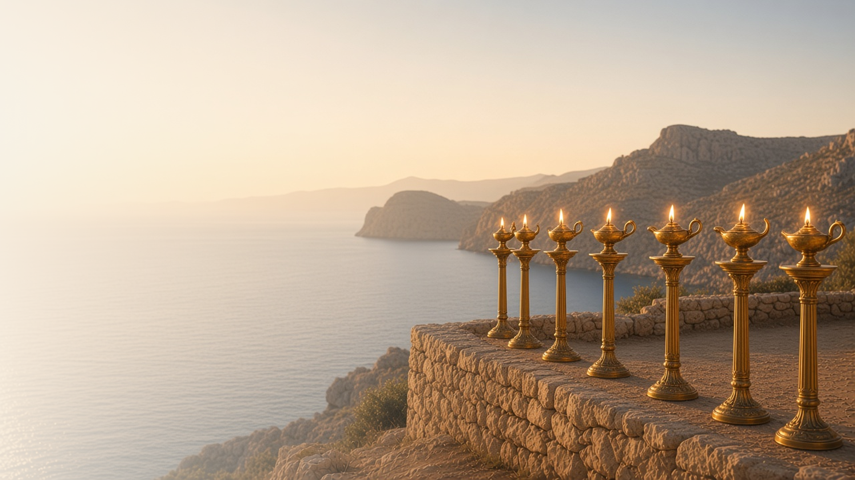
COME, FOLLOW ME · NEW TESTAMENT 2027
Glory, and Power,
Be unto … the Lamb
For Ever
November 29–December 5
Revelation 1–5
Notes:
TEACHING
On the isle of Patmos, John received a revelation of Jesus Christ. He saw the glorified Savior among seven golden candlesticks, heard His messages to seven churches promising blessings to those who overcome, beheld the Father on His throne worshipped by all creation, and saw that only the Lamb who was slain was worthy to open the sealed book.
SCRIPTURE (KJV)
Revelation 1:17–18
17 And when I saw him, I fell at his feet as dead. And he laid his right hand upon me, saying unto me, Fear not; I am the first and the last:
18 I am he that liveth, and was dead; and, behold, I am alive for evermore, Amen; and have the keys of hell and of death.
DISCUSSION
• What do these chapters teach you about who Jesus Christ is?
• Which promise to "him that overcometh" means the most to you?

Slide 2
REVELATION 1
The living Son of God
John saw the glorified Christ, who was dead and is alive.
“I am he that liveth, and was dead; and, behold, I am alive for evermore, Amen; and have the keys of hell and of death.”
REVELATION 1:18
Notes:
TEACHING
John turned to see a voice and beheld the Son of Man in glory, with eyes like fire and a voice like many waters. John fell at His feet, and the Savior laid His hand on him: fear not, I am He that liveth, and was dead, and am alive forever, with the keys of hell and of death. Invite class members to share what this vision teaches them about Christ.
SCRIPTURE (KJV)
Revelation 1:12–18
12 And I turned to see the voice that spake with me. And being turned, I saw seven golden candlesticks;
13 And in the midst of the seven candlesticks one like unto the Son of man, clothed with a garment down to the foot, and girt about the paps with a golden girdle.
14 His head and his hairs were white like wool, as white as snow; and his eyes were as a flame of fire;
15 And his feet like unto fine brass, as if they burned in a furnace; and his voice as the sound of many waters.
16 And he had in his right hand seven stars: and out of his mouth went a sharp twoedged sword: and his countenance was as the sun shineth in his strength.
17 And when I saw him, I fell at his feet as dead. And he laid his right hand upon me, saying unto me, Fear not; I am the first and the last:
18 I am he that liveth, and was dead; and, behold, I am alive for evermore, Amen; and have the keys of hell and of death.
DISCUSSION (questions quoted from the manual)
• “How have you come to know that Christ is the Living Son of the Living God?”

Slide 3
REVELATION 1:1
Revealed to His servants
God reveals His will to prophets, who share it with us.
“The Revelation of Jesus Christ, which God gave unto him, to shew unto his servants things which must shortly come to pass.”
REVELATION 1:1
Notes:
TEACHING
Revelation begins by explaining its own origin: God gave it to Jesus Christ, who sent it by an angel to His servant John, who wrote it for the churches. Blessed are those who read and keep it. Discuss how the Lord still reveals His will through His servants today.
SCRIPTURE (KJV)
Revelation 1:1–3
1 The Revelation of Jesus Christ, which God gave unto him, to shew unto his servants things which must shortly come to pass; and he sent and signified it by his angel unto his servant John:
2 Who bare record of the word of God, and of the testimony of Jesus Christ, and of all things that he saw.
3 Blessed is he that readeth, and they that hear the words of this prophecy, and keep those things which are written therein: for the time is at hand.
DISCUSSION (questions quoted from the manual)
• “What do you learn from Revelation 1:1 about how God reveals truth to His children?”

Slide 4
REVELATION 2–3
To him that overcometh
Christ knows each church’s struggles and promises help to overcome.
“To him that overcometh will I grant to sit with me in my throne.”
REVELATION 3:21
Notes:
TEACHING
To each of seven churches the Savior says, "I know thy works," names their strengths and failings, and promises great blessings to those who overcome: the tree of life, a new name, white raiment, and a seat with Him on His throne. Invite class members to find a message meant for them.
SCRIPTURE (KJV)
Revelation 2:2–5
2 I know thy works, and thy labour, and thy patience, and how thou canst not bear them which are evil: and thou hast tried them which say they are apostles, and are not, and hast found them liars:
3 And hast borne, and hast patience, and for my name’s sake hast laboured, and hast not fainted.
4 Nevertheless I have somewhat against thee, because thou hast left thy first love.
5 Remember therefore from whence thou art fallen, and repent, and do the first works; or else I will come unto thee quickly, and will remove thy candlestick out of his place, except thou repent.
Revelation 3:19–21
19 As many as I love, I rebuke and chasten: be zealous therefore, and repent.
20 Behold, I stand at the door, and knock: if any man hear my voice, and open the door, I will come in to him, and will sup with him, and he with me.
21 To him that overcometh will I grant to sit with me in my throne, even as I also overcame, and am set down with my Father in his throne.
DISCUSSION (questions quoted from the manual)
• “What evidence do you find in these passages that the Lord knows and loves His children? (see Revelation 3:19–20).”
• “What do you feel His message would be to you? (see your patriarchal blessing, if you have one).”
• “What do you find in these chapters that inspires you to stay faithful to Him?”

Slide 5
REVELATION 4
Holy, holy, holy
John saw Heavenly Father worshipped as God and King.
“Holy, holy, holy, Lord God Almighty, which was, and is, and is to come.”
REVELATION 4:8
Notes:
TEACHING
Through an open door in heaven, John saw the Father on His throne, surrounded by a rainbow, elders, and living creatures who worship Him day and night. Discuss how this vision of God as King and Creator affects the way we worship Him.
SCRIPTURE (KJV)
Revelation 4:1–11
1 After this I looked, and, behold, a door was opened in heaven: and the first voice which I heard was as it were of a trumpet talking with me; which said, Come up hither, and I will shew thee things which must be hereafter.
2 And immediately I was in the spirit: and, behold, a throne was set in heaven, and one sat on the throne.
3 And he that sat was to look upon like a jasper and a sardine stone: and there was a rainbow round about the throne, in sight like unto an emerald.
4 And round about the throne were four and twenty seats: and upon the seats I saw four and twenty elders sitting, clothed in white raiment; and they had on their heads crowns of gold.
5 And out of the throne proceeded lightnings and thunderings and voices: and there were seven lamps of fire burning before the throne, which are the seven Spirits of God.
6 And before the throne there was a sea of glass like unto crystal: and in the midst of the throne, and round about the throne, were four beasts full of eyes before and behind.
7 And the first beast was like a lion, and the second beast like a calf, and the third beast had a face as a man, and the fourth beast was like a flying eagle.
8 And the four beasts had each of them six wings about him; and they were full of eyes within: and they rest not day and night, saying, Holy, holy, holy, Lord God Almighty, which was, and is, and is to come.
9 And when those beasts give glory and honour and thanks to him that sat on the throne, who liveth for ever and ever,
10 The four and twenty elders fall down before him that sat on the throne, and worship him that liveth for ever and ever, and cast their crowns before the throne, saying,
11 Thou art worthy, O Lord, to receive glory and honour and power: for thou hast created all things, and for thy pleasure they are and were created.
DISCUSSION (questions quoted from the manual)
• “What do these descriptions suggest to you about God?”
• “What do they inspire you to do to show Him gratitude?”

Slide 6
REVELATION 5
Worthy is the Lamb
Only the Lamb could open the book and fulfil the plan.
“Worthy is the Lamb that was slain to receive power, and riches, and wisdom, and strength, and honour, and glory, and blessing.”
REVELATION 5:12
Notes:
TEACHING
No one in heaven or earth could open the sealed book, and John wept. Then he saw a Lamb as it had been slain, who took the book, and all heaven sang that He was worthy because He had redeemed us by His blood. Only Jesus Christ could make Heavenly Father's plan possible.
SCRIPTURE (KJV)
Revelation 5:1–12
1 And I saw in the right hand of him that sat on the throne a book written within and on the backside, sealed with seven seals.
2 And I saw a strong angel proclaiming with a loud voice, Who is worthy to open the book, and to loose the seals thereof?
3 And no man in heaven, nor in earth, neither under the earth, was able to open the book, neither to look thereon.
4 And I wept much, because no man was found worthy to open and to read the book, neither to look thereon.
5 And one of the elders saith unto me, Weep not: behold, the Lion of the tribe of Juda, the Root of David, hath prevailed to open the book, and to loose the seven seals thereof.
6 And I beheld, and, lo, in the midst of the throne and of the four beasts, and in the midst of the elders, stood a Lamb as it had been slain, having seven horns and seven eyes, which are the seven Spirits of God sent forth into all the earth.
7 And he came and took the book out of the right hand of him that sat upon the throne.
8 And when he had taken the book, the four beasts and four and twenty elders fell down before the Lamb, having every one of them harps, and golden vials full of odours, which are the prayers of saints.
9 And they sung a new song, saying, Thou art worthy to take the book, and to open the seals thereof: for thou wast slain, and hast redeemed us to God by thy blood out of every kindred, and tongue, and people, and nation;
10 And hast made us unto our God kings and priests: and we shall reign on the earth.
11 And I beheld, and I heard the voice of many angels round about the throne and the beasts and the elders: and the number of them was ten thousand times ten thousand, and thousands of thousands;
12 Saying with a loud voice, Worthy is the Lamb that was slain to receive power, and riches, and wisdom, and strength, and honour, and glory, and blessing.
DISCUSSION (questions quoted from the manual)
• “Have you ever wondered what it was like in the premortal existence when we realized that Jesus Christ would make Heavenly Father’s plan possible?”
• “How can you honor Christ for His sacrifice? (see verse 13).”

Slide 7
REVELATION 1:8
“I am Alpha and Omega,
the beginning and the ending.”
Open the door to the Savior a little wider each day this week.
Notes:
TEACHING
The lesson title comes from Revelation 5:13, where every creature gives glory and power to the Father and the Lamb forever. Close with the Savior's own declaration, and invite class members to open the door to Him a little wider each day.
SCRIPTURE (KJV)
Revelation 1:8
8 I am Alpha and Omega, the beginning and the ending, saith the Lord, which is, and which was, and which is to come, the Almighty.
Revelation 5:13
13 And every creature which is in heaven, and on the earth, and under the earth, and such as are in the sea, and all that are in them, heard I saying, Blessing, and honour, and glory, and power, be unto him that sitteth upon the throne, and unto the Lamb for ever and ever.
DISCUSSION
• What does it mean to you that Christ is the beginning and the ending?
• How will you open the door to Him this week?

