Slide 1
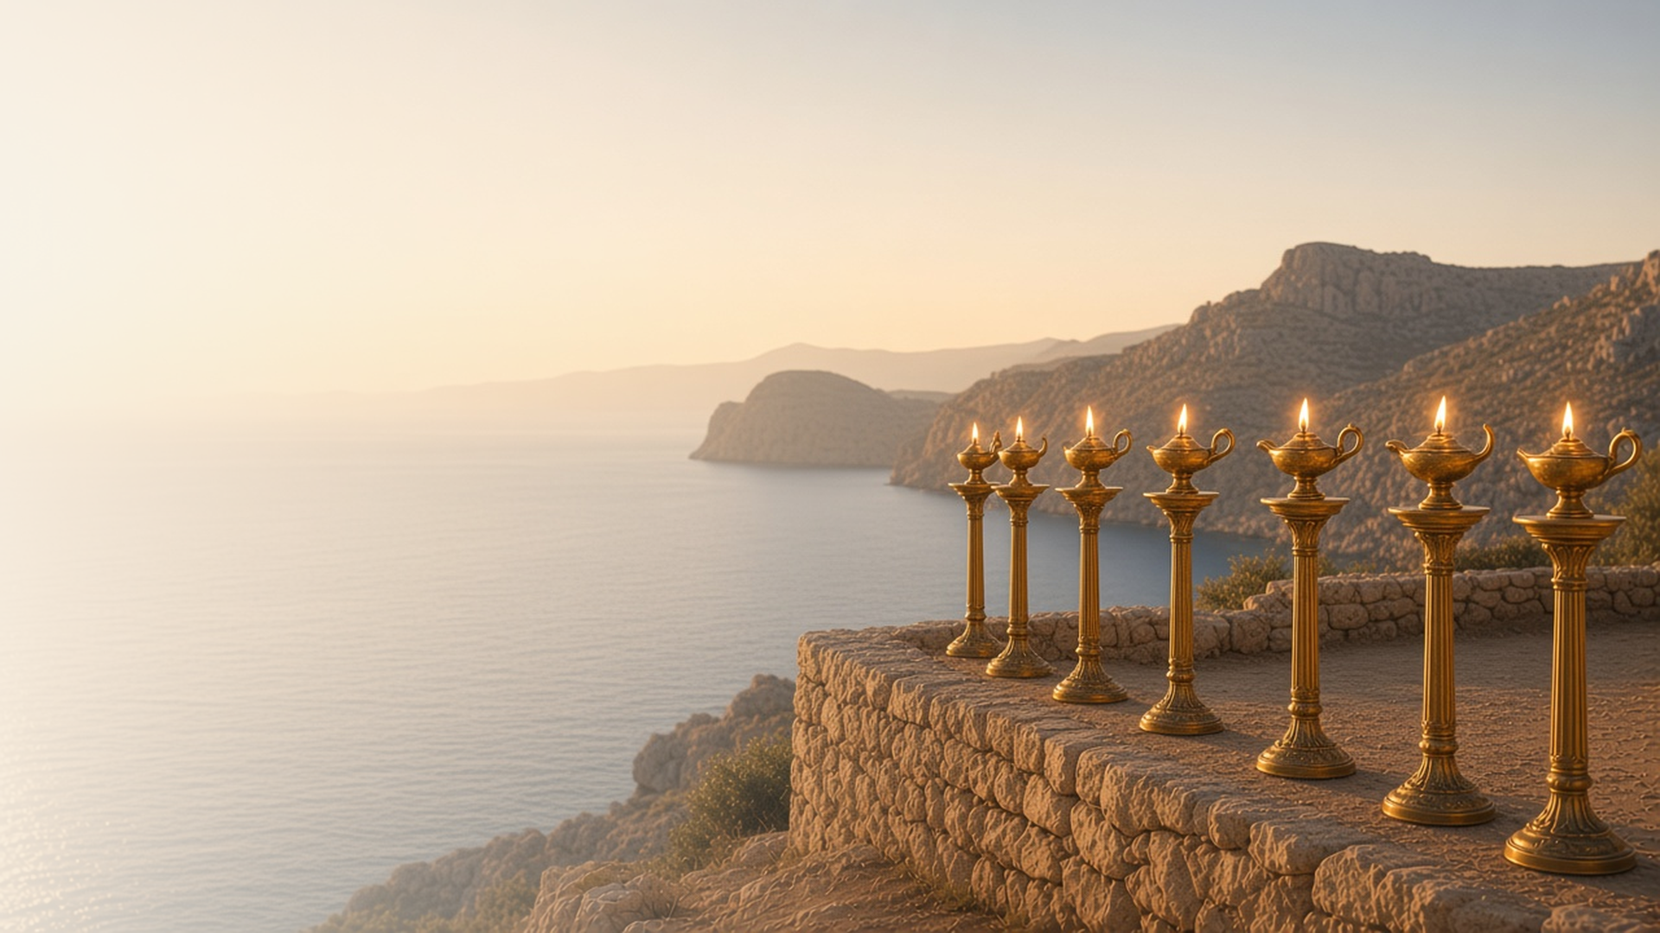
COME, FOLLOW ME · FOR CHILDREN
Glory, and Power,
Be unto … the Lamb
For Ever
November 29–December 5
Revelation 1–5
Notes:
TEACHING
This week children learn that they can shine the Savior's light, that they can be committed to His gospel, that they can invite Jesus into their lives, and that Jesus Christ is the only one who can be their Savior.
SCRIPTURE (KJV)
Revelation 3:20
20 Behold, I stand at the door, and knock: if any man hear my voice, and open the door, I will come in to him, and will sup with him, and he with me.
DISCUSSION
• What does Jesus do at the door?
• How can you open the door to Him?

Slide 2
REVELATION 1:20
I can shine His light
Jesus called His Churches candlesticks that give light.
“And the seven candlesticks which thou sawest are the seven churches.”
REVELATION 1:20
Notes:
TEACHING
Light a candle or flashlight. Explain that John saw Jesus standing among golden candlesticks, which stood for His churches. Like candles, we can shine Jesus's light by being kind and good.
SCRIPTURE (KJV)
Revelation 1:12–13
12 And I turned to see the voice that spake with me. And being turned, I saw seven golden candlesticks;
13 And in the midst of the seven candlesticks one like unto the Son of man, clothed with a garment down to the foot, and girt about the paps with a golden girdle.
Revelation 1:20
20 The mystery of the seven stars which thou sawest in my right hand, and the seven golden candlesticks. The seven stars are the angels of the seven churches: and the seven candlesticks which thou sawest are the seven churches.
DISCUSSION (questions quoted from the manual)
• “Why does the Savior want us to shine His light?”
• “What are some other ways we can share His light?”

Slide 3
REVELATION 3:15–16
I can be committed
Jesus wants me to be all in, not lukewarm.
“I know thy works, that thou art neither cold nor hot: I would thou wert cold or hot.”
REVELATION 3:15
Notes:
TEACHING
Let children feel cold, warm, and hot water. Explain that Jesus wants us to be fully committed to following Him, not just a little. Talk about ways to follow Him with all our hearts.
SCRIPTURE (KJV)
Revelation 3:15–16
15 I know thy works, that thou art neither cold nor hot: I would thou wert cold or hot.
16 So then because thou art lukewarm, and neither cold nor hot, I will spue thee out of my mouth.
DISCUSSION (questions quoted from the manual)
• “Why does the Savior not want us to be lukewarm in our commitment to the gospel?”
• “What can we do to be committed to Him?”

Slide 4
REVELATION 3:20
I can open the door
Jesus knocks, and I can invite Him into my life.
“Behold, I stand at the door, and knock.”
REVELATION 3:20
Notes:
TEACHING
Knock on a door and ask a child to open it. Jesus said He stands at the door and knocks. We open the door by praying, reading scriptures, and choosing the right.
SCRIPTURE (KJV)
Revelation 3:20
20 Behold, I stand at the door, and knock: if any man hear my voice, and open the door, I will come in to him, and will sup with him, and he with me.
DISCUSSION (questions quoted from the manual)
• “What was it like waiting for that person to knock on the door?”
• “How would that person feel if no one opened it?”
• “How do we let Jesus into our lives?”
• “How does having Him in our lives affect the way we live? (see “If the Savior Stood Beside Me,””
• “Why does Jesus knock instead of just coming inside?”
• “How are we blessed when we invite Him into our lives?”

Slide 5
REVELATION 5:1–10
Only Jesus can save me
Jesus is the only one who could be our Savior.
“Thou art worthy to take the book, and to open the seals thereof: for thou wast slain, and hast redeemed us to God by thy blood.”
REVELATION 5:9
Notes:
TEACHING
Tell how no one could open the special book until Jesus came. Everyone sang a new song because He was worthy. Jesus is the only one who could save us.
SCRIPTURE (KJV)
Revelation 5:2, 4–5, 9
2 And I saw a strong angel proclaiming with a loud voice, Who is worthy to open the book, and to loose the seals thereof?
4 And I wept much, because no man was found worthy to open and to read the book, neither to look thereon.
5 And one of the elders saith unto me, Weep not: behold, the Lion of the tribe of Juda, the Root of David, hath prevailed to open the book, and to loose the seven seals thereof.
9 And they sung a new song, saying, Thou art worthy to take the book, and to open the seals thereof: for thou wast slain, and hast redeemed us to God by thy blood out of every kindred, and tongue, and people, and nation;
Full passage: Revelation 5:1–9
DISCUSSION (questions quoted from the manual)
• “What has Jesus done for us that no one else could?”

Slide 6
REVELATION 3:20
“Behold, I stand at the door, and knock.”
Invite Jesus into your day with a morning prayer.
Notes:
TEACHING
Jesus knocks at the door. Invite children to welcome Him each morning with a prayer.
SCRIPTURE (KJV)
Revelation 3:20
20 Behold, I stand at the door, and knock: if any man hear my voice, and open the door, I will come in to him, and will sup with him, and he with me.
DISCUSSION
• When will you say your morning prayer?
• How do you feel when Jesus is close?

