Slide 1
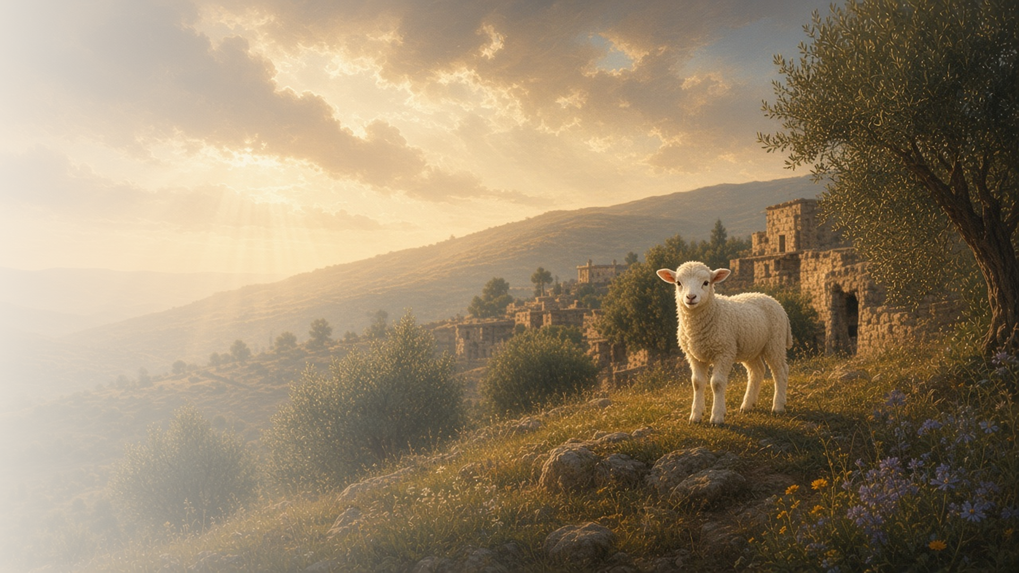
COME, FOLLOW ME · NEW TESTAMENT 2027
They Overcame …
by the Blood of the Lamb
December 6–12
Revelation 6–14
Notes:
TEACHING
As the seals are opened, John sees earth's history unfold, with special attention to the latter days. Amid wars and plagues he also sees the faithful sealed, robed in white, and comforted. He sees the war in heaven and learns that the Saints overcome Satan by the blood of the Lamb and the word of their testimony, and he sees an angel bringing the everlasting gospel to every nation.
SCRIPTURE (KJV)
Revelation 12:10–11
10 And I heard a loud voice saying in heaven, Now is come salvation, and strength, and the kingdom of our God, and the power of his Christ: for the accuser of our brethren is cast down, which accused them before our God day and night.
11 And they overcame him by the blood of the Lamb, and by the word of their testimony; and they loved not their lives unto the death.
DISCUSSION
• How do the blood of the Lamb and your testimony help you overcome?
• Where do you see hope in these chapters?

Slide 2
REVELATION 6–11
The latter days unfold
John saw earth’s history, with special focus on the last days.
“These are they which came out of great tribulation, and have washed their robes, and made them white in the blood of the Lamb.”
REVELATION 7:14
Notes:
TEACHING
Revelation 6–11 can be read as a sweep of earth's history, with most of the detail given to the latter days, including judgments, wars, and plagues. Yet in the middle of it John sees a great multitude in white robes, washed in the blood of the Lamb and comforted by God. Discuss why it matters that the hope appears in the midst of the turmoil.
SCRIPTURE (KJV)
Revelation 7:9–17
9 After this I beheld, and, lo, a great multitude, which no man could number, of all nations, and kindreds, and people, and tongues, stood before the throne, and before the Lamb, clothed with white robes, and palms in their hands;
10 And cried with a loud voice, saying, Salvation to our God which sitteth upon the throne, and unto the Lamb.
11 And all the angels stood round about the throne, and about the elders and the four beasts, and fell before the throne on their faces, and worshipped God,
12 Saying, Amen: Blessing, and glory, and wisdom, and thanksgiving, and honour, and power, and might, be unto our God for ever and ever. Amen.
13 And one of the elders answered, saying unto me, What are these which are arrayed in white robes? and whence came they?
14 And I said unto him, Sir, thou knowest. And he said to me, These are they which came out of great tribulation, and have washed their robes, and made them white in the blood of the Lamb.
15 Therefore are they before the throne of God, and serve him day and night in his temple: and he that sitteth on the throne shall dwell among them.
16 They shall hunger no more, neither thirst any more; neither shall the sun light on them, nor any heat.
17 For the Lamb which is in the midst of the throne shall feed them, and shall lead them unto living fountains of waters: and God shall wipe away all tears from their eyes.
Restoration scripture (public-domain text: bcbooks/scriptures-json)
Doctrine and Covenants 77:8–11 (Doctrine and Covenants)
8 Q. What are we to understand by the four angels, spoken of in the 7th chapter and 1st verse of Revelation? A. We are to understand that they are four angels sent forth from God, to whom is given power over the four parts of the earth, to save life and to destroy; these are they who have the everlasting gospel to commit to every nation, kindred, tongue, and people; having power to shut up the heavens, to seal up unto life, or to cast down to the regions of darkness.
9 Q. What are we to understand by the angel ascending from the east, Revelation 7th chapter and 2nd verse? A. We are to understand that the angel ascending from the east is he to whom is given the seal of the living God over the twelve tribes of Israel; wherefore, he crieth unto the four angels having the everlasting gospel, saying: Hurt not the earth, neither the sea, nor the trees, till we have sealed the servants of our God in their foreheads. And, if you will receive it, this is Elias which was to come to gather together the tribes of Israel and restore all things.
10 Q. What time are the things spoken of in this chapter to be accomplished? A. They are to be accomplished in the sixth thousand years, or the opening of the sixth seal.
11 Q. What are we to understand by sealing the one hundred and forty-four thousand, out of all the tribes of Israel—twelve thousand out of every tribe? A. We are to understand that those who are sealed are high priests, ordained unto the holy order of God, to administer the everlasting gospel; for they are they who are ordained out of every nation, kindred, tongue, and people, by the angels to whom is given power over the nations of the earth, to bring as many as will come to the church of the Firstborn.
Doctrine and Covenants 77:12–13, 15 (Doctrine and Covenants)
12 Q. What are we to understand by the sounding of the trumpets, mentioned in the 8th chapter of Revelation? A. We are to understand that as God made the world in six days, and on the seventh day he finished his work, and sanctified it, and also formed man out of the dust of the earth, even so, in the beginning of the seventh thousand years will the Lord God sanctify the earth, and complete the salvation of man, and judge all things, and shall redeem all things, except that which he hath not put into his power, when he shall have sealed all things, unto the end of all things; and the sounding of the trumpets of the seven angels are the preparing and finishing of his work, in the beginning of the seventh thousand years—the preparing of the way before the time of his coming.
13 Q. When are the things to be accomplished, which are written in the 9th chapter of Revelation? A. They are to be accomplished after the opening of the seventh seal, before the coming of Christ.
15 Q. What is to be understood by the two witnesses, in the eleventh chapter of Revelation? A. They are two prophets that are to be raised up to the Jewish nation in the last days, at the time of the restoration, and to prophesy to the Jews after they are gathered and have built the city of Jerusalem in the land of their fathers.
DISCUSSION (questions quoted from the manual)
• “What thoughts do you have about this work? (see also Doctrine and Covenants 77:8–11).”
• “What do you learn from verses 13–17 about Jesus Christ and those who come to Him?”
• “What do chapters 8; 9; and 11 teach you about the events of the last days? (see also Doctrine and Covenants 77:12–13, 15).”
• “How can we prepare spiritually for these events?”
• “What recurring themes do you find as you search these chapters?”
• “Even though these chapters describe wars and plagues, what do you find that gives hope and confidence in Jesus Christ? (see, for example, Revelation 11:15–17).”

Slide 3
REVELATION 12–14
By the word of their testimony
Saints overcome Satan through Christ’s blood and their witness.
“Now is come salvation, and strength, and the kingdom of our God, and the power of his Christ.”
REVELATION 12:10
Notes:
TEACHING
John saw war in heaven: Michael and his angels fought the dragon, who was cast out. The faithful overcame him by the blood of the Lamb and the word of their testimony. That same war continues on earth, and we overcome in the same way. Invite class members to consider how the Atonement and their testimony help them resist evil.
SCRIPTURE (KJV)
Revelation 12:7–11
7 And there was war in heaven: Michael and his angels fought against the dragon; and the dragon fought and his angels,
8 And prevailed not; neither was their place found any more in heaven.
9 And the great dragon was cast out, that old serpent, called the Devil, and Satan, which deceiveth the whole world: he was cast out into the earth, and his angels were cast out with him.
10 And I heard a loud voice saying in heaven, Now is come salvation, and strength, and the kingdom of our God, and the power of his Christ: for the accuser of our brethren is cast down, which accused them before our God day and night.
11 And they overcame him by the blood of the Lamb, and by the word of their testimony; and they loved not their lives unto the death.
DISCUSSION (questions quoted from the manual)
• “What do you learn about how to overcome Satan? (see also Joseph Smith Translation, Revelation 12:7–11 [in the Bible appendix]; Topics and Questions, “War in Heaven,””
• “What do you learn from Revelation 13 about how Satan wages war today?”
• “According to chapter 14, how does the Lamb fight it?”
• “How are “the blood of the Lamb” and “the word of [your] testimony” (Revelation 12:11) helping you in this war today?”

Slide 4
REVELATION 14:6–7
The everlasting gospel
John saw an angel bringing the gospel to every nation.
“And I saw another angel fly in the midst of heaven, having the everlasting gospel to preach unto them that dwell on the earth.”
REVELATION 14:6
Notes:
TEACHING
John saw an angel flying in the midst of heaven with the everlasting gospel to preach to every nation, kindred, tongue, and people. Latter-day Saints see this fulfilled in the Restoration, through angelic ministers who restored truth and authority. Discuss how we help carry that gospel to all people.
SCRIPTURE (KJV)
Revelation 14:6–7
6 And I saw another angel fly in the midst of heaven, having the everlasting gospel to preach unto them that dwell on the earth, and to every nation, and kindred, and tongue, and people,
7 Saying with a loud voice, Fear God, and give glory to him; for the hour of his judgment is come: and worship him that made heaven, and earth, and the sea, and the fountains of waters.
DISCUSSION (questions quoted from the manual)
• “How can you participate in the work mentioned in Revelation 14:6–7?”

Slide 5
REVELATION 12:11
“They overcame him by the blood of the Lamb,
and by the word of their testimony.”
Strengthen someone this week with the word of your testimony.
Notes:
TEACHING
The title of this lesson describes how the faithful overcome. Close by inviting class members to strengthen someone this week with their testimony of the Savior.
SCRIPTURE (KJV)
Revelation 12:11
11 And they overcame him by the blood of the Lamb, and by the word of their testimony; and they loved not their lives unto the death.
DISCUSSION
• Whom could your testimony strengthen this week?
• How has the Savior's Atonement helped you overcome?

