Slide 1
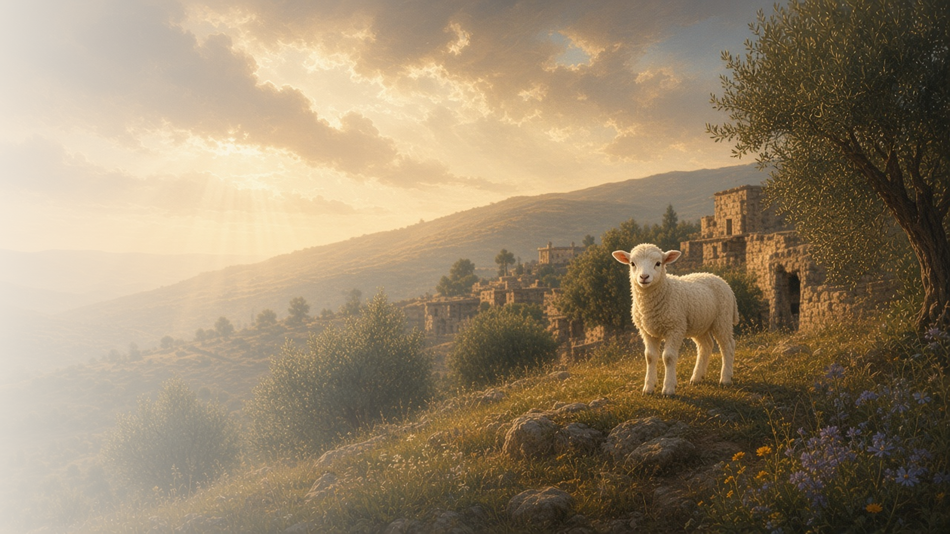
COME, FOLLOW ME · FOR CHILDREN
They Overcame …
by the Blood of the Lamb
December 6–12
Revelation 6–14
Notes:
TEACHING
This week children learn that Jesus Christ helps them be forgiven and comforts them, that they showed faith in Jesus Christ in the premortal life, and that Jesus Christ restored His gospel in our day.
SCRIPTURE (KJV)
Revelation 14:6
6 And I saw another angel fly in the midst of heaven, having the everlasting gospel to preach unto them that dwell on the earth, and to every nation, and kindred, and tongue, and people,
DISCUSSION
• What did the angel bring?
• How does Jesus comfort you?

Slide 2
REVELATION 7:9, 13–17
Jesus comforts me
Jesus helps me be forgiven and comforts me when I’m sad.
“And God shall wipe away all tears from their eyes.”
REVELATION 7:17
Notes:
TEACHING
Explain that John saw people dressed in white because Jesus had made them clean. God promised to wipe away all their tears. Pretend to wipe away a tear and talk about how Jesus comforts us.
SCRIPTURE (KJV)
Revelation 7:13–17
13 And one of the elders answered, saying unto me, What are these which are arrayed in white robes? and whence came they?
14 And I said unto him, Sir, thou knowest. And he said to me, These are they which came out of great tribulation, and have washed their robes, and made them white in the blood of the Lamb.
15 Therefore are they before the throne of God, and serve him day and night in his temple: and he that sitteth on the throne shall dwell among them.
16 They shall hunger no more, neither thirst any more; neither shall the sun light on them, nor any heat.
17 For the Lamb which is in the midst of the throne shall feed them, and shall lead them unto living fountains of waters: and God shall wipe away all tears from their eyes.
DISCUSSION (questions quoted from the manual)
• (The manual gives no direct questions for this section.)
Suggested: When has Jesus helped you feel better?

Slide 3
REVELATION 12:7–11
I chose Jesus before
In the premortal life, I chose to follow Jesus.
“And they overcame him by the blood of the Lamb.”
REVELATION 12:11
Notes:
TEACHING
Explain that before we were born, we lived with Heavenly Father and chose to follow Jesus. Satan did not, and he was cast out. Each day we can keep choosing Jesus.
SCRIPTURE (KJV)
Revelation 12:7–11
7 And there was war in heaven: Michael and his angels fought against the dragon; and the dragon fought and his angels,
8 And prevailed not; neither was their place found any more in heaven.
9 And the great dragon was cast out, that old serpent, called the Devil, and Satan, which deceiveth the whole world: he was cast out into the earth, and his angels were cast out with him.
10 And I heard a loud voice saying in heaven, Now is come salvation, and strength, and the kingdom of our God, and the power of his Christ: for the accuser of our brethren is cast down, which accused them before our God day and night.
11 And they overcame him by the blood of the Lamb, and by the word of their testimony; and they loved not their lives unto the death.
DISCUSSION (questions quoted from the manual)
• “Why is it important to know about what happened in the War in Heaven?”

Slide 4
REVELATION 14:6–7
The gospel restored
Jesus restored His gospel in our day.
“And I saw another angel fly in the midst of heaven, having the everlasting gospel.”
REVELATION 14:6
Notes:
TEACHING
Explain that John saw an angel bringing the gospel back to earth. Heavenly Father and Jesus restored the gospel through the Prophet Joseph Smith. Talk about blessings we have because of the Restoration.
SCRIPTURE (KJV)
Revelation 14:6
6 And I saw another angel fly in the midst of heaven, having the everlasting gospel to preach unto them that dwell on the earth, and to every nation, and kindred, and tongue, and people,
DISCUSSION (questions quoted from the manual)
• “How have we been blessed because Jesus sent these angels to earth in our day?”

Slide 5
REVELATION 14:7
“Worship him that made heaven, and earth,
and the sea, and the fountains of waters.”
Thank Heavenly Father for the restored gospel in your prayers.
Notes:
TEACHING
The angel invited everyone to worship God. Invite children to thank Heavenly Father for the restored gospel in their prayers.
SCRIPTURE (KJV)
Revelation 14:6–7
6 And I saw another angel fly in the midst of heaven, having the everlasting gospel to preach unto them that dwell on the earth, and to every nation, and kindred, and tongue, and people,
7 Saying with a loud voice, Fear God, and give glory to him; for the hour of his judgment is come: and worship him that made heaven, and earth, and the sea, and the fountains of waters.
DISCUSSION
• What do you love about the gospel?
• How can you worship Heavenly Father?

