Slide 1
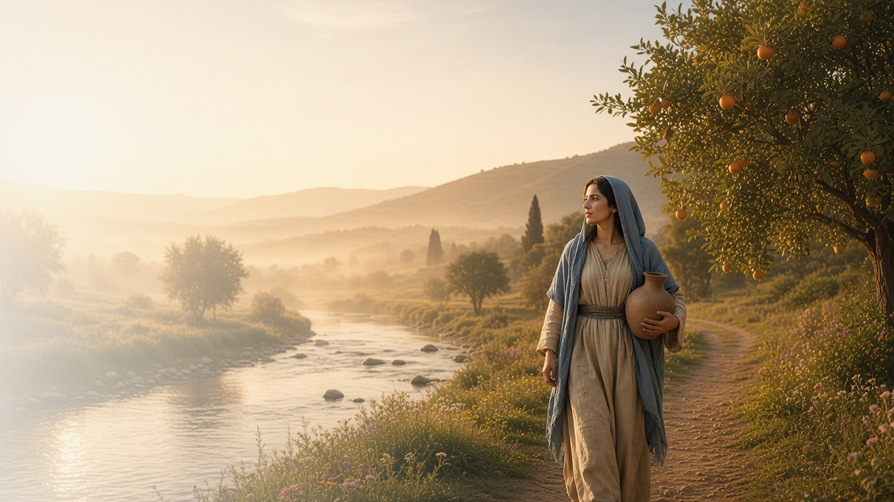
COME, FOLLOW ME · NEW TESTAMENT 2027
He That Overcometh
Shall Inherit
All Things
December 13–19
Revelation 15–22
Notes:
TEACHING
Revelation ends in triumph. The faithful sing the song of Moses and the Lamb, Babylon falls, Christ returns as King of kings, all are judged out of the books, and John sees a new heaven and a new earth where God dwells with His people and wipes away all tears. The final invitation is to come, and the final prayer is: Even so, come, Lord Jesus.
SCRIPTURE (KJV)
Revelation 21:1–7
1 And I saw a new heaven and a new earth: for the first heaven and the first earth were passed away; and there was no more sea.
2 And I John saw the holy city, new Jerusalem, coming down from God out of heaven, prepared as a bride adorned for her husband.
3 And I heard a great voice out of heaven saying, Behold, the tabernacle of God is with men, and he will dwell with them, and they shall be his people, and God himself shall be with them, and be their God.
4 And God shall wipe away all tears from their eyes; and there shall be no more death, neither sorrow, nor crying, neither shall there be any more pain: for the former things are passed away.
5 And he that sat upon the throne said, Behold, I make all things new. And he said unto me, Write: for these words are true and faithful.
6 And he said unto me, It is done. I am Alpha and Omega, the beginning and the end. I will give unto him that is athirst of the fountain of the water of life freely.
7 He that overcometh shall inherit all things; and I will be his God, and he shall be my son.
DISCUSSION
• How does the end of Revelation change how you see the rest of the book?
• What does it mean to you to "inherit all things"?

Slide 2
REVELATION 15:2–4
Great and marvellous
The faithful sing praise to God for His mighty works.
“Great and marvellous are thy works, Lord God Almighty; just and true are thy ways, thou King of saints.”
REVELATION 15:3
Notes:
TEACHING
Those who had gained the victory stood on a sea of glass and sang the song of Moses and the song of the Lamb, praising God's great and marvellous works and His just and true ways. Invite class members to name works of God they want to praise, perhaps through a favorite hymn.
SCRIPTURE (KJV)
Revelation 15:2–4
2 And I saw as it were a sea of glass mingled with fire: and them that had gotten the victory over the beast, and over his image, and over his mark, and over the number of his name, stand on the sea of glass, having the harps of God.
3 And they sing the song of Moses the servant of God, and the song of the Lamb, saying, Great and marvellous are thy works, Lord God Almighty; just and true are thy ways, thou King of saints.
4 Who shall not fear thee, O Lord, and glorify thy name? for thou only art holy: for all nations shall come and worship before thee; for thy judgments are made manifest.
DISCUSSION (questions quoted from the manual)
• “What do you find in those Old Testament verses that would make this a good victory song for your personal battle against sin?”
• “What hymn would be your personal “song of the Lamb”—one that expresses how you feel about the victory you gain through Him?”

Slide 3
REVELATION 16–18; 21–22
Come out of Babylon
The Lord invites us to flee worldliness for the holy city.
“Come out of her, my people, that ye be not partakers of her sins.”
REVELATION 18:4
Notes:
TEACHING
Babylon represents worldliness and wickedness: rich, proud, and finally fallen. A voice from heaven calls God's people to come out of her. In contrast, John sees the holy city, new Jerusalem, coming down from God. Discuss practical ways to leave Babylon behind while still living in the world.
SCRIPTURE (KJV)
Revelation 18:1–4
1 And after these things I saw another angel come down from heaven, having great power; and the earth was lightened with his glory.
2 And he cried mightily with a strong voice, saying, Babylon the great is fallen, is fallen, and is become the habitation of devils, and the hold of every foul spirit, and a cage of every unclean and hateful bird.
3 For all nations have drunk of the wine of the wrath of her fornication, and the kings of the earth have committed fornication with her, and the merchants of the earth are waxed rich through the abundance of her delicacies.
4 And I heard another voice from heaven, saying, Come out of her, my people, that ye be not partakers of her sins, and that ye receive not of her plagues.
Revelation 21:2–3
2 And I John saw the holy city, new Jerusalem, coming down from God out of heaven, prepared as a bride adorned for her husband.
3 And I heard a great voice out of heaven saying, Behold, the tabernacle of God is with men, and he will dwell with them, and they shall be his people, and God himself shall be with them, and be their God.
DISCUSSION (questions quoted from the manual)
• “What verses in Revelation 21–22 inspire you to do so?”

Slide 4
REVELATION 19; 21:1–7; 22
Even so, come, Lord Jesus
Christ will return, and God will dwell with His people.
“And God shall wipe away all tears from their eyes; and there shall be no more death.”
REVELATION 21:4
Notes:
TEACHING
John saw heaven opened and the Faithful and True riding forth as King of kings and Lord of lords. Then came a new heaven and a new earth, where God dwells with His people and there is no more death, sorrow, or pain. The book closes with the prayer of every faithful heart: Even so, come, Lord Jesus.
SCRIPTURE (KJV)
Revelation 19:11–16
11 And I saw heaven opened, and behold a white horse; and he that sat upon him was called Faithful and True, and in righteousness he doth judge and make war.
12 His eyes were as a flame of fire, and on his head were many crowns; and he had a name written, that no man knew, but he himself.
13 And he was clothed with a vesture dipped in blood: and his name is called The Word of God.
14 And the armies which were in heaven followed him upon white horses, clothed in fine linen, white and clean.
15 And out of his mouth goeth a sharp sword, that with it he should smite the nations: and he shall rule them with a rod of iron: and he treadeth the winepress of the fierceness and wrath of Almighty God.
16 And he hath on his vesture and on his thigh a name written, KING OF KINGS, AND LORD OF LORDS.
Revelation 21:1–7
1 And I saw a new heaven and a new earth: for the first heaven and the first earth were passed away; and there was no more sea.
2 And I John saw the holy city, new Jerusalem, coming down from God out of heaven, prepared as a bride adorned for her husband.
3 And I heard a great voice out of heaven saying, Behold, the tabernacle of God is with men, and he will dwell with them, and they shall be his people, and God himself shall be with them, and be their God.
4 And God shall wipe away all tears from their eyes; and there shall be no more death, neither sorrow, nor crying, neither shall there be any more pain: for the former things are passed away.
5 And he that sat upon the throne said, Behold, I make all things new. And he said unto me, Write: for these words are true and faithful.
6 And he said unto me, It is done. I am Alpha and Omega, the beginning and the end. I will give unto him that is athirst of the fountain of the water of life freely.
7 He that overcometh shall inherit all things; and I will be his God, and he shall be my son.
Revelation 22:20–21
20 He which testifieth these things saith, Surely I come quickly. Amen. Even so, come, Lord Jesus.
21 The grace of our Lord Jesus Christ be with you all. Amen.
DISCUSSION (questions quoted from the manual)
• “How is your covenant relationship with the Savior similar to a marriage?”
• “How can you make yourself ready, like a bride preparing for marriage?”
• “Which of these are especially meaningful to you?”
• “What have you found in the Church of Jesus Christ that has satisfied your spiritual thirst? (see Revelation 22:17).”
• “What are people today spiritually thirsty for?”
• “How will you invite them to “come”? (Revelation 22:17).”

Slide 5
REVELATION 20:12–15
The book of life
All will be judged according to their works.
“And the dead were judged out of those things which were written in the books, according to their works.”
REVELATION 20:12
Notes:
TEACHING
John saw the dead, small and great, standing before God as the books were opened, including the book of life, and each was judged according to their works. Through the Savior, judgment is both just and merciful. Discuss how this vision encourages us to keep a faithful record of our lives.
SCRIPTURE (KJV)
Revelation 20:12–15
12 And I saw the dead, small and great, stand before God; and the books were opened: and another book was opened, which is the book of life: and the dead were judged out of those things which were written in the books, according to their works.
13 And the sea gave up the dead which were in it; and death and hell delivered up the dead which were in them: and they were judged every man according to their works.
14 And death and hell were cast into the lake of fire. This is the second death.
15 And whosoever was not found written in the book of life was cast into the lake of fire.
DISCUSSION (questions quoted from the manual)
• “What details or experiences would you want included?”
• “If you knew that your future actions would also be recorded, how would you approach your life differently?”

Slide 6
REVELATION 21:7
“He that overcometh shall inherit all things;
and I will be his God, and he shall be my son.”
Choose one way to keep overcoming with Christ this week.
Notes:
TEACHING
The lesson title is the promise: he that overcometh shall inherit all things. Close by inviting class members to choose one way to keep overcoming with Christ this week.
SCRIPTURE (KJV)
Revelation 21:6–7
6 And he said unto me, It is done. I am Alpha and Omega, the beginning and the end. I will give unto him that is athirst of the fountain of the water of life freely.
7 He that overcometh shall inherit all things; and I will be his God, and he shall be my son.
DISCUSSION
• What are you working to overcome with His help?
• What does it mean to be His son or daughter and heir?

