Slide 1
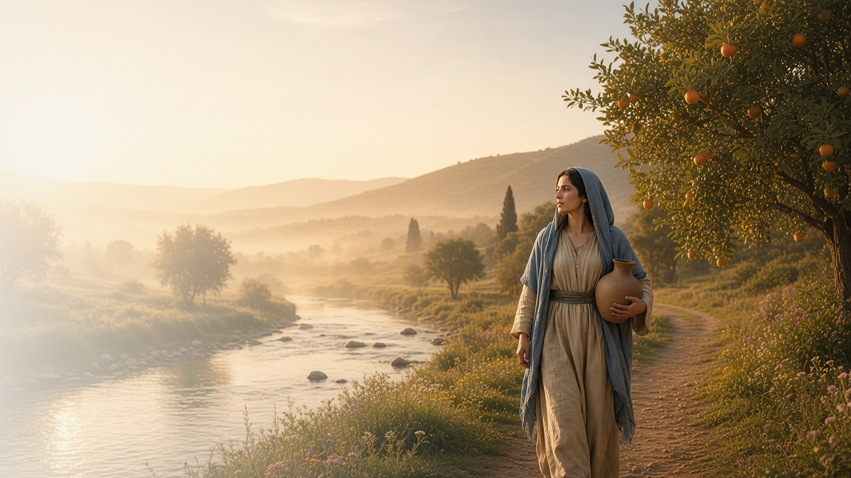
COME, FOLLOW ME · FOR CHILDREN
He That Overcometh
Shall Inherit
All Things
December 13–19
Revelation 15–22
Notes:
TEACHING
This week children learn that they can praise God by singing, that Jesus Christ's Second Coming will be joyful, that all of us will be judged out of the book of life, and that Jesus is their bright and morning star.
SCRIPTURE (KJV)
Revelation 21:4
4 And God shall wipe away all tears from their eyes; and there shall be no more death, neither sorrow, nor crying, neither shall there be any more pain: for the former things are passed away.
DISCUSSION
• What will it be like when Jesus comes again?
• What song can you sing to praise God?

Slide 2
REVELATION 15:2–4
I can praise God by singing
The faithful sang a song to praise God.
“Great and marvellous are thy works, Lord God Almighty.”
REVELATION 15:3
Notes:
TEACHING
Sing a favorite Primary song or hymn together. Explain that in John's vision the faithful sang to praise God. Singing is a way to pray and show our love.
SCRIPTURE (KJV)
Revelation 15:3–4
3 And they sing the song of Moses the servant of God, and the song of the Lamb, saying, Great and marvellous are thy works, Lord God Almighty; just and true are thy ways, thou King of saints.
4 Who shall not fear thee, O Lord, and glorify thy name? for thou only art holy: for all nations shall come and worship before thee; for thy judgments are made manifest.
DISCUSSION (questions quoted from the manual)
• (The manual gives no direct questions for this section.)
Suggested: What is your favorite song to praise God?

Slide 3
REVELATION 19:7–8; 20:2–3; 21:1–4; 22:1–5
A joyful day
When Jesus comes again, there will be no more sadness.
“And God shall wipe away all tears from their eyes.”
REVELATION 21:4
Notes:
TEACHING
Ask children what makes them sad. Explain that when Jesus comes again, there will be no more crying, pain, or death. It will be a very happy day for those who are ready.
SCRIPTURE (KJV)
Revelation 21:3–4
3 And I heard a great voice out of heaven saying, Behold, the tabernacle of God is with men, and he will dwell with them, and they shall be his people, and God himself shall be with them, and be their God.
4 And God shall wipe away all tears from their eyes; and there shall be no more death, neither sorrow, nor crying, neither shall there be any more pain: for the former things are passed away.
DISCUSSION (questions quoted from the manual)
• “Why are people happy at a wedding?”
• “How does a bride get ready for marriage?”
• “How do we get ready for the Savior’s return?”

Slide 4
REVELATION 20:12–13
The book of life
Heavenly Father will judge me with love and fairness.
“And the books were opened: and another book was opened, which is the book of life.”
REVELATION 20:12
Notes:
TEACHING
Show a journal or record book. Explain that John saw books with the record of how people lived. Heavenly Father knows our good choices and, through Jesus, forgives us when we repent.
SCRIPTURE (KJV)
Revelation 20:12
12 And I saw the dead, small and great, stand before God; and the books were opened: and another book was opened, which is the book of life: and the dead were judged out of those things which were written in the books, according to their works.
DISCUSSION (questions quoted from the manual)
• (The manual gives no direct questions for this section.)
Suggested: What good choices do you want in your book of life?

Slide 5
REVELATION 22:16
My bright and morning star
Jesus brings light like the star that comes before dawn.
“I am the root and the offspring of David, and the bright and morning star.”
REVELATION 22:16
Notes:
TEACHING
Explain that the morning star shines brightly just before the sun rises, telling us a new day is coming. Jesus is like that star: He brings light and hope.
SCRIPTURE (KJV)
Revelation 22:16
16 I Jesus have sent mine angel to testify unto you these things in the churches. I am the root and the offspring of David, and the bright and morning star.
DISCUSSION (questions quoted from the manual)
• “How is Jesus Christ like that star?”

Slide 6
REVELATION 22:20
“Even so, come, Lord Jesus.”
Sing a happy song about Jesus coming again.
Notes:
TEACHING
The last words of the Bible ask Jesus to come again. Invite children to sing a happy song about His Second Coming.
SCRIPTURE (KJV)
Revelation 22:20
20 He which testifieth these things saith, Surely I come quickly. Amen. Even so, come, Lord Jesus.
DISCUSSION
• How do you feel about Jesus coming again?
• What song will you sing?

