Slide 1
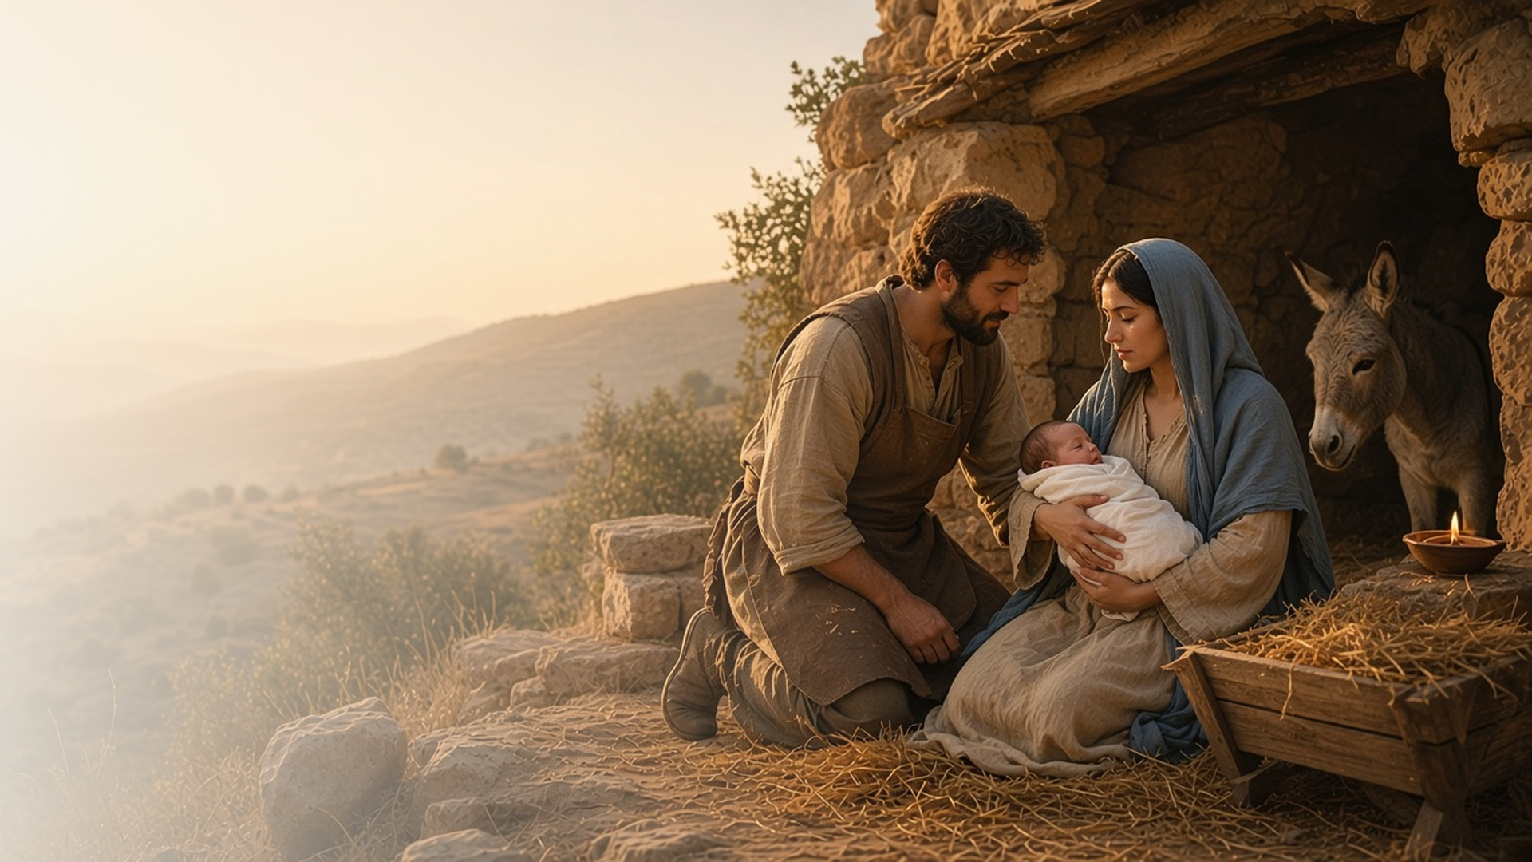
COME, FOLLOW ME · FOR CHILDREN
Good Tidings
of Great Joy
December 20–26
Christmas
Notes:
TEACHING
This week we celebrate the birth of Jesus Christ. Children will learn that prophets told about Him, angels shared the good news, Mary and Joseph cared for Him, He was born in Bethlehem, shepherds and Wise Men sought Him, and He came so we can live with Heavenly Father again. The manual has no separate children's section for Christmas week, so these slides are drawn from the daily sections.
SCRIPTURE (KJV)
Luke 2:10–11
10 And the angel said unto them, Fear not: for, behold, I bring you good tidings of great joy, which shall be to all people.
11 For unto you is born this day in the city of David a Saviour, which is Christ the Lord.
DISCUSSION
• Why do we celebrate Christmas?
• What gift can you give Jesus?

Slide 2
ISAIAH 7:14; 9:6–7; MICAH 5:2
Prophets told about Jesus
Long ago, prophets said Jesus would be born.
“Behold, a virgin shall conceive, and bear a son, and shall call his name Immanuel.”
ISAIAH 7:14
Notes:
TEACHING
Explain that long before Jesus was born, prophets like Isaiah and Micah told that He would come and even named the town, Bethlehem. Show Bethlehem on a map if you have one. (Note: the manual has no children's section for Christmas week; this slide is distilled from the daily sections.)
SCRIPTURE (KJV)
Isaiah 7:14
14 Therefore the Lord himself shall give you a sign; Behold, a virgin shall conceive, and bear a son, and shall call his name Immanuel.
Micah 5:2
2 But thou, Bethlehem Ephratah, though thou be little among the thousands of Judah, yet out of thee shall he come forth unto me that is to be ruler in Israel; whose goings forth have been from of old, from everlasting.
DISCUSSION
• What did the prophets say about Jesus?
• How do prophets help us today?

Slide 3
LUKE 1:26–38; 2:9–15
Angels shared good news
Angels told Mary, Joseph, and the shepherds about Jesus.
“Fear not, Mary: for thou hast found favour with God.”
LUKE 1:30
Notes:
TEACHING
Act out the angel visiting Mary and the angels singing to the shepherds. Each time, the angels said not to be afraid because they had happy news about Jesus. (Note: the manual has no children's section for Christmas week; this slide is distilled from the daily sections.)
SCRIPTURE (KJV)
Luke 1:30–31
30 And the angel said unto her, Fear not, Mary: for thou hast found favour with God.
31 And, behold, thou shalt conceive in thy womb, and bring forth a son, and shalt call his name JESUS.
Full passage: Luke 1:26–31
Luke 2:10–11
10 And the angel said unto them, Fear not: for, behold, I bring you good tidings of great joy, which shall be to all people.
11 For unto you is born this day in the city of David a Saviour, which is Christ the Lord.
Full passage: Luke 2:9–14
DISCUSSION
• Who did the angels visit?
• What good news did they share?

Slide 4
MATTHEW 1:19–25
Mary and Joseph loved Jesus
Heavenly Father trusted them to care for His Son.
“And she shall bring forth a son, and thou shalt call his name JESUS: for he shall save his people from their sins.”
MATTHEW 1:21
Notes:
TEACHING
Talk about how Mary and Joseph took care of baby Jesus, keeping Him warm and safe. Heavenly Father chose them because they were faithful. Talk about how families care for babies. (Note: the manual has no children's section for Christmas week; this slide is distilled from the daily sections.)
SCRIPTURE (KJV)
Matthew 1:20–21
20 But while he thought on these things, behold, the angel of the Lord appeared unto him in a dream, saying, Joseph, thou son of David, fear not to take unto thee Mary thy wife: for that which is conceived in her is of the Holy Ghost.
21 And she shall bring forth a son, and thou shalt call his name JESUS: for he shall save his people from their sins.
DISCUSSION
• How did Mary and Joseph take care of Jesus?
• How can you help your family?

Slide 5
LUKE 2:1–20
Jesus was born
Jesus was born in Bethlehem and laid in a manger.
“And she brought forth her firstborn son, and wrapped him in swaddling clothes, and laid him in a manger.”
LUKE 2:7
Notes:
TEACHING
Tell the Christmas story with a simple nativity set or pictures: the long trip, no room at the inn, and baby Jesus in a manger. Let children place each figure. (Note: the manual has no children's section for Christmas week; this slide is distilled from the daily sections.)
SCRIPTURE (KJV)
Luke 2:4, 6–7
4 And Joseph also went up from Galilee, out of the city of Nazareth, into Judaea, unto the city of David, which is called Bethlehem; (because he was of the house and lineage of David:)
6 And so it was, that, while they were there, the days were accomplished that she should be delivered.
7 And she brought forth her firstborn son, and wrapped him in swaddling clothes, and laid him in a manger; because there was no room for them in the inn.
Full passage: Luke 2:1–7
DISCUSSION
• Where was Jesus born?
• Why was He laid in a manger?

Slide 6
LUKE 2:15–18; MATTHEW 2:1–12
I can seek Jesus
Shepherds and Wise Men came to find Jesus.
“For we have seen his star in the east, and are come to worship him.”
MATTHEW 2:2
Notes:
TEACHING
Hide a picture of baby Jesus and let children search for it, like the shepherds and Wise Men. Talk about ways we seek Jesus today: praying, reading scriptures, and going to church. (Note: the manual has no children's section for Christmas week; this slide is distilled from the daily sections.)
SCRIPTURE (KJV)
Matthew 2:1–2
1 Now when Jesus was born in Bethlehem of Judaea in the days of Herod the king, behold, there came wise men from the east to Jerusalem,
2 Saying, Where is he that is born King of the Jews? for we have seen his star in the east, and are come to worship him.
Luke 2:15–16
15 And it came to pass, as the angels were gone away from them into heaven, the shepherds said one to another, Let us now go even unto Bethlehem, and see this thing which is come to pass, which the Lord hath made known unto us.
16 And they came with haste, and found Mary, and Joseph, and the babe lying in a manger.
DISCUSSION
• How did the Wise Men find Jesus?
• How can you find Jesus today?

Slide 7
JOHN 3:16–17
Jesus’s gift to me
Jesus came so I can live with Heavenly Father again.
“For God so loved the world, that he gave his only begotten Son.”
JOHN 3:16
Notes:
TEACHING
Show a wrapped gift. Explain that Heavenly Father gave us the best gift of all, His Son, because He loves us. Because of Jesus, we can live with Heavenly Father again. (Note: the manual has no children's section for Christmas week; this slide is distilled from the daily sections.)
SCRIPTURE (KJV)
John 3:16
16 For God so loved the world, that he gave his only begotten Son, that whosoever believeth in him should not perish, but have everlasting life.
DISCUSSION
• What is the best gift Heavenly Father gave us?
• What gift can you give Jesus?

Slide 8
LUKE 2:14
“Glory to God in the highest,
and on earth peace, good will toward men.”
Share the Christmas story with your family this week.
Notes:
TEACHING
The angels sang praises when Jesus was born. Invite children to share the Christmas story with their family this week.
SCRIPTURE (KJV)
Luke 2:13–14
13 And suddenly there was with the angel a multitude of the heavenly host praising God, and saying,
14 Glory to God in the highest, and on earth peace, good will toward men.
DISCUSSION
• Who will you tell the Christmas story to?
• What part of the story do you love most?

